Slide 1


An Educational Code for Topological Optimization in Gibiane
Jason Le Coz^{(1,2)}, François Di Paola⁽¹⁾, Guénhaël Le Quilliec⁽³⁾
⁽¹⁾ Université Paris-Saclay, CEA, Service d’Études Mécaniques et Thermiques
⁽²⁾ Université de Technologie de Compiègne, Laboratoire Roberval
⁽³⁾ Université de Tours, Laboratoire de Mécanique Gabriel Lamé
Cast3M annual user’s conference “Club”
November 28, 2025

Slide 2
I. Optimization operators/procedures in Cast3M
A brief reminder
Find the minimum/maximum of a linear/nonlinear function with several variables, with/without constraints (linear/nonlinear)
● Simplex method
SIMP max. of a linear function, with linear equalities/inequalities constraints
● Least Squares method
MOCA min. of the sum of squares distances (observation – prediction)² for a linear function
AJUSTE idem but on a nonlinear function (the iterative scheme is included)
LEVM Levenberg Marquardt method (“damped” least squares)
● Method of Moving Asymptotes (MMA) [1]
Min. of a nonlinear function with nonlinear inequalities
EXCE a variation of the MMA
MMA new “generic” Method of Moving Asymptotes [2]
Approximate the original nonlinear problem with a succession of (simpler) convex problems
Must be included in a iterative scheme to deal with nonlinear functions

Slide 3
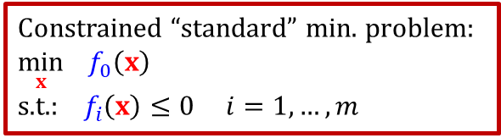
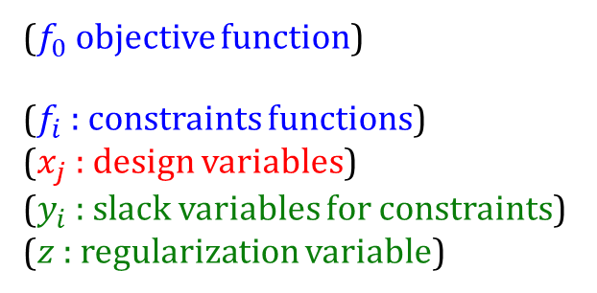

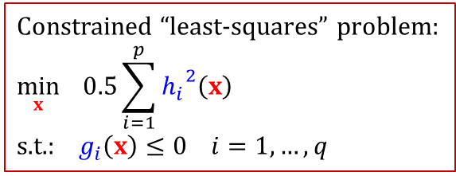
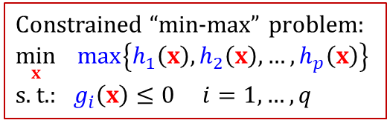
I. Optimization operators/procedures in Cast3M
Method of Moving Asymptotes (MMA)
● New MMA operator: “generic” Method of Moving Asymptotes [2]
Can handle several “classical” optimization problems:
● KKT_MMA procedure: residuals for the Karush-Kuhn-Tucker conditions
test cases: mma_00.dgibi mma_01.dgibi mma_02.dgibi mma_03.dgibi mma_04.dgibi
new MMA operator:
- uses LISTREELs (instead of TABLEs)
which improves performances
- more generic framework
$$\min_{x,y,z}{ f_{0}\left(x\right)+a_{0}z+\sum_{i=1}^{m}{\left[c_{i}y_{i}+0.5d_{i}{y_{i}}^{2}\right]}}$$
subject to: $f_{i}\left(x\right)−a_{i}z−y_{i}≤0$ for $i=1,…,m$
$x_{j}^{min}≤x_{j}≤x_{j}^{max}$ for $i=1,…,n$
$y_{j}≥0$ for $j=1,…,m$
$z≥0$ _____
($f_{0}$objective function)
($f_{i}$: constraints functions)
($x_{j}$ : design variables)
($y_{i}$ : slack variables for constraints)
($z$ : regularization variable)
Constrained “standard” min. problem:
$$\min_{x}{ f_{0}\left(x\right)}$$
s.t.: $f_{i}\left(x\right)≤0$ $i=1,…,m$
Constrained “min-max” problem:
$$\min_{x}{ max\left\{h_{1}\left(x\right),h_{2}\left(x\right),…,h_{p}\left(x\right)\right\}}$$
s. t.: $g_{i}\left(x\right)≤0$ $i=1,…,q$
Constrained “least-squares” problem:
$$\min_{x}{ 0.5\sum_{i=1}^{p}{{h_{i}}^{2}\left(x\right)}}$$
s.t.: $g_{i}\left(x\right)≤0$ $i=1,…,q$
Most used for topological optimization

Slide 4
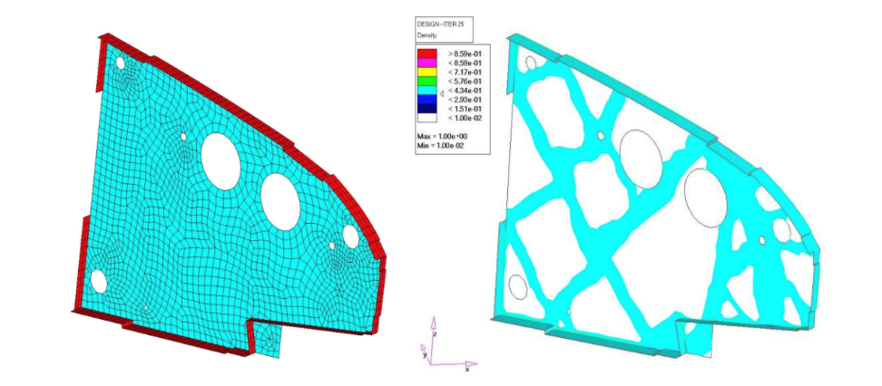
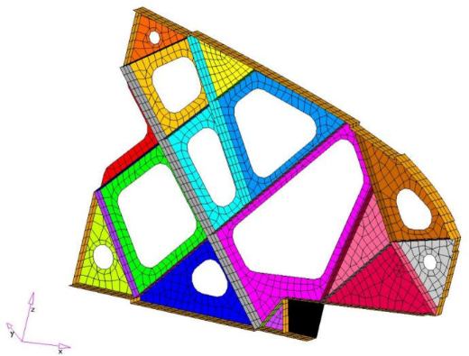
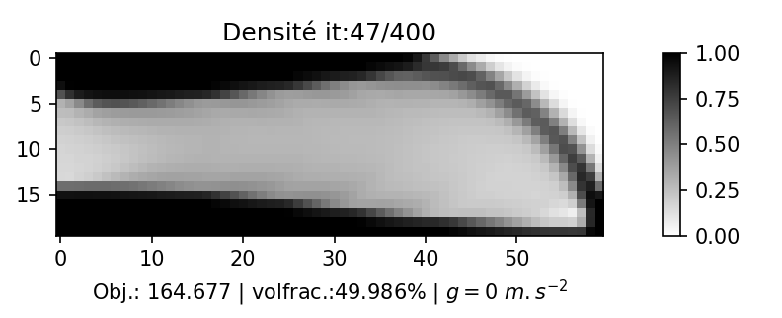
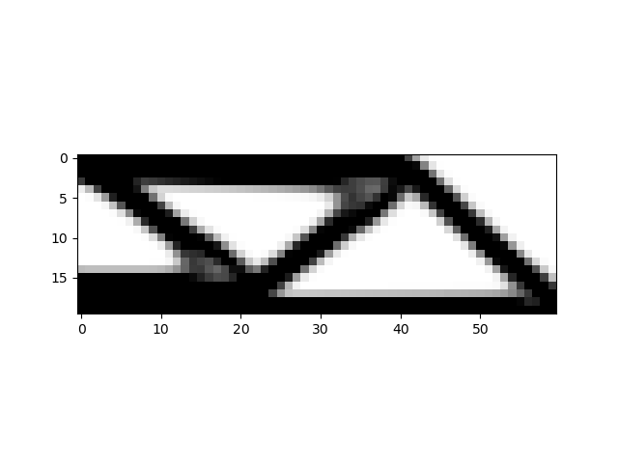




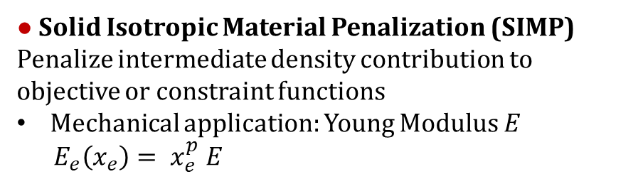



II. Topological Optimization
Introduction to density-based TO
● Find the optimal matter distribution in a meshed space to minimize/maximize some properties
optimization variable: continuous element volume fraction (density) $x_{e}∈[0,1]$
mesh
optimize
design
● Identify holes for shape/parametric optimization
Airplane structure TO application [3]
Hashin-Strickmann criteria
● Solid Isotropic Material Penalization (SIMP)
Penalize intermediate density contribution to objective or constraint functions
Mechanical application: Young Modulus $E$
$E_{e}\left(x_{e}\right)= x_{e}^{p} E_{}$
$$p=1$$
$$E$$
HS+
$$p=3$$
HS-
$$p=3$$
$$x$$
$$0$$
$$1$$

Slide 5
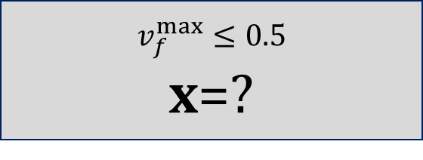
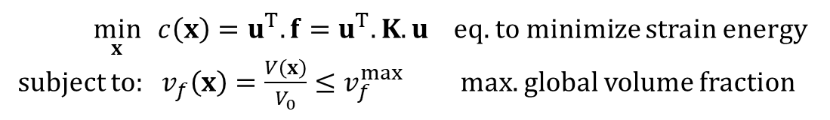


II. Topological Optimization
In Cast3M: the TOPOPTIM procedure [4]
$$f$$
$x={\left[x_{1},x_{2},…,x_{n}\right]}^{T}$ density field
MCHAML object (“element field” on centroids)
● Easy to use procedure
Solve the “classical” compliance minimization problem:
$$v_{f}^{max}≤0.5$$
$x$=?
$\min_{x}{ c\left(x\right)=u^{T}.f=u^{T}.K.u}$ eq. to minimize strain energy
subject to: $v_{f}\left(x\right)=\frac{V\left(x\right)}{V_{0}}≤v_{f}^{max}$ max. global volume fraction

Slide 6
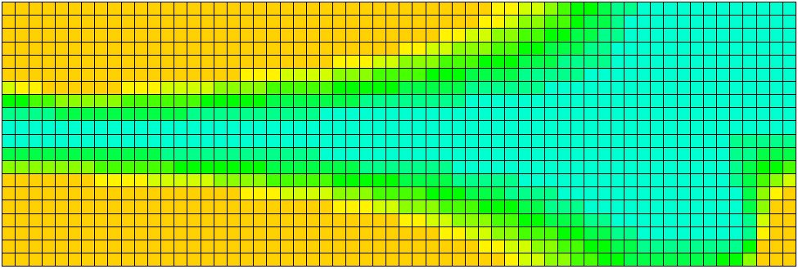
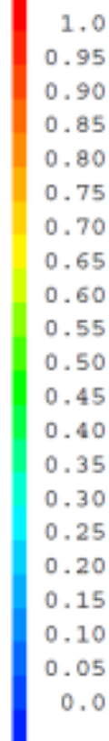
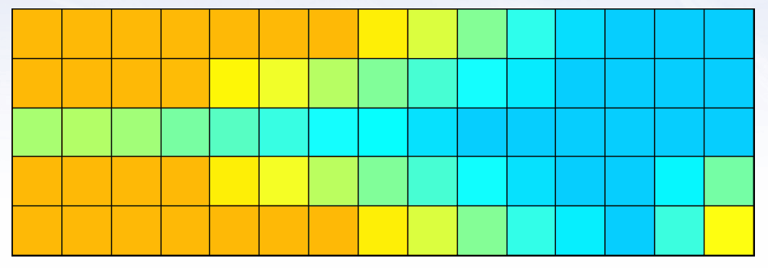
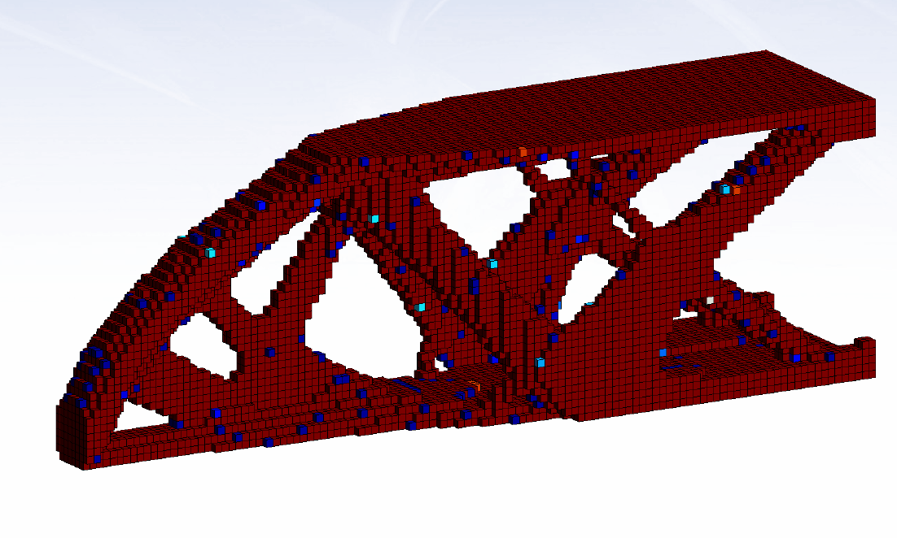

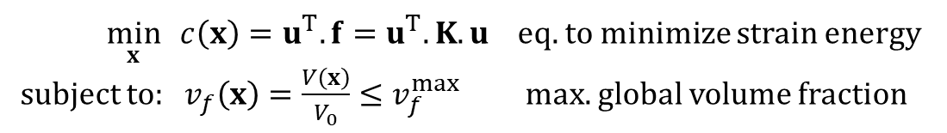
II. Topological Optimization
In Cast3M: the TOPOPTIM procedure [4]
$$f$$
$x={\left[x_{1},x_{2},…,x_{n}\right]}^{T}$ density field
MCHAML object (“element field” on centroids)
● Easy to use procedure
Solve the “classical” compliance minimization problem:
● Additional features:
● Additional smoothing procedure TOPOSURF
A lot of examples
topoptim_01.dgibi … topoptim_11.dgibi
toposurf_01.dgibi toposurf_03.dgibi
$\min_{x}{ c\left(x\right)=u^{T}.f=u^{T}.K.u}$ eq. to minimize strain energy
subject to: $v_{f}\left(x\right)=\frac{V\left(x\right)}{V_{0}}≤v_{f}^{max}$ max. global volume fraction
unstructured meshes
2D (plane/axis) 3D models
fixed full/empty zones
multi-case loading
automatic element removal
thermal analysis
nonlinear behavior (plasticity, contact,…)
can be stopped/restarted (remeshing…)
geometric restrictions

Slide 7
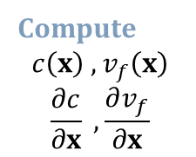

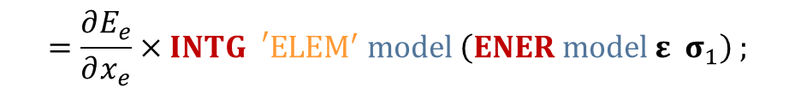
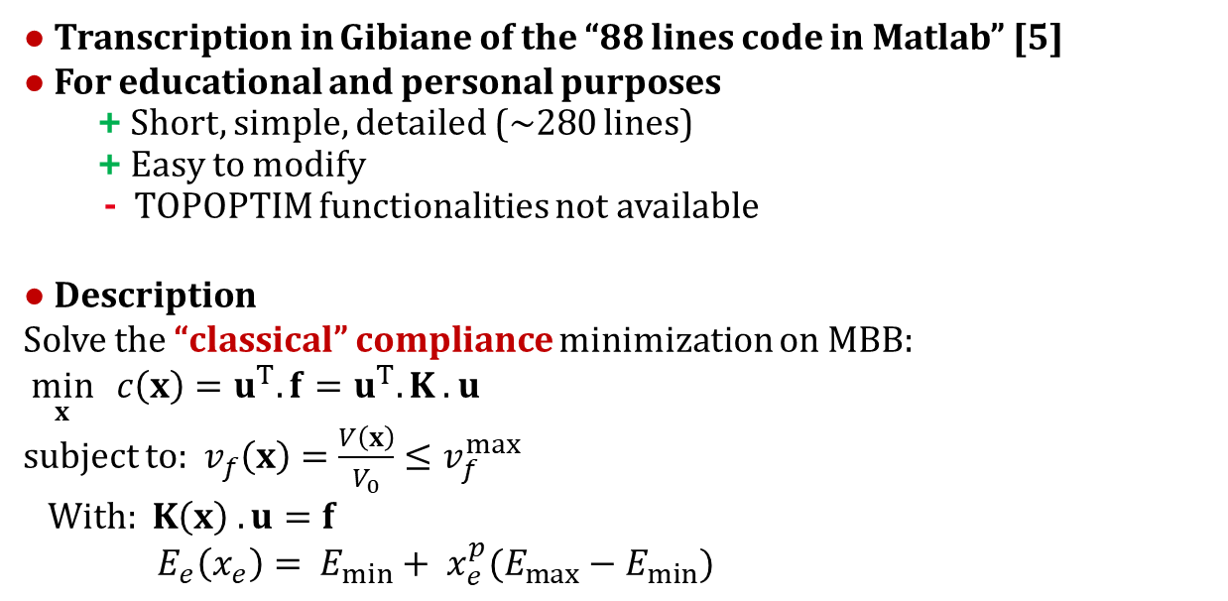
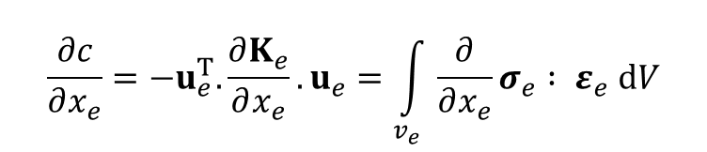


III. The educational codes top_oc.dgibi & top_mma.dgibi
Presentation
Code flowchart
● Transcription in Gibiane of the “88 lines code in Matlab” [5]
● For educational and personal purposes
+ Short, simple, detailed (~280 lines)
+ Easy to modify
- TOPOPTIM functionalities not available
● Description
Solve the “classical” compliance minimization on MBB:
$\min_{x}{ c\left(x\right)=u^{T}.f=u^{T}.K .u}$
subject to: $v_{f}\left(x\right)=\frac{V\left(x\right)}{V_{0}}≤v_{f}^{max}$
With: $K\left(x\right) . u=f$
$E_{e}\left(x_{e}\right)= E_{min}+ x_{e}^{p}(E_{max}−E_{min})$
Mesh & Model
SURF, …
MODE ‘MECA’ …
$${x=x}^{ini}$$
Resolution
MATE, RIGI
RESO …
Compute
$$c\left(x\right) , v_{f}\left(x\right)$$
$$\frac{∂c}{∂x} , \frac{∂v_{f}}{∂x}$$
Sensitivity analysis
$${x=x}^{new}$$
Optimizer
MMA, OC, …
$$x^{new}$$
Filter (+ threshold)
MFIL
● Sensitivity analysis
$$\frac{∂c}{∂x_{e}}=−u_{e}^{T}.\frac{∂K_{e}}{∂x_{e}}.u_{e}=\int_{v_{e}}{\frac{∂}{∂x_{e}}σ_{e} : ε_{e} dV}$$
Convergence?
no
yes
$$=\frac{∂E_{e}}{∂x_{e}}×INTG{}_{}^{′}E{LEM}^{′} model \left(ENER model ε σ_{1}\right) ;$$
Solution

Slide 8
Some examples!

Slide 9
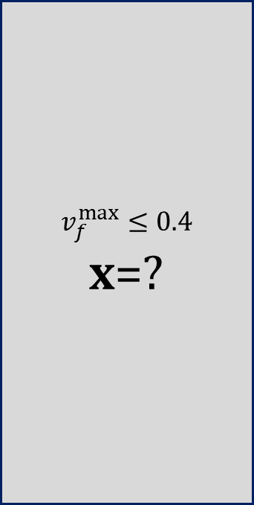
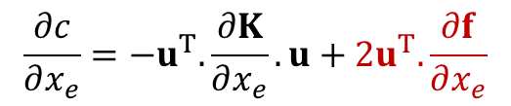


IV. Nonconvex problems
Example of design-dependent loads (gravity, centrifugal forces, Laplace forces,…)
● Compliance minimization problem with a non convex object:
Compliance gradient becomes:
● Test case: hanging bar (punctual force + gravity)
$$\frac{∂c}{∂x_{e}}=−u^{T}.\frac{∂K}{∂x_{e}}.u+2u^{T}.\frac{∂f}{∂x_{e}}$$
$$v_{f}^{max}≤0.4$$
$x$=?
$$f_{v}=xρg$$
$$f_{p}$$

Slide 10
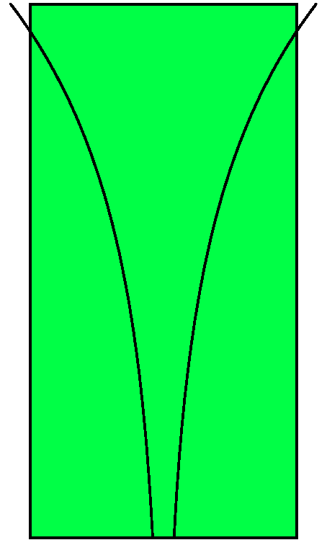

IV. Nonconvex problems
Example of design-dependent loads (gravity, centrifugal forces, Laplace forces,…)
● Compliance minimization problem with a non convex object:
Compliance gradient becomes:
● Test case: hanging bar (punctual force + gravity)
$$\frac{∂c}{∂x_{e}}=−u^{T}.\frac{∂K}{∂x_{e}}.u+2u^{T}.\frac{∂f}{∂x_{e}}$$
Good agreement with the reference analytical solution [6]
$$f_{ p}$$

Slide 11
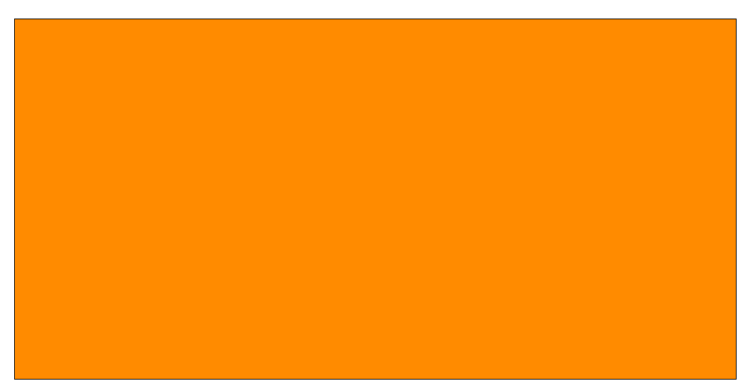


IV. Nonconvex problems
Example of design-dependent loads (gravity, centrifugal forces, Laplace forces,…)
● Compliance minimization problem with a non convex object:
Compliance gradient becomes:
● Test case: hanging bar (punctual force + gravity)
● Test case: arch bridge (gravity only!)
$$\frac{∂c}{∂x_{e}}=−u^{T}.\frac{∂K}{∂x_{e}}.u+2u^{T}.\frac{∂f}{∂x_{e}}$$
$$v_{f}^{max}≤1$$
$x$=?
$$f_{v}=xρg$$

Slide 12
IV. Nonconvex problems
Example of design-dependent loads (gravity, centrifugal forces, Laplace forces,…)
● Compliance minimization problem with a non convex object:
Compliance gradient becomes:
● Test case: hanging bar (punctual force + gravity)
● Test case: arch bridge (gravity only!)
Solution may depend on the starting point
and be only a local minimum!
$$\frac{∂c}{∂x_{e}}=−u^{T}.\frac{∂K}{∂x_{e}}.u+2u^{T}.\frac{∂f}{∂x_{e}}$$

Slide 13
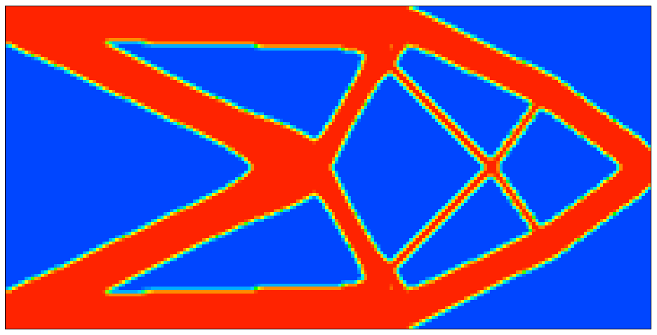


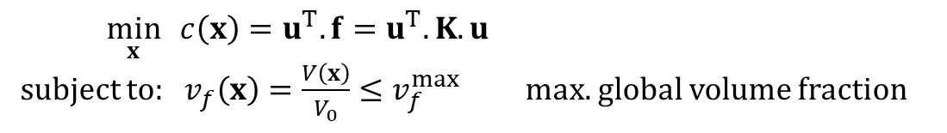


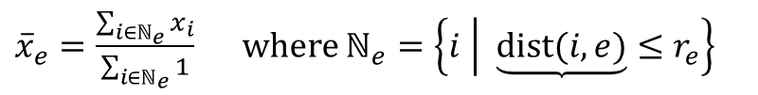
IV. Multi-constrained problem
Example of “infill” optimization for additive manufacturing [7]
● From the compliance minimization problem:
● Measure of the “local” (neighboring) volume fraction
● Local constraints → aggregated into a single differentiable constraint
?
$\min_{x}{ c\left(x\right)=u^{T}.f=u^{T}.K.u}$
subject to: $v_{f}\left(x\right)=\frac{V\left(x\right)}{V_{0}}≤v_{f}^{max}$ max. global volume fraction
$$R_{e}$$
$$f$$
${\left(\frac{1}{n}\sum_{e}{{{\overline{x}}_{e}}^{P}}\right)}^{1/P}≤α$ max. local volume fraction
Optimal topology with $v_{f}^{max}≤0.4$
${\overline{x}}_{e}=\frac{\sum_{i∈ℕ_{e}}{x_{i}}}{\sum_{i∈ℕ_{e}}{1}}$ where $ℕ_{e}=\left\{i | \underbrace{dist(i,e)}≤r_{e}\right\}$
Linear filter
MFIL operator
centroid
distance $i↔e$
${\overline{x}}_{e}≤α$ $∀e∈\left[1,n\right]$ → $\max_{∀e}\left({\overline{x}}_{e}\right)≤α$ → ${\left(\frac{1}{n}\sum_{e}{{{\overline{x}}_{e}}^{P}}\right)}^{1/P}≤α$
P-mean function: soft max.
AGRE operator

Slide 14
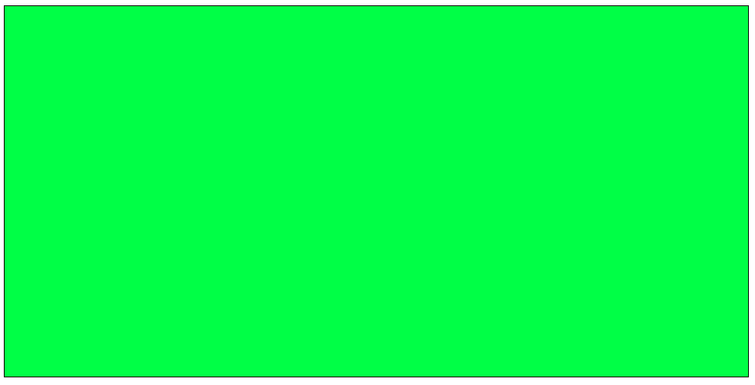

IV. Multi-constrained problem
Example of “infill” optimization for additive manufacturing [7]
● From the compliance minimization problem:
● Measure of the “local” (neighboring) volume fraction
● Local constraints → aggregated into a single differentiable constraint
$\min_{x}{ c\left(x\right)=u^{T}.f=u^{T}.K.u}$
subject to: $v_{f}\left(x\right)=\frac{V\left(x\right)}{V_{0}}≤v_{f}^{max}$ max. global volume fraction
$$R_{e}$$
${\left(\frac{1}{n}\sum_{e}{{{\overline{x}}_{e}}^{P}}\right)}^{1/P}≤α$ max. local volume fraction
Optimal topology with $v_{f}^{max}≤0.4$
${\overline{x}}_{e}=\frac{\sum_{i∈ℕ_{e}}{x_{i}}}{\sum_{i∈ℕ_{e}}{1}}$ where $ℕ_{e}=\left\{i | \underbrace{dist(i,e)}≤r_{e}\right\}$
Linear filter
MFIL operator
centroid
distance $i↔e$
${\overline{x}}_{e}≤α$ $∀e∈\left[1,n\right]$ → $\max_{∀e}\left({\overline{x}}_{e}\right)≤α$ → ${\left(\frac{1}{n}\sum_{e}{{{\overline{x}}_{e}}^{P}}\right)}^{1/P}≤α$
P-mean function: soft max.
AGRE operator
Optimal topology with $v_{f}^{max}≤0.4$ and
$α≤0.6$ $r_{e}=6×element size$ $P=16$

Slide 15
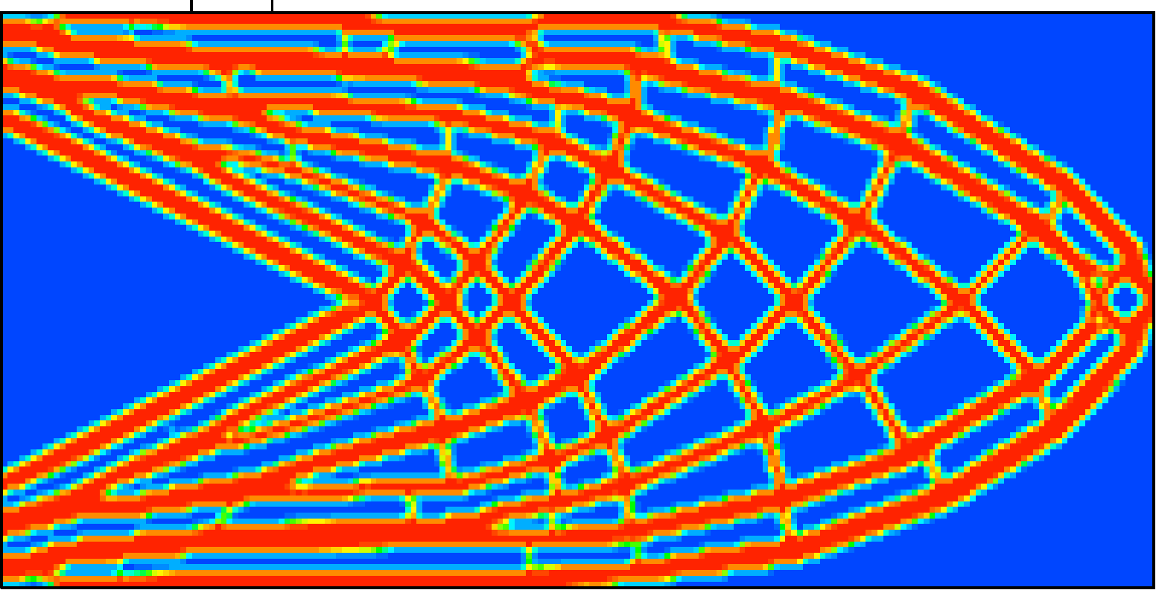
IV. Multi-constrained problem
Example of “infill” optimization for additive manufacturing [7]
● Robustness (to damage)
Let’s introduce a damaged zone in the structure
What’s the effect on the compliance (objective function)?
Optimal topology with $v_{f}^{max}≤0.4$
Optimal topology with $v_{f}^{max}≤0.4$ and
$α≤0.6$ $r_{e}=6×element size$ $P=16$

Slide 16
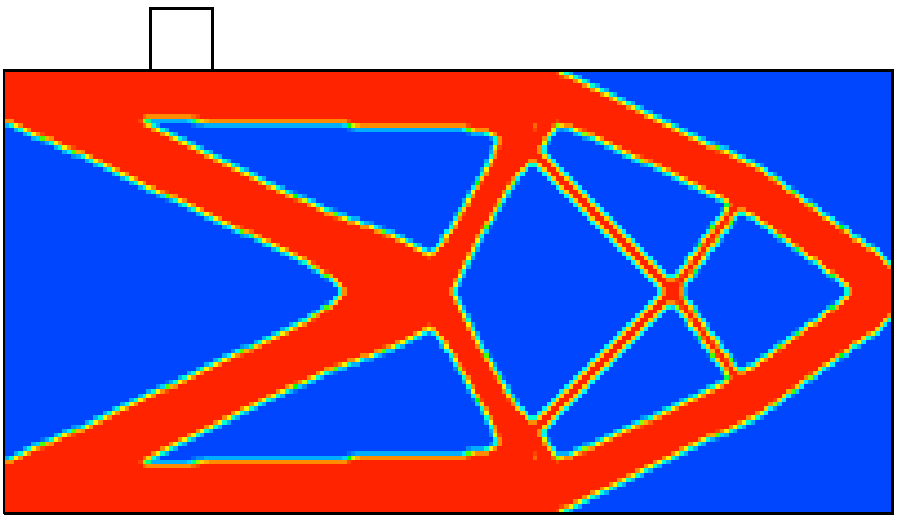
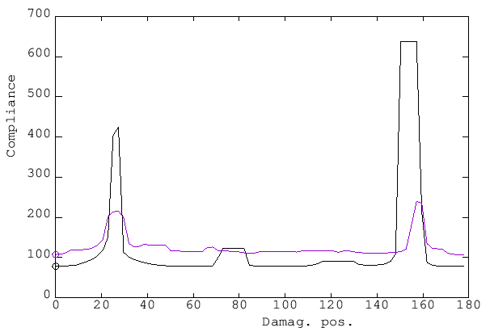
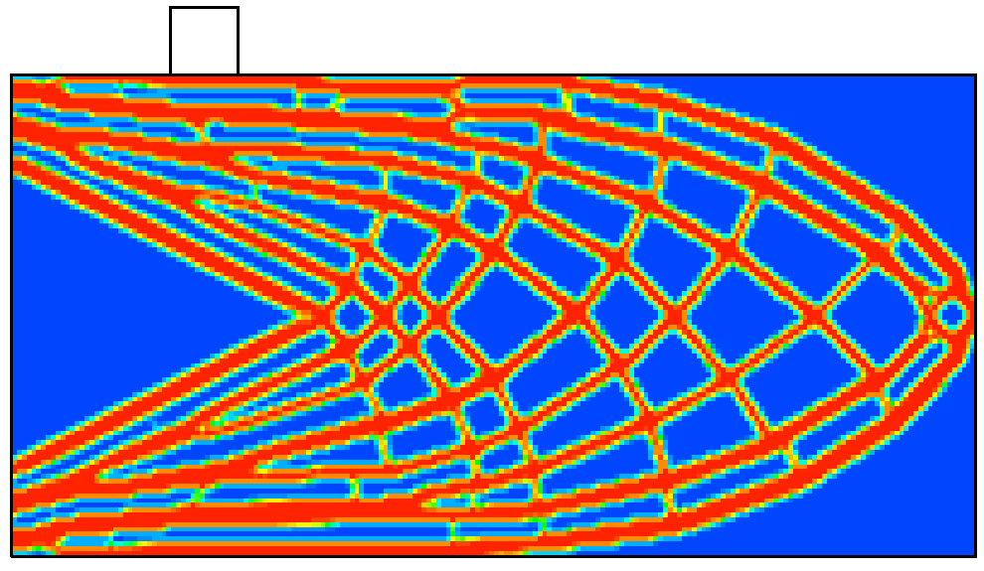
IV. Multi-constrained problem
Example of “infill” optimization for additive manufacturing [7]
● Robustness (to damage)
Let’s introduce a damaged zone in the structure
What’s the effect on the compliance (objective function)?
● Robustness (to load uncertainty)
Without infill constraint
With infill constraint
Without infill constraint
With infill constraint
Optimal topology with $v_{f}^{max}≤0.4$
Optimal topology with $v_{f}^{max}≤0.4$ and
$α≤0.6$ $r_{e}=6×element size$ $P=16$

Slide 17
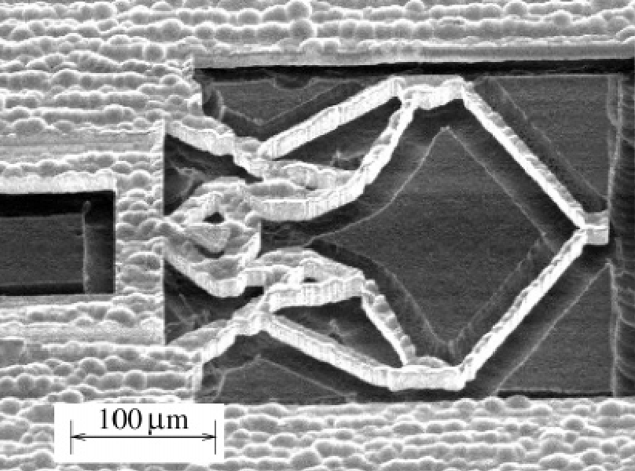


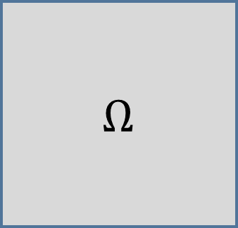


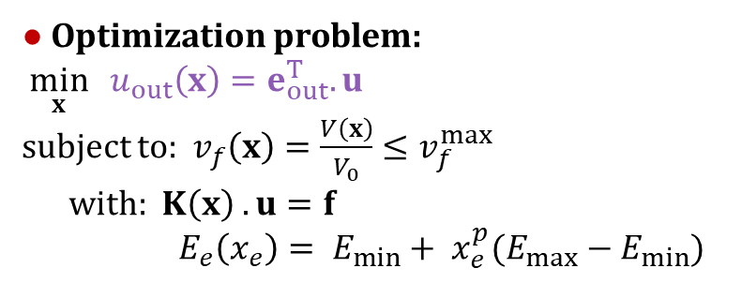


IV. Adjoint problem
Case of compliant mechanism [8]
● Maximize structure displacement according to a load/displacement input
● Optimization problem:
$\min_{x}{ u_{out}\left(x\right)=e_{out}^{T}.u}$
subject to: $v_{f}\left(x\right)=\frac{V\left(x\right)}{V_{0}}≤v_{f}^{max}$
with: $K\left(x\right) . u=f$
$E_{e}\left(x_{e}\right)= E_{min}+ x_{e}^{p}(E_{max}−E_{min})$
$$Ω$$
$$e_{out}^{T}=−\left\langle 0…0 1 0 …0\right\rangle$$
$$f_{in}/u_{in}$$
$$u_{out}$$
$$k_{out}$$
$$y$$
$$x$$
$$300μm$$

Slide 18
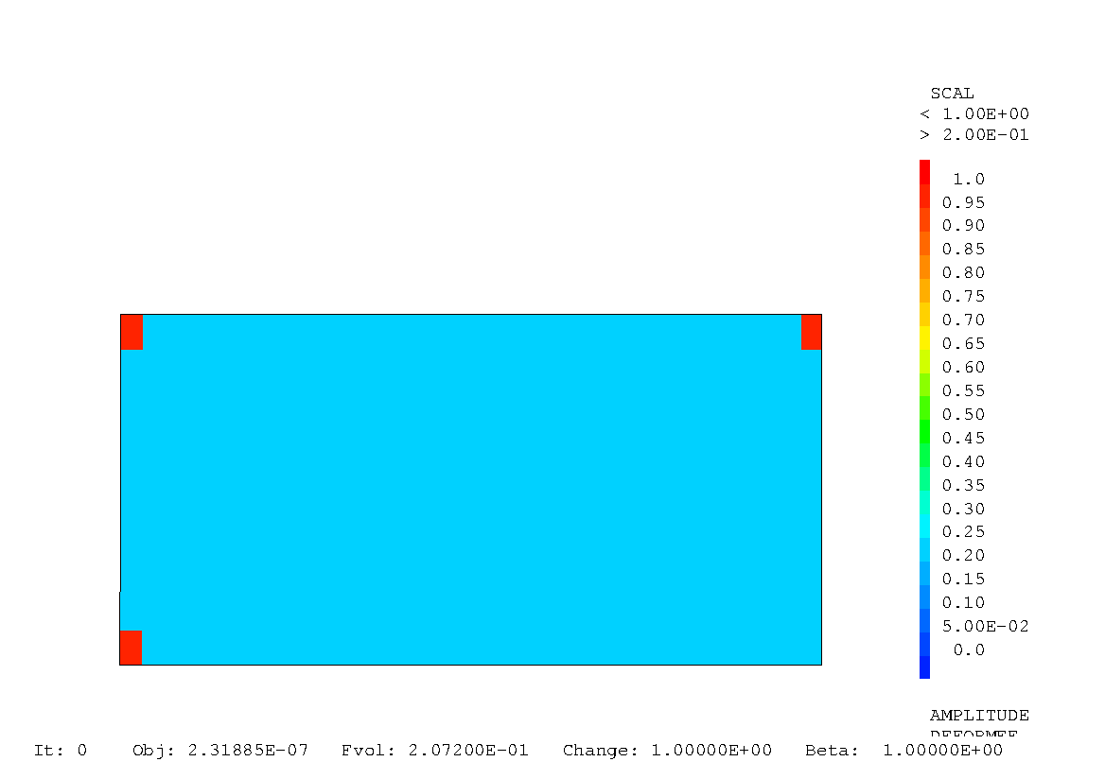
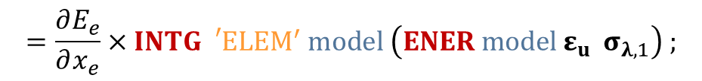

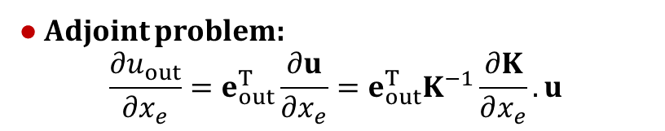
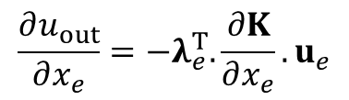
IV. Adjoint problem
Case of compliant mechanism [8]
● Maximize structure displacement according to a load/displacement input
● Optimization problem:
$\min_{x}{ u_{out}\left(x\right)=e_{out}^{T}.u}$
subject to: $v_{f}\left(x\right)=\frac{V\left(x\right)}{V_{0}}≤v_{f}^{max}$
with: $K\left(x\right) . u=f$
$E_{e}\left(x_{e}\right)= E_{min}+ x_{e}^{p}(E_{max}−E_{min})$
$$Ω$$
$$e_{out}^{T}=−\left\langle 0…0 1 0 …0\right\rangle$$
$$f_{in}/u_{in}$$
$$u_{out}$$
$$k_{out}$$
$$y$$
● Adjoint problem:
$$\frac{∂u_{out}}{∂x_{e}}=e_{out}^{T}\frac{∂u}{∂x_{e}}=e_{out}^{T}K^{−1}\frac{∂K}{∂x_{e}}.u$$
$$x$$
$$300μm$$
Adjoint system:
$$=λ^{T}$$
$$K .λ=e_{out} u λ=RESO K f e_{out}$$
$$\frac{∂u_{out}}{∂x_{e}}=−λ_{e}^{T}.\frac{∂K}{∂x_{e}}.u_{e}$$
$$=\frac{∂E_{e}}{∂x_{e}}×INTG{}_{}^{′}E{LEM}^{′} model \left(ENER model ε_{u} σ_{λ,1}\right) ;$$

Slide 19

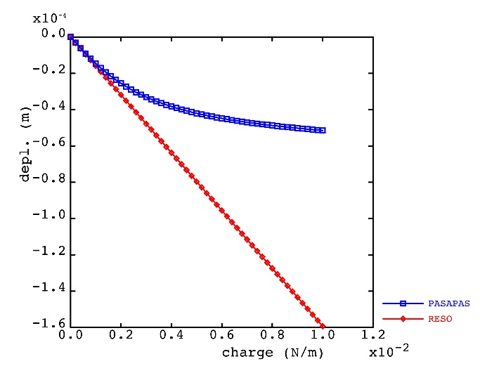
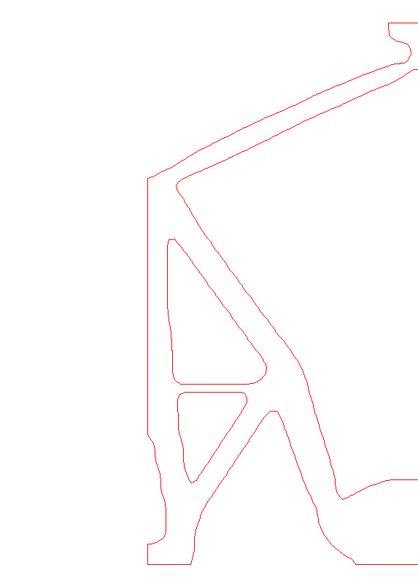
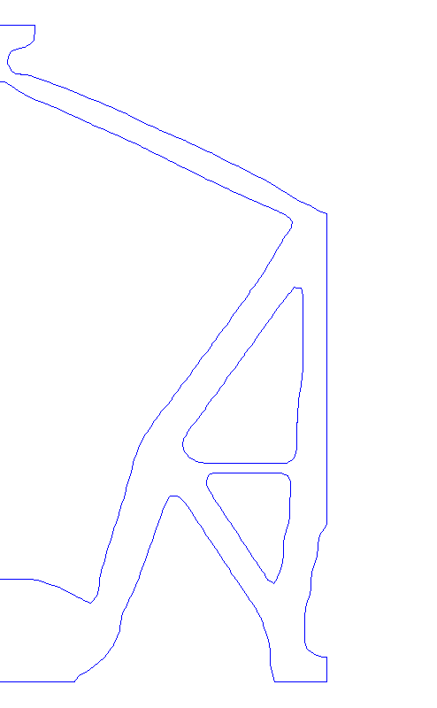
IV. Adjoint problem
Case of compliant mechanism [8]
● Maximize structure displacement according to a load/displacement input
● Optimization problem:
$\min_{x}{ u_{out}\left(x\right)=e_{out}^{T}.u}$
subject to: $v_{f}\left(x\right)=\frac{V\left(x\right)}{V_{0}}≤v_{f}^{max}$
with: $K\left(x\right) . u=f$
$E_{e}\left(x_{e}\right)= E_{min}+ x_{e}^{p}(E_{max}−E_{min})$
$$Ω$$
$$e_{out}^{T}=−\left\langle 0…0 1 0 …0\right\rangle$$
$$f_{in}/u_{in}$$
$$u_{out}$$
$$k_{out}$$
$$y$$
● Adjoint problem:
$$\frac{∂u_{out}}{∂x_{e}}=e_{out}^{T}\frac{∂u}{∂x_{e}}=e_{out}^{T}K^{−1}\frac{∂K}{∂x_{e}}.u$$
$$x$$
$$300μm$$
small disp. ≢ large disp.
Adjoint system:
$$=λ^{T}$$
$$K .λ=e_{out} u λ=RESO K f e_{out}$$
$$\frac{∂u_{out}}{∂x_{e}}=−λ_{e}^{T}.\frac{∂K}{∂x_{e}}.u_{e}$$
$$=\frac{∂E_{e}}{∂x_{e}}×INTG{}_{}^{′}E{LEM}^{′} model \left(ENER model ε_{u} σ_{λ,1}\right) ;$$

Slide 20
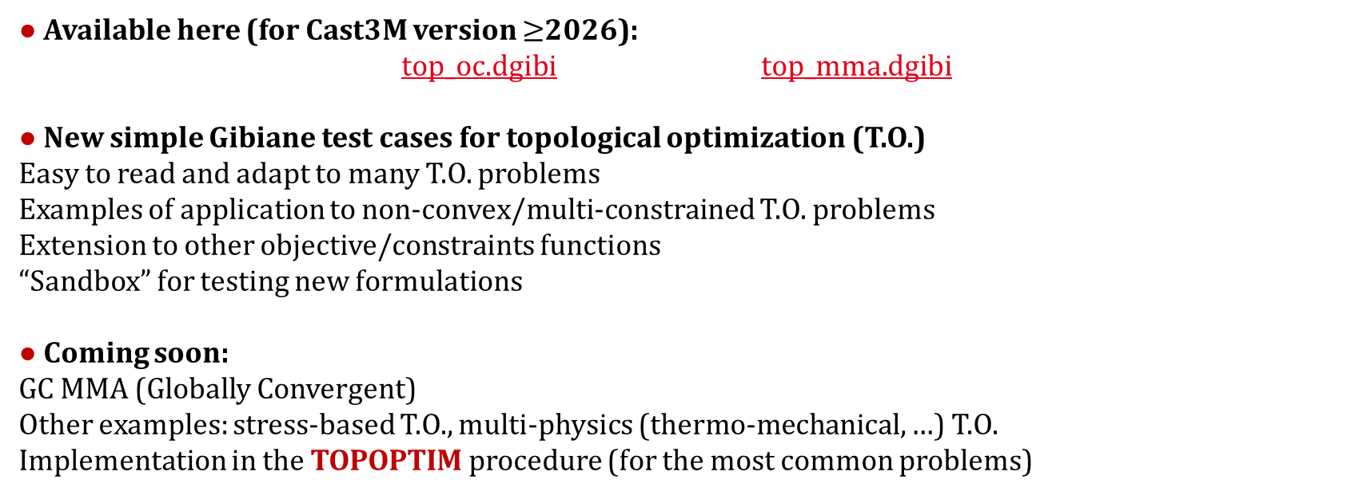
Conclusion and perspectives
● Available here (for Cast3M version $≥$2026):
top_oc.dgibi top_mma.dgibi
● New simple Gibiane test cases for topological optimization (T.O.)
Easy to read and adapt to many T.O. problems
Examples of application to non-convex/multi-constrained T.O. problems
Extension to other objective/constraints functions
“Sandbox” for testing new formulations
● Coming soon:
GC MMA (Globally Convergent)
Other examples: stress-based T.O., multi-physics (thermo-mechanical, …) T.O.
Implementation in the TOPOPTIM procedure (for the most common problems)

Slide 21
References
[1] K. Svanberg The method of moving asymptotes – a new method for structural optimization International Journal for Numerical Methods in Engineering, 24, 359-373 (1987)
[2] K. Svanberg MMA and GCMMA – two methods for nonlinear optimization (2017) https://people.kth.se/~krille/mmagcmma.pdf
[3] L. A. Krog, L. A. Tucker, G. Rollema
Application of Topology, Sizing and Shape Optimization Methods to Optimal Design of Aircraft Components
https://api.semanticscholar.org/CorpusID:11846281
[4] G. Le Quilliec Procédure d'optimisation topologique TOPOPTIM Version 2 Club Cast3M (2017)
[5] E. Andreassen, A. Clausen, M. Schevenels, B. S. Lazarov, O. Sigmund Efficient topology optimization in MATLAB using 88 lines of code
Structural and Multidisciplinary Optimization, vol. 43 (2011)

Slide 22
References
[6] B. L. Karihaloo, W. S. Hemp
Maximum strength/stiffness design of structural members in presence of self-weight
Proceedings of the Royal Society, A 389, 119-32 (1983)
[7] J. Wu, N. Aage, R. Westermann, O. Sigmund Infill Optimization for Additive Manufacturing – Approaching Bone-like Porous Structures
IEEE Transactions on Visualization and Computer Graphics 24(2):1127--1140 (2018)
[8] C.B.W. Pedersen, T. Buhl, O. Sigmund Topology synthesis of large-displacement compliant mechanisms
Int. J. Numer. Meth. Engng., 50: 2683-2705 (2001)

