Slide 1





Introduction of specific residual stress profile in tubular 316L pipe sample Robin DE BOSSCHER
Experimental methodology for the study of welding residual stresses in nuclear industry components
Laboratory of Structural Integrity and Normalization (LISN)
CEA Paris-Saclay
Club Cast3m 2025

Slide 2
Contents
Introduction
Methodology and numerical model development
Experimental rig development
Experiments to introduce Residual stress in pipes
Comparison Experiments/numerical
Present and future works

Slide 3
Introduction - Subject
Objective
Study the influence of welding residual stress (RS) on fatigue crack growth in structure size samples
Difficulties
RS influence depends on their value and distribution
Hard to control introduced RS profile through welding
Proposition
Develop an experimental rig to introduce predetermined RS profiles through a specific thermo-mechanical cycle

Slide 4
Introduction - Methodology
Objective
Develop an experimental rig to introduce predetermined RS profiles through a specific thermo-mechanical cycle
Develop a Finite Element Model (FEM) to verify if the proposition satisfies the objective
Determine parameters of influence through parametric analysis
Numerically fabricate RS profiles to design the experimental rig
Design the experimental rig and build it
Starts experiment on the rig to calibrate the numerical model on the real thermal behavior
Realize the introduction of residual stress in the pipe
Measure the residual stress at ILL through neutron diffraction
Find out why the predictive FE model isn’t predictive…Or is he ?
Steps
Today
Describe the current state of progress of the project

Slide 5
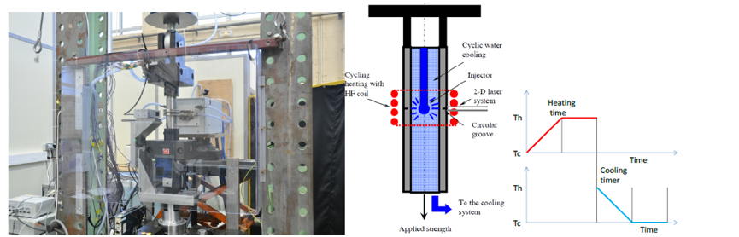
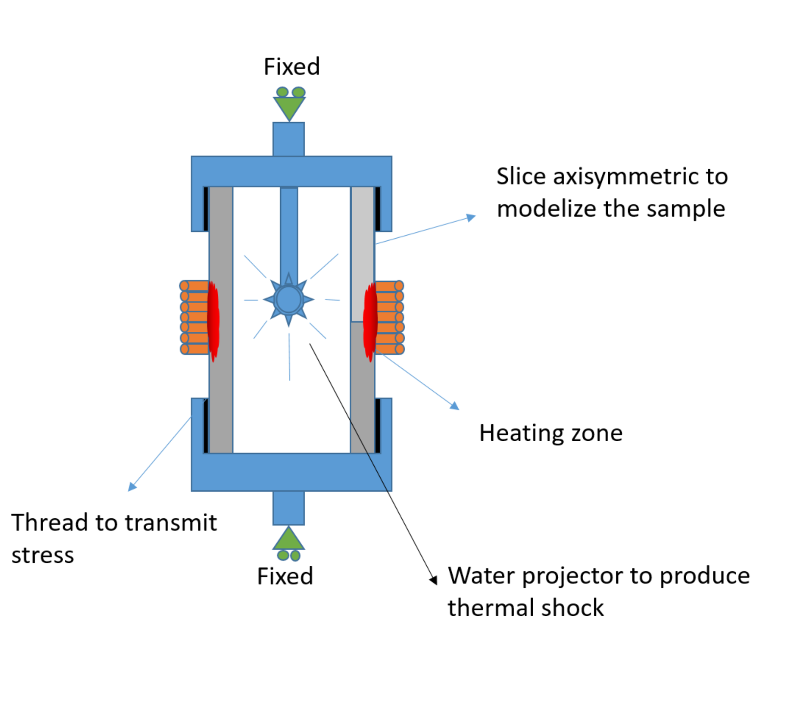
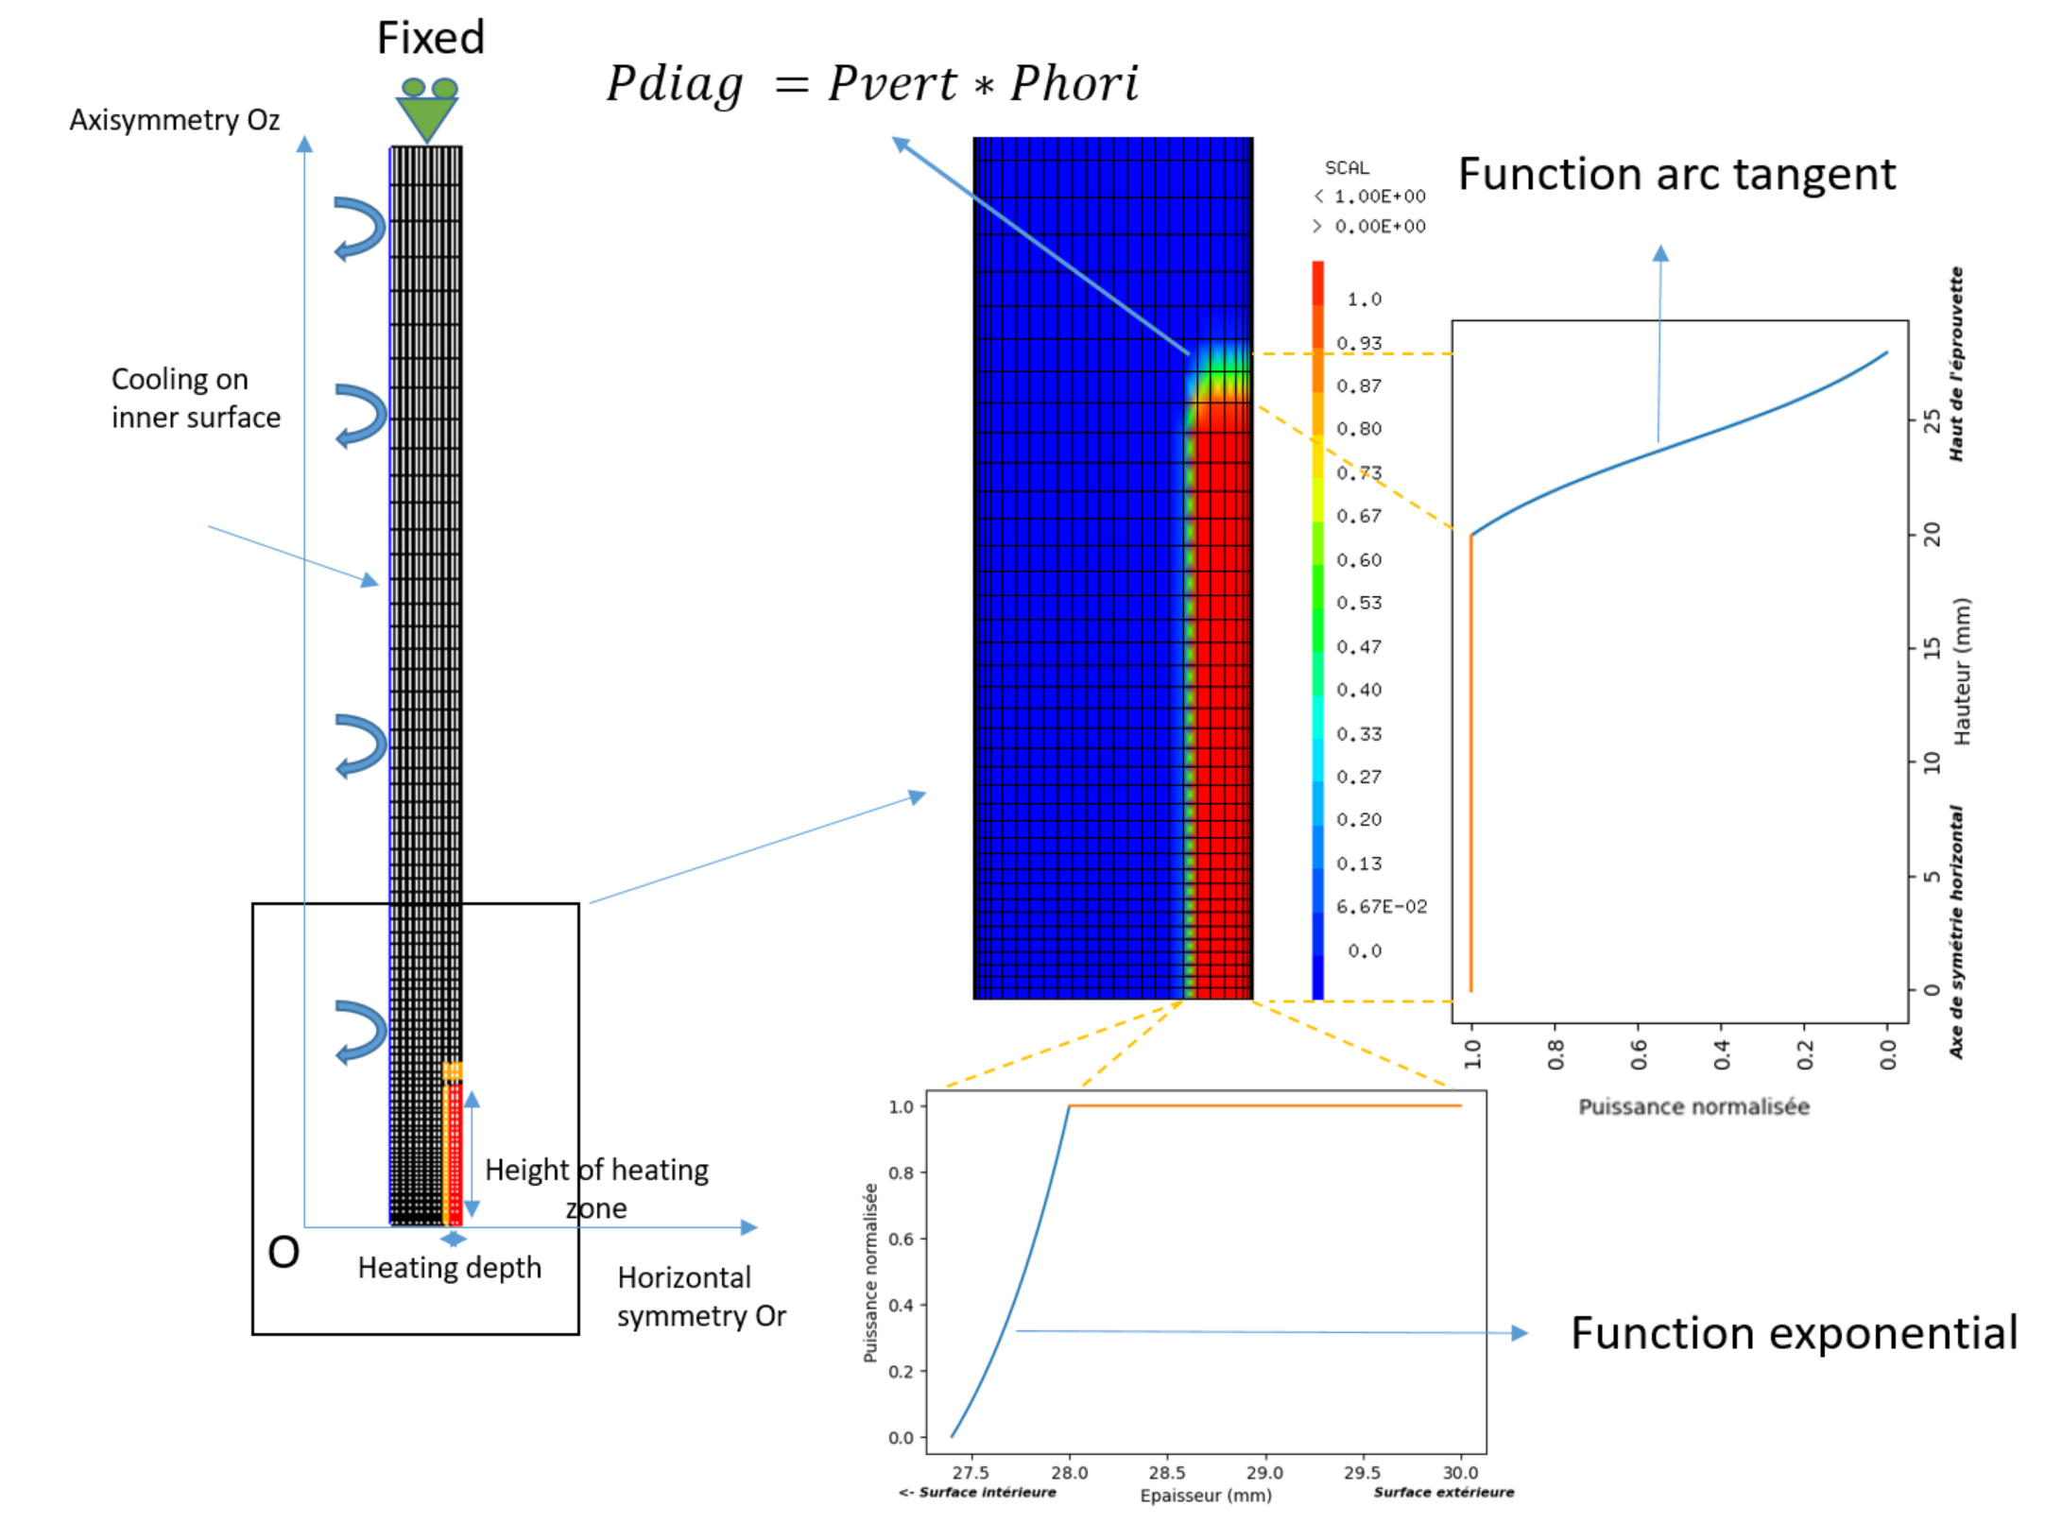
First Step – Finite element model part.1
Previously developed experiment at LISN for the study of PROpagation through THermal Fatigue in 10mm thick pipes (OuterDiam=30mm)
Need of 2 fitting parameters for decreasing heat zone size
=> Using experimental thermocouple data

Slide 6
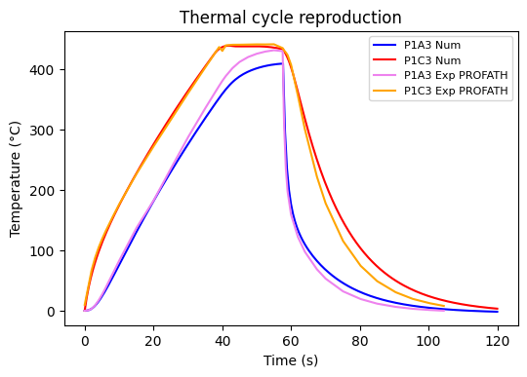
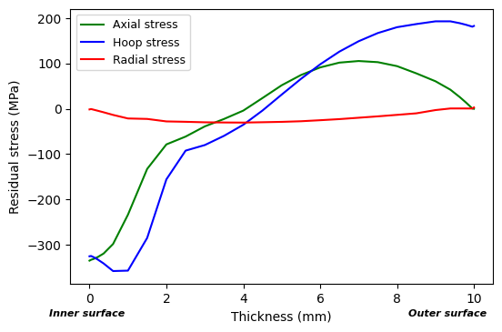
First Step – Finite Element model part.2
Objective
Determine the thermal parameters using previous experimental data
Verify the ability to introduce residual stress using PROFATH geometry
Mid-height through thickness residual stress field obtained with PROFATH geometry
PROFATH
Allows introduction of residual stress

Slide 7
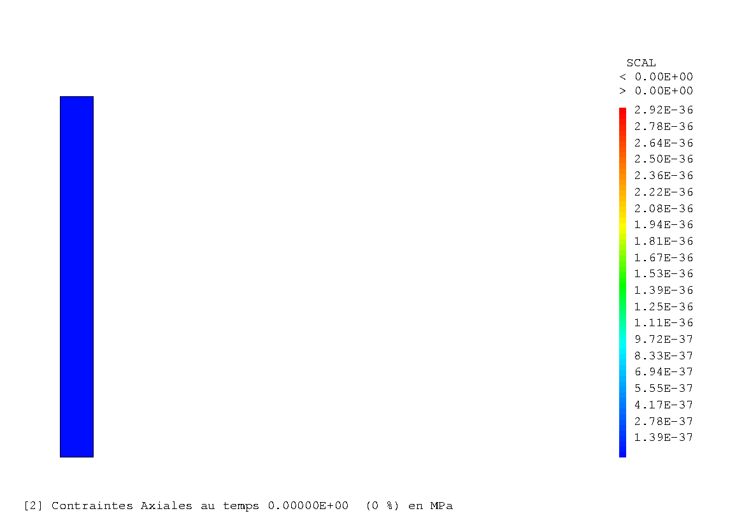
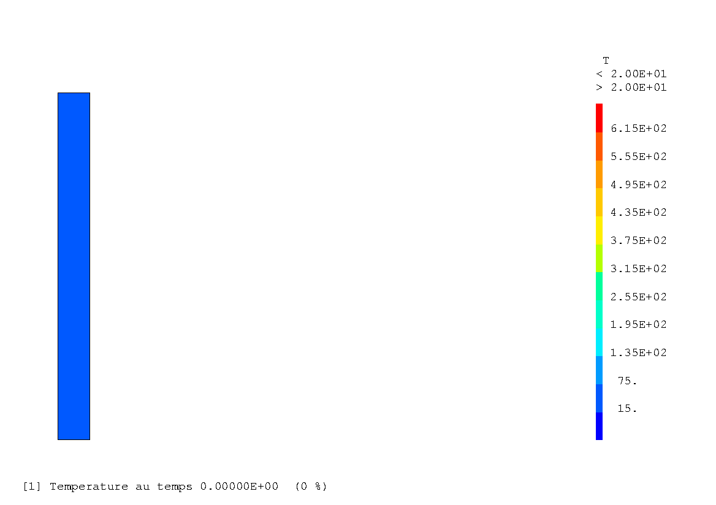
First Step – Thermal and axial mechanical behaviour

Slide 8
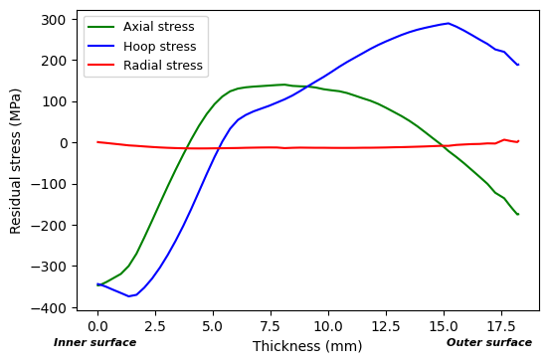
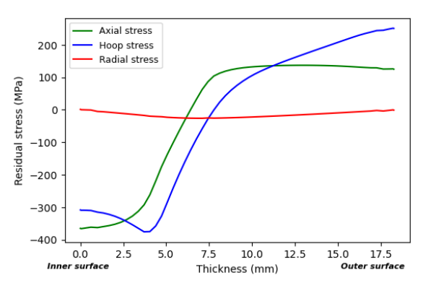
Second Step – Parametric analysis
Objective
Determine the most influential experimental parameters influencing residual stress
Most influent parameters :
Applied stress on the sample
Heating zone height (inductor size)
Heating cycle
Cooling speed (thermal shock violence)
2 different coils for heating in 2 different ways
=> 2 types of residual stress profiles
20mm height inductor
50mm height inductor
2 profile chosen on the real geometry :
Pipe 168*17.75*400mm
Mid-height through thickness RS fields obtained by FEM

Slide 9
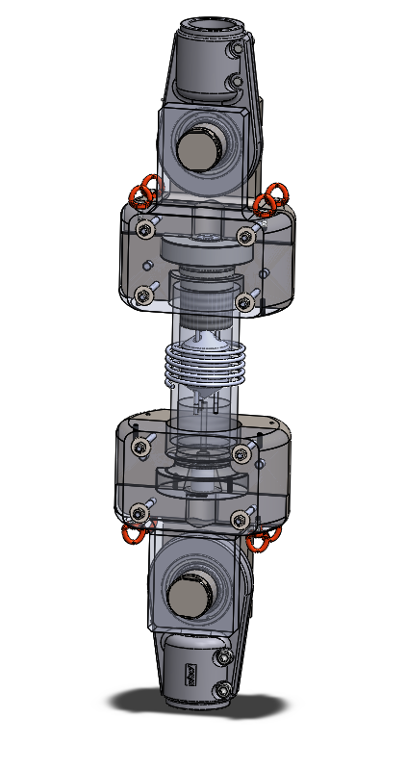
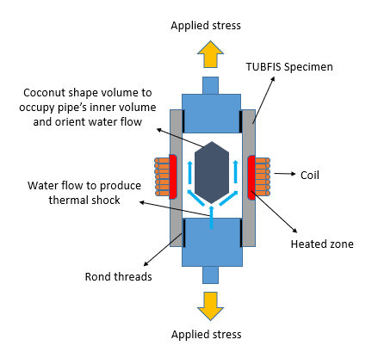
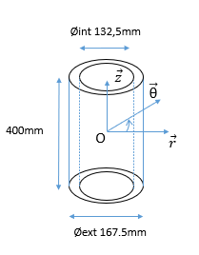
Third Step – rig development

Slide 10
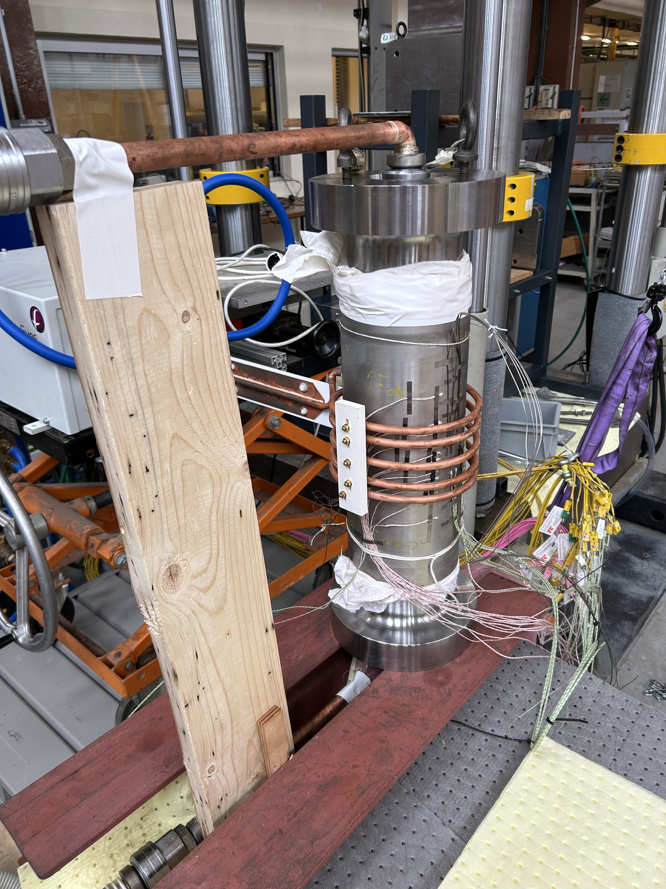
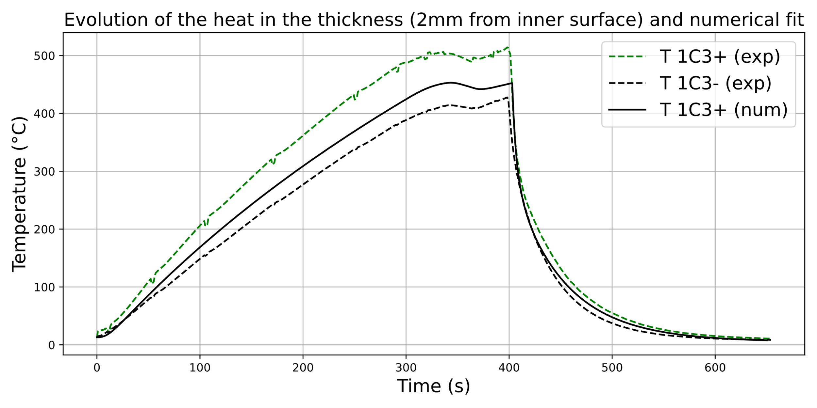
Fourth Step - Experiments and thermal FEM calibration
Heating phase
Water injection
42 thermocouples data fitted numerically to reproduce the real thermal behavior of the pipe

Slide 11
Fifth Step – Final experiment and Numerical prediction
1) Installation of the pipe of the coil, and of lower clamping part
2) Installation upper clamping part and of tensile stress
3) Heating until max temperature then stabilisation
4) Water injection through lower clamping to produce thermal shock on inner surface

Slide 12
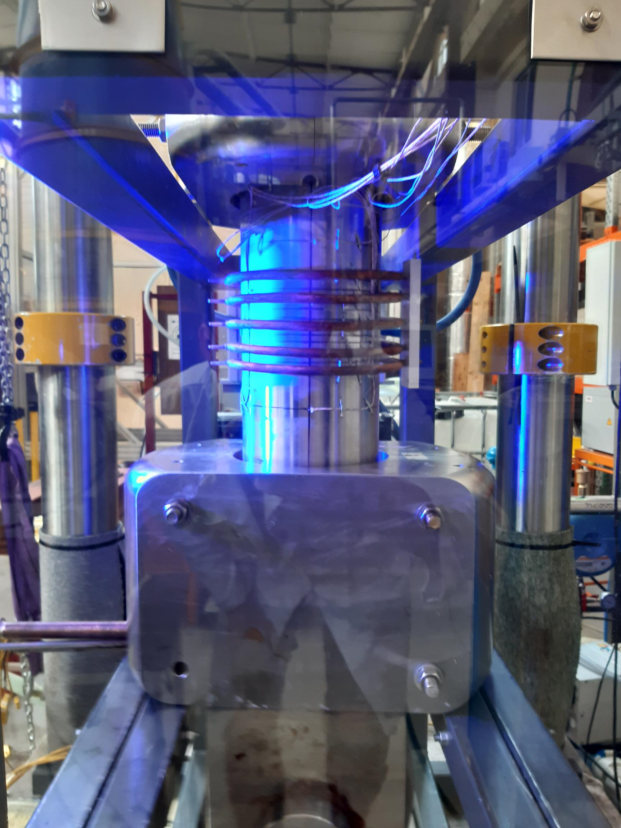
Fifth Step – Final experiment and Numerical prediction
Applied tensile force of 1250 kN in the direction of the pipe axis during the whole process
Induction heating up to 550°C on the middle of the pipe
Thermal shock produced by 5°C-water injection inside the pipe
Use of Digital Image Correlation (DIC) to map the displacements and deformation on the outer surface

Slide 13
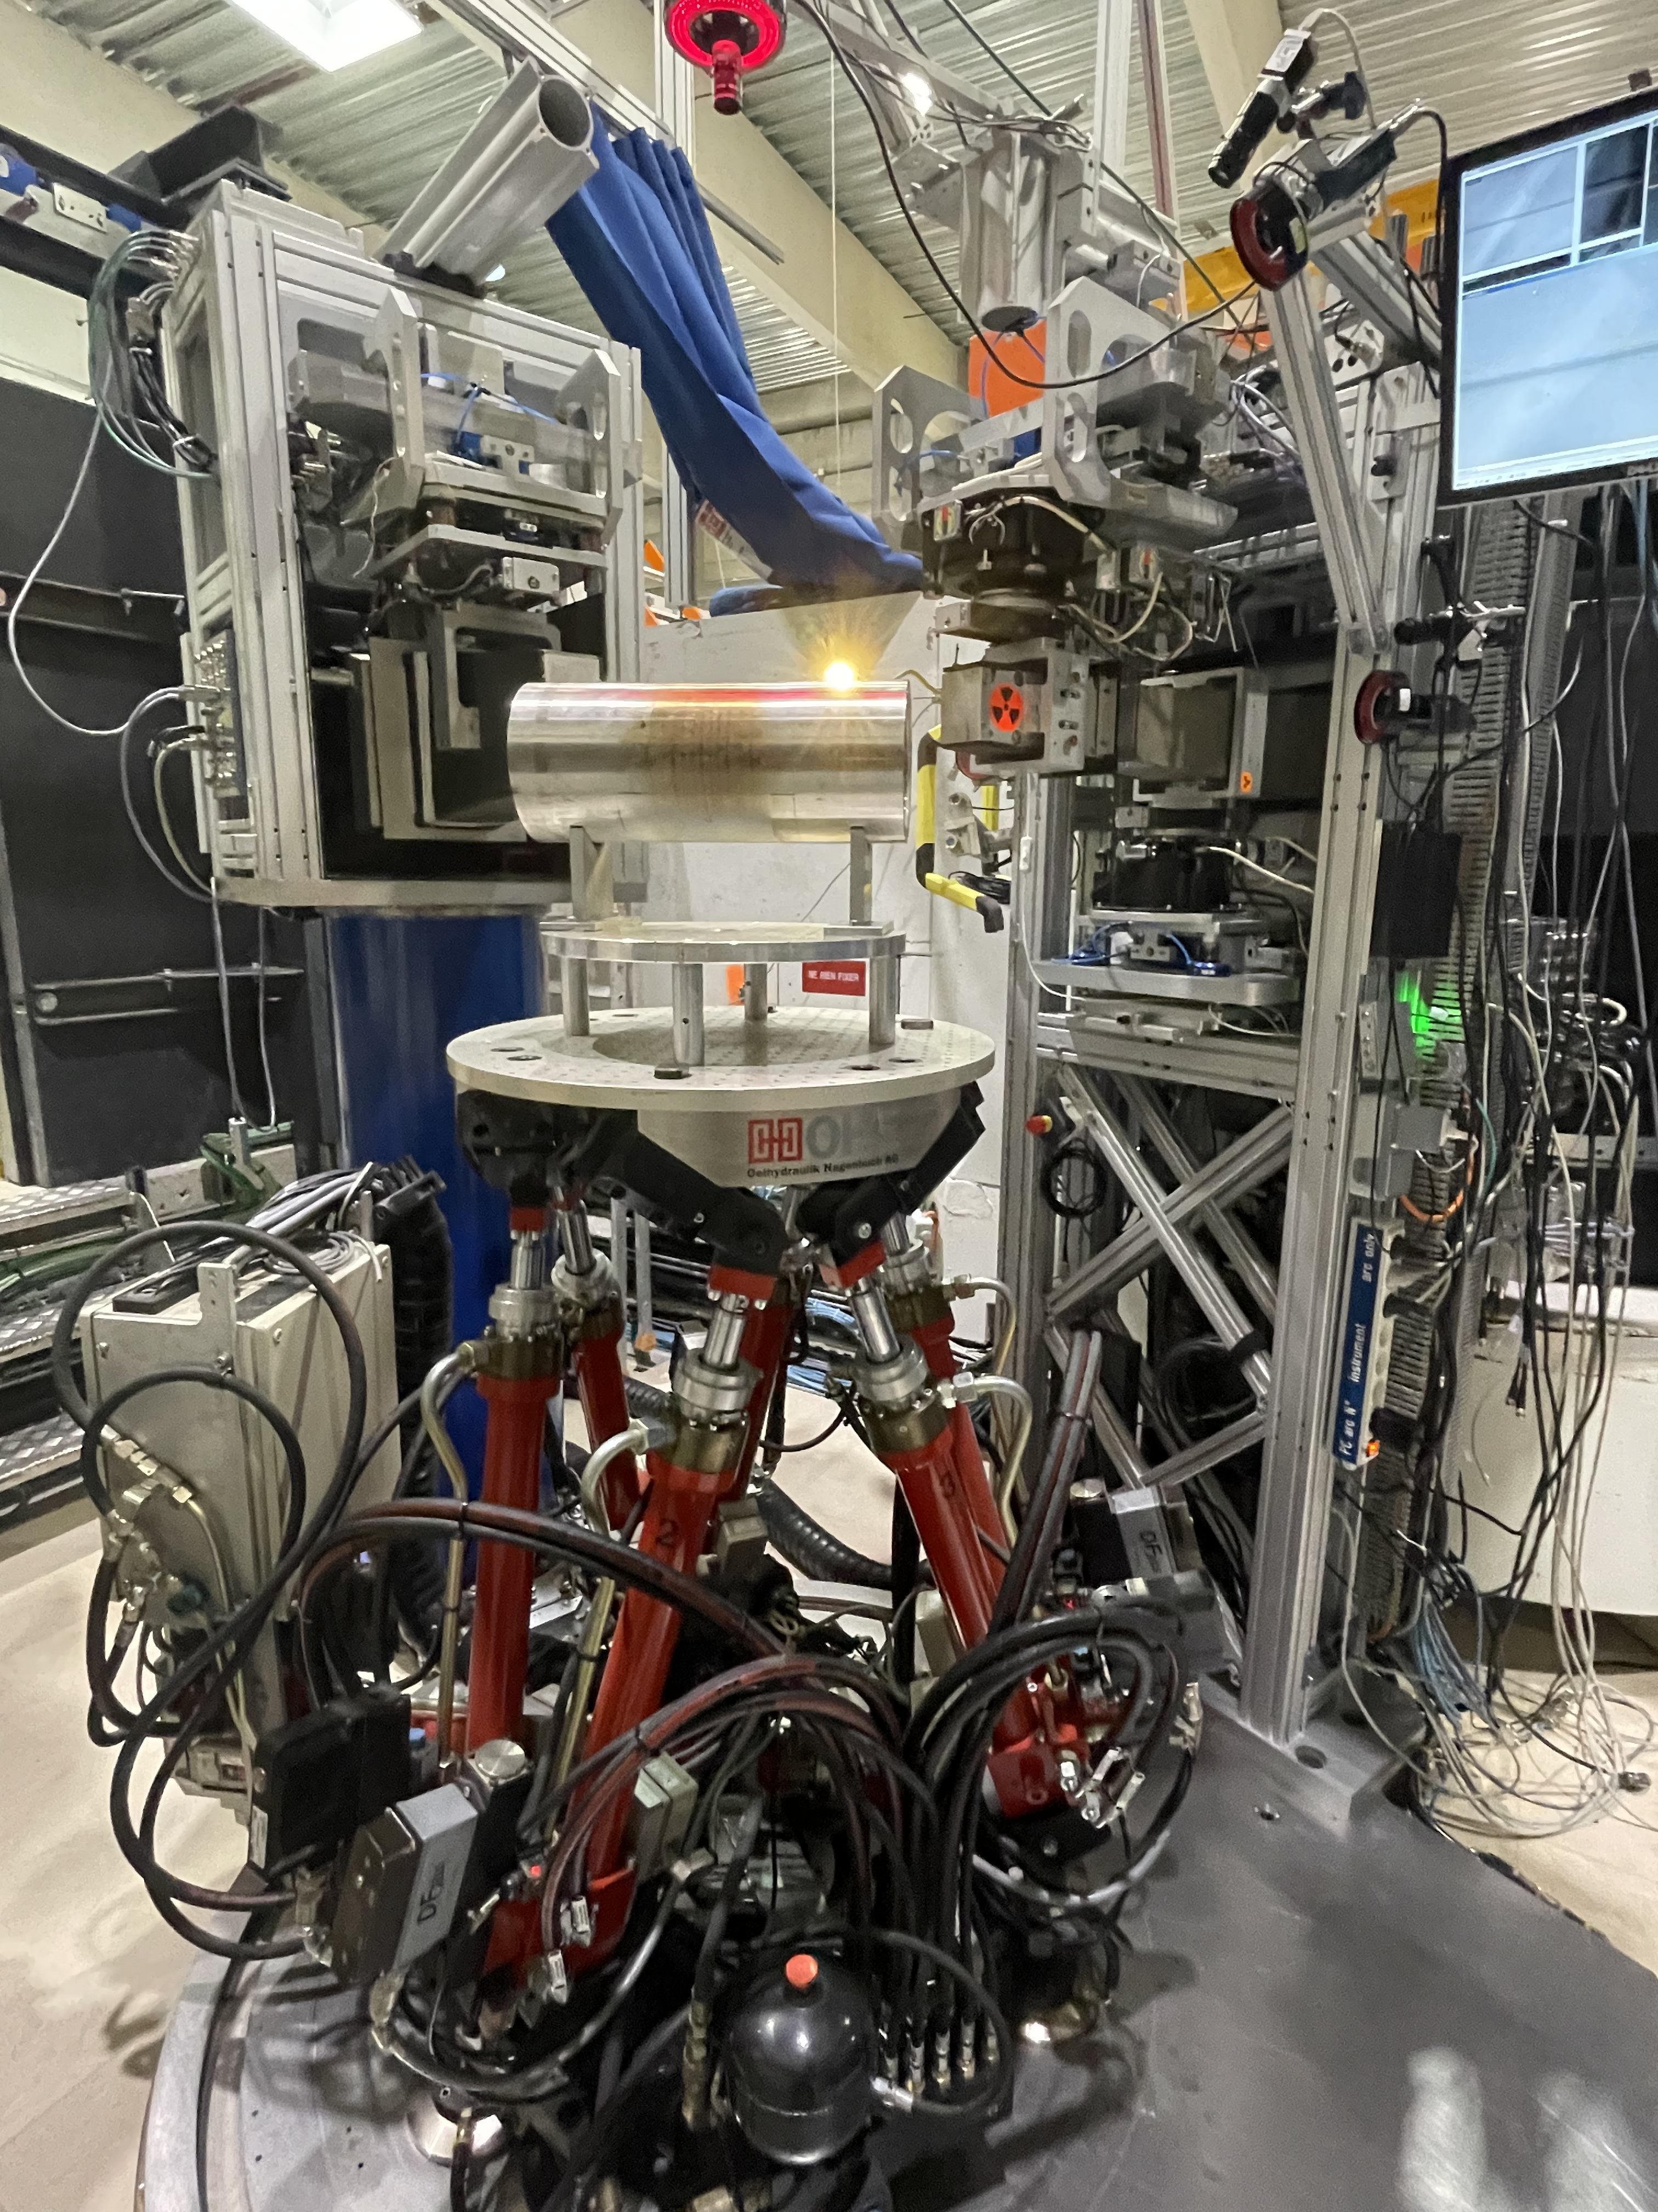
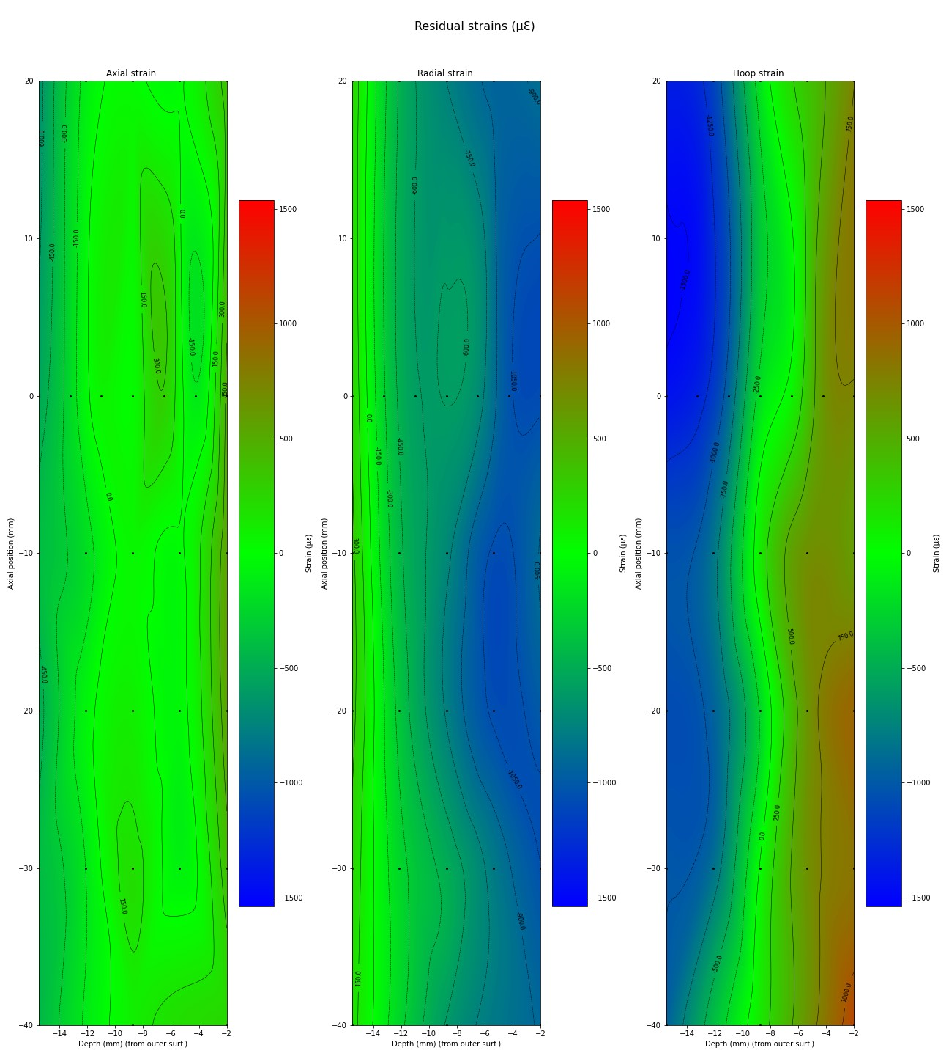
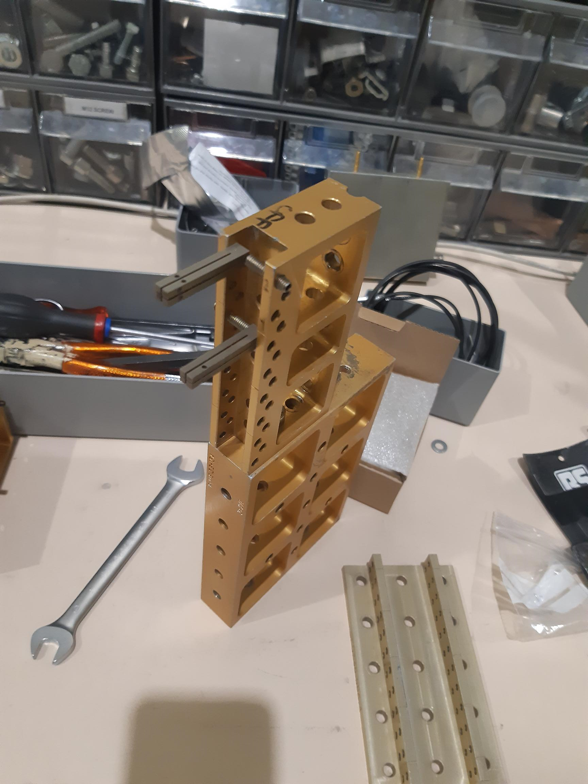
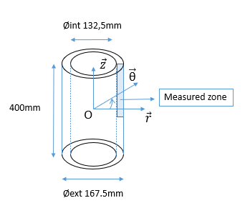
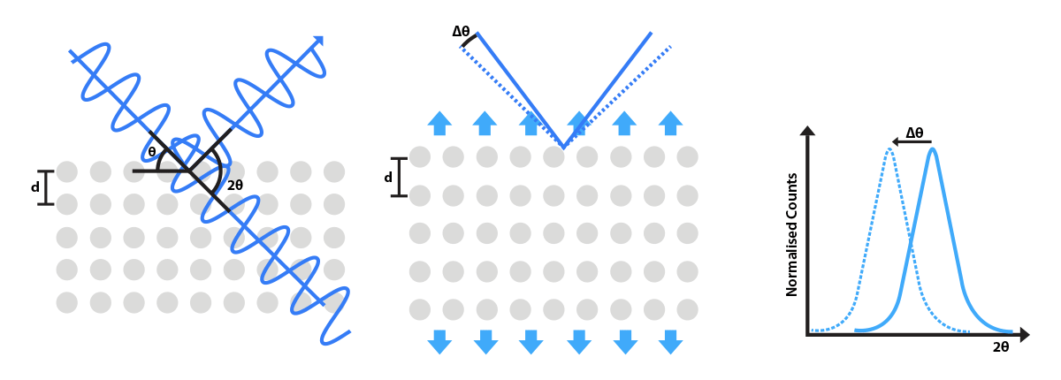

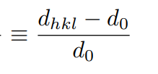
Sixth Step – ILL neutron diffraction measurements
d0 samples
Presence of residual strains
Compressive hoop and axial strains at inner surface = typical of quench residual strains
Global strains are mainly compressive In the measured zone
Axial strains are way lower than the other components
black dot : Measured point

Slide 14
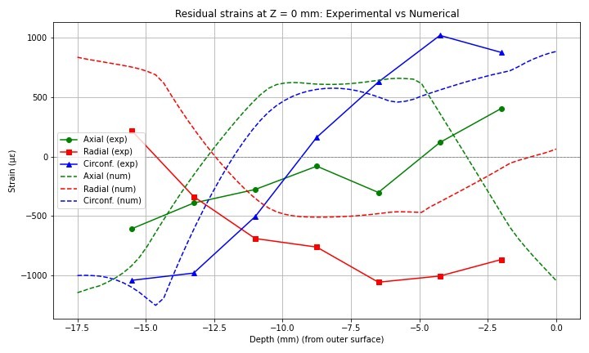
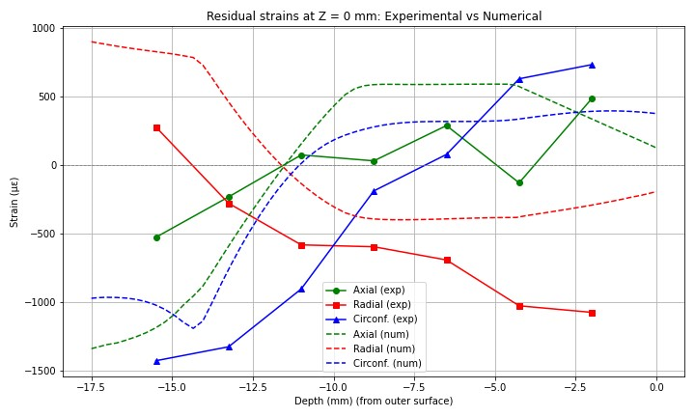
Seventh Step – Experimental/numerical comparison part.1
????
Offset ?
Offset ?
Small coil
Large coil
Big offset on the radial strains
Experimental axial strains are very different from numerical ones
Both coil axial strains are similar
For strains :

Slide 15
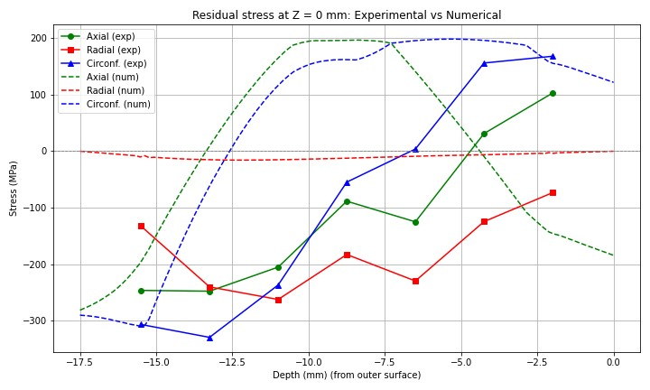
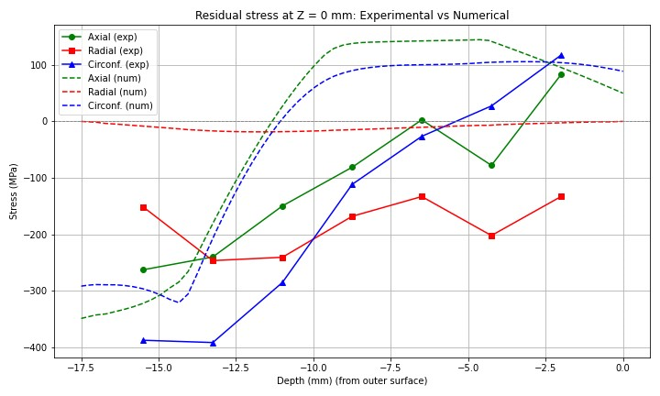
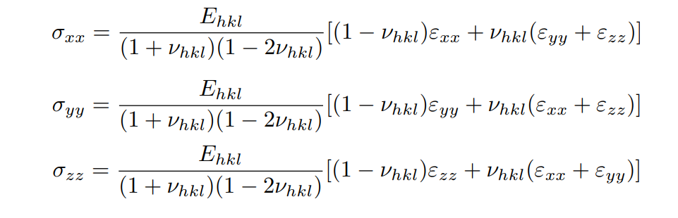
Seventh Step – Experimental/numerical comparison part.2
150MPa radial stress variation
Small coil
Large coil
Isotropic Hooke’s law :
Most curves are completely in disagreement
Radial stress is way too high to by physical
Both coil axial stresses are similar
For stresses :

Slide 16
Eighth Step - Panic
Introduction of residual stress ? ☑
Predictive ? Numerical model unable to reproduce the measured fields
Multiple RSF possibilities ? ~less than expected impact of the heating height from measurement data
Interesting stress fields ? ~
Similarities with Welding ones ? ~
What went wrong ?
For now let’s focus on the numerical

Slide 17

Current work – Mystery solving
First test
Boundaries condition, elasto-plasticity material parameters, visco-plasticity , adding cooling from assembly mass, anisotropic elasticity, Kinematic hardening, using different software (Abaqus), decentered heating…
No effect
The residual stress fields from the FEM are very stable in the experimental constraints
None of the calculations are able to reproduce the offset of the radial strains/stress
Other ideas
Initial residual stress in the pipe (before experiment) ?
Problem with experimental data ?
Texture causing anisotropic elasto-plasticity ?

Slide 18
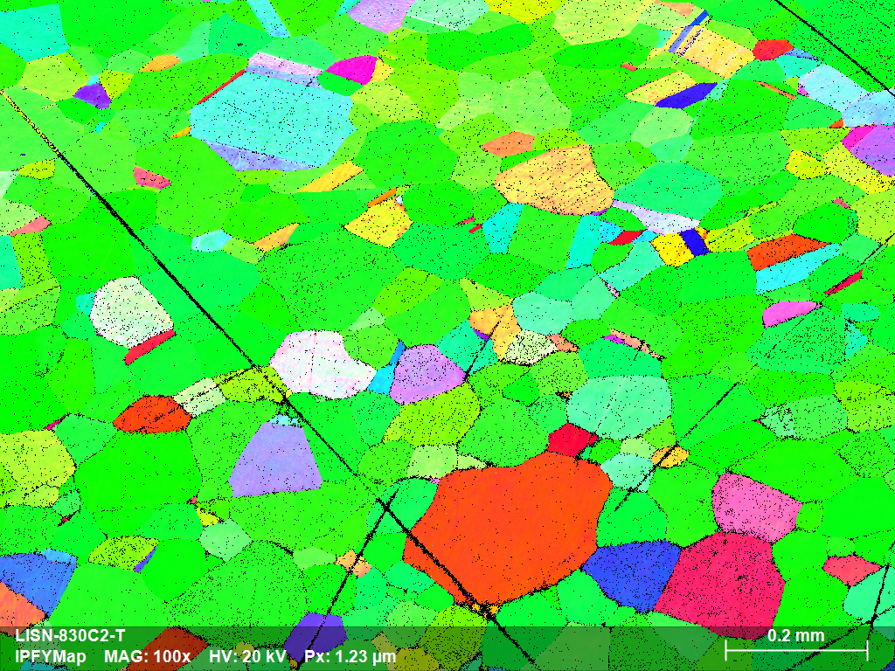
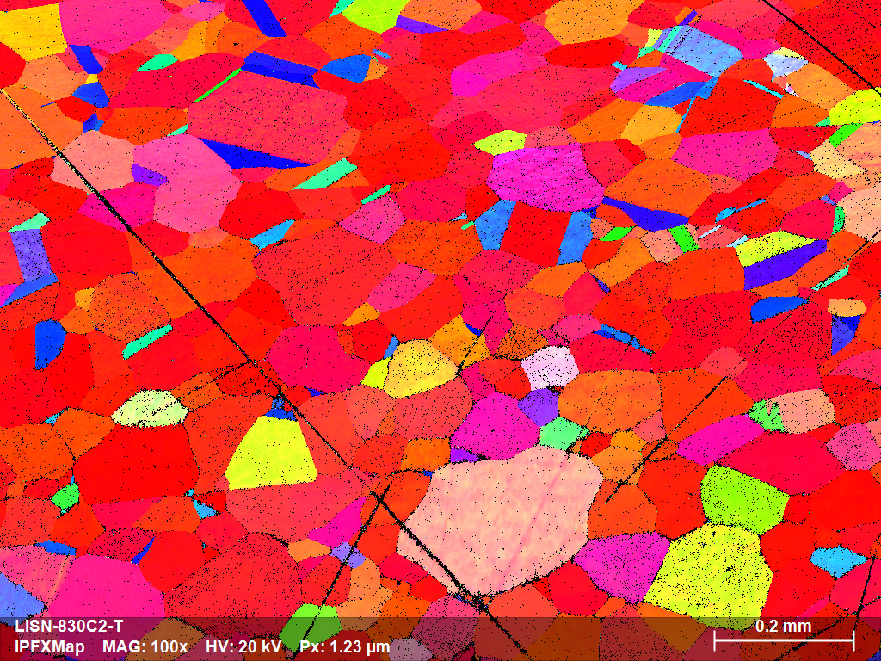
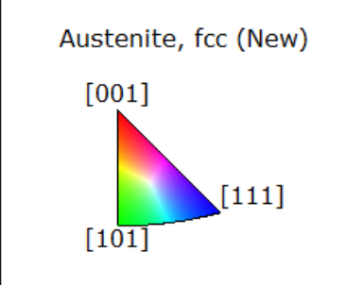
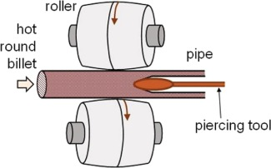
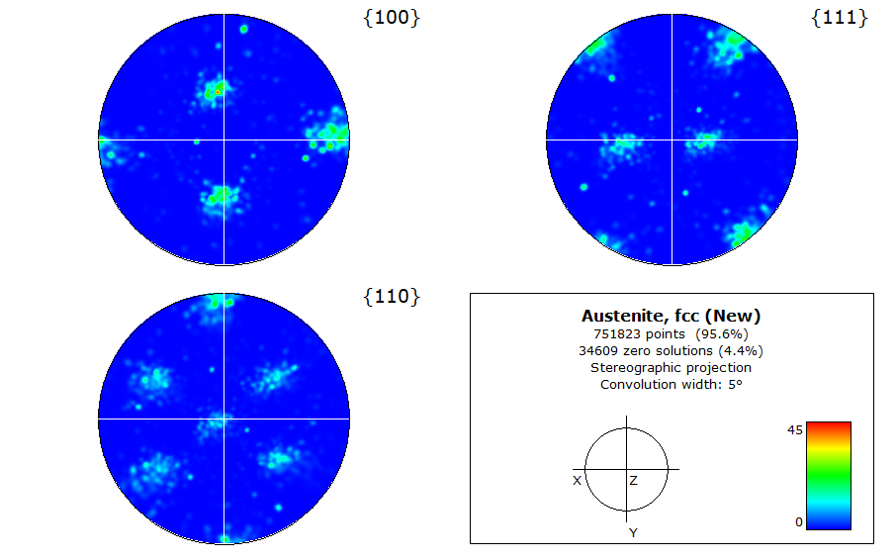
Current work – Anisotropy study
2) Where does the material come from ?
Tubacex ASTM-ASME TP312 316-316L
Seamless tube forming
1) Do we have texture ?
For austenite (FCC) :
We expect mechanical anisotropy to be less than 20% of yield limit variation

Slide 19
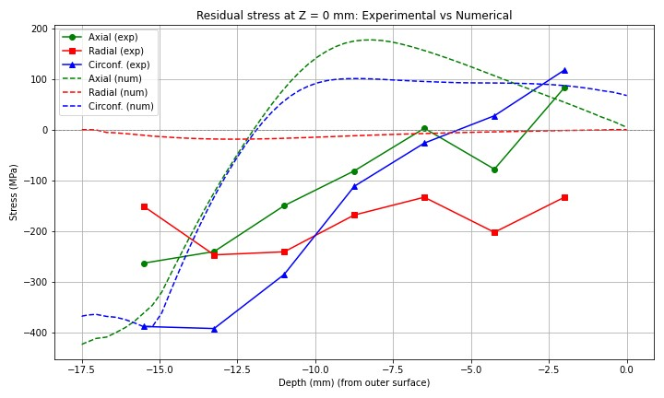

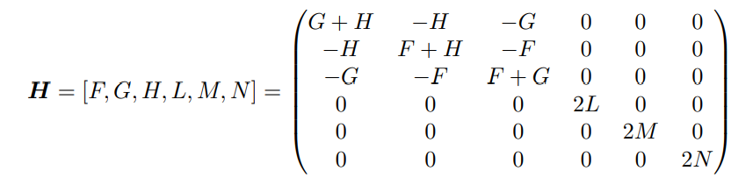
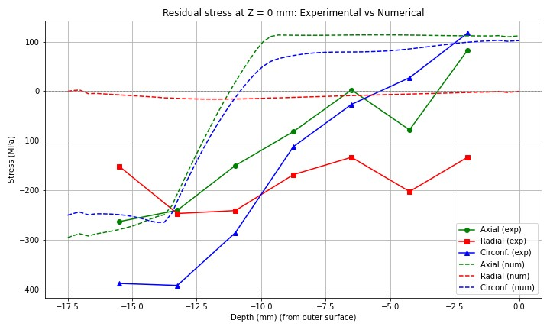
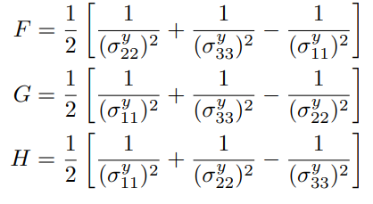
Current work – Anisotropy study
Yield stress+20% on pipe axis
Hill orthotropic plasticity criteria via Mfront :
Yield limit-20% on pie axis
Equivalent to modifying applied stress…
Doesn’t explain our gap

Slide 20
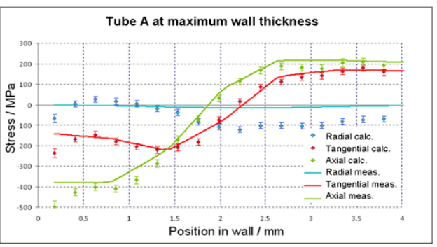
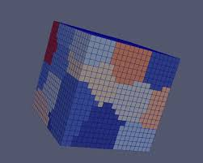
Current work – Problem with neutron diffraction behaviour in strongly textured samples
Literature :
X-Ray diffraction measurements : a lot of data => influence of texture + of triaxiality
Neutron diffraction measurements : less data
some works on influence of texture + garden engineering data corrections ?
usually at least 2 measurements methods are used
Ongoing discussions with neutron diffraction experts/crystal plasticity
researchers modelling to correct residual stress measurement data
MEB microstructure Study to develop CPFE model to correct residual stress
Reproduce measured strains and determine with inverse method the necessary stress to apply

Slide 21


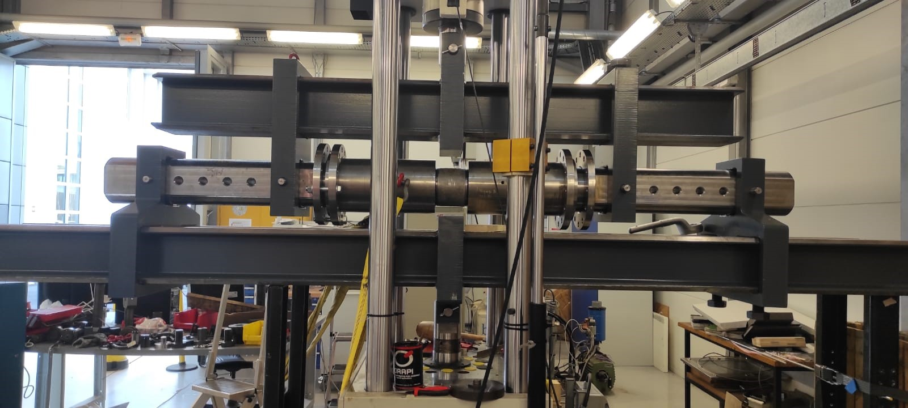
Conclusion and future works
1 vs 0
Cast3m numerical model is very consistent
Validation of the numerical model with the DIC measurements
Fatigue crack growth experiment on 8 point bending rig

Slide 22

Thank you
“I wouldn’t say it was a failure, I would say that it didn’t work”
E. Macron 10/14/2020
CEA SACLAY
91191 Gif-sur-Yvette Cedex
France
robin.debosscher@cea.fr

Slide 23
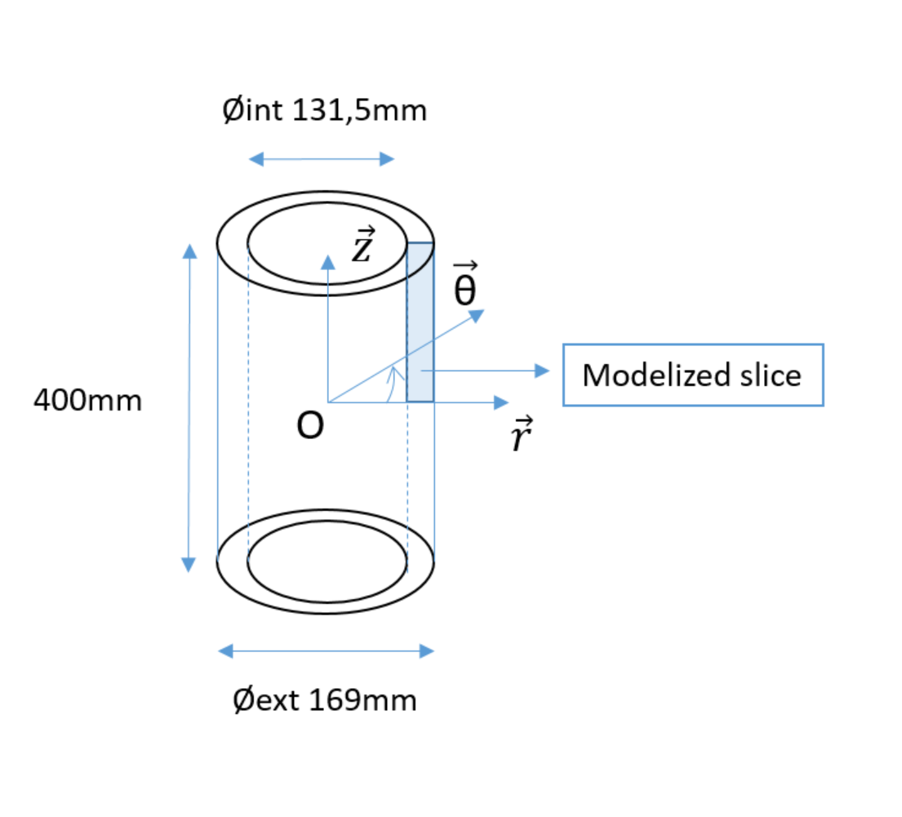
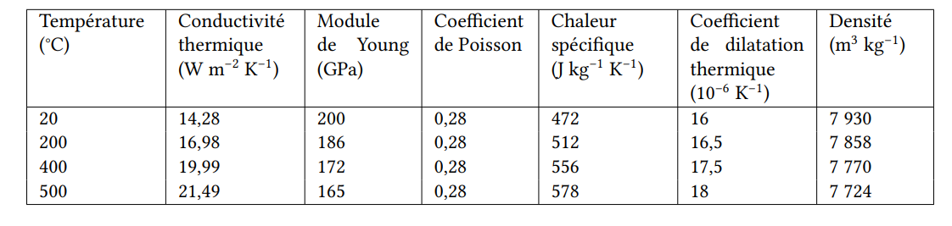
Residual stress profiles chosen – New geometry and new material
Properties of 316L as function of temperature
(RCC-MRX et Aciers inoxydables – Techniques de l’Ingénieur)

Slide 24
Current work – Mystery solving – Influence of plastic anisotropy ?
“A lesson from this study is that to accurately predict residual stresses and strains, one must be wary of seemingly reasonable simplifying assumptions such as neglecting mild plastic anisotropy”
Michael B. Prime, Amplified effect of mild plastic anisotropy on residual stress and strain anisotropy, International Journal of Solids and Structures, Volumes 118–119, 2017, Pages 70-77, ISSN 0020-7683, https://doi.org/10.1016/j.ijsolstr.2017.04.022.
Microstructure observations are in progress to justify this lead
Numerical calculations with arbitrary orthotropic behavior arriving soon
DIC measurements from the experiments are being processed in hope to constrain the orthotropic behavior

