Slide 1
An approach to thermomechanical modelling of welding and additive manufacturing in Cast3M
S. Pascal, DES/ISAS/DRMP/SRMA/LTA, CEA Saclay, France

Slide 2

Introduction
  State of the art
    Numerical welding simulation uses finite element codes for structural analysis
    It takes benefit of decades of experience in thermomechanical modelling that have led to:
      Robust and proven numerical methods
      Performant nonlinear solvers
      Numerous mechanical behavior laws
      Accessible and validated material data
  However, modelling welding and additive manufacturing processes presents two specific characteristics:
    Mobile heat input, also variable in time
    Material deposition
Subject of today’s talk!

Slide 3
Outlines
Mobile heat input
  Heat source models
  Spatiotemporal evolution
Material deposition
  Model geometry evolution
  Energy conservation
Applications

Slide 4
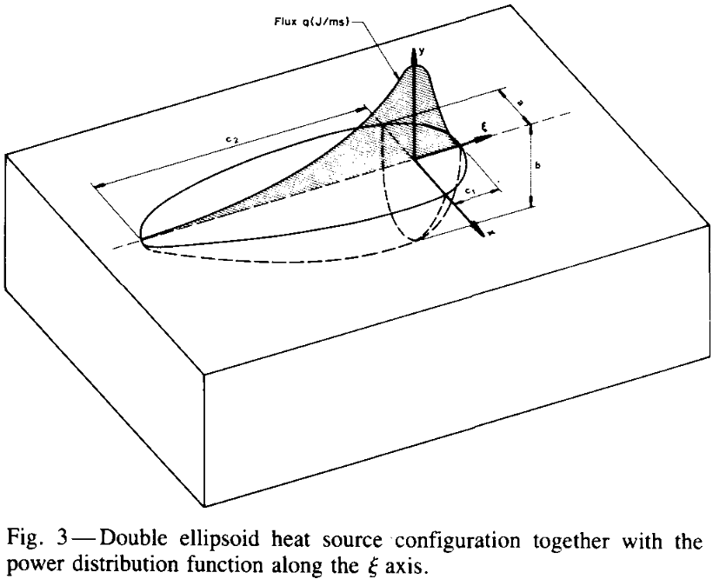
Mobile heat input
  Heat source models: why?
    Heat input processes impose heat fluxes (electric arc, laser…)
    However:
    Thermal modelling of these processes uses heat source models
    to account for hydrodynamic effects in the molten pool
    Example: Goldak¹ heat source model
    Good representation of the molten pool but 8 parameters to identify (at least)
  Heat source models in Cast3M
    Development of heat source models:
    MOD1 = MODE GEO1 THERMIQUE SOURCE… ;
    Two gaussian heat source models:
      … SOURCE GAUSSIENNE ELLIPTIQUE ;
      … SOURCE GAUSSIENNE ELARGIE ;
Goldak¹ heat source model
¹J. Goldak, A. Chakravarti, M. Bibby. “A new finite element model for welding heat sources”, Metallurgical Transactions B, vol. 15, 299–305, 1984.

Slide 5
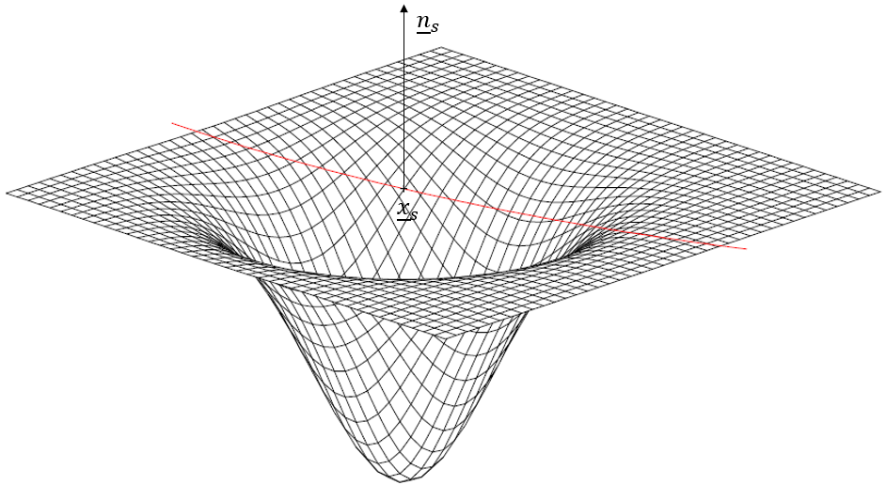

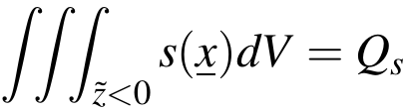
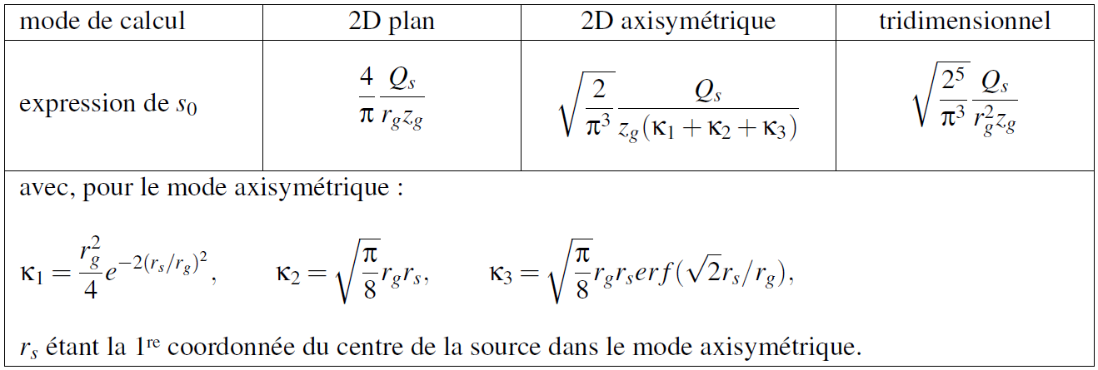

Mobile heat input
  “SOURCE GAUSSIENNE ELLIPTIQUE”
    “Basic” gaussian heat source model
    Thermal power density distribution function:
    $(\tilde{r},\tilde{z})$ space coordinates in local cylindrical frame of axis ${\underline{n}}_{s}$,
    and $s_{0}$ such that:
    5 parameters:
      ${\underline{x}}_{s},{\underline{n}}_{s}$ : location and orientation
      $r_{g}, z_{g}$ : shape
      $Q_{s}$ : power
Expression of $s_{0}$ for 3 calculation modes: plane, axisymmetric and tridimensional.

Slide 6
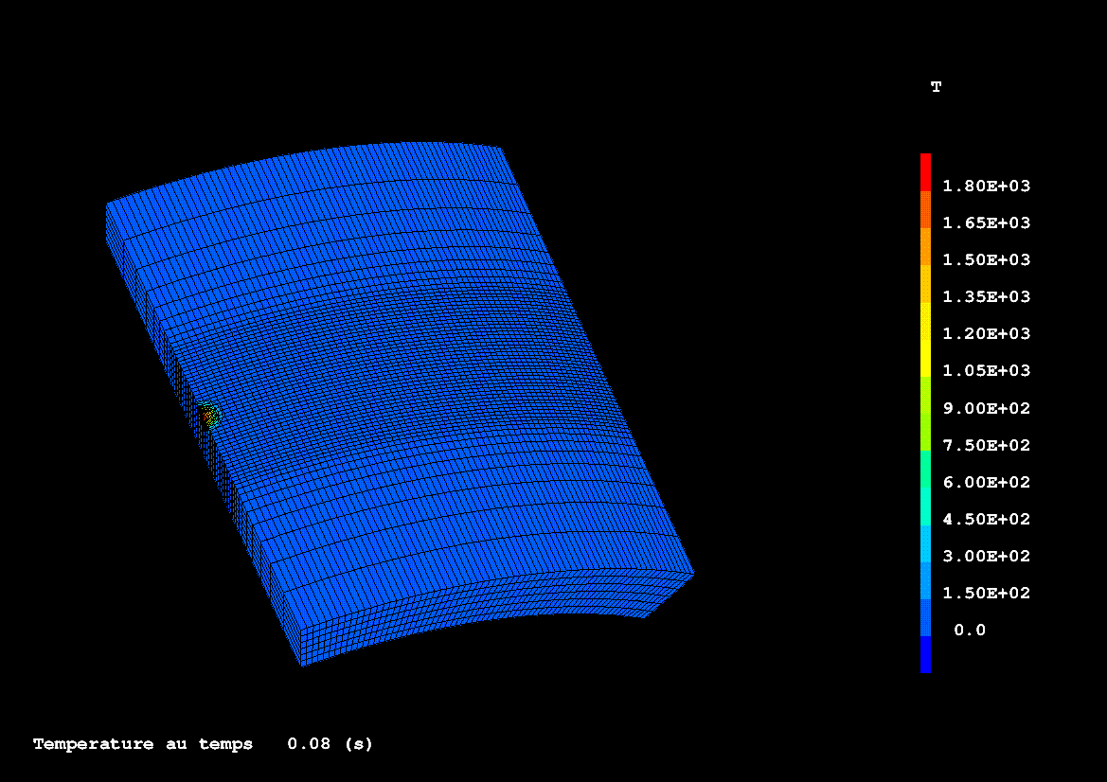
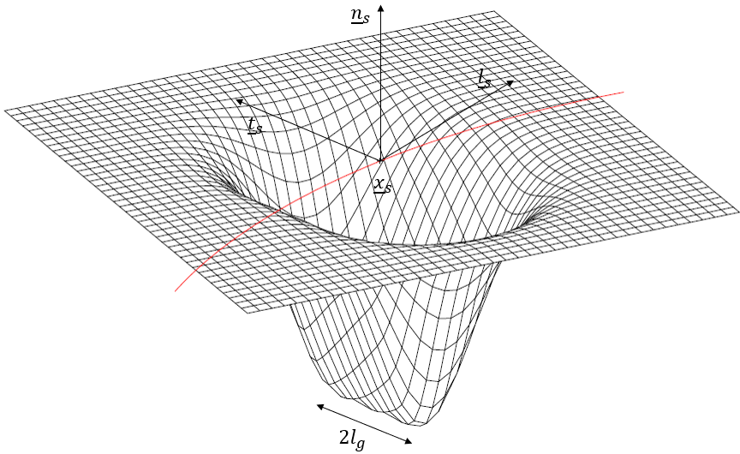

Mobile heat input
  “SOURCE GAUSSIENNE ELARGIE”
    Simplified heat source model to represent sweep welding
    Thermal power density distribution function (only in 3D mode):
    $\left(u,v,w\right)$ space coordinates in local frame $({\underline{l}}_{s},{\underline{t}}_{s}{,\underline{n}}_{s})$
    7 parameters:
      ${\underline{x}}_{s}, {{\underline{t}}_{s},\underline{n}}_{s}$ : location and orientation
      $r_{g}, z_{g}, l_{g}$ : shape
      $Q_{s}$ : power

Slide 7
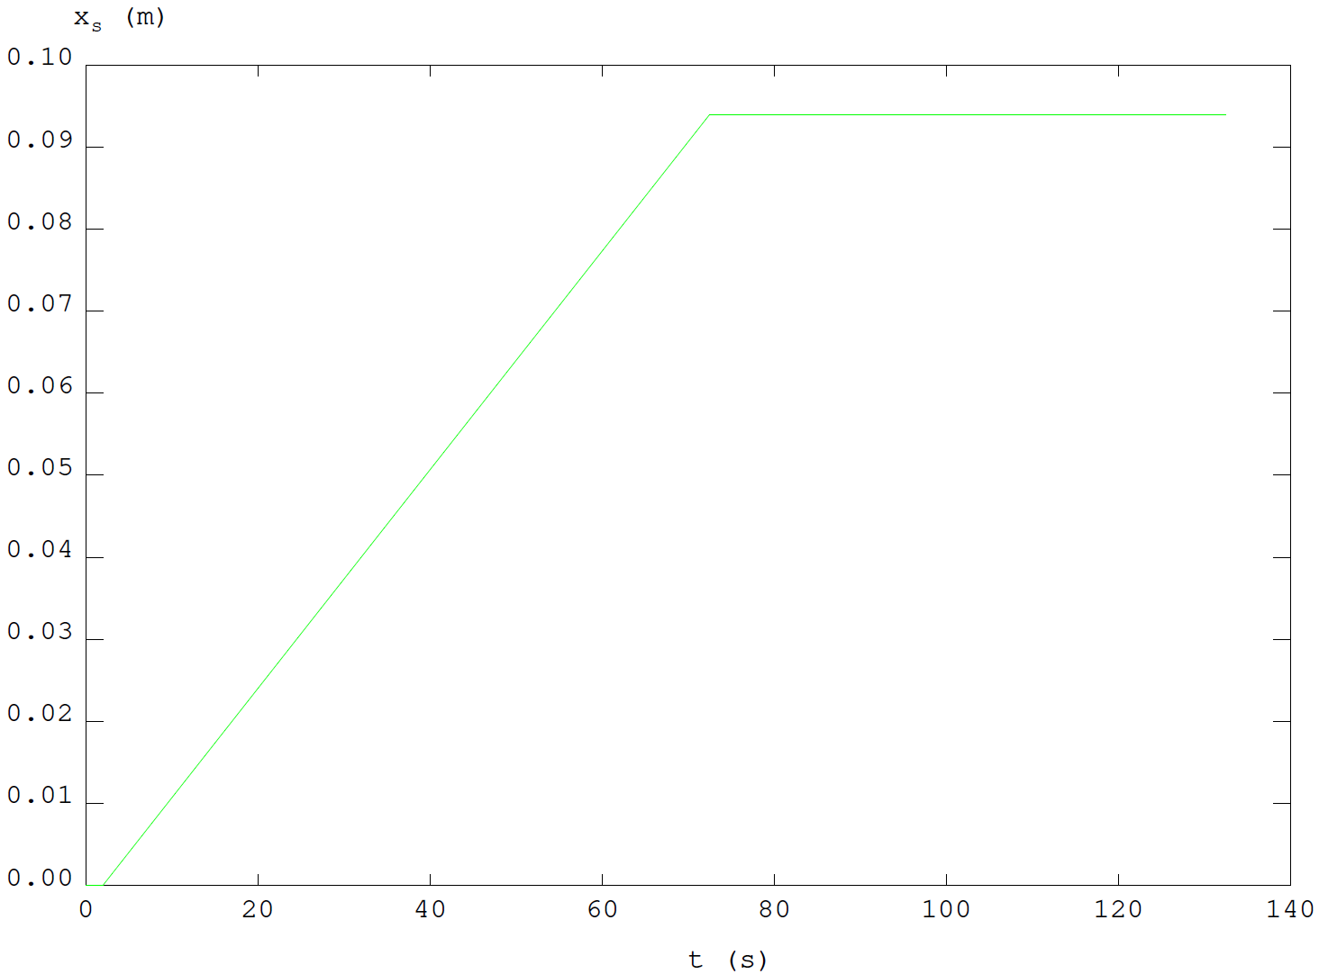
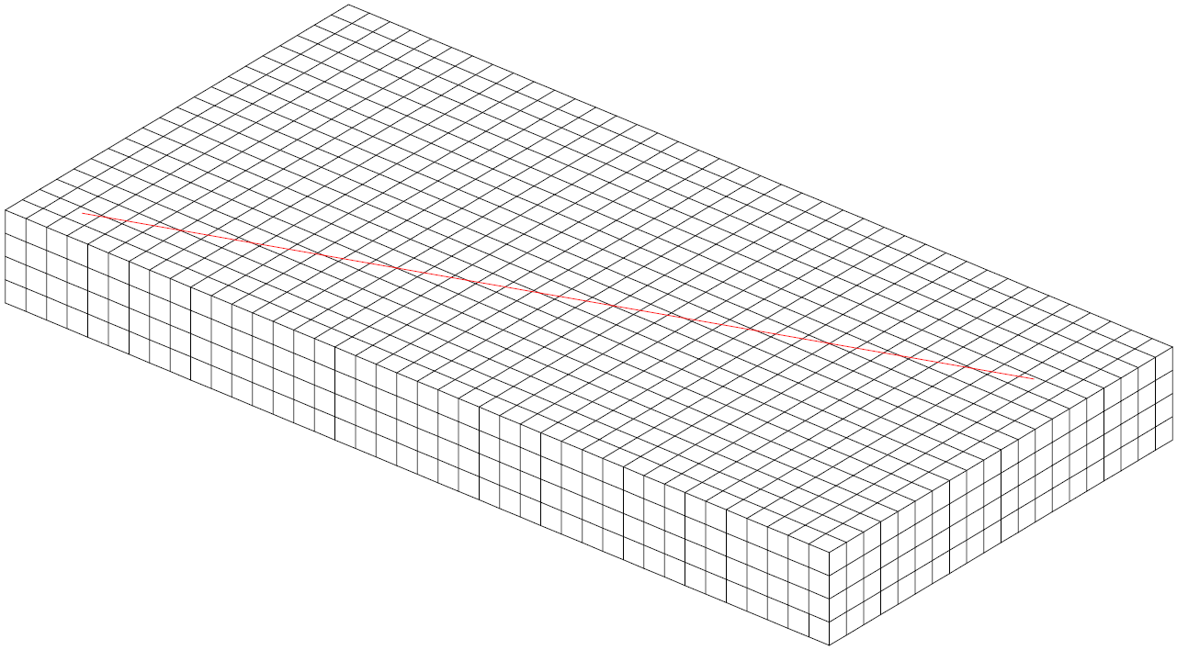
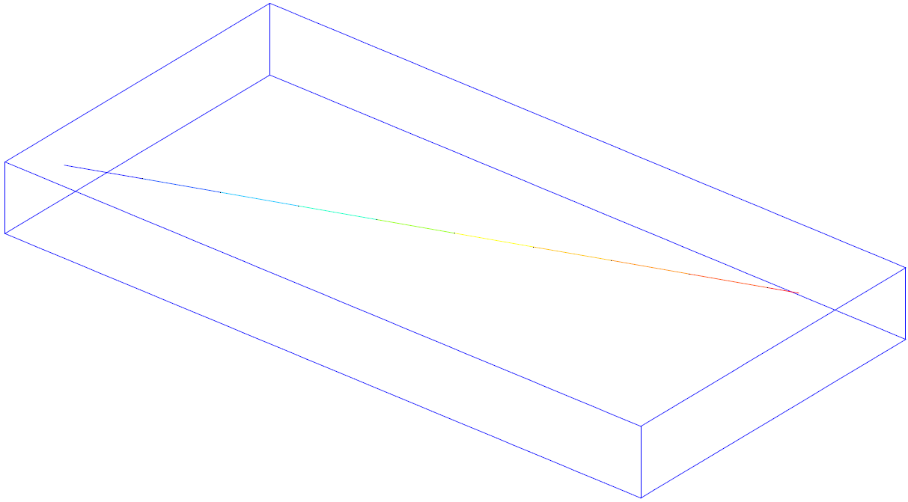
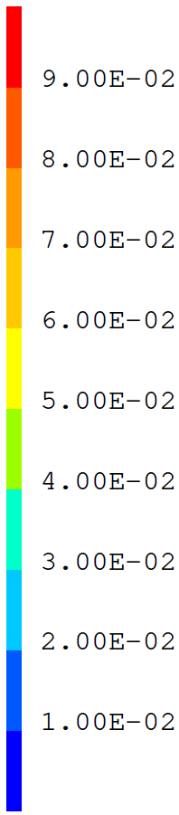
Mobile heat input
  Mobile heat source modelling
    Based on:
      Heat source trajectory, modelled as an oriented meshed line (LTRAJ1)
      Time evolution of its displacement along this line (EVXS1)
    In Cast3M, definition of a CHARGEMENT type object:
    CHXS1 = LTRAJ1 COOR CURV ;
    CGXS1 = CHAR TRAJ CHXS1 EVXS1 ;
    Use for a given time TPS1:
    PTXS1 = TIRE CGXS1 TRAJ TPS1 ;
EVXS1
LTRAJ1
CHXS1
x
PTXS1

Slide 8
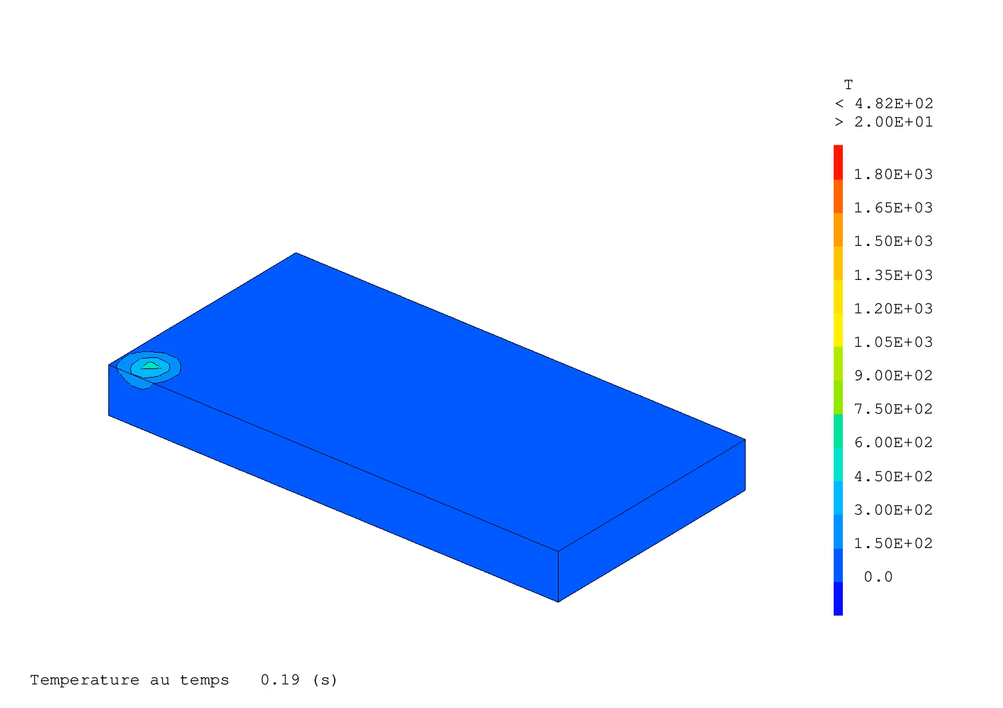
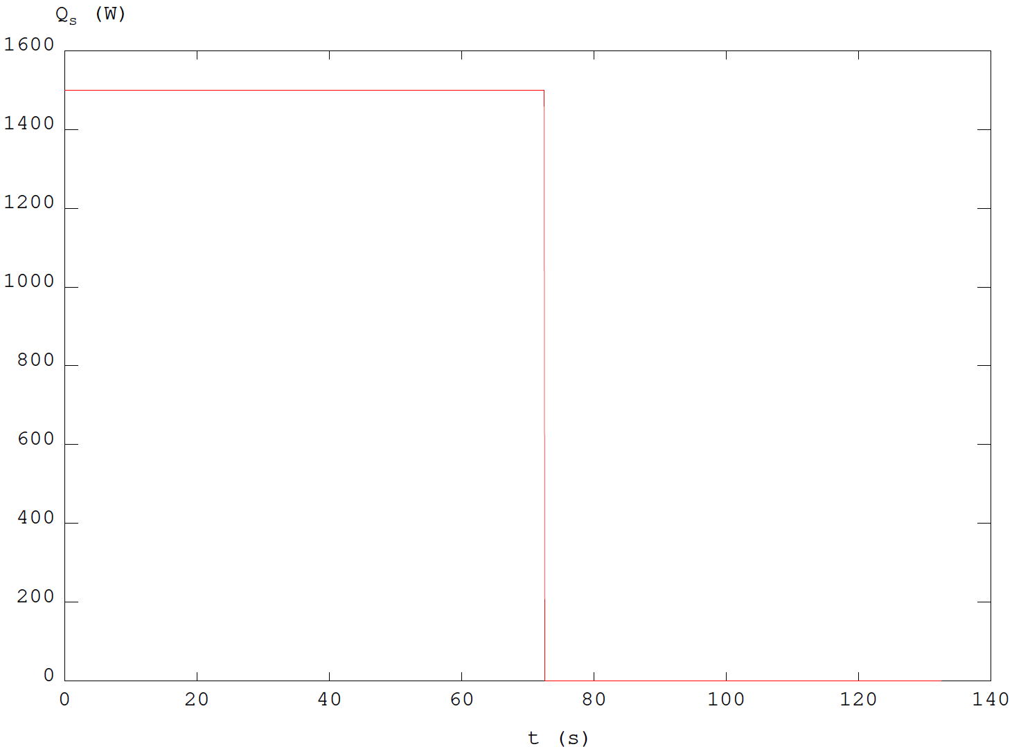
Mobile heat input
  Mobile heat source modelling
    Connection to the heat source models in Cast3M:
    MODQS1 = MODE GEO1 THERMIQUE SOURCE GAUSSIENNE… ;
    MATQS1 = MATE MODQS1 ORIG CGXS1 QTOT EVQS1 RGAU RG1 ZGAU ZG1 DIRE NS1… ;
    the location of the heat source can be updated at any time by giving CGXS1,
    as well as the heat source intensity by giving EVQS1
EVQS1

Slide 9
Outlines
Mobile heat input
  Heat source models
  Spatiotemporal evolution
Material deposition
  Model geometry evolution
  Energy conservation
Applications

Slide 10
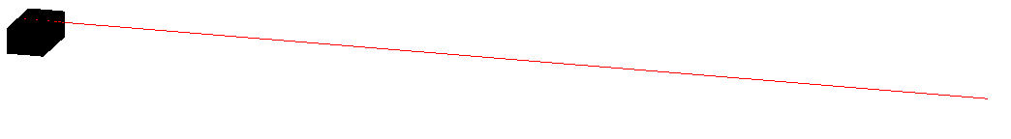
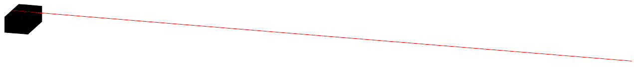
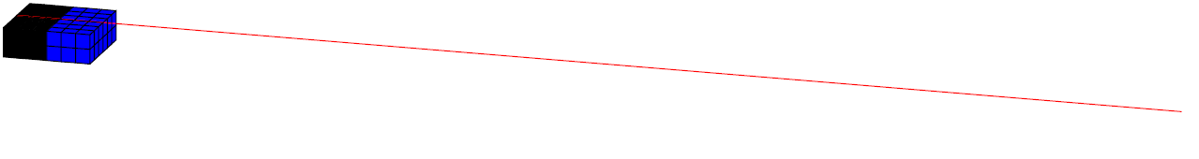
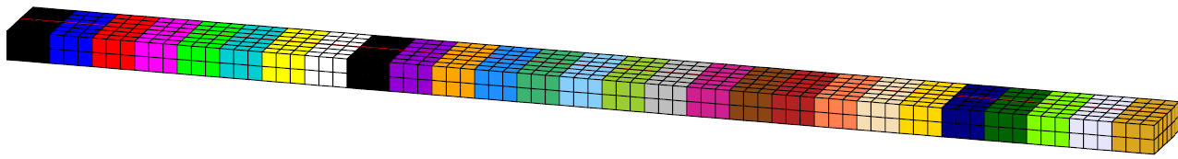


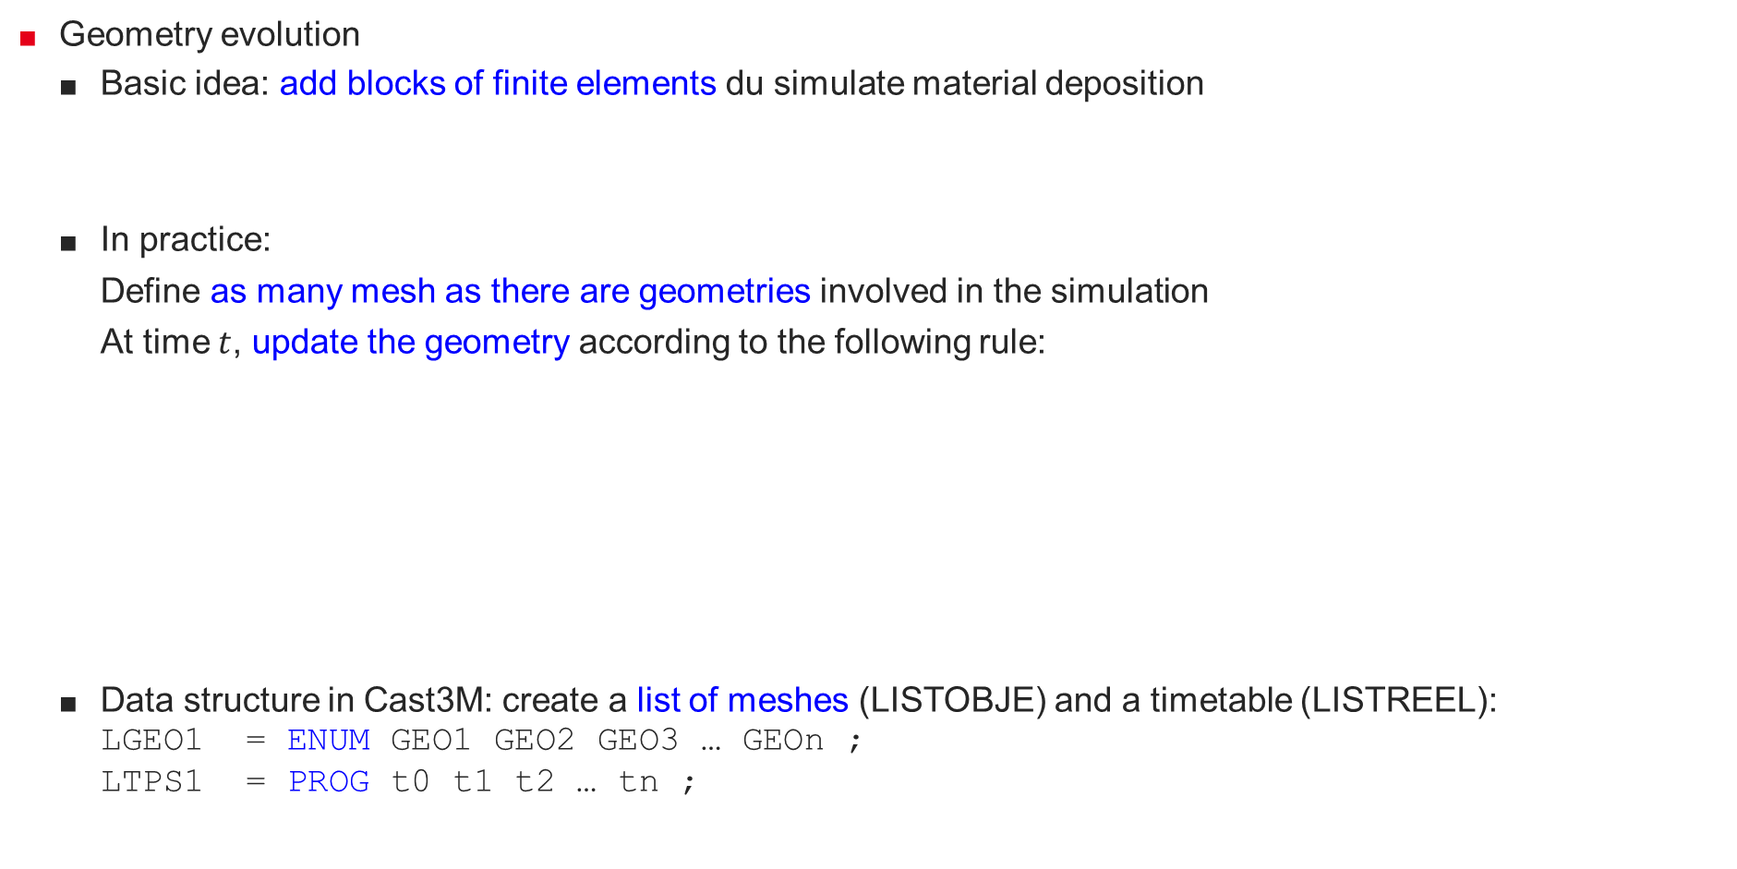



Material deposition
  Geometry evolution
    Basic idea: add blocks of finite elements du simulate material deposition
    In practice:
      Define as many mesh as there are geometries involved in the simulation
      At time $t$, update the geometry according to the following rule:
    Data structure in Cast3M: create a list of meshes (LISTOBJE) and a timetable (LISTREEL):
    LGEO1 = ENUM GEO1 GEO2 GEO3 … GEOn ;
    LTPS1 = PROG t0 t1 t2 … tn ;
$t_{0}≤t<t_{1}$ geometry GEO1
$$…$$
$t_{1}≤t<t_{2}$ geometry GEO2
$$…$$
$t_{n−1}≤t<t_{n}$ geometry GEOn

Slide 11
Material deposition
  Model evolution
    Define as many models as there are meshes in LGEO1:
    LMOD1 = ENUM ;
    LMAT1 = ENUM ;
    REPE B1 (DIME LGEO1) ;
    GEOI1 = LGEO1 EXTR &B1 ;
    MODI1 = MODE GEOI1 MECANIQUE ELASTIQUE … ;
    MATI1 = MATE MODI1 YOUN YM1 NU NU1 … ;
    LMOD1 = LMOD1 ET MODI1 ;
    LMAT1 = LMAT1 ET MATI1
    FIN B1 ;
    CGMOD1 = CHAR MODE LTPS1 LMOD1 ;
    CGMAT1 = CHAR MATE LTPS1 LMAT1 ;
    Use in PASAPAS input table:
    TAB1.MODELE = CGMOD1 ;
    TAB1.CARACTERISTIQUES = CGMAT1 ;
    During resolution, PASAPAS updates the model and its characteristics, which makes the geometry evolving.

Slide 12
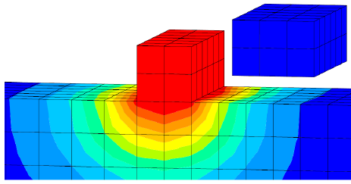
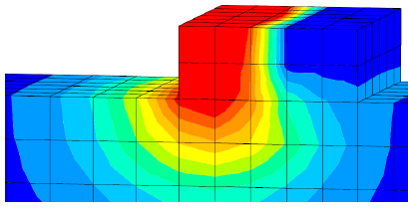

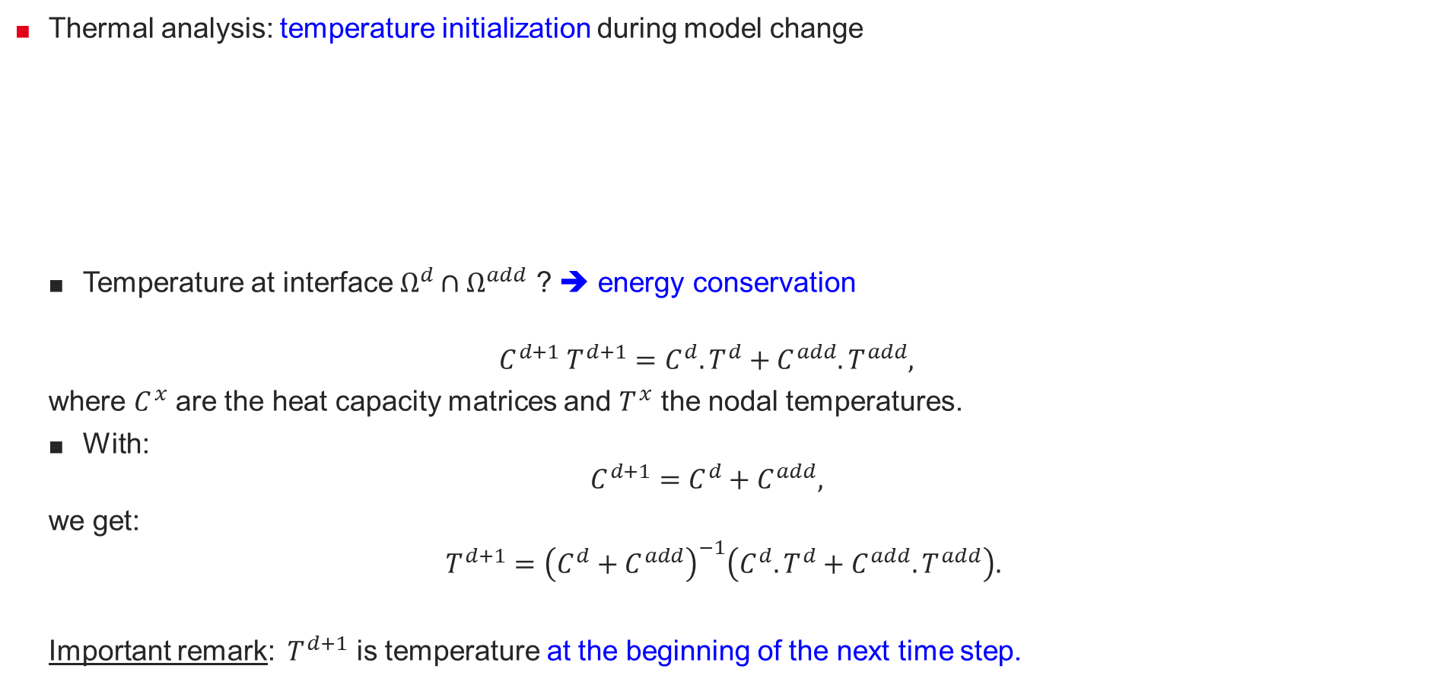


Material deposition
  Thermal analysis: temperature initialization during model change
    Temperature at interface $Ω^{d}∩Ω^{add}$ ? ➔ energy conservation
    $$C^{d+1} T^{d+1}=C^{d}.T^{d}+C^{add}. T^{add},$$
    where $C^{x}$ are the heat capacity matrices and $T^{x}$ the nodal temperatures.
    With:
    $$C^{d+1}=C^{d}+C^{add},$$
    we get:
  $$T^{d+1}={\left(C^{d}+C^{add}\right)}^{−1}\left(C^{d}.T^{d}+C^{add}. T^{add}\right).$$
    Important remark: $T^{d+1}$ is temperature at the beginning of the next time step.
?
$$Ω^{add}$$
$$Ω^{d}$$
$$Ω^{d+1}$$

Slide 13
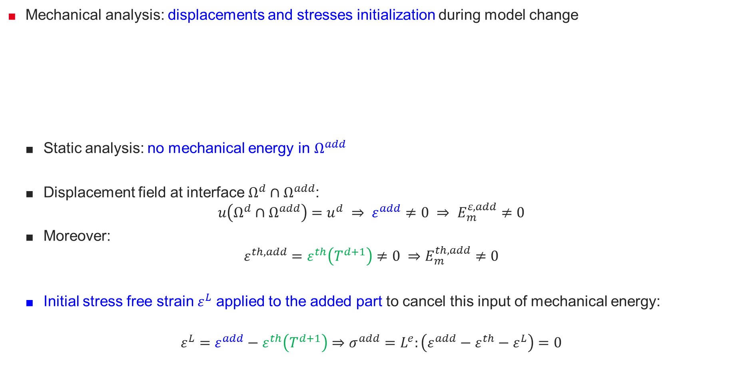
Material deposition
  Mechanical analysis: displacements and stresses initialization during model change
    Static analysis: no mechanical energy in $Ω^{add}$
    Displacement field at interface $Ω^{d}∩Ω^{add}$:
    $$u\left(Ω^{d}∩Ω^{add}\right)=u^{d} ⇒ ε^{add}≠0 ⇒ E_{m}^{ε,add}≠0$$
    Moreover:
    $$ε^{th,add}=ε^{th}\left(T^{d+1}\right)≠0 ⇒E_{m}^{th,add}≠0$$
    Initial stress free strain $ε^{L}$ applied to the added part to cancel this input of mechanical energy:
    $$ε^{L}=ε^{add}−ε^{th}\left(T^{d+1}\right)⇒σ^{add}=L^{e}:\left(ε^{add}−ε^{th}−ε^{L}\right)=0$$
?
$$Ω^{add}$$
$$Ω^{d}$$
$$Ω^{d+1}$$

Slide 14
Outlines
Mobile heat input
  Heat source models
  Spatiotemporal evolution
Material deposition
  Model geometry evolution
  Energy conservation
Applications

Slide 15
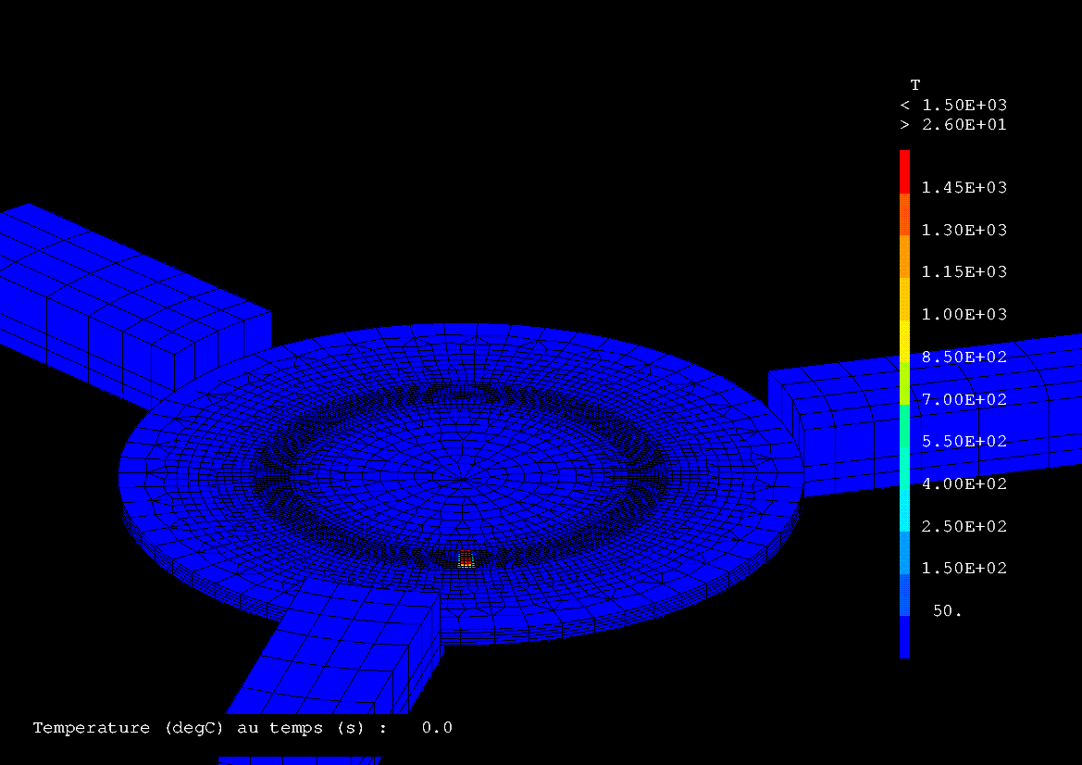
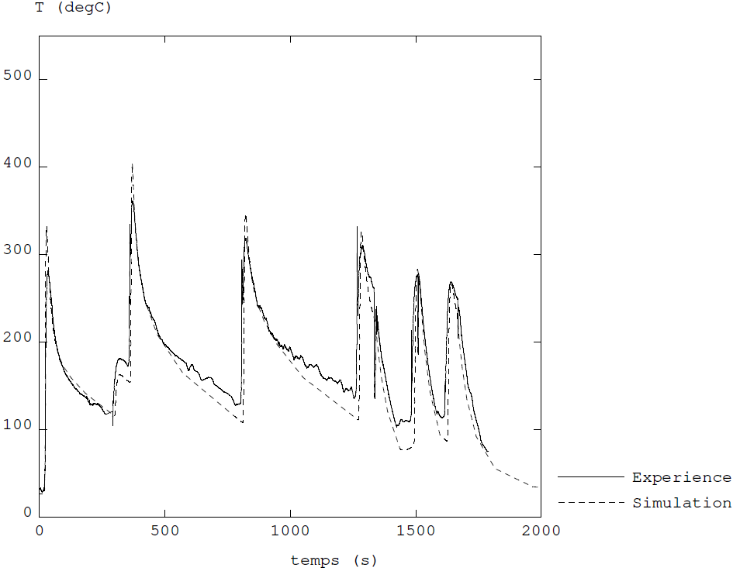
Applications
  Example of thermal analysis : tube manufacturing with WAAM process ¹
Time evolution of temperature node field (°C)
Time evolution of temperature (°C) at a thermocouple location
TC-7
¹S. Pascal, M. Garnier, M. Garric, J. Le Mercier. Modélisation thermomécanique de la fabrication additive arc-fil d’un tube droit avec Cast3M, 16ieme Colloque National en Calcul des Structures (CSMA 2024), CNRS, CSMA, ENS Paris-Saclay, CentraleSupélec, mai 2024, Hyères, France.

Slide 16
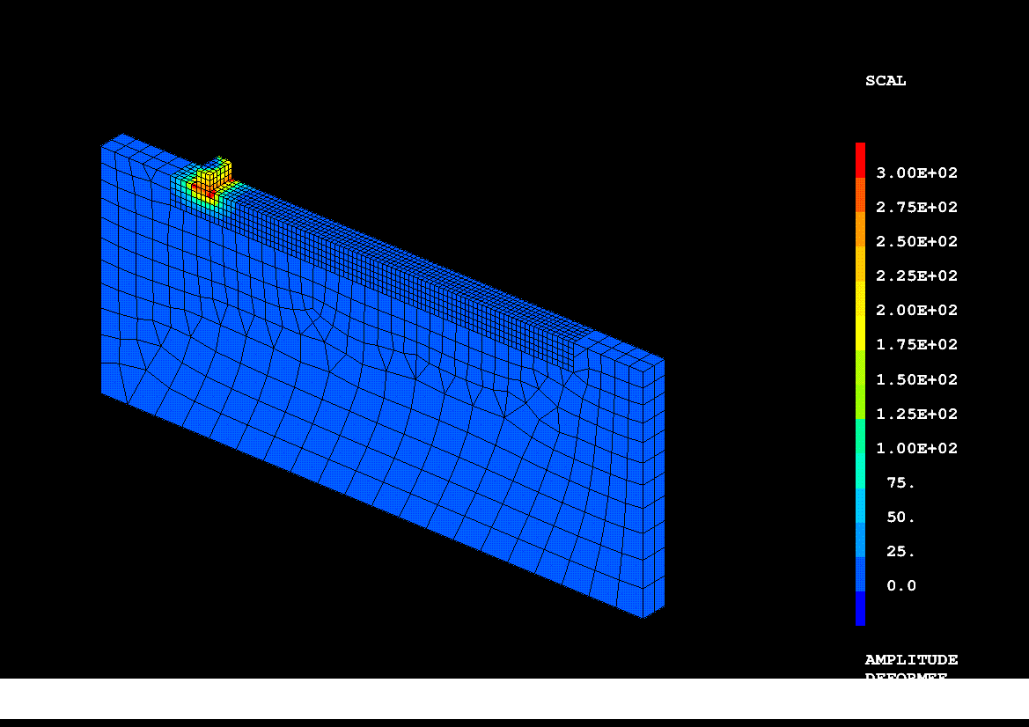
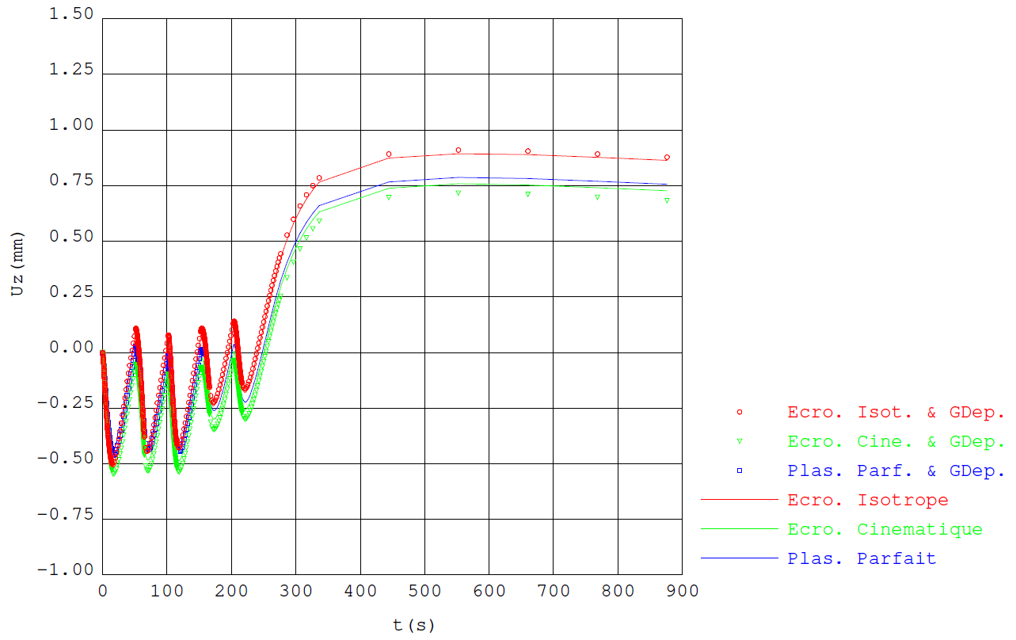
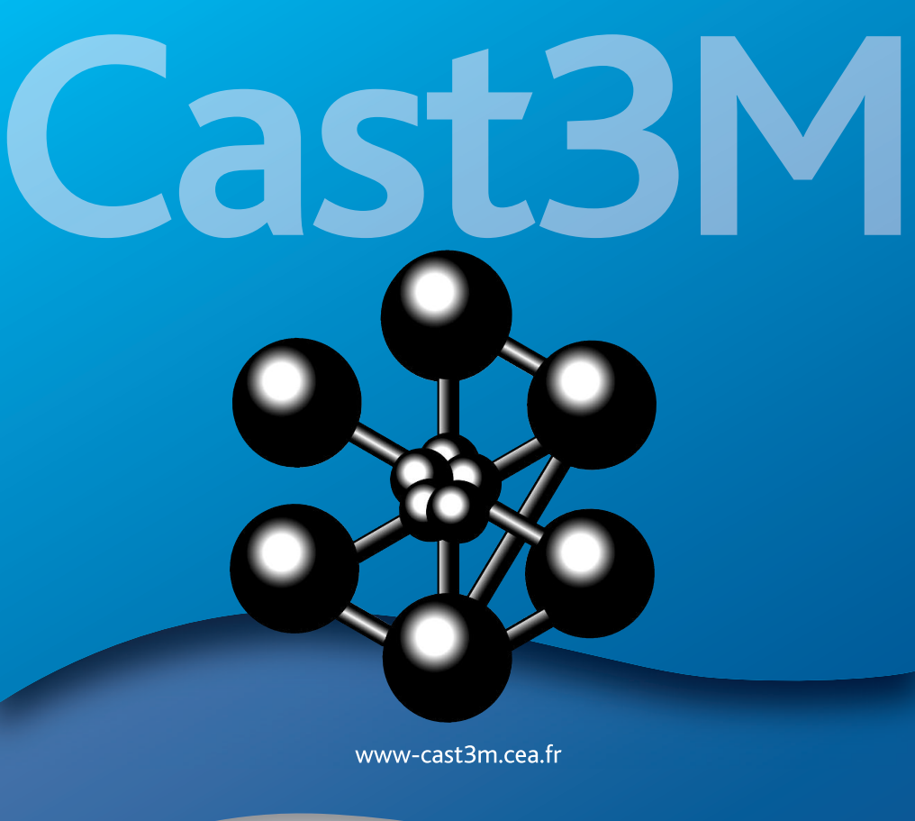
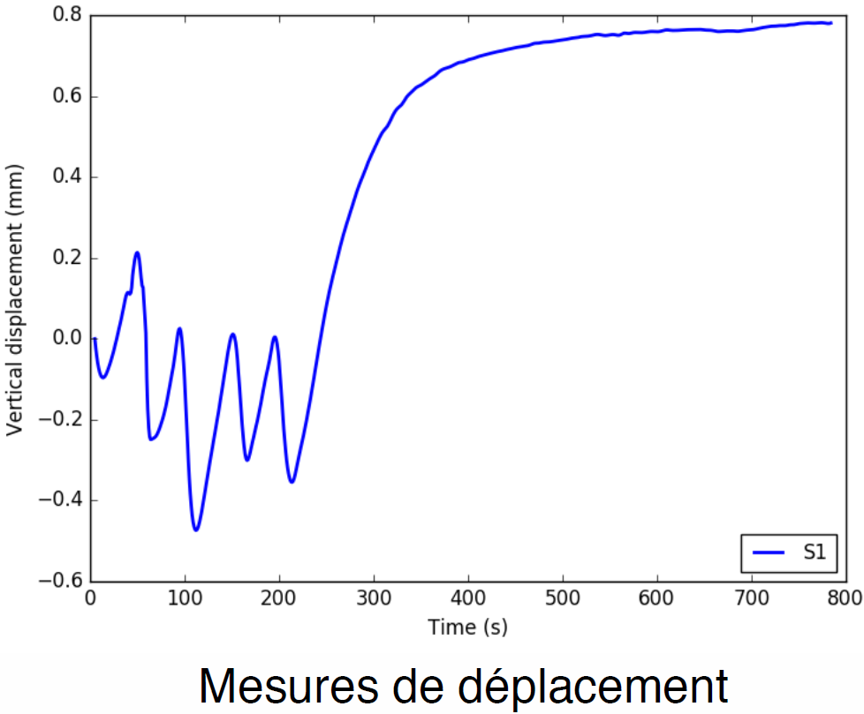
Applications
  Example of mechanical analysis : wall manufacturing with WAAM process^{1,2}
Time evolution of $U_{z}$ displacement (mm) at the plate end
Time evolution of von Mises stress field (MPa)
Experimental measure
exe
Linear isotropic hardening, large displacement analysis
¹C. Cambon, S. Rouquette, I. Bendaoud, C. Bordreuil, R. Wimpory, F. Soulié. Thermo-mechanical simulation of overlaid layers made with Wire + Arc Additive Manufacturing and GMAW-Cold Metal Transfer, Welding in the World, Vol. 64 No. 8, pp 1427-1435.
²S. Pascal, S. Gounand. Modélisation thermomécanique d’un cas d’étude de fabrication additive arc-fil,15ieme Colloque National en Calcul des Structures (CSMA 2022), Université Polytechnique Hauts-de-France, [UPHF], mai 2022, Hyères, France.

Slide 17
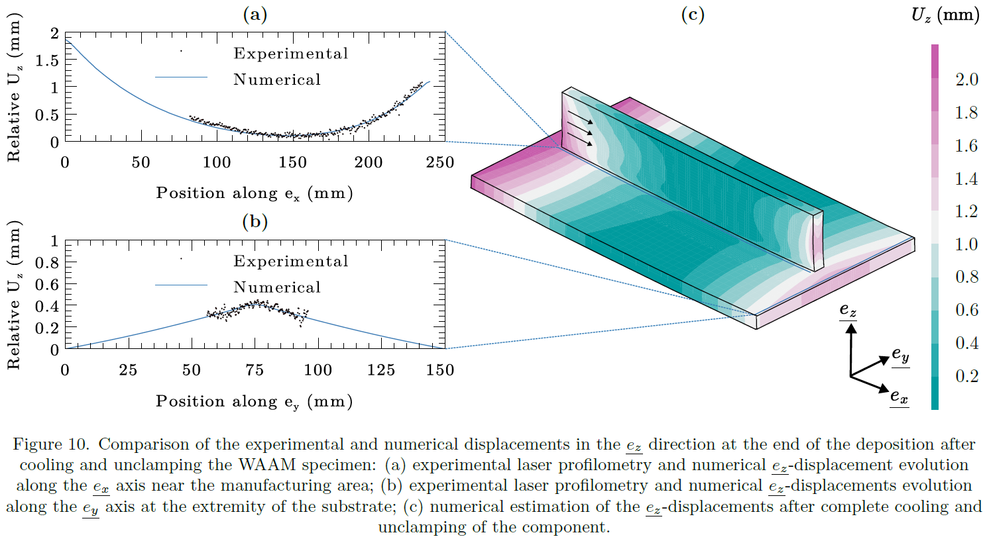
Applications
  Example of mechanical analysis : wall manufacturing with WAAM process¹
¹D. Artieres. Microstructure et propriétés de l’acier 316L élaboré par fabrication additive par dépôt de fil (WAAM & WLAM) : caractérisation expérimentale et modélisation, thèse de doctorat, Université Paris sciences et lettres, 2025.

Slide 18
Merci de votre attention
CEA SACLAY
91191 Gif-sur-Yvette Cedex
France
serge.pascal@cea.fr
Standard. + 33 1 69 08 60 00

