Slide 1




Thermal Equilibrium and Non-Equilibrium in
Composite Materials: A Comparison between
DNS and Analytical Homogenization
$\text{S}\text{. }\text{Pastor}{\text{e}}^{\text{a}}$, $\text{D}\text{. }\text{Lasseu}{\text{x}}^{\text{a}\text{,}\text{b}}$, $\text{G}\text{. }\text{Scium}{\text{è}}^{\text{a}}$, $\text{S}\text{. }\text{Dal} \text{Pon}{\text{t}}^{\text{c}}$
$^{\text{a}}$ Institut de Mécanique et d Ingénierie de Bordeaux (I2M), Université de Bordeaux
$^{\text{b}}$ Centre National de la Recherche Scientifique (CNRS)
$^{\text{c}}$ Laboratoire Sols – Solides – Structures –Risque (3SR), Université de Grenoble-Alpes
Club Cast3M November 2025

Slide 2
Introduction

Slide 3
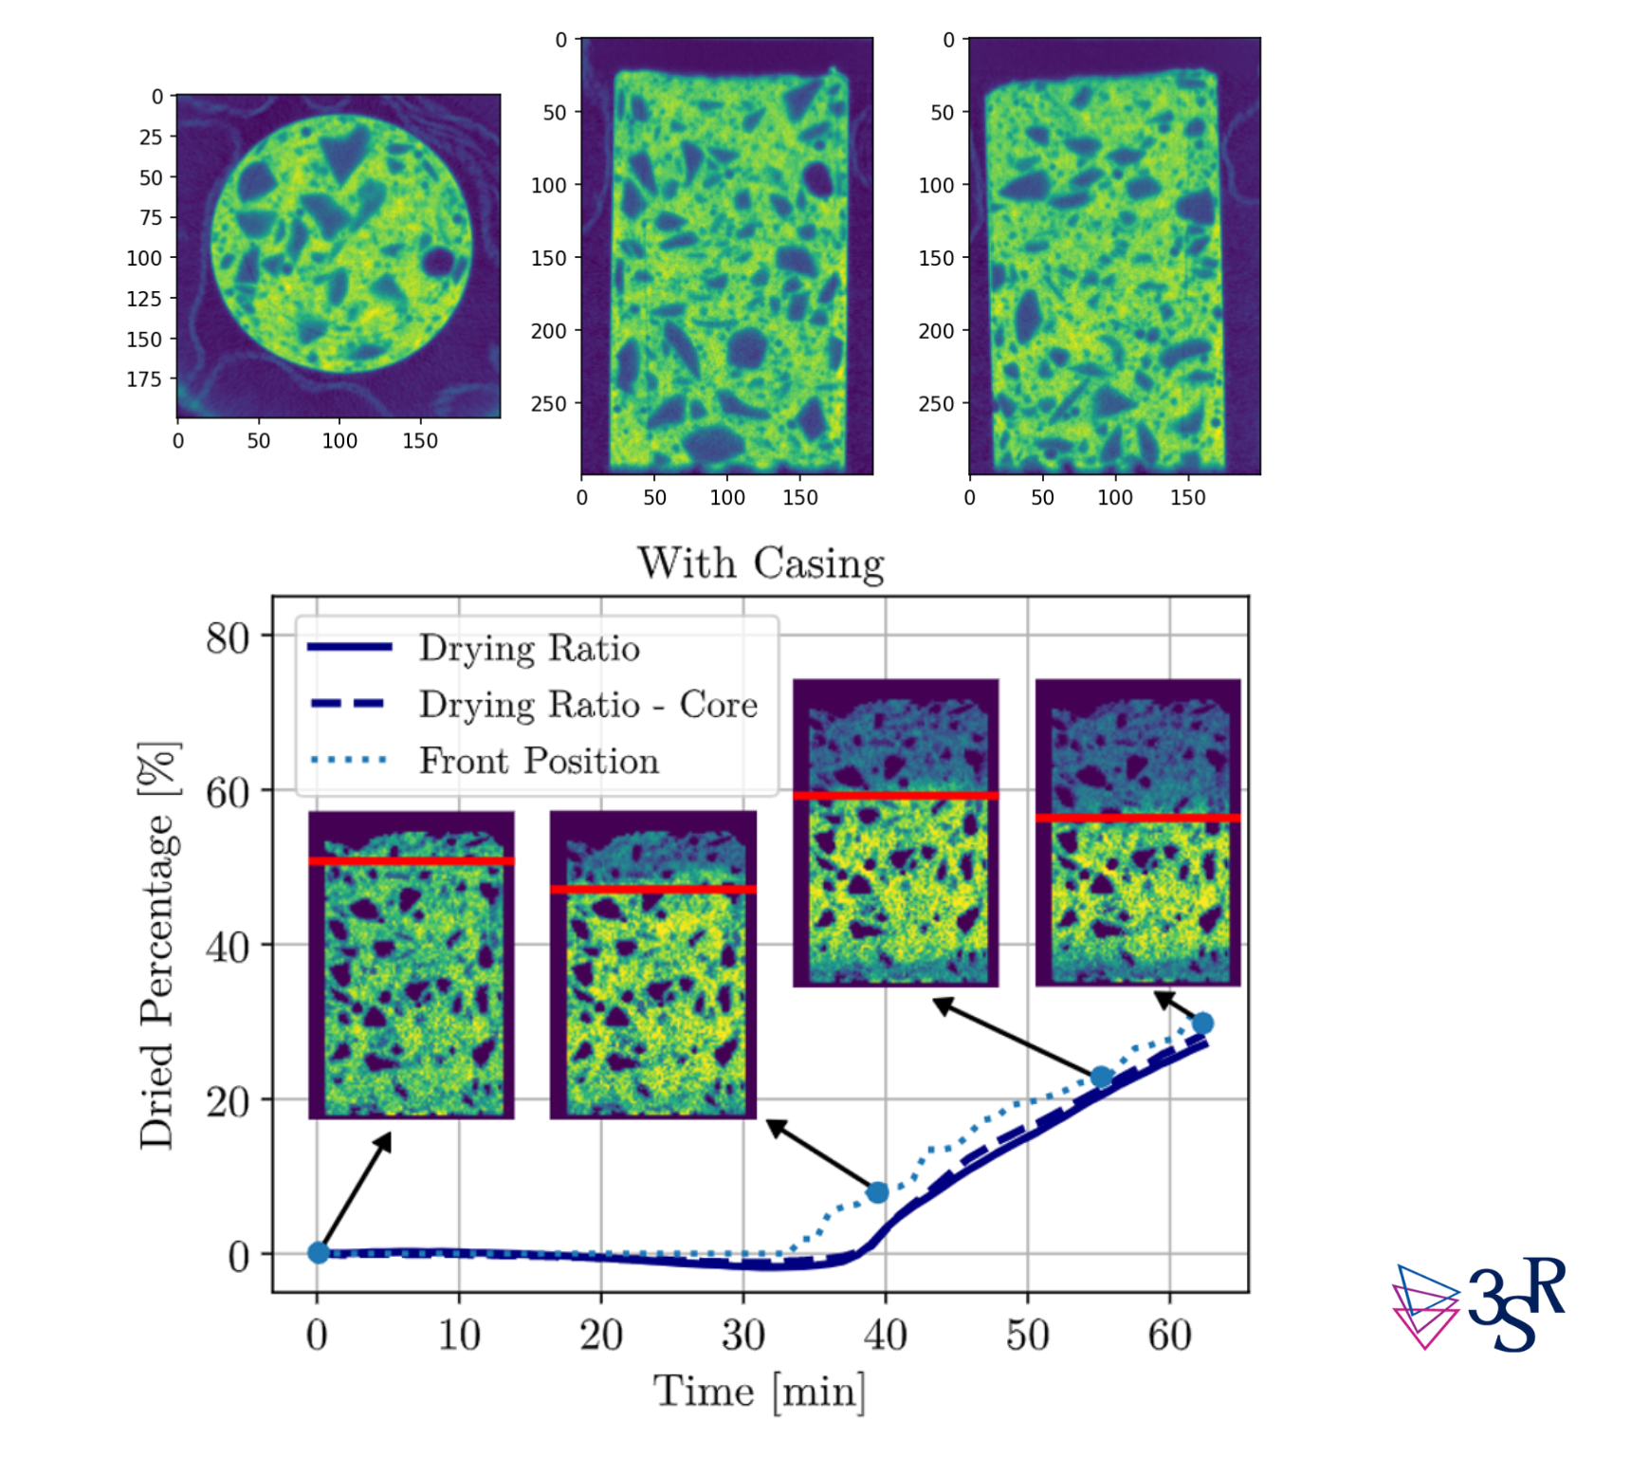
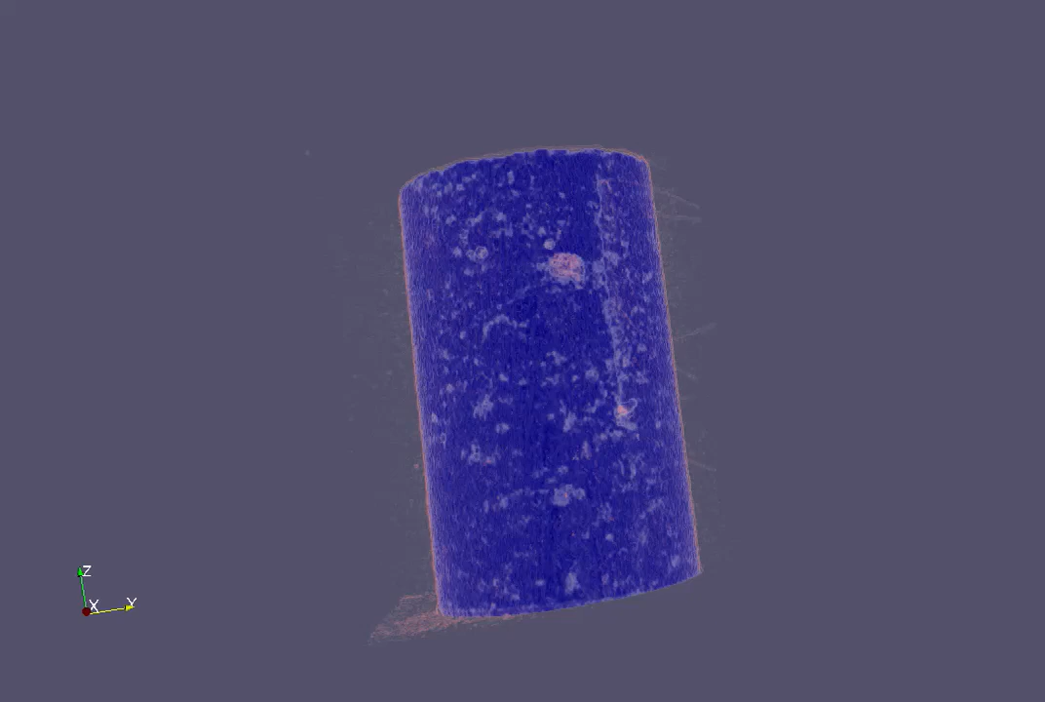
Introduction: State of Art
Video 1: X- ray/Neutron images of a drying concrete
sample. (S. Dal Pont 3SR)
Figure 1: Sample tomography and drying Evolution.
(M.H. Moreira et al. 2022, C.S. Hani et al. 2024)

Slide 4
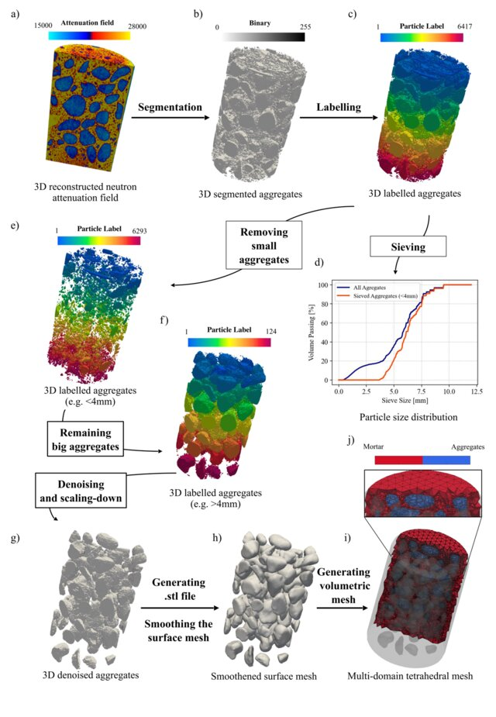
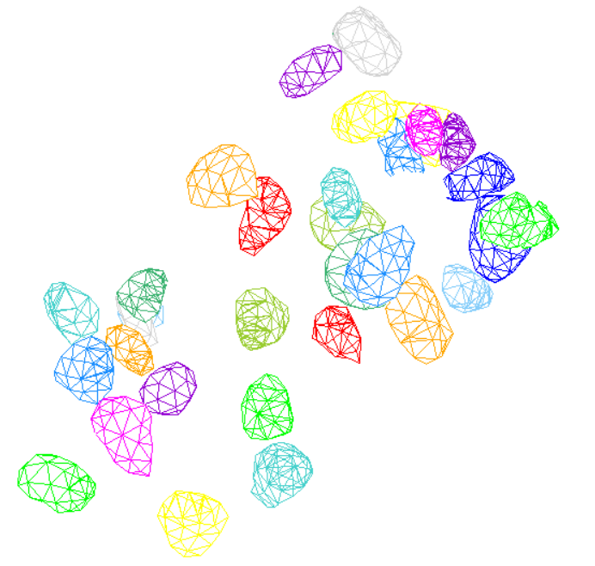
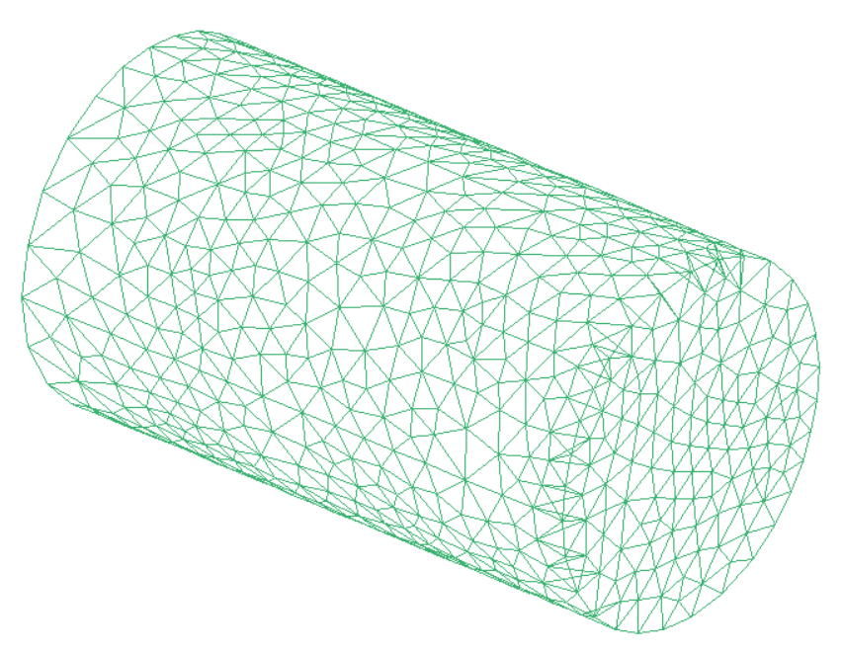
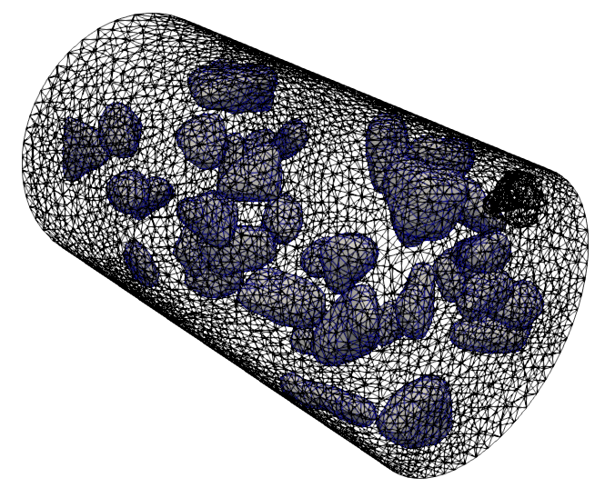
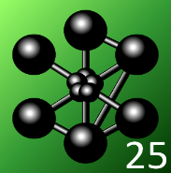
Introduction: Research Motivation
(A)
(B)
Figure 2: (A) TomoToFE Python pipeline: https://github.com/ANR-MultiFIRE/TomoToFE,
(C.S. Hani et al. 2024, 10.21809/rilemtechlett.2023.184 ). (B) Imported mesh on CAST3M .

Slide 5
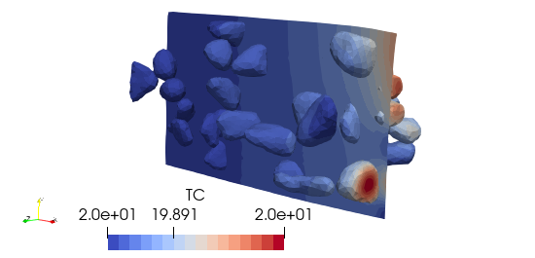
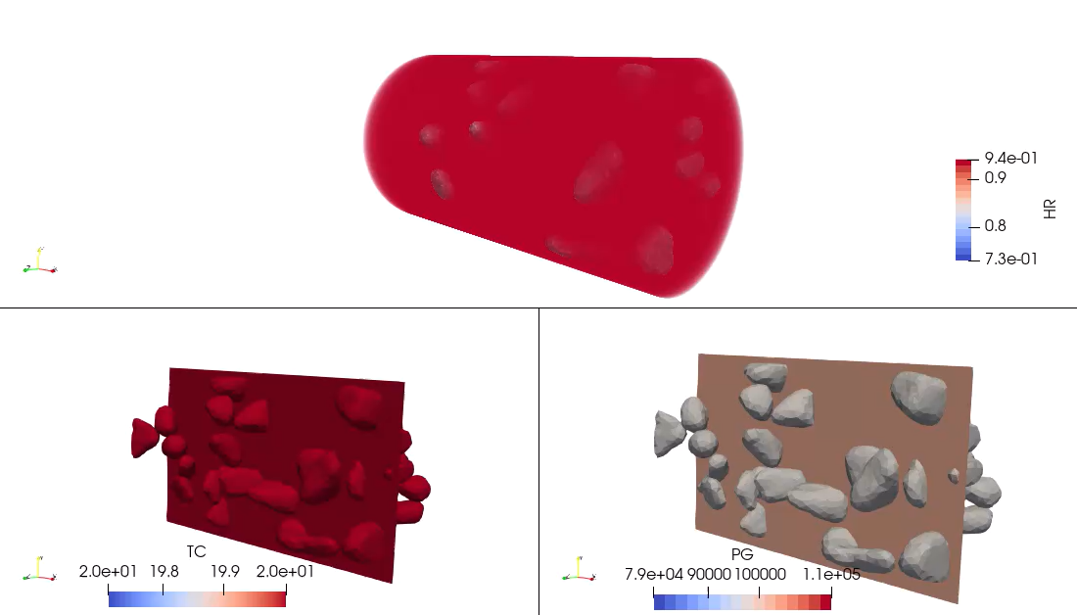
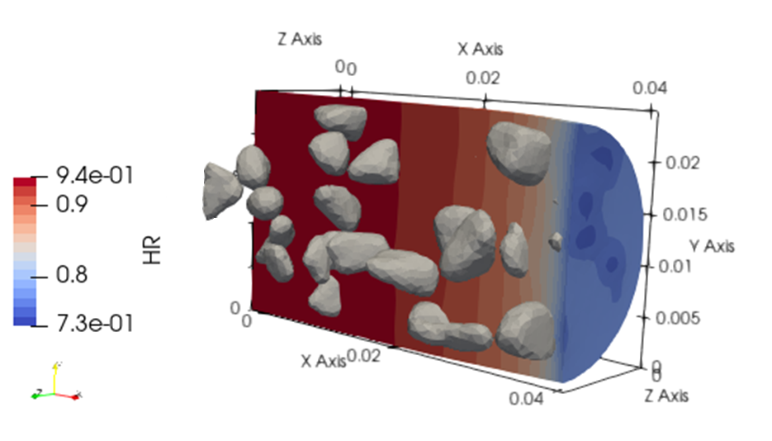
Introduction: Research Motivation
Video 2: Shrinkage simulation on the mesh exported from the bbbbb real sample.
Figure 2: Snapshot of a shrinkage simulation with a THCM model on the imported mesh with CAST3M.

Slide 6
Introduction
Mathematical Model

Slide 7
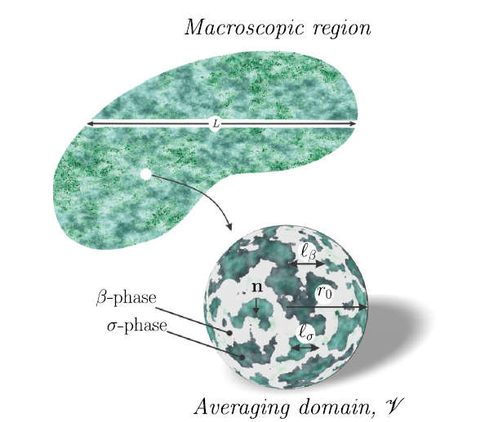






Mathematical Model: Meso-Scale Equations
Non Thermal Equilibrium;
Fourier’s Law applicability;
Neglecting the interfacial resistance to heat transfer.
Figure 3: Sketch of a porous medium including a sample of the averaging volume and the characteristic length-scales. D. Lasseux and F.J.Valdés-Parada2025. https://doi.org/10.1016/j.advwatres.2025.104899

Slide 8
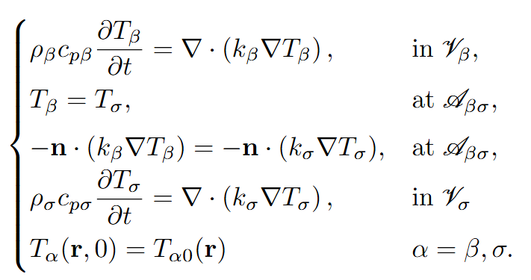



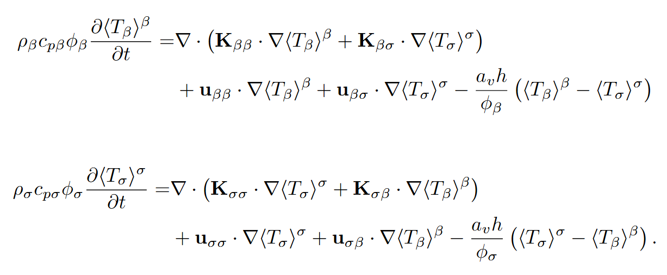

Mathematical Model: Volume Averaging Method (VAM)
Applying the intrinsic average operator
${\left\langle ⋅\right\rangle }^{α}= \frac{1}{V_{α}}\int_{V_{α}}{⋅dV}$
Separation of the length-scales: $max\left(𝓁_{β},𝓁_{σ}\right)≪r_{0}≪L$;
The media is statiscally homogeneous at $r_{0}$;
The media is pseudo-periodic;
Spatial averaging theorems (Whitaker 1999, 10.1007/978-94-017-3389-2);
Decomposition (Gray 1975, https://doi.org/10.1016/0009-2509(75)80010-8);
Macroscopic Thermal Non - Equilibrium Equations

Slide 9
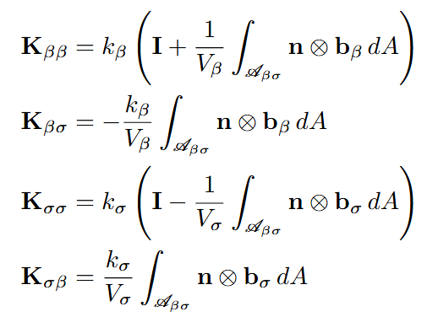
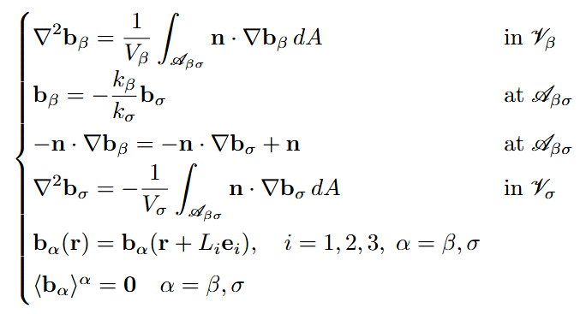
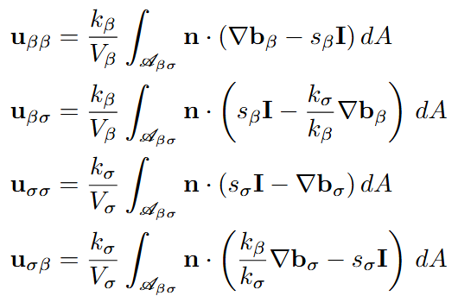

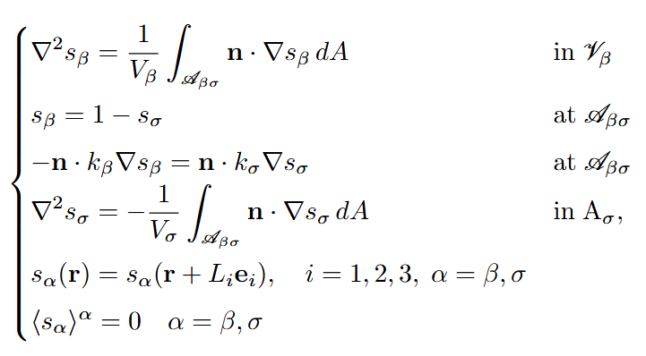

Mathematical Model: Effective Coefficients
Dominant and Coupled
heat conductivity tensors
Dominant Conduction and Co-Conduction heat corrective vectors
Effective interfacial heat coefficient

Slide 10



Mathematical Model: Properties of Effective Coefficients
As showen in D. Lasseux and F.J. Valdés-Parada 2025 (https://doi.org/10.1016/j.advwatres.2025.104899)

Slide 11
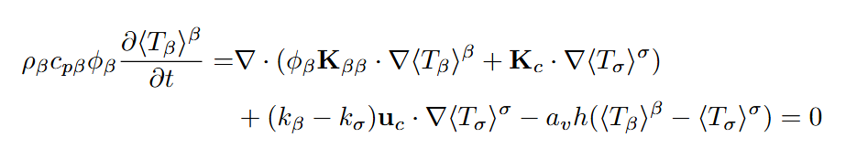
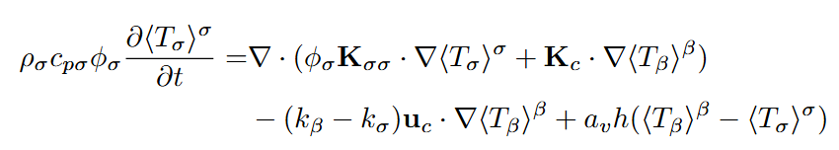

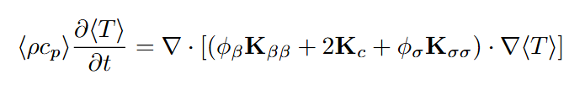
Mathematical Model: Thermal Non - Equilibrium and Thermal Equilibrium
Macroscopic Thermal Non - Equilibrium Equations (2Eqs. Model)
Macroscopic Thermal Equilibrium Equation (1Eq. Model)

Slide 12
Introduction
Mathematical Model
Numerical Simulations

Slide 13
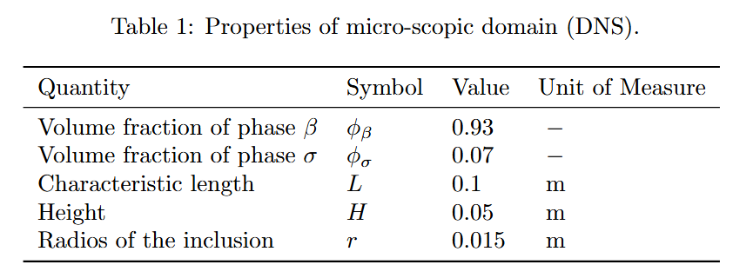
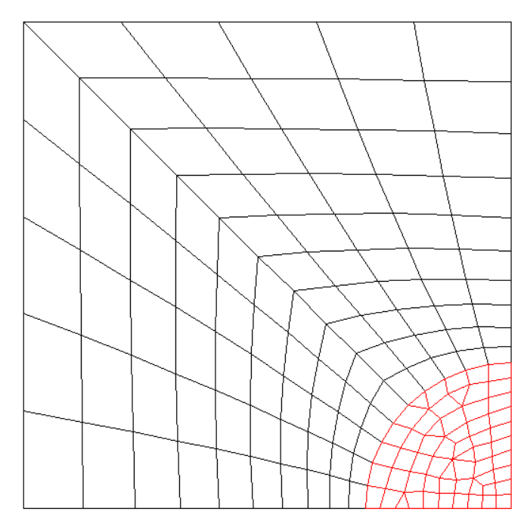
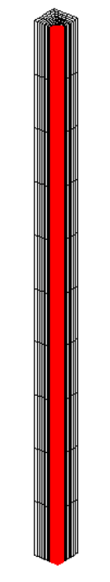
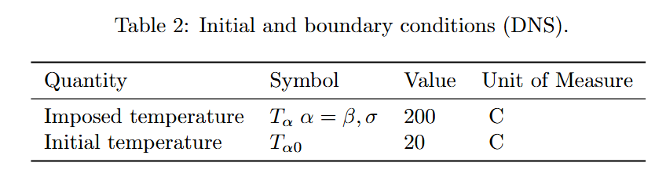




Numerical Simulations: Direct Numerical Simulation (DNS)
$$y$$
$$O$$
$$z$$
$$x$$
Figure 3: Sketch of the microscale domain considered for the DNS.

Slide 14
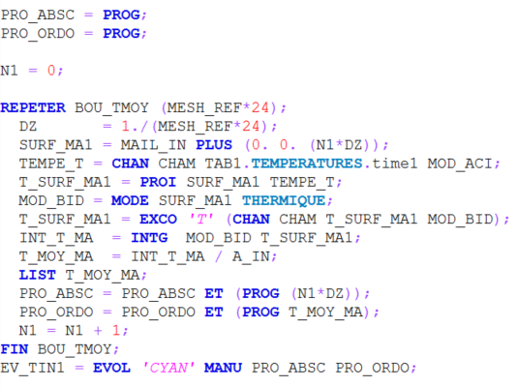
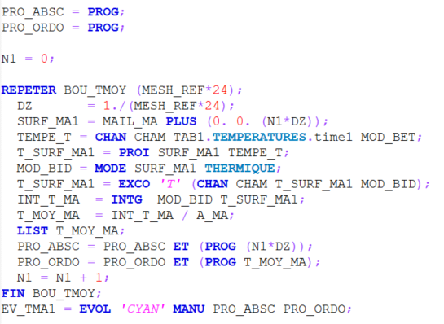


Numerical Simulations: Direct Numerical Simulation (DNS)
Proposed CAST3M procedure

Slide 15
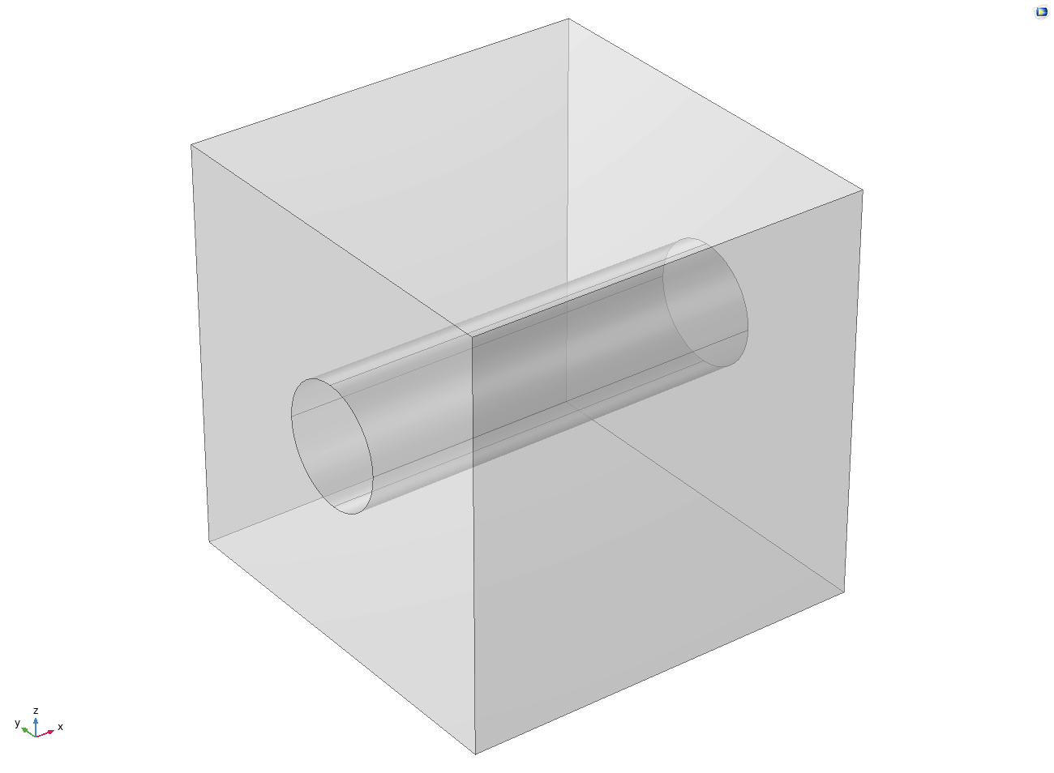
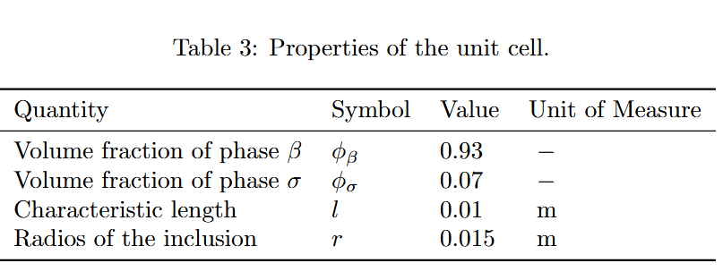
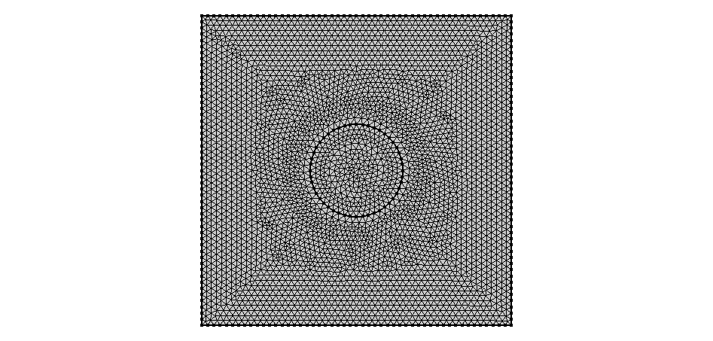



Numerical Simulations: Closure Problems
$$x$$
Figure 5: Periodic and symmetric unit cell for the closure problems solution.
$$z$$
$$O$$
$$y$$
Figure 6: 2D - Periodic and symmetric unit cell for the closure problems.
Notes:
By exploiting the symmetry of the unit cell, the three-dimensional closure problem can be reduced to a two-dimensional one in the $y$–$z$ plane.
In this configuration, there is no flow along the $x$-direction, and the $x$-component of the normal vector $n$ is zero.
Consequently, the problem reduces to a purely 2D formulation.

Slide 16

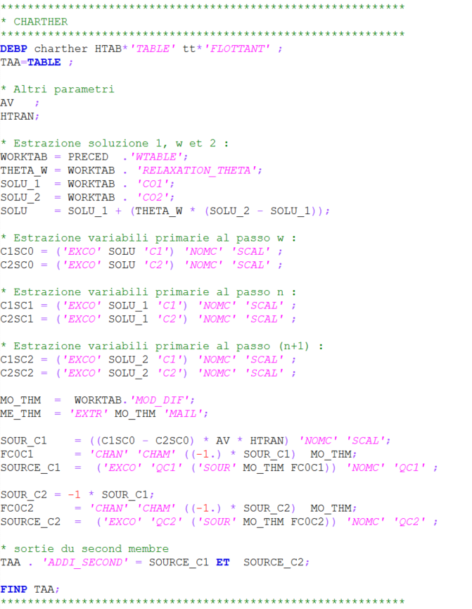
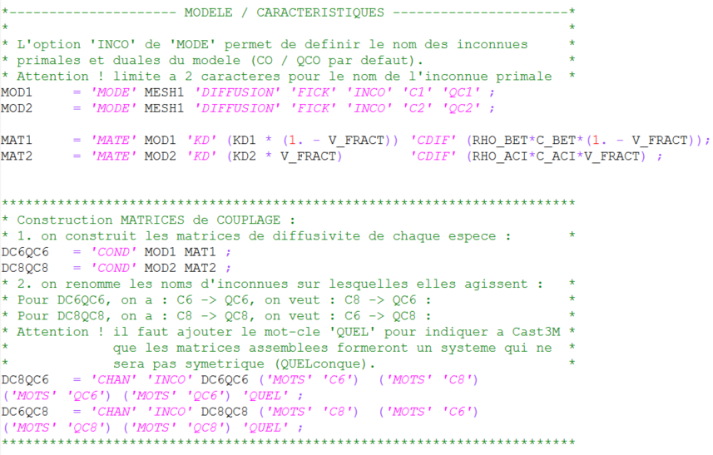

Numerical Simulations: Macroscopic Model
CAST3M procedure:
CHARTHER
Proposed CAST3M procedure:
diffu2.dgibi

Slide 17
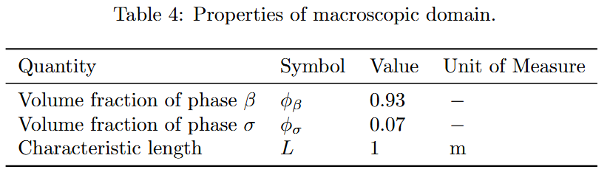

Numerical Simulations: Macroscopic Model
$$L$$
Figure 7: Macroscopic 1D representation of the considered geometry.
Macroscopic No-Thermal Equilibrium Equations (2Eqs. Model)

Slide 18
Numerical Simulations: Summery
Macroscale Equations
Microscale Equations (DNS)
Closure Problems
$$1D$$
$$3D$$
$$2D$$

Slide 19
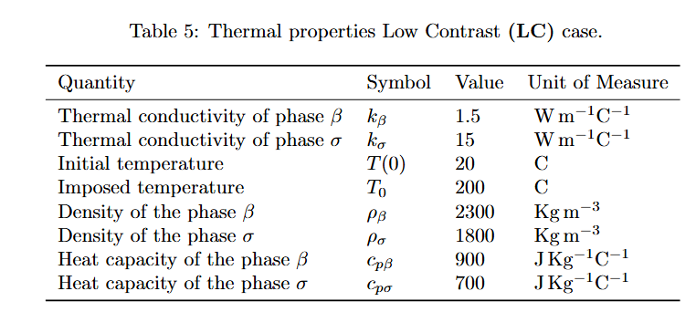
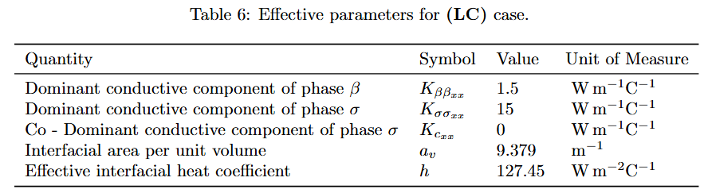
Numerical Simulations: Test Cases $\frac{k_{σ}}{k_{β}}=10,φ_{β}=0.93,φ_{σ}=0.07$

Slide 20
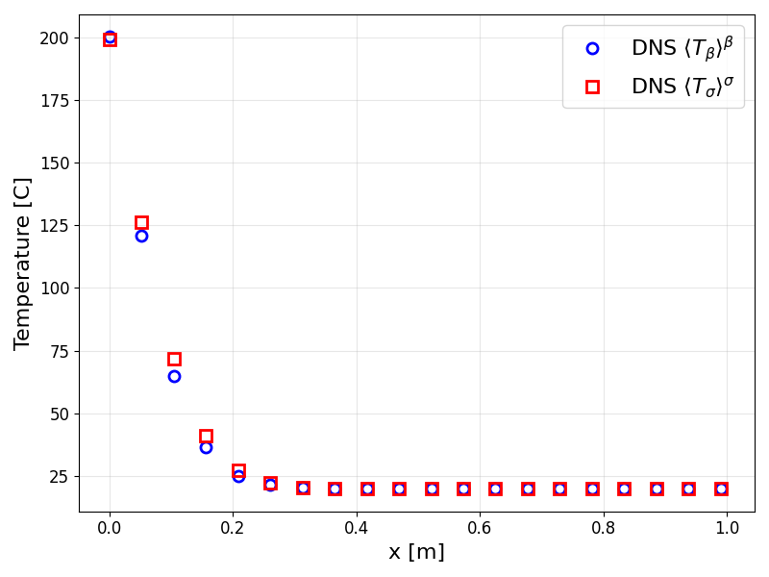
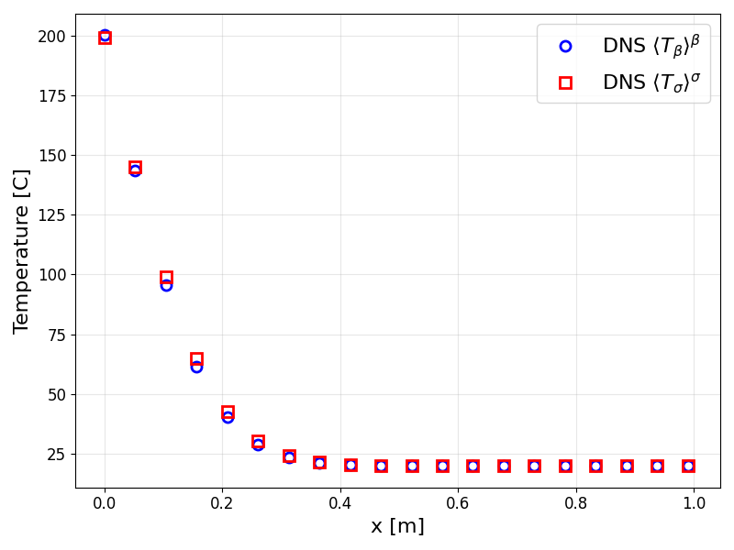
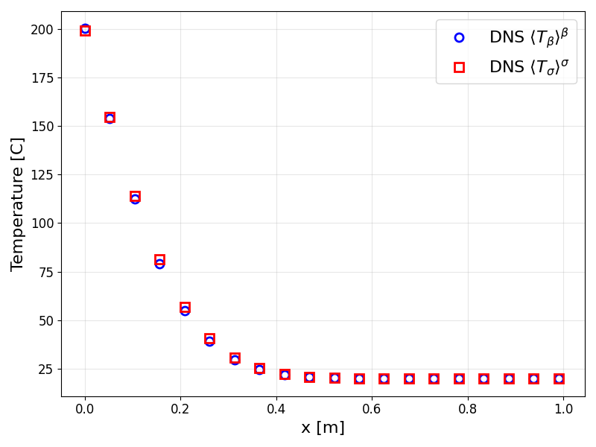
Numerical Simulations: DNS - Test Case LC -
Figure 8: Direct Numerical Simulation (DNS) at different time of ${\left\langle T_{α}\right\rangle }^{α}$ for $α= β,σ$ in LC-case.

Slide 21
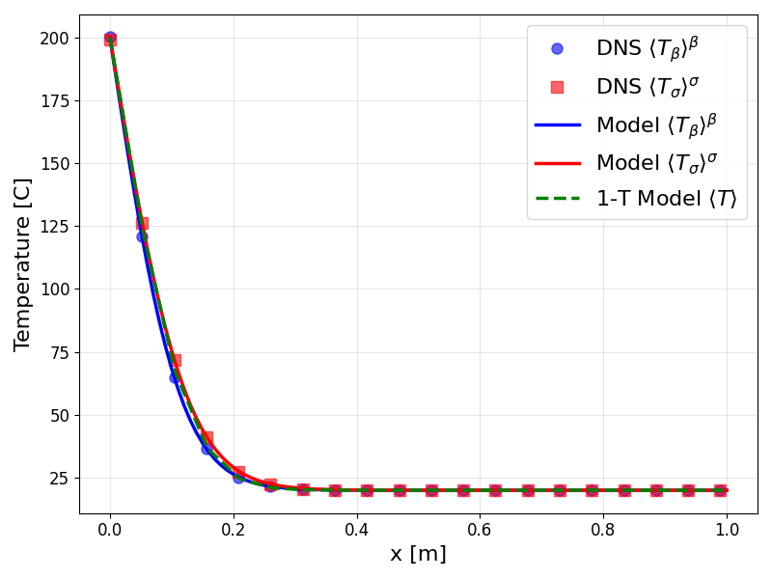
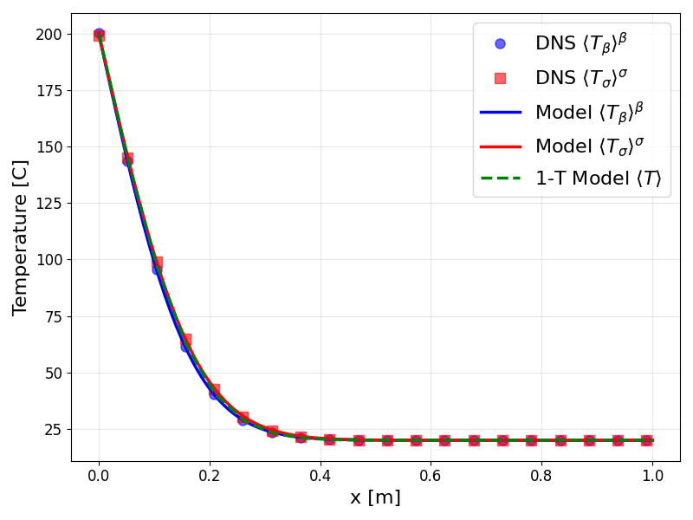
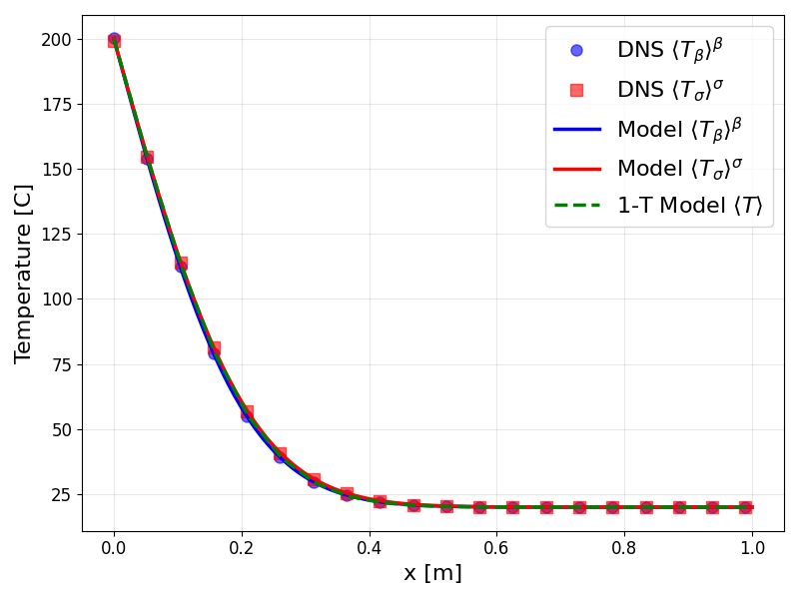
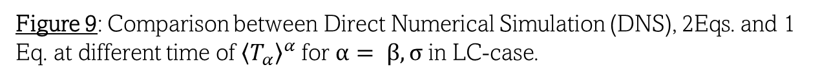
Numerical Simulations: DNS vs 2 Eqs. vs 1 Eq. - Test Case LC -
Figure 9: Comparison between Direct Numerical Simulation (DNS), 2Eqs. and 1 Eq. at different time of ${\left\langle T_{α}\right\rangle }^{α}$ for $α= β,σ$ in LC-case.

Slide 22
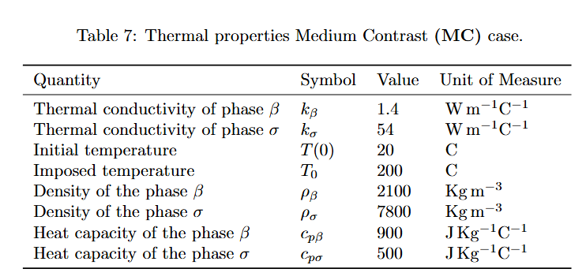
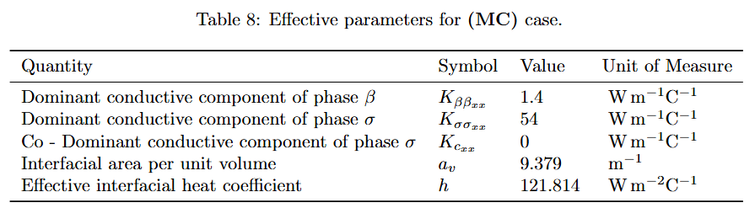
Numerical Simulations: Test Cases $\frac{k_{σ}}{k_{β}}=38.6,φ_{β}=0.93,φ_{σ}=0.07$

Slide 23
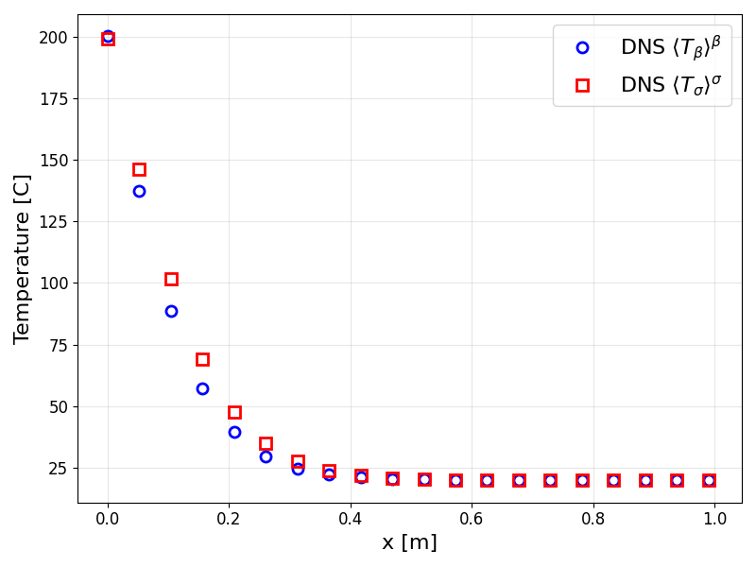
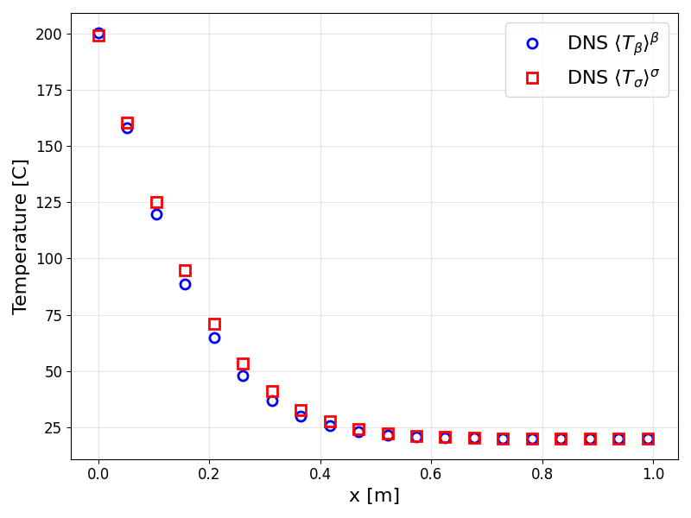
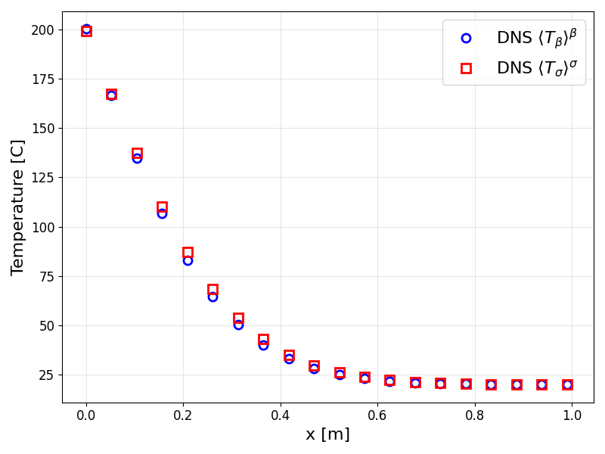
Numerical Simulations: DNS - Test Case MC -
Figure 10: Direct Numerical Simulation (DNS) at different time of ${\left\langle T_{α}\right\rangle }^{α}$ for $α= β,σ$ in MC-case.

Slide 24
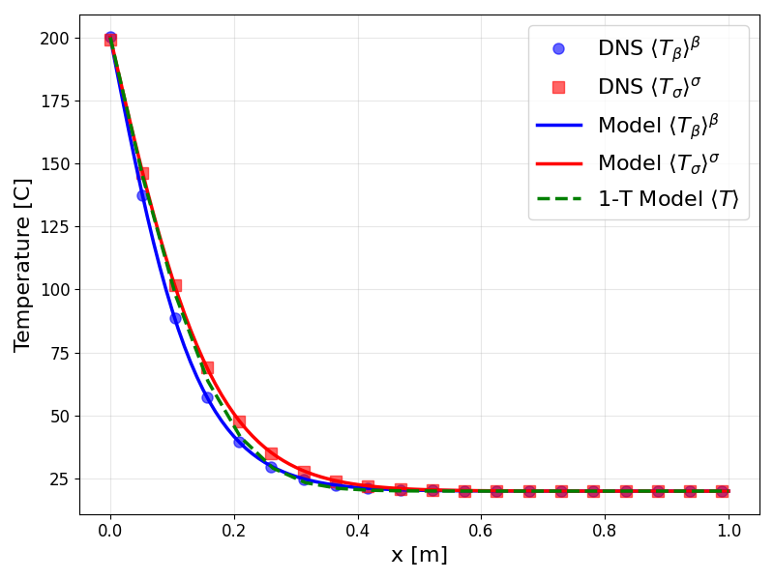
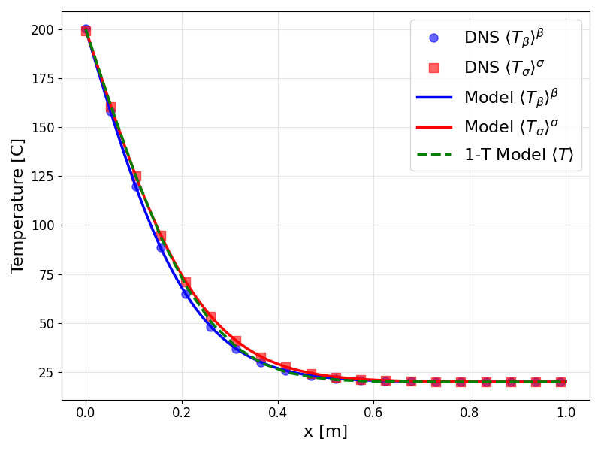
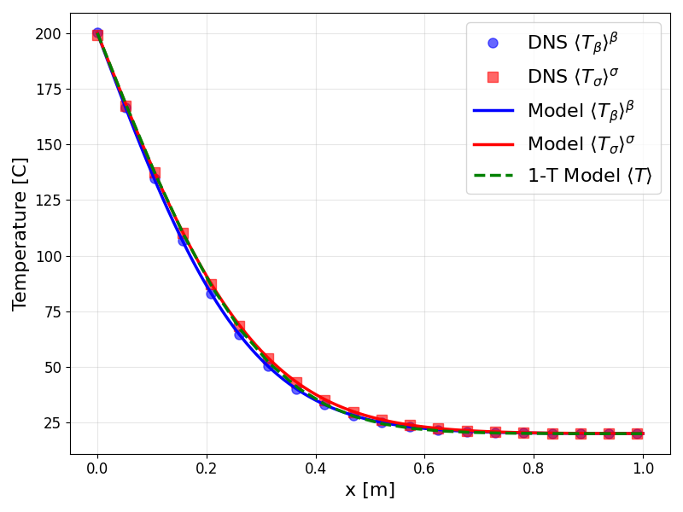
Numerical Simulations: DNS vs 2 Eqs. vs 1 Eq. - Test Case MC -
Figure 11: Comparison between Direct Numerical Simulation (DNS), 2Eqs. and 1 Eq. at different time of ${\left\langle T_{α}\right\rangle }^{α}$ for $α= β,σ$ in MC-case.

Slide 25


Numerical Simulations: Test Cases $\frac{k_{σ}}{k_{β}}=176.5,φ_{β}=0.93,φ_{σ}=0.07$

Slide 26



Numerical Simulations: DNS - Test Case HC -
Figure 12: Direct Numerical Simulation (DNS) at different time of ${\left\langle T_{α}\right\rangle }^{α}$ for $α= β,σ$ in HC-case.

Slide 27



Numerical Simulations: DNS vs 2 Eqs. vs 1 Eq. - Test Case HC -
Figure 13: Comparison between Direct Numerical Simulation (DNS), 2Eqs. and 1 Eq. at different time of ${\left\langle T_{α}\right\rangle }^{α}$ for $α= β,σ$ in HC-case.

Slide 28





Numerical Simulations: DNS vs 2 Eqs. vs 1 Eq. - Test Case HC -
Figure 14: Comparison between 1 Eq. model and $〈θ〉$ at different time in HC-case.

Slide 29
Introduction
Mathematical Model
Numerical Simulations
Conclusion

Slide 30

Conclusion: Objectives Achieved and Future Perspectives
Estimation of the effective parameters;
Good agreement between DNS and homogenized model;
Assessment of the applicability of the two-equation vs one-equation model.
Relax the time constraint hypothesis $→$ (Unsteady macroscopic one and two-equation models for equilibrium and non-equilibrium diffusive process in heterogeneous media, IN PREPARATION) .
Promote the implementation of periodic boundary conditions in CAST3M to solve closure problems.

Slide 31


