Slide 1

Dynamic characterization of cross-physics coupling strengths, a methodology to coupling and reordering partitioned solvers for multiphysics applications
Presenter Christopher NAHED Research Engineer Université Paris Saclay – CEA-Saclay
Collaborator Jacques DE LAMARE Research Engineer Université Paris Saclay – CEA-Saclay
Dev Support Stéphane GOUNAND Research Engineer Université Paris Saclay – CEA-Saclay
Acknowledgements Agence Nationale pour la Gestion des Déchets Radioactifs

Slide 2
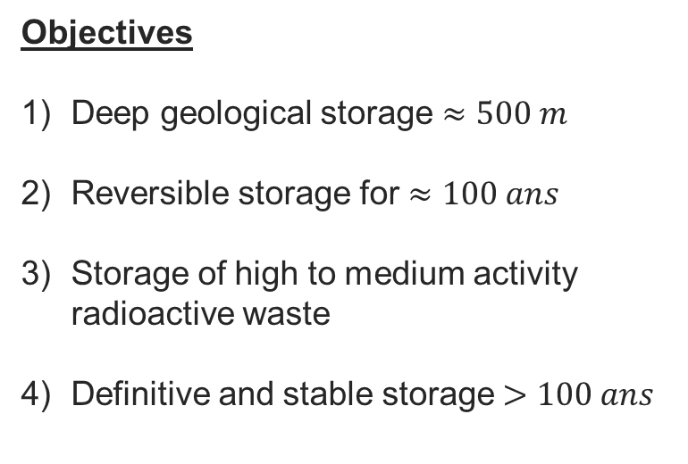
Industrial context
CIGEO : Centre de stockage GEOlogique
Objectives
Deep geological storage $≈500 m$
Reversible storage for $≈100 ans$
Storage of high to medium activity radioactive waste
Definitive and stable storage $>100 ans$

Slide 3
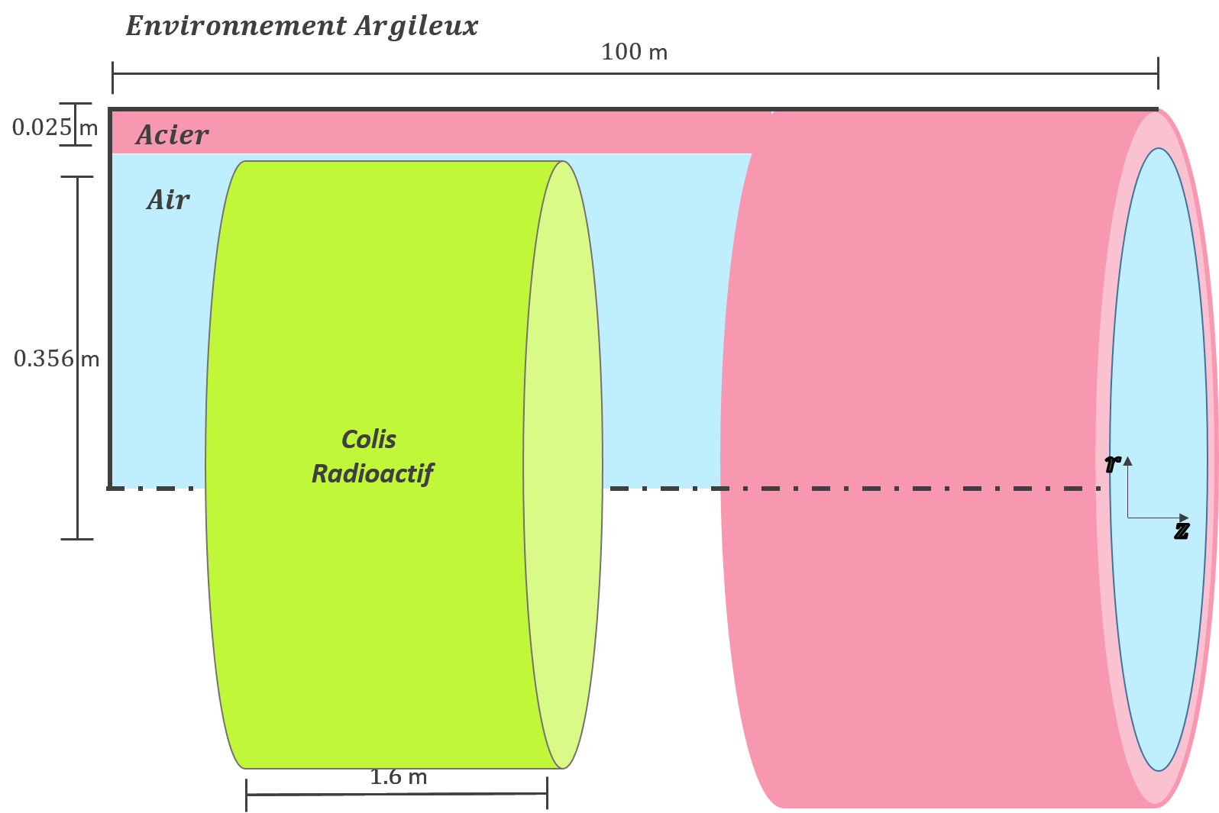
Industrial context (2)
Alveolus
Underground structure of the network:
Principal gallery is connected to the atmosphere via ventilators. Main material – reinforced concrete and clay
Storage alveoli to be filled with radioactive packages. Humid clay environment, humid and hot interior. Material – steel
Gallery

Slide 4
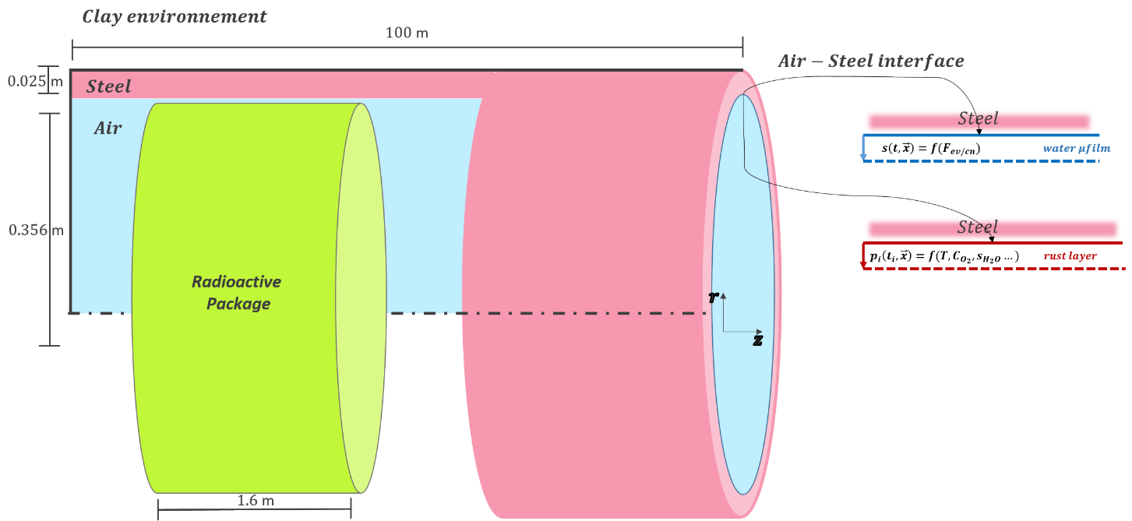
Context – R&D
Problem Statement
The humid and hot environment that the alveoli live in strongly rust their exposed steel surfaces. That which degrades the steel quality over time.
The collaboration
Our team at the commission has been collaborating with the ANDRA for the past decade on this particular rusting problem.
The objectives of the collaboration
Understand the dominant phenomena that contribute to the rusting of the surfaces of the alveoli
Understand the dominant phenomena that contribute to liquid water accumulation over time in the alveoli
Develop, for the ANDRA, a predictive calculator of the thermo-hygro-corrosive system so as to be able to study the effects of the different operational scenarios of the alveoli network onto the corrosion rates.

Slide 5
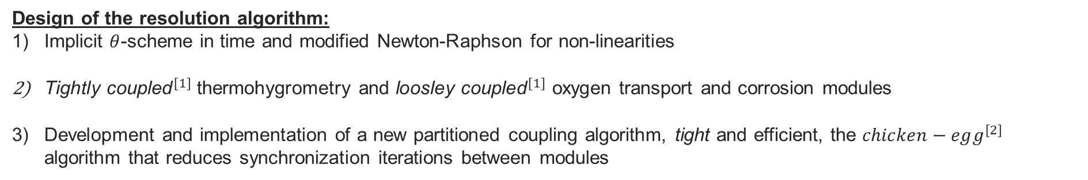
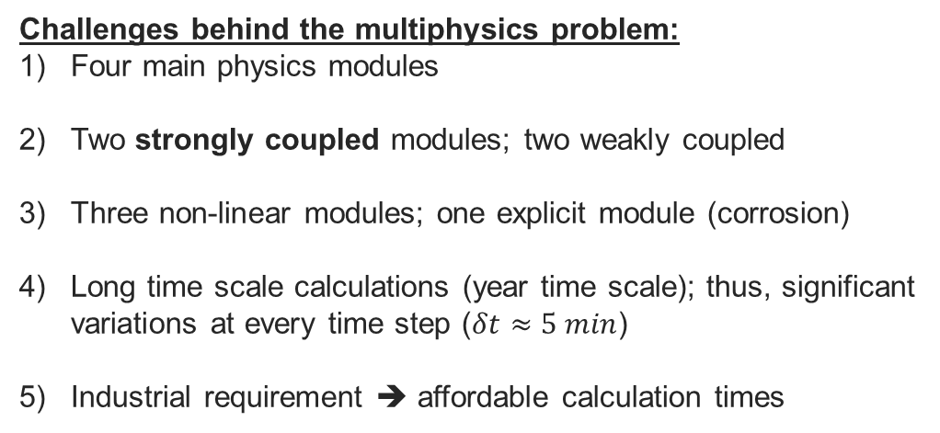
Context – Modeling and Simulation
Corrosion Module
Challenges behind the multiphysics problem:
Four main physics modules
Two strongly coupled modules; two weakly coupled
Three non-linear modules; one explicit module (corrosion)
Long time scale calculations (year time scale); thus, significant variations at every time step ($δt≈5 min$)
Industrial requirement ➔ affordable calculation times
O₂
Transport Module
Heat Transfer Module
Vapor Transport Module
Global Model
Design of the resolution algorithm:
Implicit $θ$-scheme in time and modified Newton-Raphson for non-linearities
${\text{T}\text{ightly} \text{coupled}}^{[1]}$ thermohygrometry and ${\text{loosley} \text{coupled}}^{[1]}$ oxygen transport and corrosion modules
Development and implementation of a new partitioned coupling algorithm, tight and efficient, the $chicken−egg^{[2]}$ algorithm that reduces synchronization iterations between modules
[1] Multiphysics Simulations: Challenges and Opportunities. Keyes et al. 2012
[2] Dynamic characterization of cross-physics coupling strengths, a methodology to coupling and reordering partitioned solvers for multiphysics applications. Nahed et al. (under review)

Slide 6
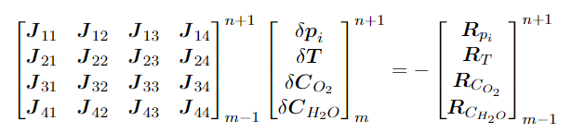








Posing my multiphysics problem
Nominal Jacobian
Corrosion Module
Thermal Module
Oxygen Module
Vapor Module
The enormous size of the nominal Jacobian meant I needed to partition the coupling method
How do I characterize coupling strengths ? Which modules need to be tightly coupled ?
How do I choose my module partitioning order on the fly ?
Classic Diagonalization
How do I synchronize my coupled modules and when ?
$$0$$
$$0$$
Still too expensive and inefficient to properly synchronize the partitions together
Notes:
When I first started working on this project, I had three main issues
How do i characterize coupling strength (what is weak what is strong)
How do order modules in a partitioned scheme
How do I synchronize the modules on the fly ?

Slide 7
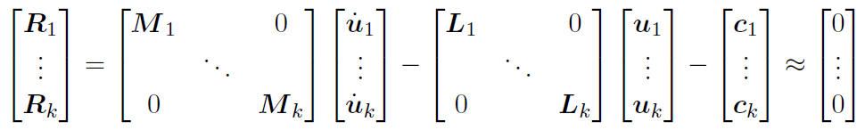
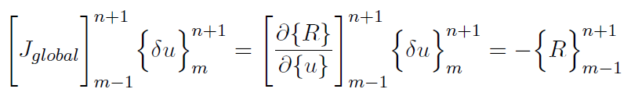
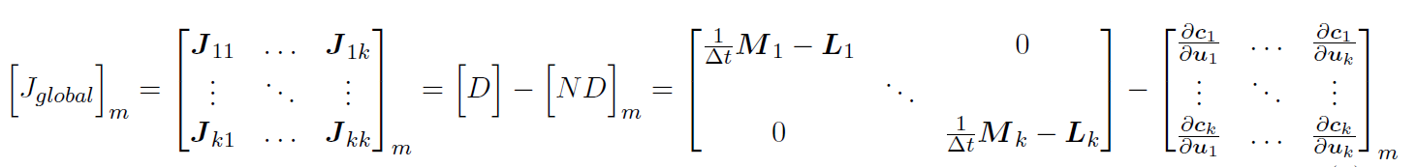
The Jacobian (1)
To attempt to answer my personal interrogations, I needed to better understand the physical meaning of a generic Jacobian…
Separable Operators
Separable Operators
Nonlinear coupling terms
Applying
Newton Raphson

Slide 8

The Jacobian (2)
To attempt to answer my personal interrogations, I needed to better understand the physical meaning of a generic Jacobian…
Diagonal
Nondiagonal
Only the nondiagonal matrix is difficult to deal with! It stems directly from the nonlinear coupling terms $c_{i}$
Reinterpreting the physical meaning of the nondiagonal contribution
The total perturbation is equivalent to the sum of all partial perturbations w.r.t the $i=1→k$ physics variables
Chain Rule

Slide 9

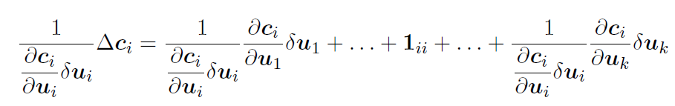
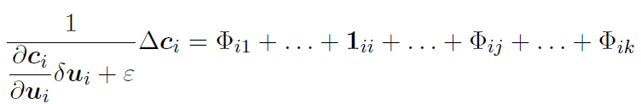



The Jacobian (3)
To attempt to answer my personal interrogations, I needed to better understand the physical meaning of a generic Jacobian…
Then, I asked myself, how do I compare the relative strengths of the many partial perturbations ?
By nondimensionalizing ${Δc}_{i}$ w.r.t the ${δc}_{i}(u_{i})$ perturbation
$$ε={10}^{−9}$$

Slide 10
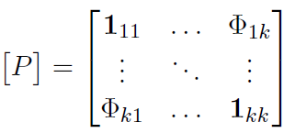
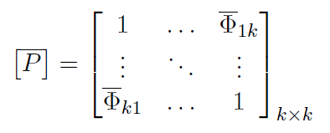
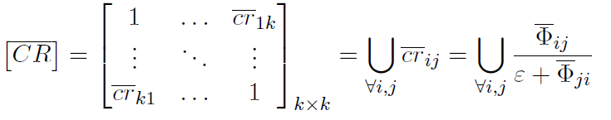
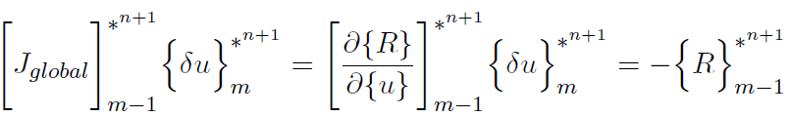
Lumped coupling ratio matrix
Lumping of all dimensionless fields into scalar floating numbers
Float up all small entries, sink down all big entries
A new reordered system of equations.
Least Perturbable on Top,
Most Perturbable on the Bottom
*

Slide 11
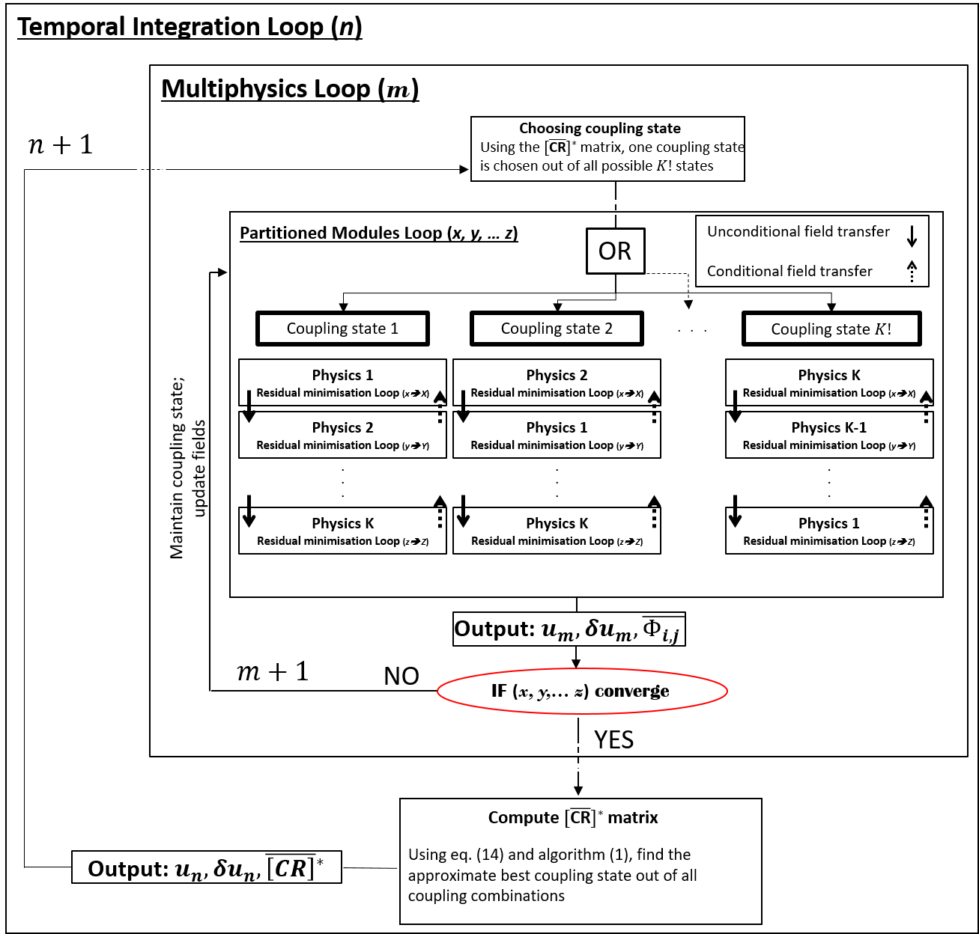

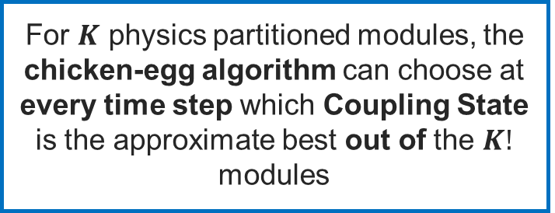
Generic Chicken Egg Algorithm
Who came first ? The chicken or the egg ?
For $K$ physics partitioned modules, the chicken-egg algorithm can choose at every time step which Coupling State is the approximate best out of the $K!$ modules

Slide 12
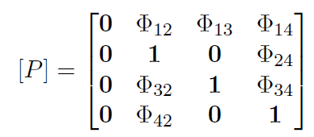



Answering my interrogations (1)
How do I characterize coupling strengths ? Which modules need to be tightly coupled ?
Nominal Jacobian
How do I choose my module partitioning order on the fly ?
How do I synchronize my coupled modules and when ?
Linear Explicit Equation and weakly coupled to all other modules
Nonlinear and strongly coupled only to vapor transport module
Nonlinear but weakly coupled to vapor and thermal modules
Nonlinear and strongly coupled to thermal module
Thermohygrometric Tight Module
New Partitioned System
$$=f(T,C_{H_{2}O},C_{O_{2}})$$

Slide 13
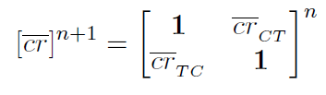





Answering my interrogations (2)
How do I characterize coupling strengths ? Which modules need to be tightly coupled ?
Nominal Jacobian
How do I choose my module partitioning order on the fly ?
How do I synchronize my coupled modules and when ?
Thermohygrometric Tight Module
IF
$$≲1$$
New Partitioned System
$$≳1$$
$$=f(T,C_{H_{2}O},C_{O_{2}})$$
ELSE

Slide 14
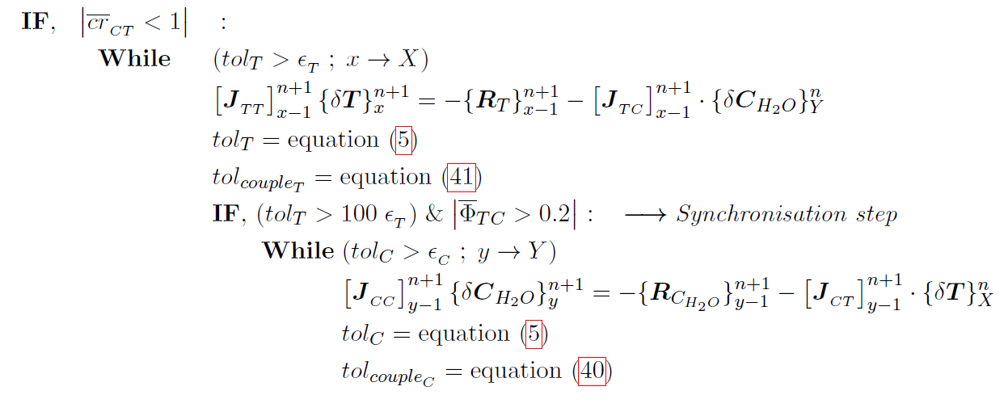








Answering my interrogations (2)
First, why do I need to synchronize the modules using subcycling ?
How do I synchronize my coupled modules and when ?
Because, I want to avoid the off-diagonal terms in the remaining thermohygrometric Jacobian
Example of Synchronization
eq(1) $tol_{T}=\max\left(\frac{T^{m}−T^{m−1}}{T^{m}}\right)$
(1)
eq(2) $tol_{C}=\max\left(\frac{C^{m}−C^{m−1}}{C^{m}}\right)$
(4)
$\text{eq}\text{(3) }$
$$max⁡( )$$
$\text{eq}\text{(4) }$
$$max⁡( )$$
(2)
(3)

Slide 15
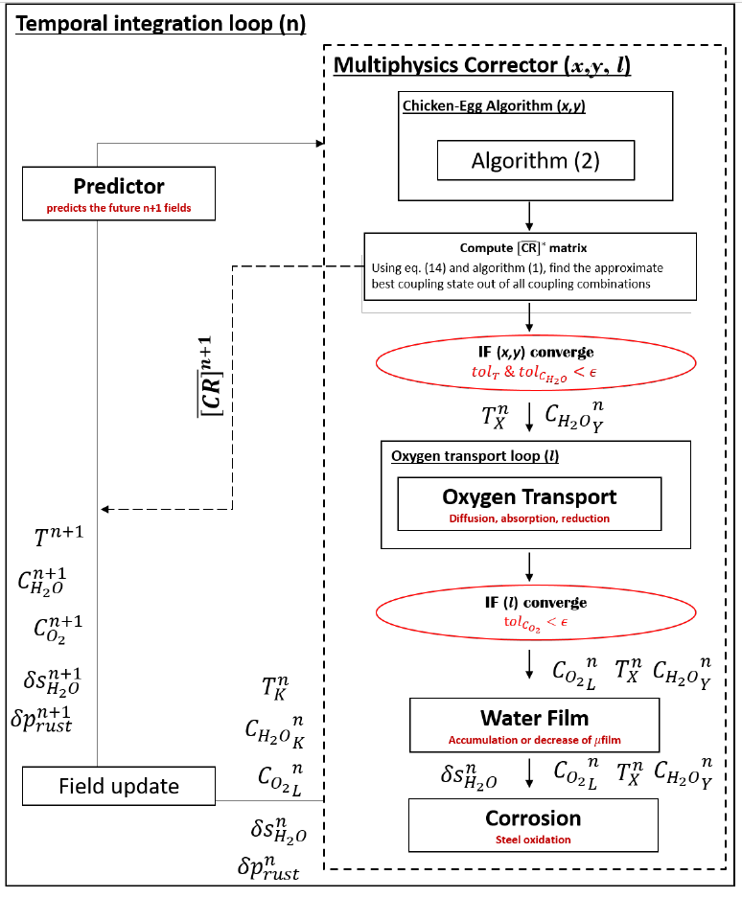
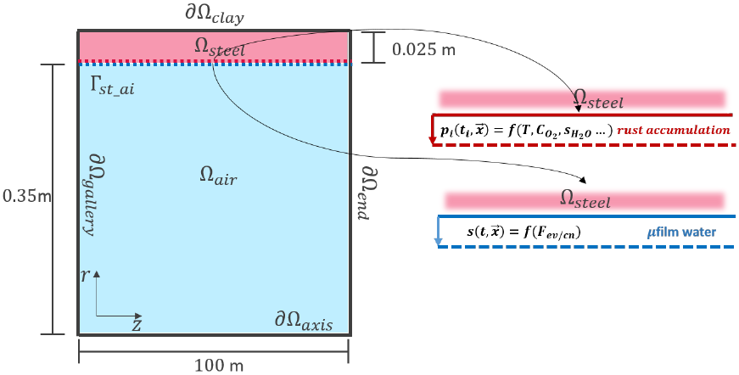
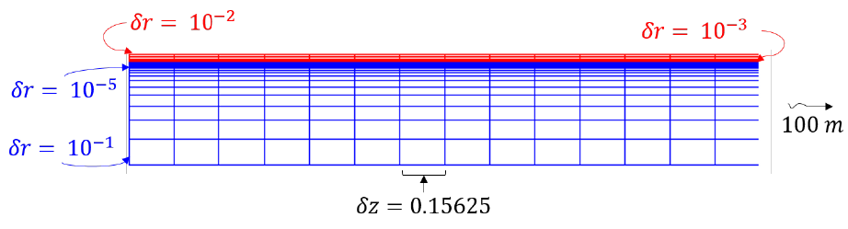
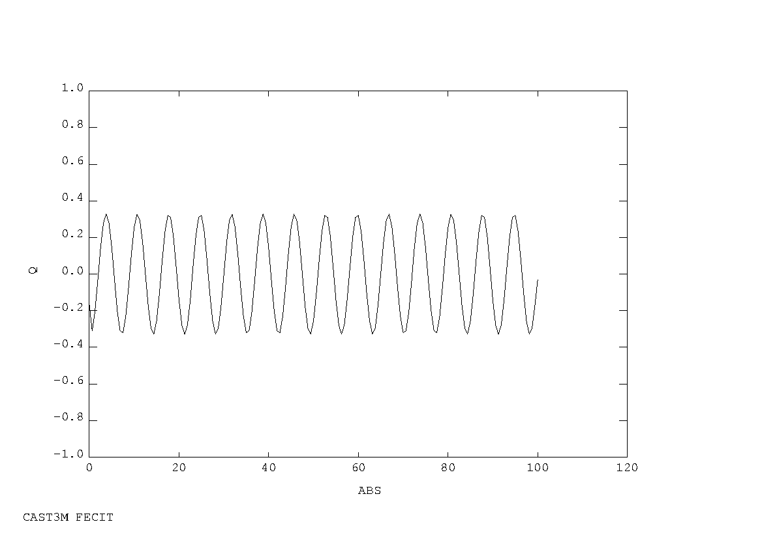
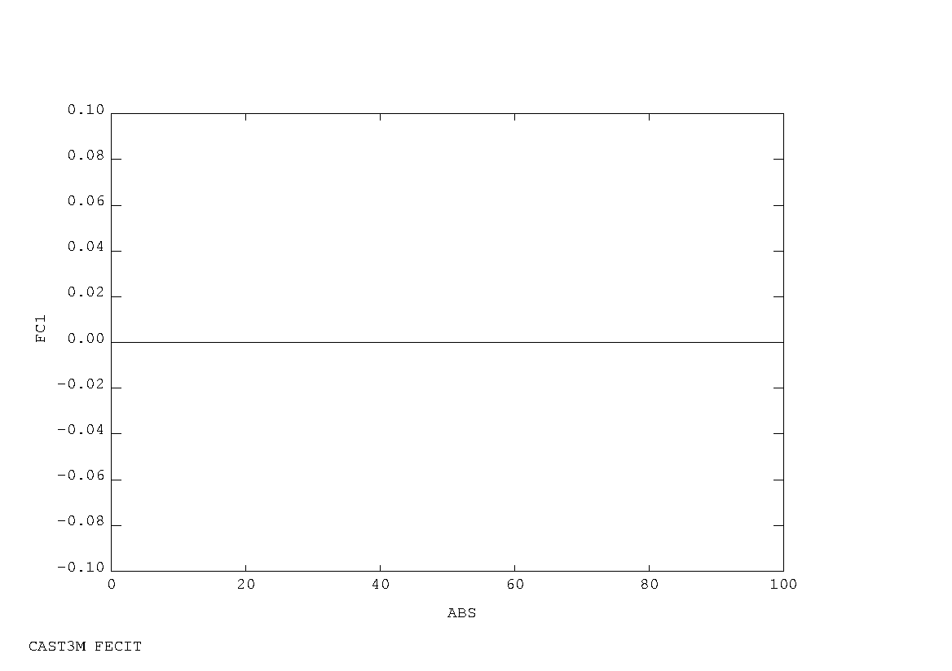
Testing the methodology (1)
Heat and humidity sources
Heat source
➔
➔
Humidity source/sink

Slide 16
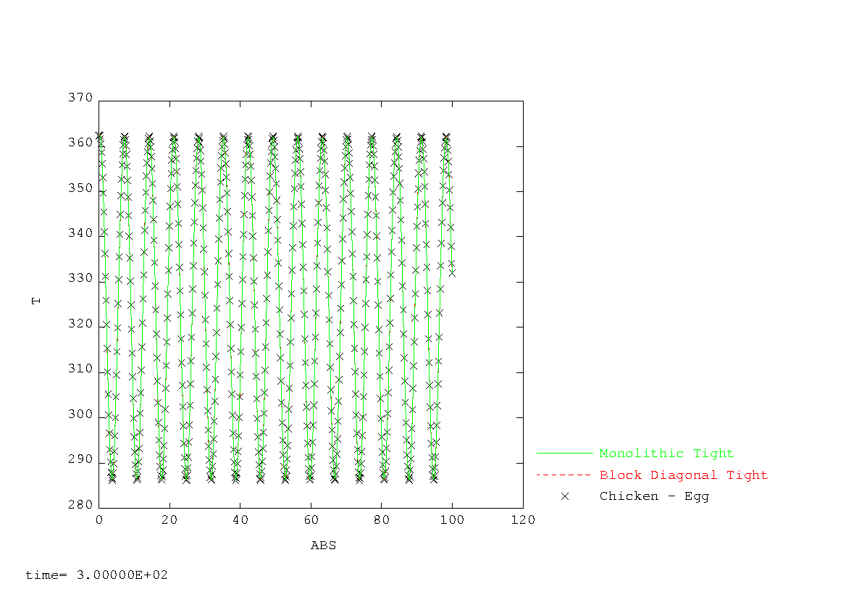
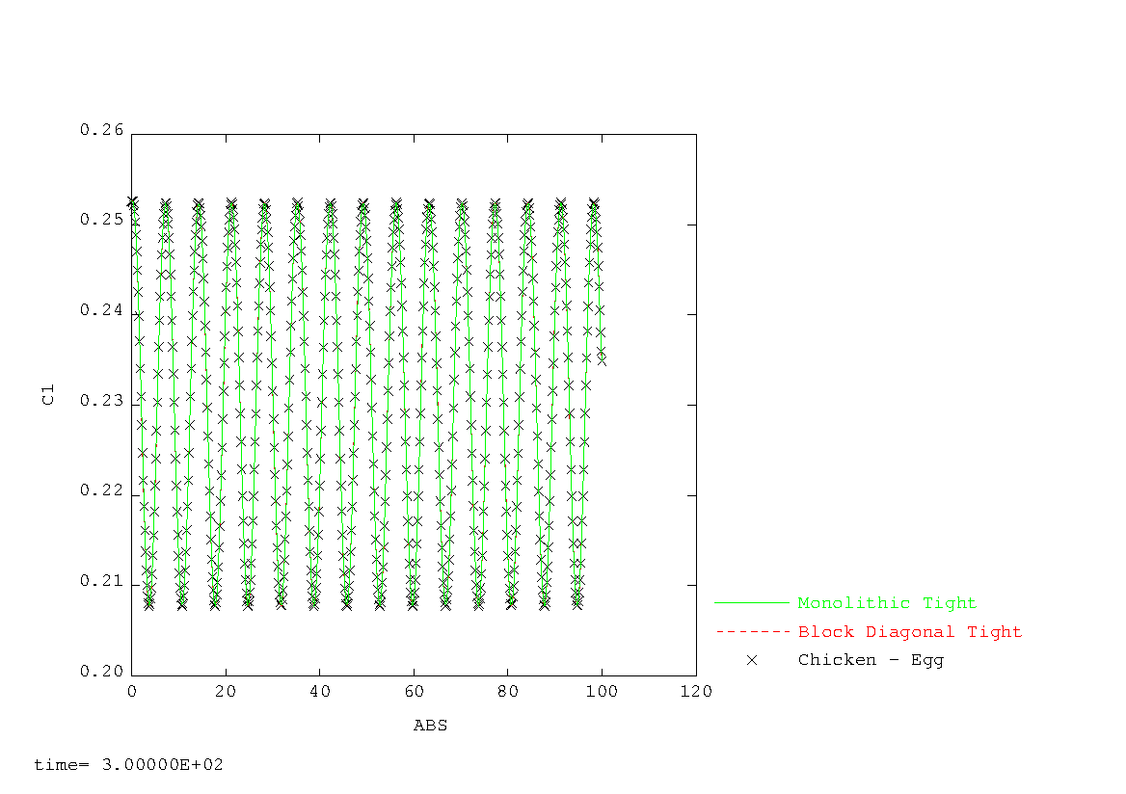
Testing the methodology (2)
Testing the methodology (2)
Chicken-egg version 1 :
Temperatures
Primordial question
Can I trust my algorithm to be consistent?
Vapor Concentration
Chicken-Egg Version 1 ➔ Not satisfactory
Because my synchronization criteria was too loose
Notes:
On the stiffest time steps, my algorithm was off due to bad synchronization

Slide 17
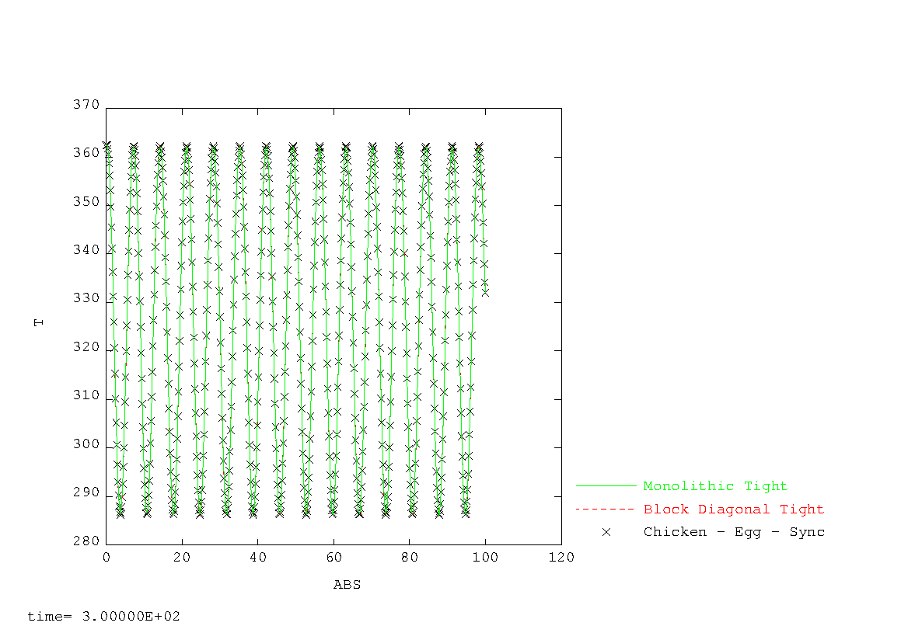

Testing the methodology (3)
Version 2 du chicken-egg :
Temperatures
Primordial question
Can I trust my algorithm to be consistent?
Vapor Concentration
Chicken-Egg Version 2 ➔ Satisfactory
Because the synchronization criteria was very tight ☺

Slide 18
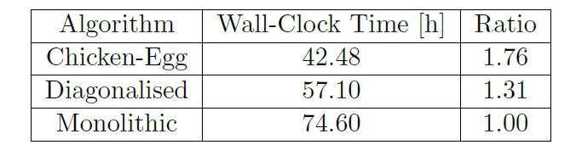

Benchmarking the algorithm (1)
Iterations before convergence
Time steps $t_{n}$

Slide 19
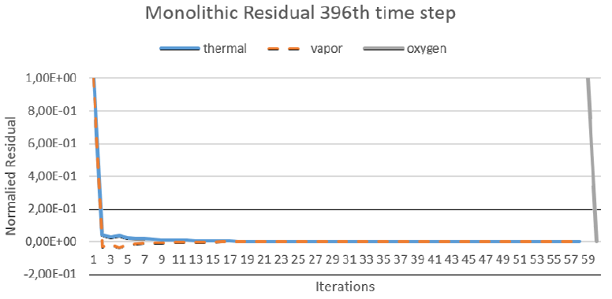
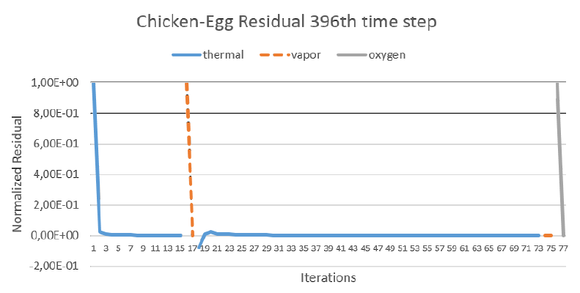


Benchmarking the algorithm (2)
$1^{st}$Synchronization
$2^{nd}$Synchronization

Slide 20
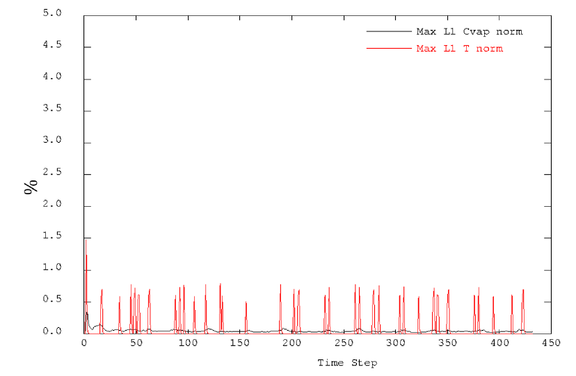
Benchmarking the algorithm (3)

Slide 21
Conclusions et Perspectives (1)
Conclusions
A dimensionless approach was proposed to numerically quantify strong and weak coupling dynamically along a simulation.
An affordable and dynamic partitioned module reordering method was proposed that improves on the execution speed of the coupling scheme
New off-diagonal tolerances were defined so as to monitor synchronization quality
Perspectives
Wait for our paper to be officially published ☺
Update method using finite difference perturbations, makes it passive/automated (no human intervention)
Apply acceleration methods to improve on the convergence characteristics of the thermal module
Establish a formal description of the dimensionless analysis applied to multivariate problems

Slide 22
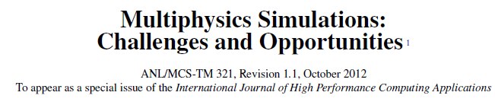


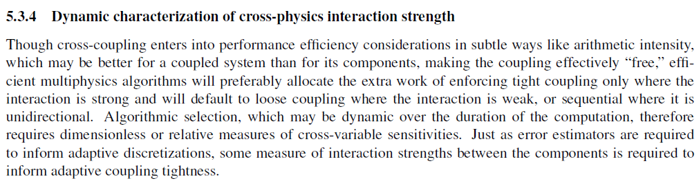
Conclusions et Perspectives (2)
David Keyes et al.

Slide 23
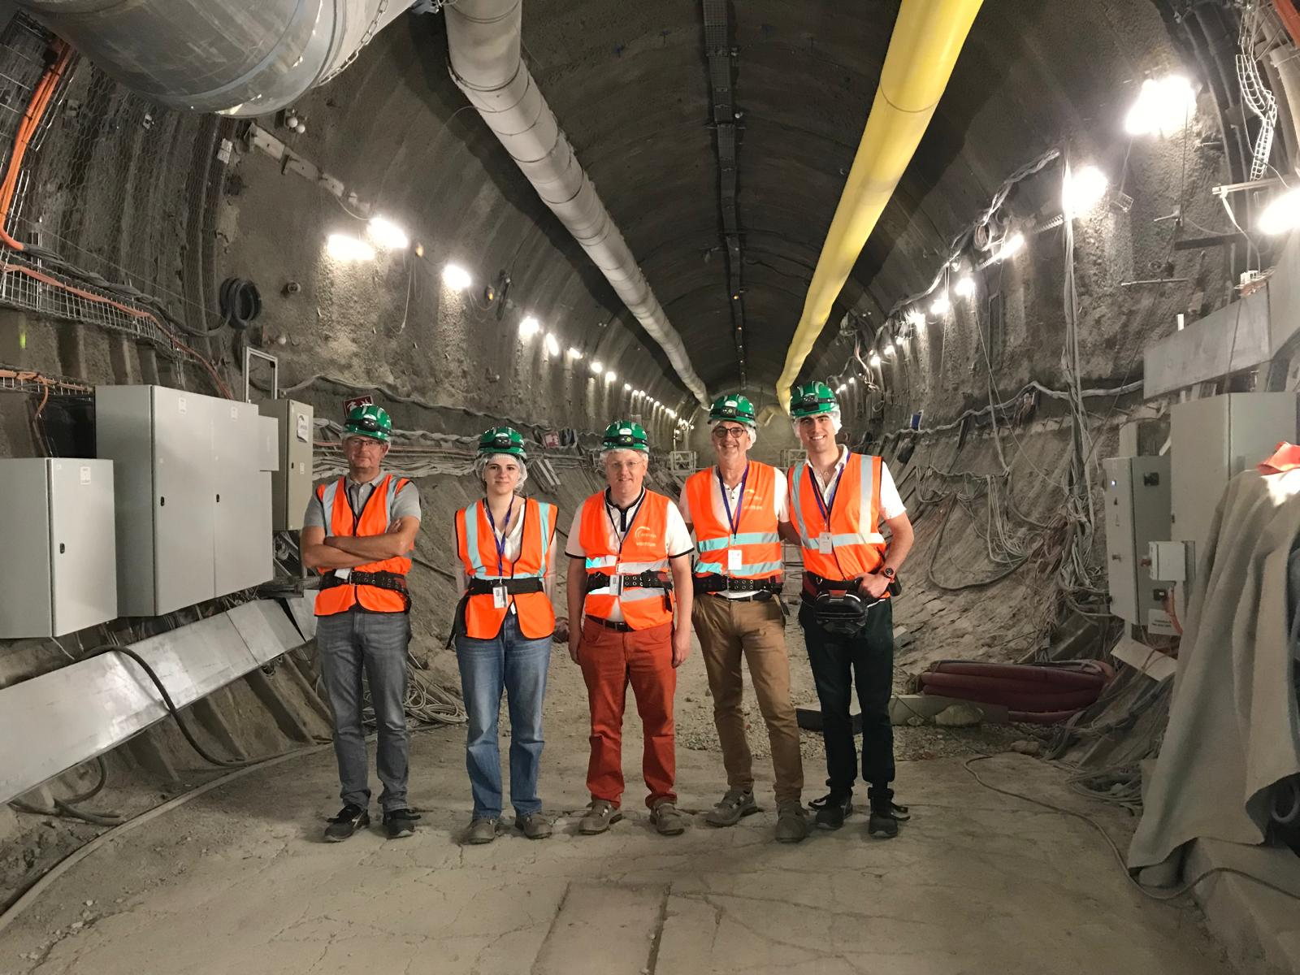
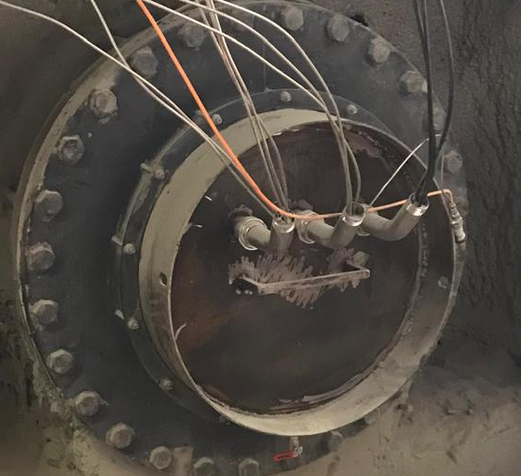
Merci de votre attention

Slide 24
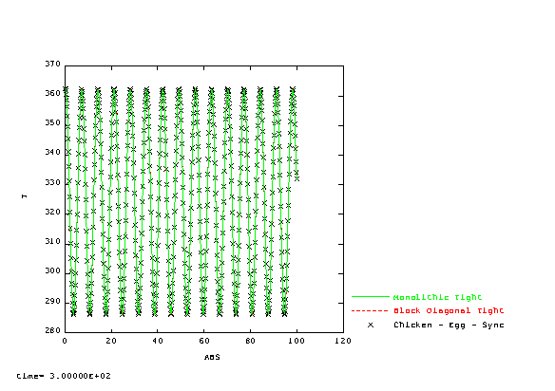
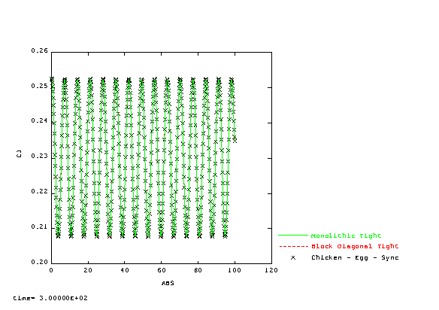
Vérification de la cohérence des schémas de couplage multiphysique (4-bis)
Version 2 du chicken-egg :
Températures
Concentration Vapeur
Question Primordiale
Puis-je faire confiance à ce calcul rapide ?
Chicken-Egg Version 2 ➔ Vérifié
Parce que nous synchronisons bien les modules physiques

Slide 25
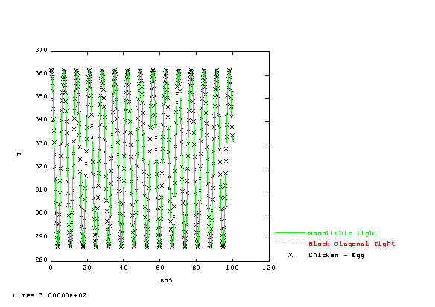

Vérification de la cohérence des schémas de couplage multiphysique (4)
Version 1 du chicken-egg :
Températures
Concentration Vapeur
Question Primordiale
Puis-je faire confiance à ce calcul rapide ?
Chicken-Egg Version 1 ➔ Pas Vérifié
Parce que nous synchronisons mal les modules physiques

