Slide 1

Integrating CAST3M and Python for Simulating Cross-Correlated Random Field Material Properties in Structural Elements
Owoeye Peter Abayomi, Frederic Duprat,
Thomas De Larrard and Zakaria Djamai
LMDC, INSA TOULOUSE
Club Cast3M 2024. 29th NOV. 2024

Slide 2
Summary.
1
PART 1
Introduction and General Context
2
PART 2
Random Field Simulation and Cross-Correlation
3
PART 3
Random Field Simulation and Propagation Framework
4
PART 4
Practical Example and Current Research in Progress
5
PART 5
Conclusion

Slide 3
Summary.
1
PART 1
Introduction and General Context
2
PART 2
Random Field Simulation and Cross-Correlation
3
PART 3
Random Field Simulation and Propagation Framework
4
PART 4
Practical Example and Current Research in Progress
5
PART 5
Conclusion

Slide 4
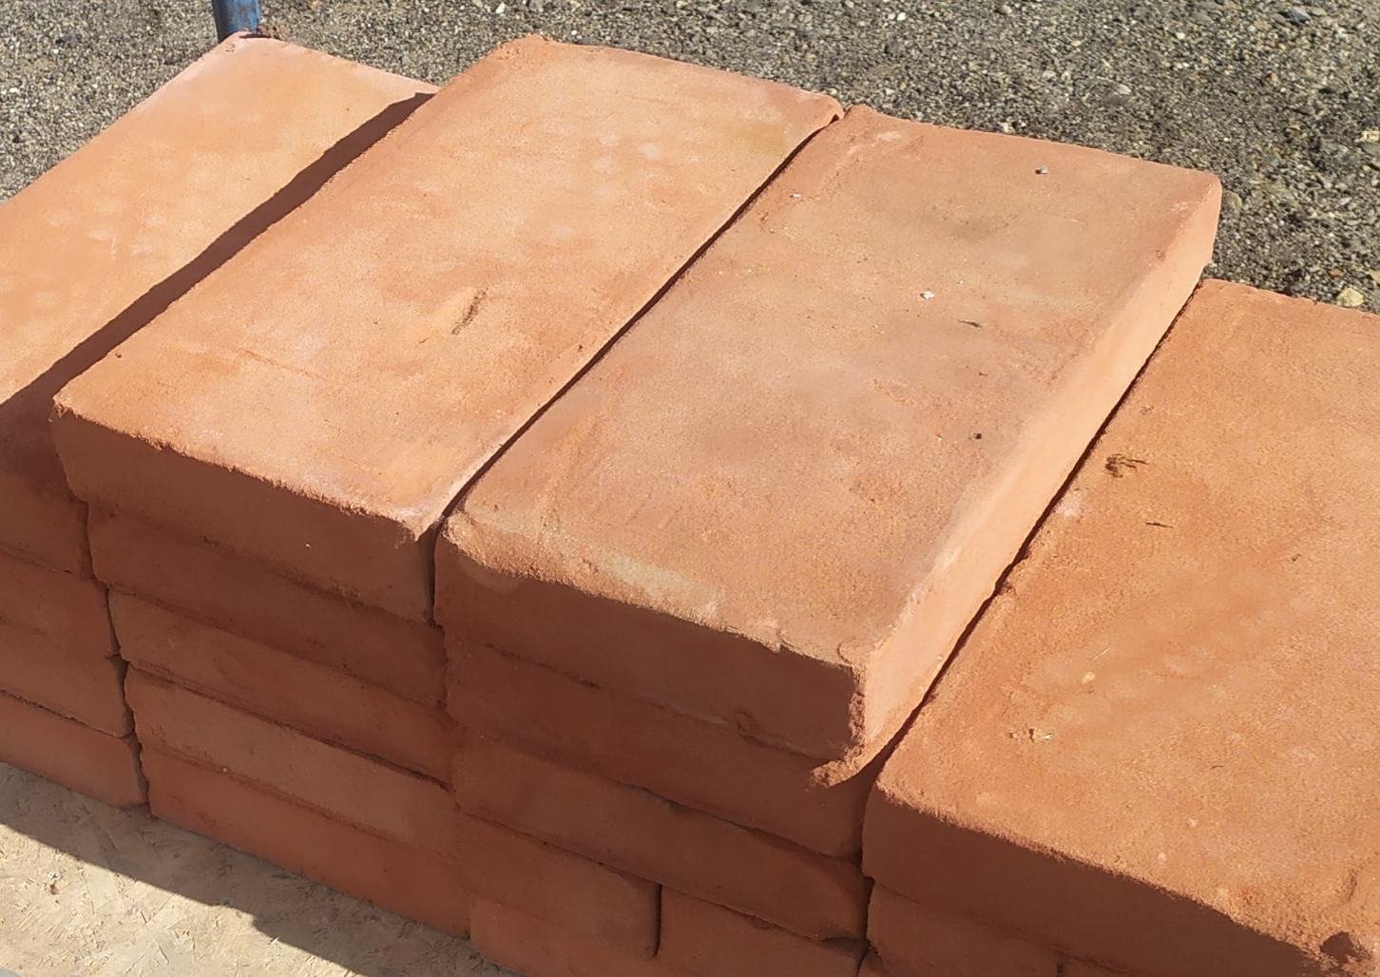
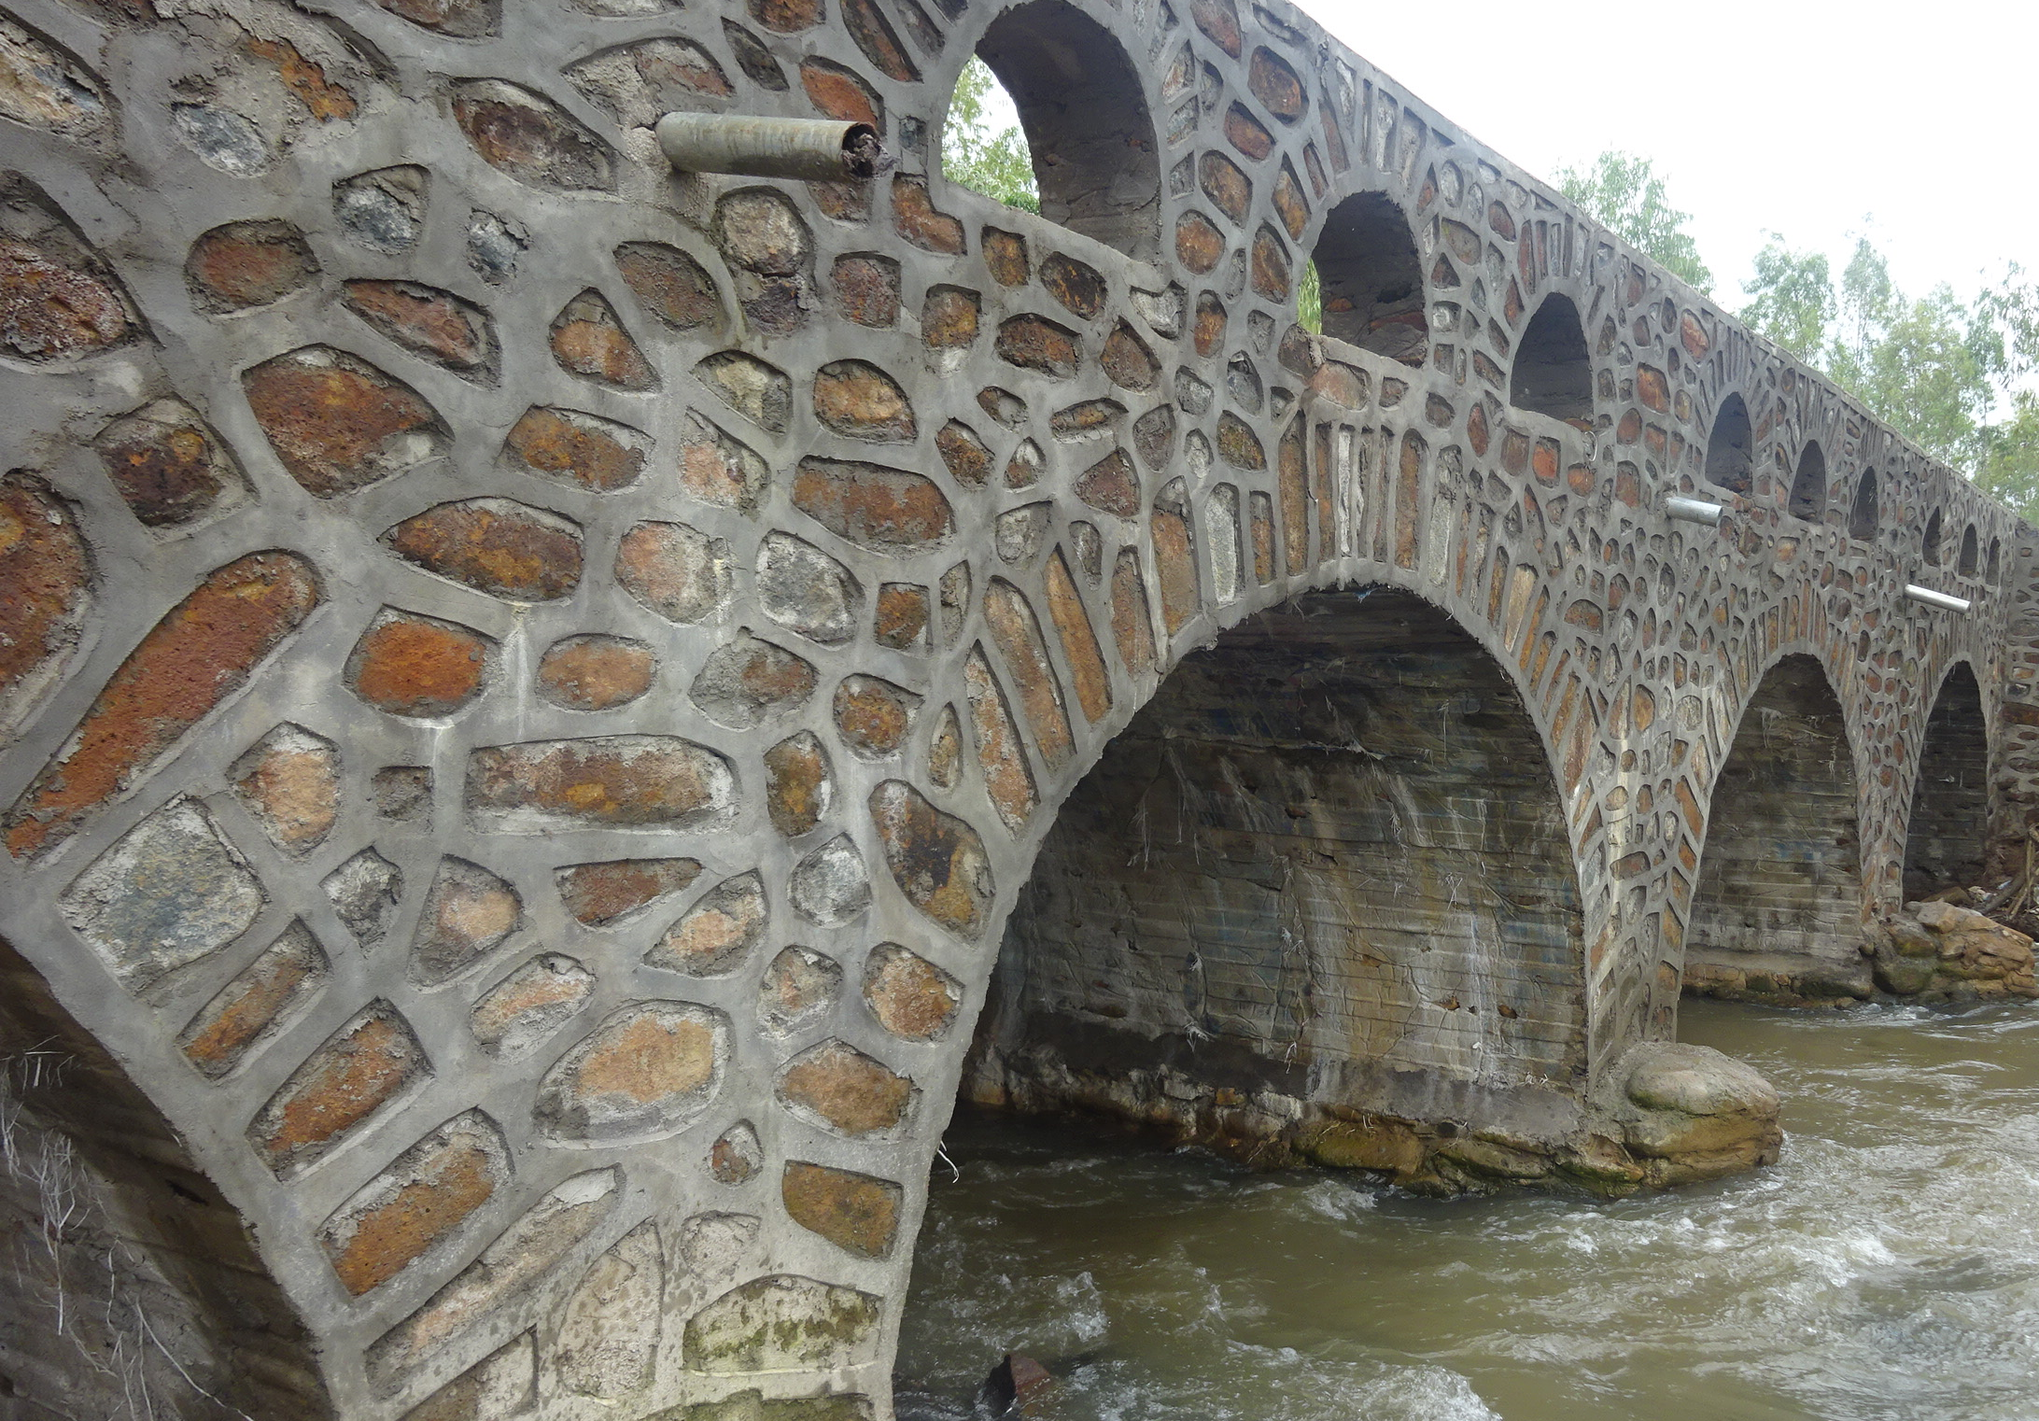
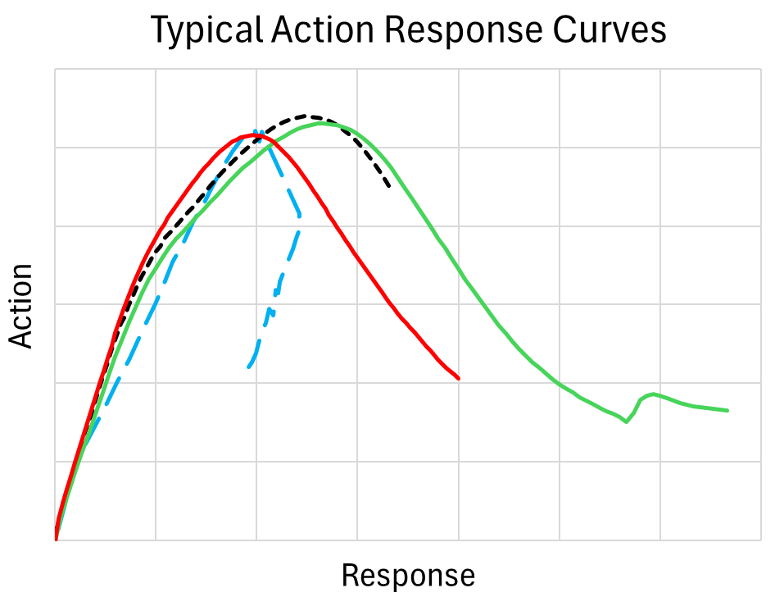
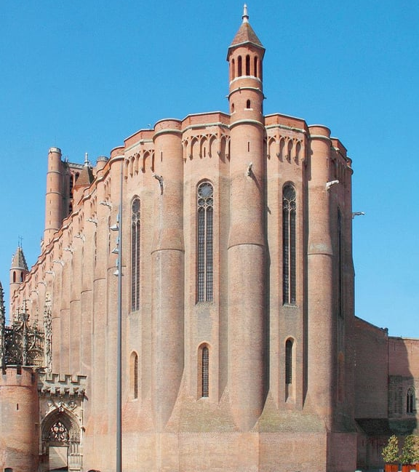
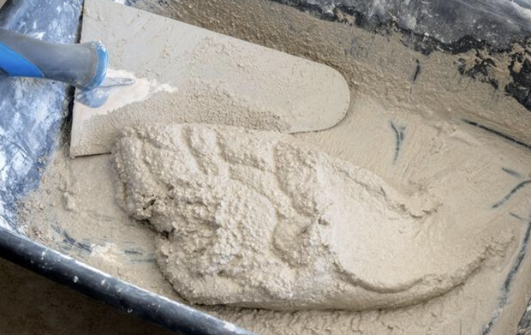
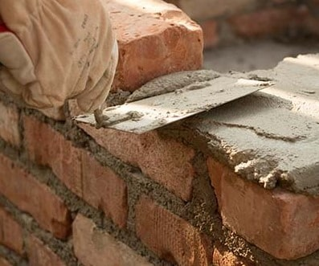


Introduction and general context
Engineering system
Structural components
Masonry Brick Unit
Local Response
Mortar
&
Global Response
Masonry Stone
Variable geometrical and mechanical properties highly influenced by workmanship, environmental condition during construction, weathering etc.
Club Cast3M 2024. 29th NOV. 2024

Slide 5
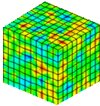
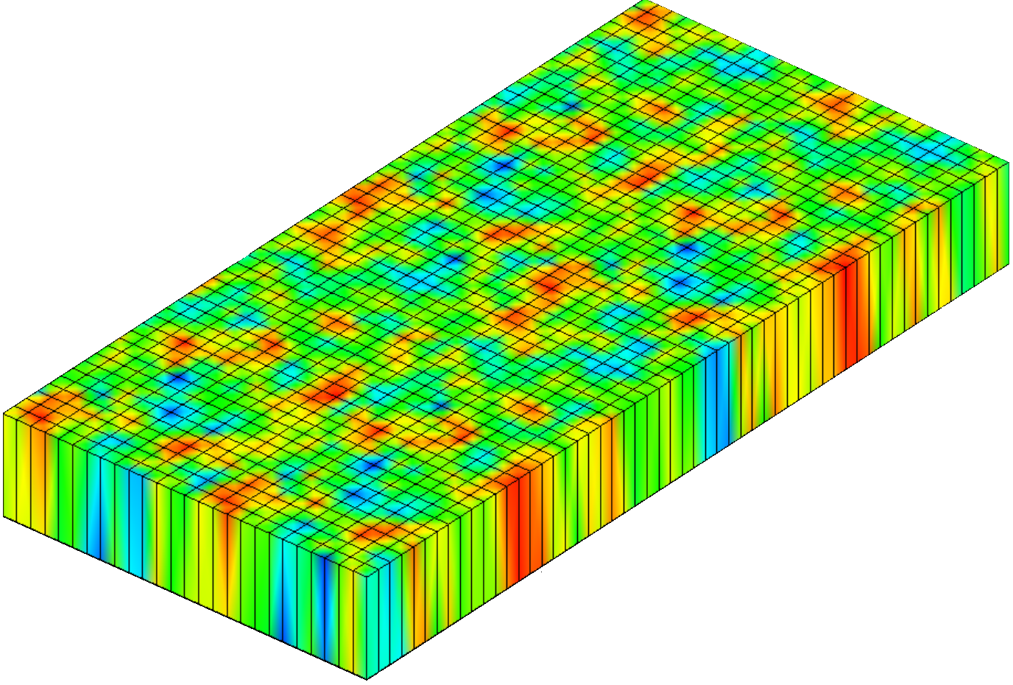

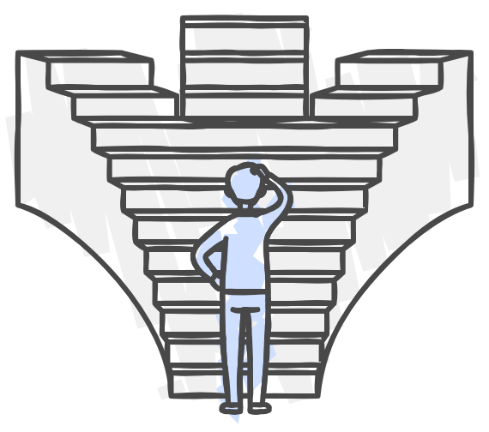
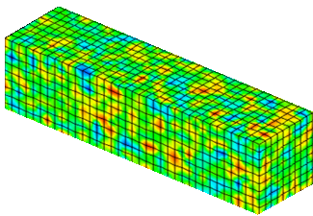
Introduction and general context
Random Field Theories
Complex Properties
Multidimensionality
Computational Cost
Accommodates intricate & varied material characteristics
Allows for multiple dimensions in property variation
Simulation Complexity
Software Limitation
Challenges of integrating random fields into nonlinear FE simulation
Stochastic Framework
Multivariate Characteristics
Foundational structure for randomness in fields
Support various variables influencing material properties
Proposed Approach
Framework integrating Cast3m model and Python script defined mechanical properties
Club Cast3M 2024. 29th NOV. 2024

Slide 6
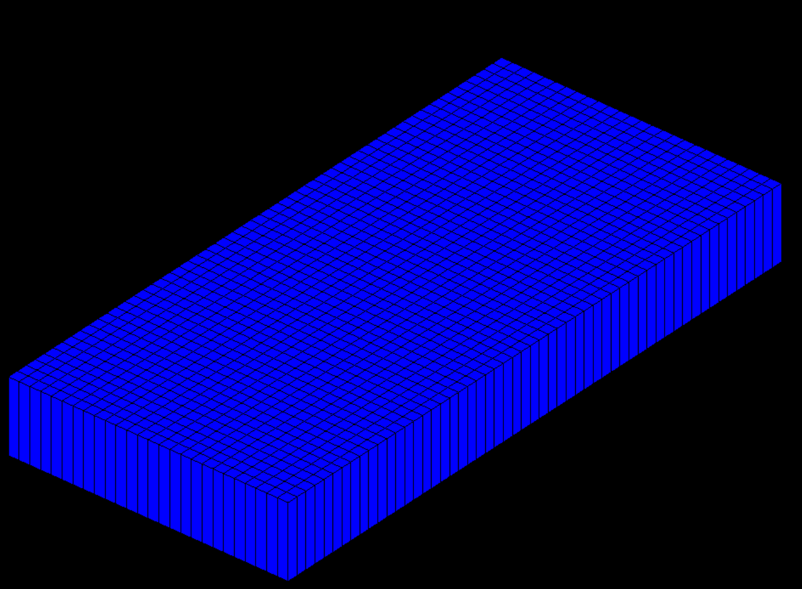
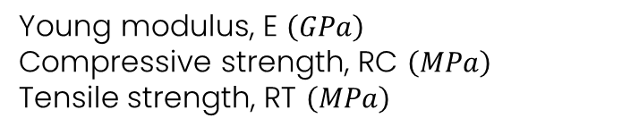
Introduction and general context
Practical application
Vertical displacement Unit brick under uniaxial compression
Masonry brick wall in-plane displacement
FEM for a unit brick uniaxial compression
Z
Y
X
Correlated random property fields
Young modulus, E $\left(GPa\right)$
Compressive strength, RC $\left(MPa\right)$
Tensile strength, RT $\left(MPa\right)$
Material of interest
Material of interest
Single Unit brick
Unit bricks
And
Mortar joints
Club Cast3M 2024. 29th NOV. 2024

Slide 7
Summary.
1
PART 1
Introduction and General Context
2
PART 2
Random Field Simulation and Cross-Correlation
3
PART 3
Random Field Simulation and Propagation Framework
4
PART 4
Practical Example and Current Research in Progress
5
PART 5
Conclusion

Slide 8
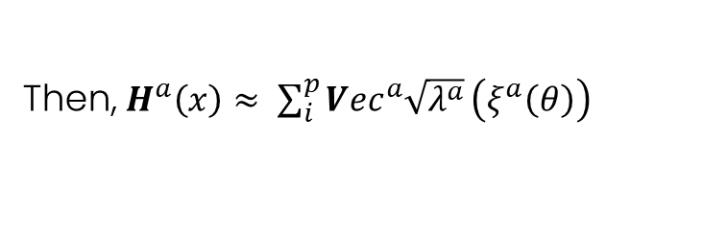


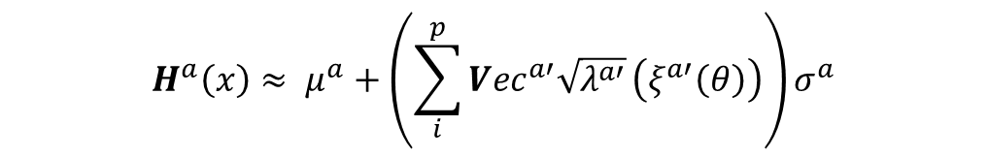

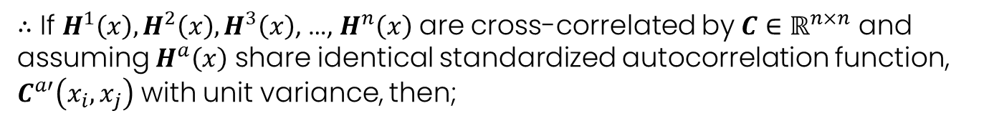
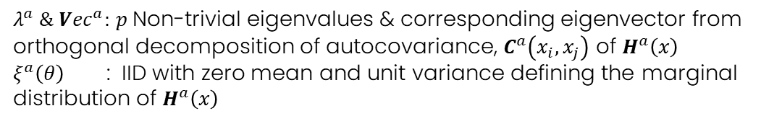
Random Field Simulation and Cross-Correlation
Cross-Correlated Random Field Brief
If $H^{a}\left(x\right)$ defines the spatial variability of a random parameter over
${H^{1}\left(x_{i}\right), H^{2}\left(x_{i}\right), H}^{3}\left(x_{i}\right)$, …, $H^{n}\left(x_{i}\right)$
$$x_{i}$$
domain $Ω$
Then, $H^{a}\left(x\right)≈ \sum_{i}^{p}{{Vec}^{a}\sqrt{λ^{a}}}\left(ξ^{a}\left(θ\right)\right)$
$λ^{a} \&{ Vec}^{a}:$ $p$Non-trivial eigenvalues & corresponding eigenvector from orthogonal decomposition of autocovariance, $C^{a}\left(x_{i},x_{j}\right)$ of $H^{a}\left(x\right)$
$ξ^{a}\left(θ\right)$ : IID with zero mean and unit variance defining the marginal distribution of $H^{a}\left(x\right)$
$∴$ If ${H^{1}\left(x\right), H^{2}\left(x\right), H}^{3}\left(x\right)$, …, $H^{n}\left(x\right)$ are cross-correlated by $C∈ℝ^{n×n}$ and assuming $H^{a}\left(x\right)$ share identical standardized autocorrelation function, $C^{a′}\left(x_{i},x_{j}\right)$ with unit variance, then;
$$H^{a}\left(x\right)≈ μ^{a}+\left(\sum_{i}^{p}{{Vec}^{a′}\sqrt{λ^{a′}}}\left(ξ^{a′}\left(θ\right)\right)\right)σ^{a}$$
$μ^{a} \& σ^{a}$: Mean and standard deviation of $H^{a}\left(x\right)$
$ξ^{a′}\left(θ\right)∈ξ^{D}={\left[{\left[ξ^{1}\right]}^{T} {\left[ξ^{2}\right]}^{T} {\left[ξ^{3}\right]}^{T}… {\left[ξ^{n}\right]}^{T}\right]}^{T}$: Jointly distributed correlated random vectors
Club Cast3M 2024. 29th NOV. 2024
Notes:
Jointly distributed random vector

Slide 9

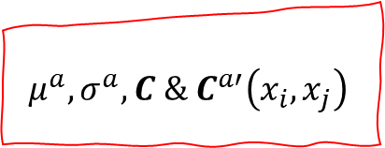
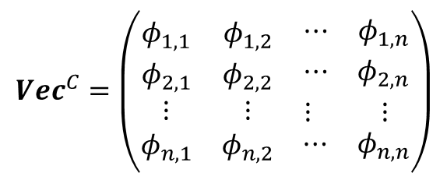
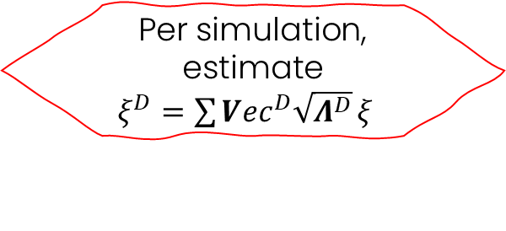

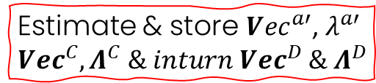
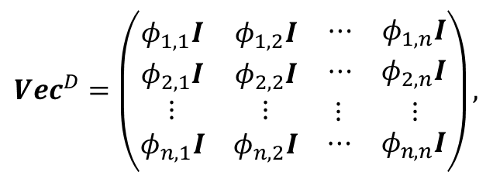
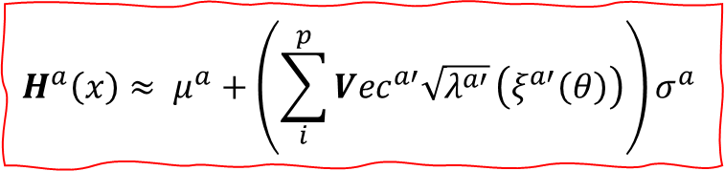
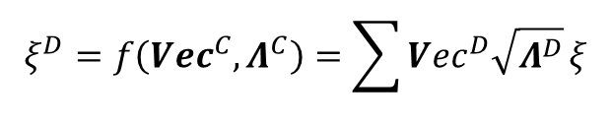
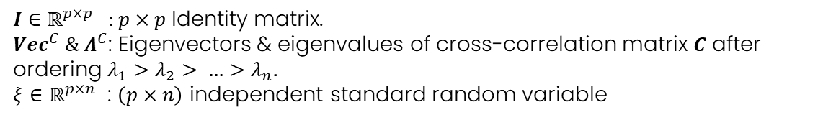
Random Field Simulation and Cross-Correlation
Cross-Correlated Random Field Brief
$$ξ^{D}=f\left({Vec}^{C},Λ^{C}\right)=\sum{{Vec}^{D}\sqrt{Λ^{D}}}ξ$$
$$μ^{a}, σ^{a}, C \& C^{a′}\left(x_{i}, x_{j}\right)$$
However;
Where;
$${Vec}^{D}=\left(\begin{matrix}φ_{1,1}I & φ_{1,2}I & \begin{matrix}⋯ & φ_{1,n}I\end{matrix} \\ φ_{2,1}I & φ_{2,2}I & \begin{matrix}⋯ & φ_{2,n}I\end{matrix} \\ \begin{matrix}⋮ \\ φ_{n,1}I\end{matrix} & \begin{matrix}⋮ \\ φ_{n,2}I\end{matrix} & \begin{matrix}\begin{matrix}⋮ & ⋮ \end{matrix} \\ \begin{matrix}⋯ & φ_{n,n}I\end{matrix}\end{matrix}\end{matrix}\right),$$
$${Vec}^{C}=\left(\begin{matrix}φ_{1,1} & φ_{1,2} & \begin{matrix}⋯ & φ_{1,n}\end{matrix} \\ φ_{2,1} & φ_{2,2} & \begin{matrix}⋯ & φ_{2,n}\end{matrix} \\ \begin{matrix}⋮ \\ φ_{n,1}\end{matrix} & \begin{matrix}⋮ \\ φ_{n,2}\end{matrix} & \begin{matrix}\begin{matrix}⋮ & ⋮ \end{matrix} \\ \begin{matrix}⋯ & φ_{n,n}\end{matrix}\end{matrix}\end{matrix}\right)$$
Estimate & store ${Vec}^{a′}$, $λ^{a′}$ ${Vec}^{C}, Λ^{C} \& inturn {Vec}^{D} \& Λ^{D}$
Per simulation, estimate
$ξ^{D}=\sum{{Vec}^{D}\sqrt{Λ^{D}}}ξξ$
$$Λ^{D}=diag \left(λ_{1}I,λ_{2}I,λ_{3}I, …,λ_{n}I\right),$$
$$Λ^{C}=diag \left(λ_{1},λ_{2},λ_{3}, …,λ_{n}\right),$$
$I∈ℝ^{p×p}$ : $p×p$ Identity matrix.
${Vec}^{C} \&{ Λ}^{C}$: Eigenvectors & eigenvalues of cross-correlation matrix $C$ after ordering $λ_{1}>λ_{2}> …>λ_{n}$.
$ξ∈ℝ^{p×n}$ : $\left(p×n\right)$ independent standard random variable
$$H^{a}\left(x\right)≈ μ^{a}+\left(\sum_{i}^{p}{{Vec}^{a′}\sqrt{λ^{a′}}}\left(ξ^{a′}\left(θ\right)\right)\right)σ^{a}$$
Club Cast3M 2024. 29th NOV. 2024
Notes:
Jointly distributed random vector

Slide 10
Summary.
1
PART 1
Introduction and General Context
2
PART 2
Random Field Simulation and Cross-Correlation
3
PART 3
Random Field Simulation and Propagation Framework
4
PART 4
Practical Example and Current Research in Progress
5
PART 5
Conclusion

Slide 11

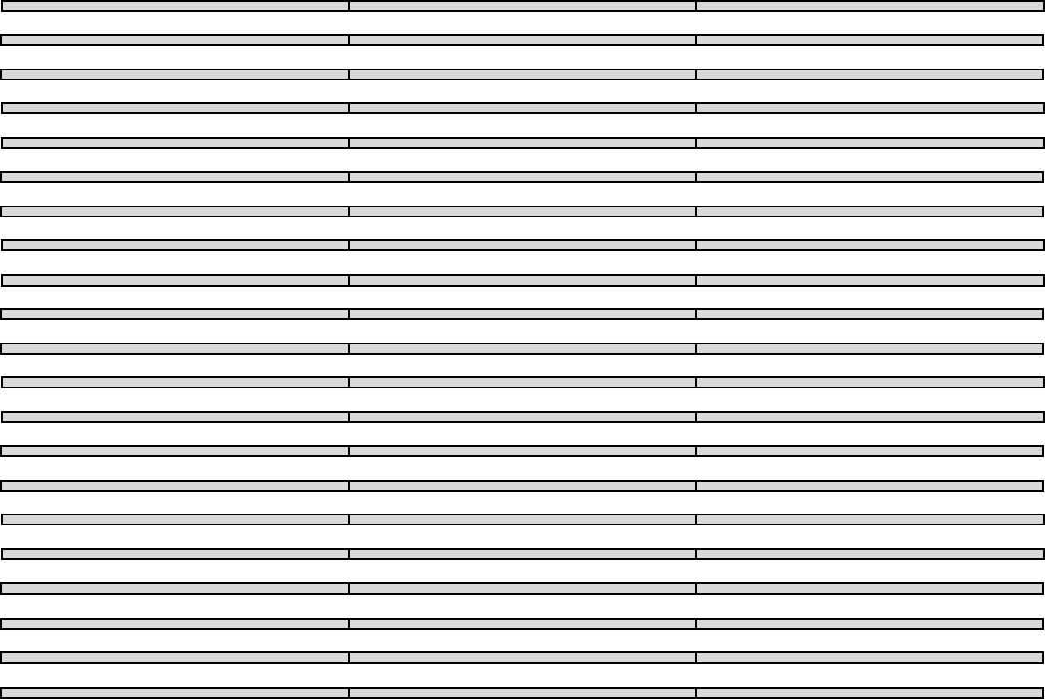
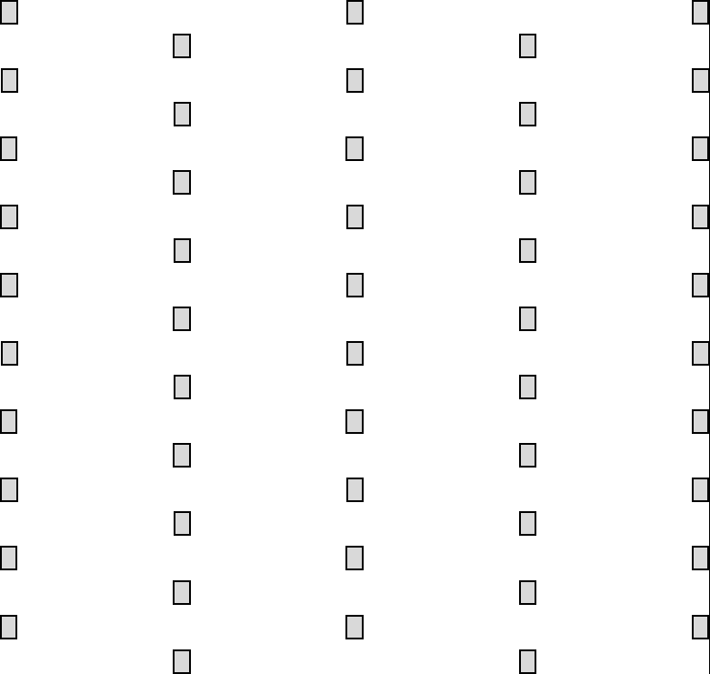
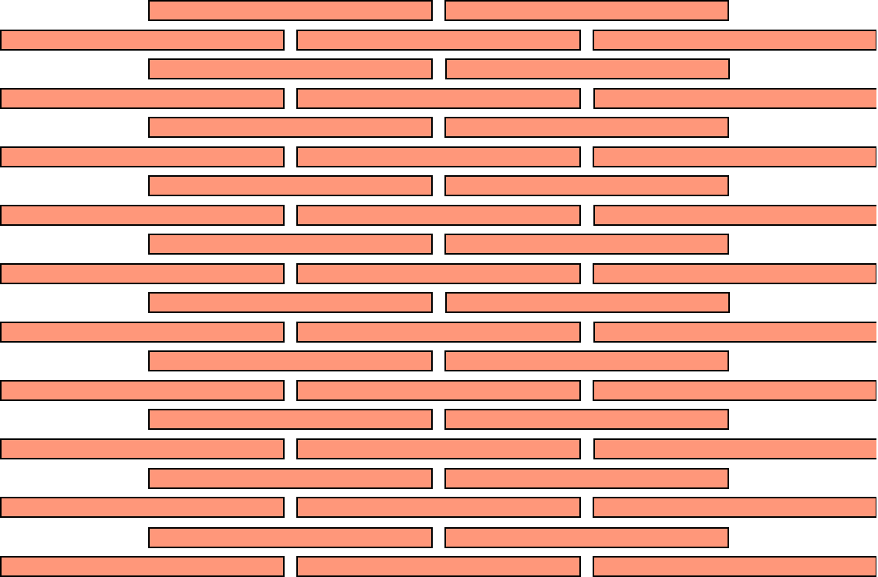
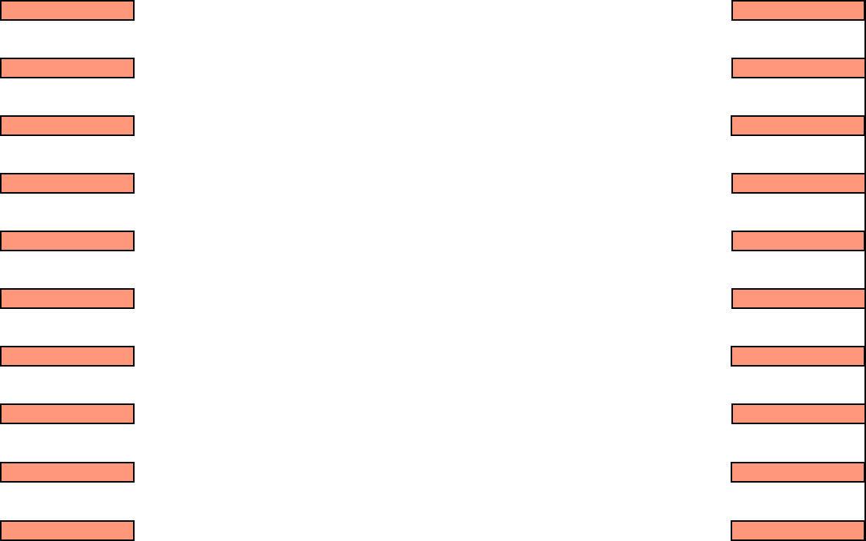
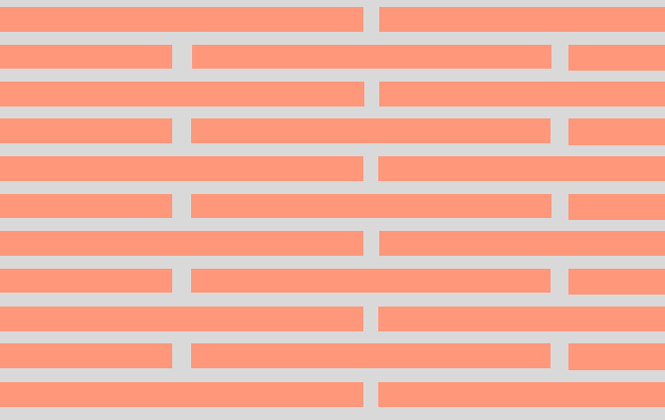
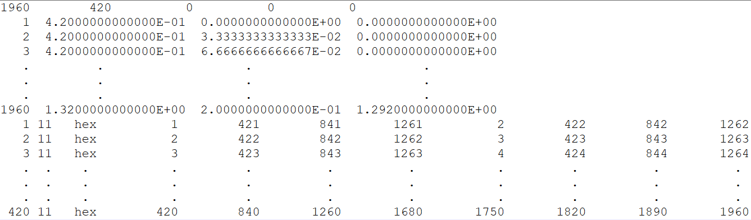
Random Field Simulation and Propagation Framework
Define the structure’s component by sizes to include discretization
Define the structure’s geometry and model the its volumetric mesh based on the define component and discretization
Save the total volumetric mesh of each component as a Cast3m.INP file
Example of Cast3m.INP file
Meta data {no. of node, no. of elements, nodal properties, element properties, constant}
Nodal numbers and x, y and z coordinates
Element number, type of element, element nodal number
CAST3M
Club Cast3M 2024. 29th NOV. 2024

Slide 12
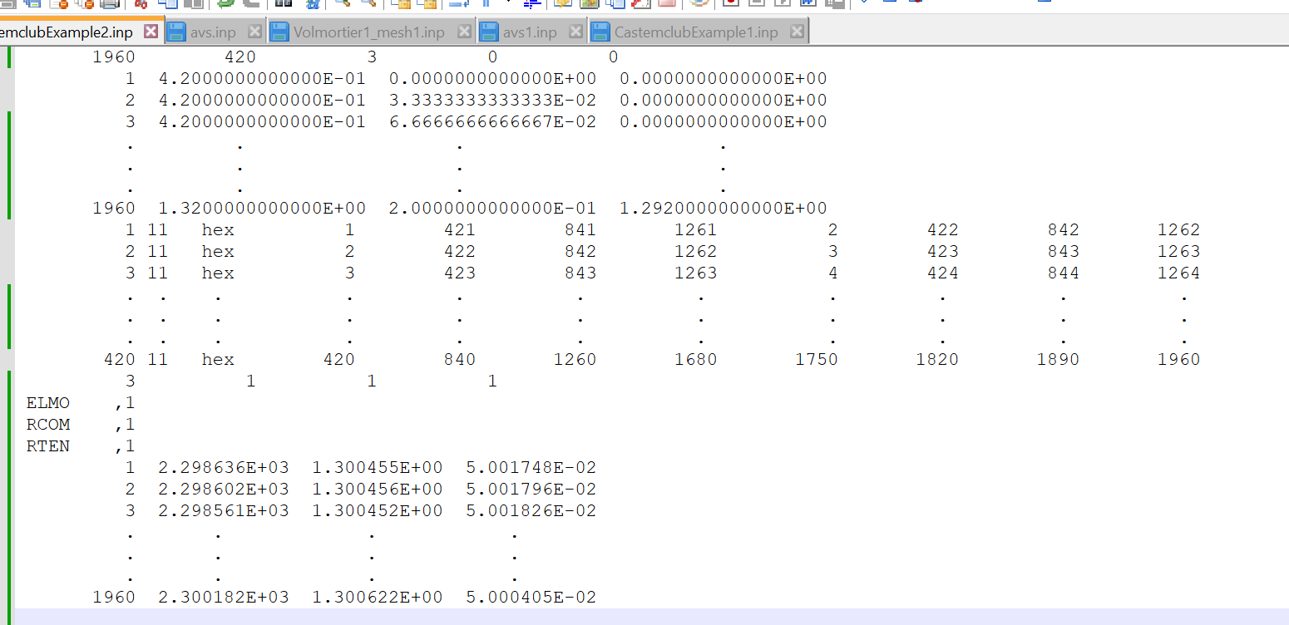

Random Field Simulation and Propagation Framework
Define the structure’s component by sizes to include discretization
Define the total number of each of component
Define the structure’s geometry and model the its volumetric mesh based on the define component and discretization
Save the total volumetric mesh of each component as a Cast3m.INP file
$$\left(x_{i}, y_{i}, z_{i}\right)$$
Model the total coordinate system of each component
$$z_{i}$$
$$y_{i}$$
$$x_{i}$$
Modified meta data {nodal properties = 3}
Define the number of random field realizations, random field material properties of interest and their parameters for each component
$$μ^{a}$$
$$σ^{a}$$
$$C$$
$$C^{a′}$$
Import & merge Cast3m.INP with simulated random field data by coordinates
Simulate random field data at the nodal coordinates of all the component
Save the merged data as a Python.INP file & call Cast3m
Identities of nodal property
CAST3M
Nodal properties
PYTHON
Club Cast3M 2024. 29th NOV. 2024

Slide 13
Random Field Simulation and Propagation Framework
Define the structure’s component by sizes to include discretization
Define the number of element in each of the component
Define the structure’s geometry and model the its volumetric mesh based on the define component and discretization
Save the total volumetric mesh of each component as a Cast3m.INP file
$$\left(x_{i}, y_{i}, z_{i}\right)$$
Model the total coordinate system of each component
$$z_{i}$$
$$y_{i}$$
$$x_{i}$$
Define the number of random field realizations, random field material properties of interest and their parameters for each component
Import and extract the Python.INP volumetric mesh and corresponding coordinate point field characteristics
Import & merge Cast3m.INP with simulated random field data by coordinates
Simulate random field data at the nodal coordinates of all the component
Merge imported and existing volumetric mesh
Save the merged data as a Python.INP file & call Cast3m
CAST3M
Define mechanical behaviour and characteristics on imported volumetric mesh
PYTHON
Define boundary condition and loading on existing mesh
Define and run analysis procedure
Extract and save response of interest
End Cast3m, for Python to start the next iteration
REALIZATION, SIMULATION & ANALYSIS CONTROL BY PYTHON
Club Cast3M 2024. 29th NOV. 2024

Slide 14
Summary.
1
PART 1
Introduction and General Context
2
PART 2
Random Field Simulation and Cross-Correlation
3
PART 3
Random Field Simulation and Propagation Framework
4
PART 4
Practical Example and Current Research in Progress
5
PART 5
Conclusion

Slide 15
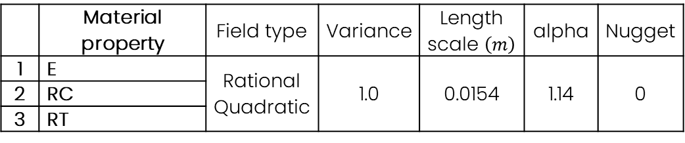
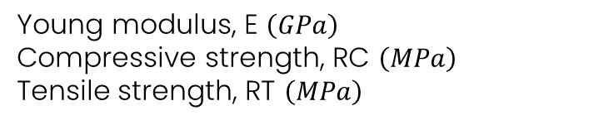
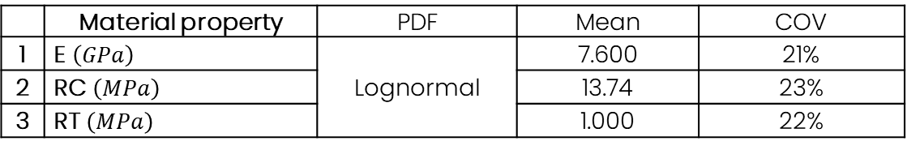
Practical Example
Vertical displacement Unit brick under uniaxial compression
Correlated unit brick property fields
Young modulus, E $\left(GPa\right)$
Compressive strength, RC $\left(MPa\right)$
Tensile strength, RT $\left(MPa\right)$
FEM for a unit brick uniaxial compression
Z
Random field statistical parameter
Y
Variogram Parameter
X
 | Material property | Field type | Variance | Length scale $\left(m\right)$ | alpha | Nugget
1 | E | Rational Quadratic | 1.0 | 0.0154 | 1.14 | 0
2 | RC
3 | RT
Marginal PDF Parameter
 | Material property | PDF | Mean | COV
1 | E $\left(GPa\right)$ | Lognormal | 7.600 | 21%
2 | RC $\left(MPa\right)$ |  | 13.74 | 23%
3 | RT $\left(MPa\right)$ |  | 1.000 | 22%
Club Cast3M 2024. 29th NOV. 2024

Slide 16
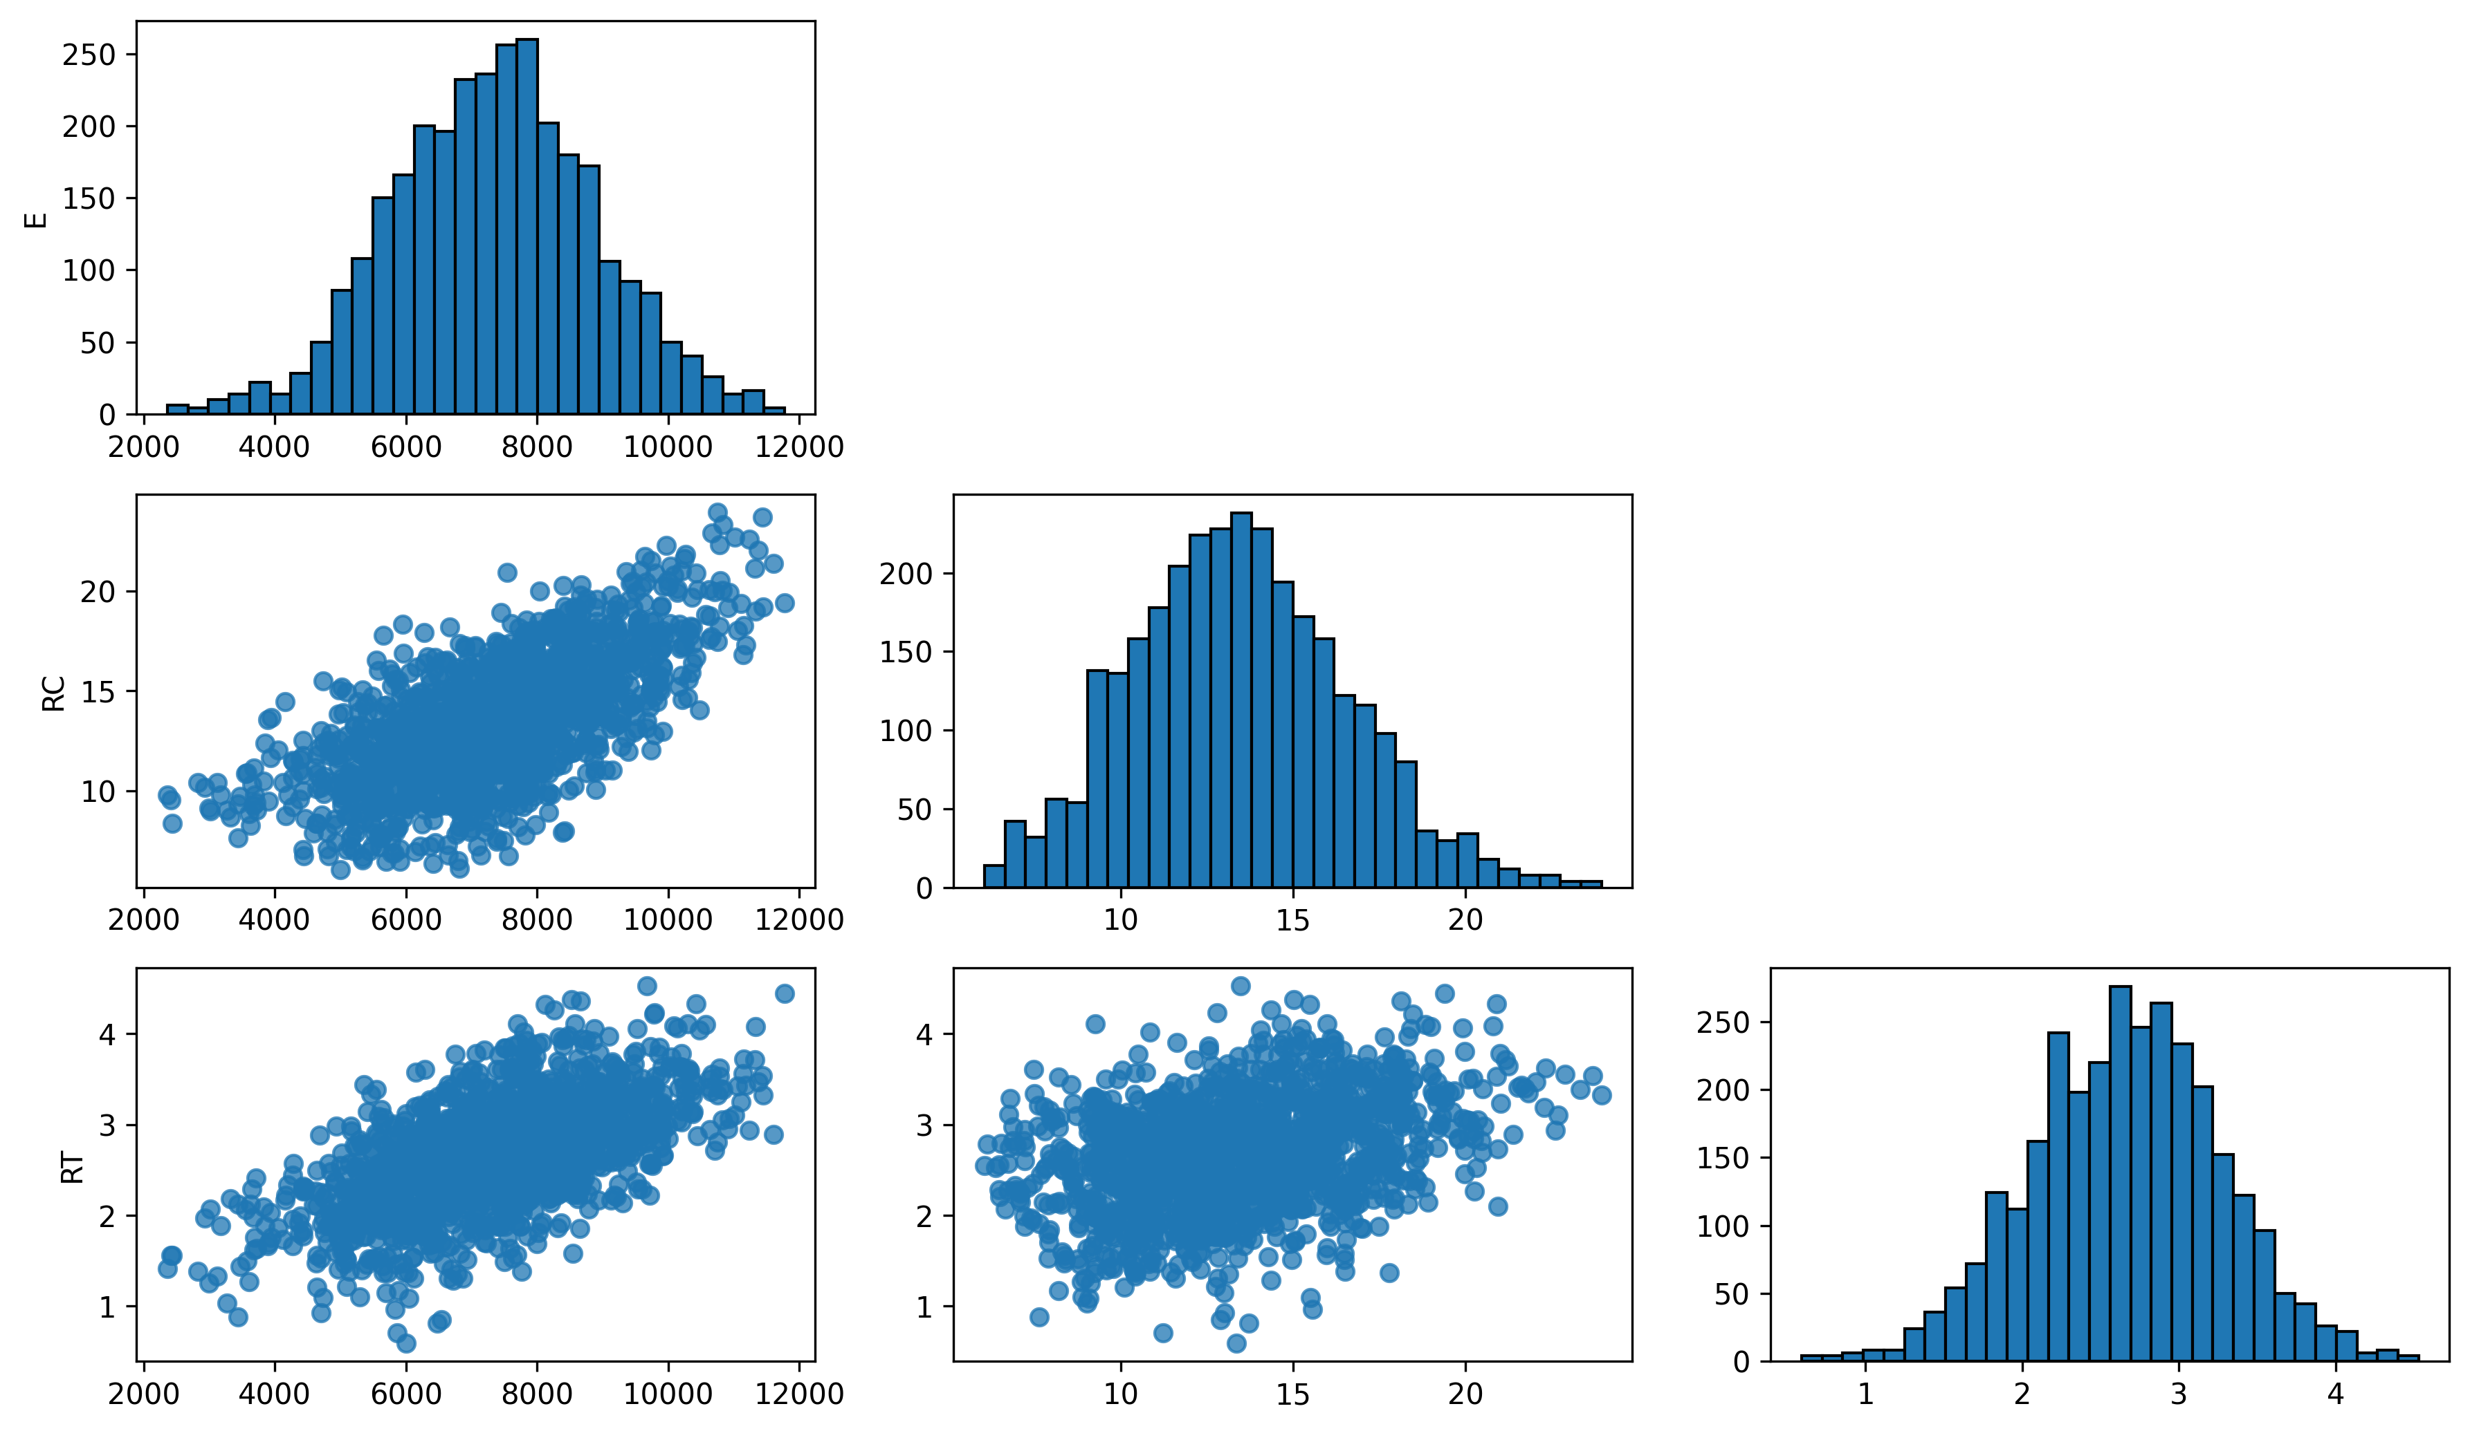
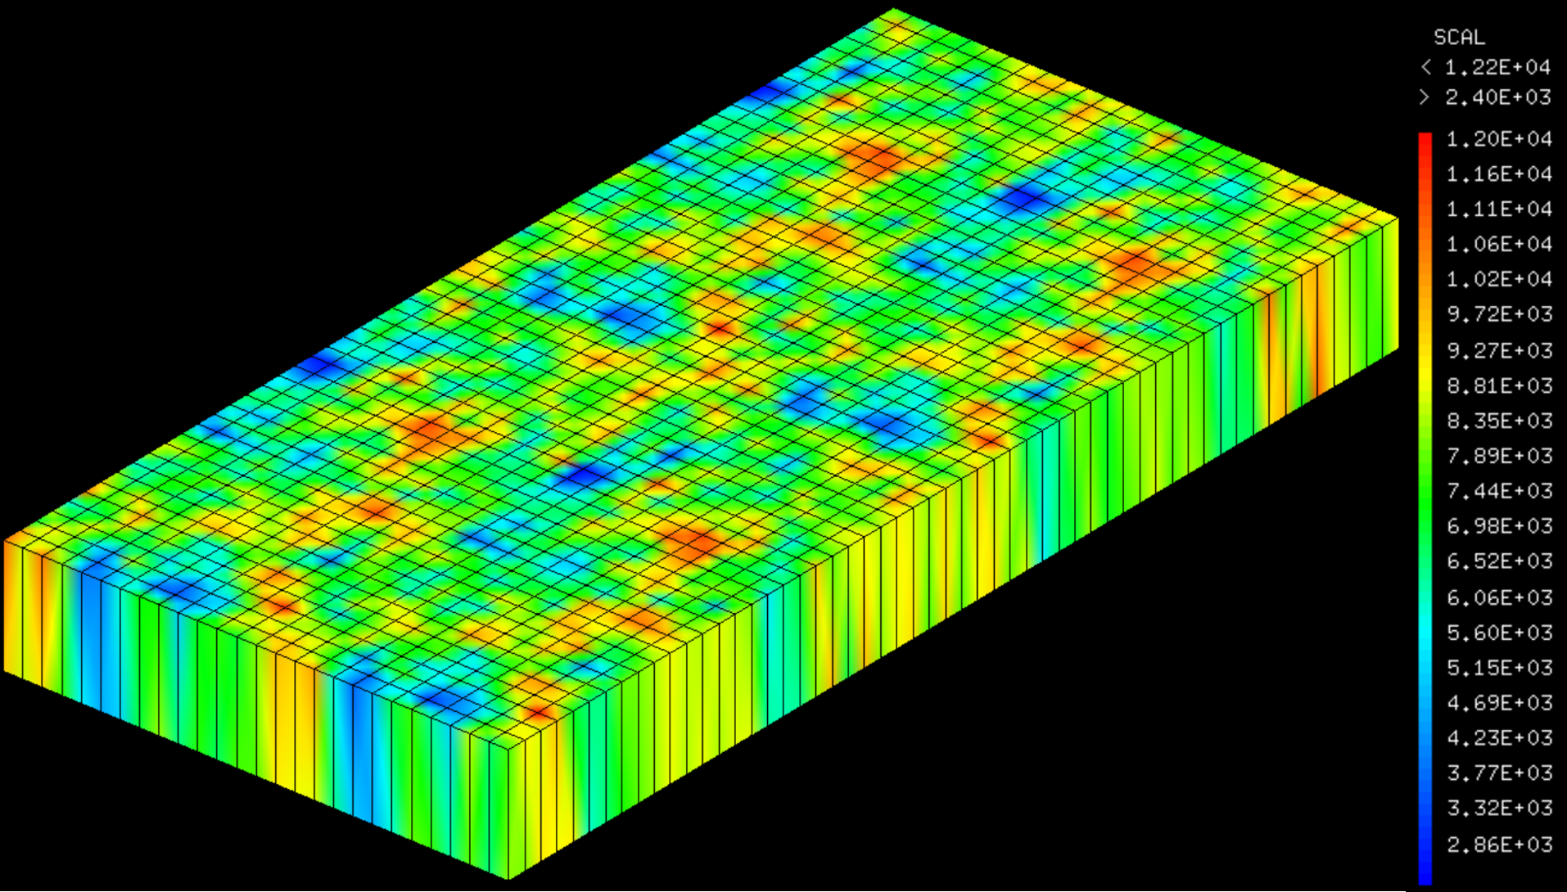
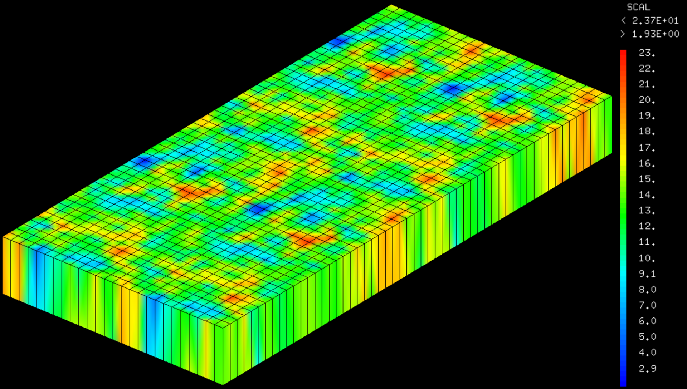
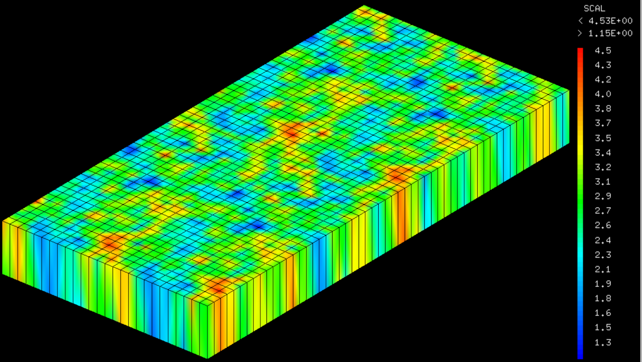

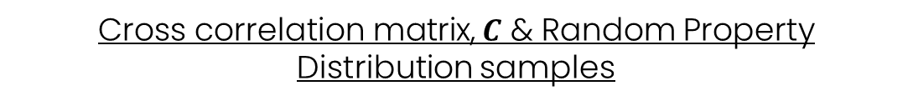
Practical Example
Vertical displacement Unit brick under uniaxial compression
Cross correlation matrix, $C$ & Random Property Distribution samples
E
$\begin{matrix}E & RC & RT\end{matrix}$
$$C= \begin{matrix}E \\ RC \\ RT \end{matrix}\left(\begin{matrix}\begin{matrix}1 \\ 0.70 \\ 0.65\end{matrix} & \begin{matrix}0.70 \\ 1 \\ 0.40\end{matrix} & \begin{matrix}0.65 \\ 0.40 \\ 1\end{matrix}\end{matrix}\begin{matrix} \\ \\ \end{matrix}\right)$$
Density
RC
RC (MPa)
RT
RT (MPa)
E (MPa)
RC (MPa)
RT (MPa)
Club Cast3M 2024. 29th NOV. 2024

Slide 17
Practical Example
Vertical displacement Unit brick under uniaxial compression
Framework Validation
 | Nodes | Time (s)
Deterministic | 6048
 | Nodes | Time (s)
Deterministic | 3024
Club Cast3M 2024. 29th NOV. 2024

Slide 18
Practical Example
Vertical displacement Unit brick under uniaxial compression
Framework Validation
 | Nodes | Time (s)
Deterministic | 6048 | 21.0
 | Nodes | Time (s)
Deterministic | 3024 | 5.5
Club Cast3M 2024. 29th NOV. 2024

Slide 19
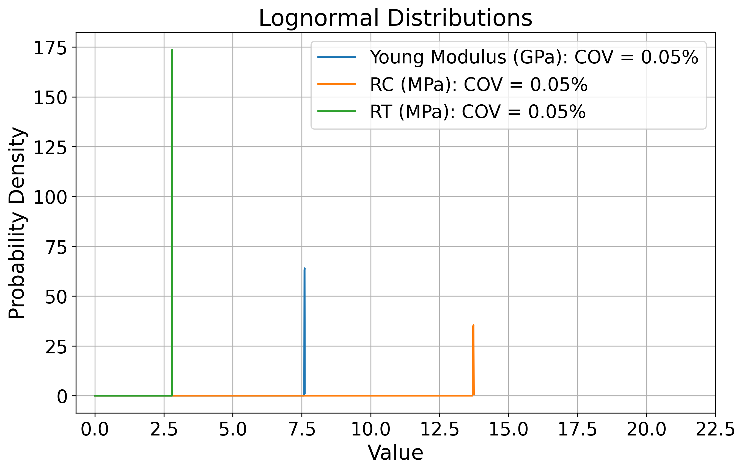
Practical Example
Vertical displacement Unit brick under uniaxial compression
Framework Validation
 | Nodes | Time (s)
Deterministic | 6048 | 21.0
COV = 0.05% |  | 27.47
 | Nodes | Time (s)
Deterministic | 3024 | 5.5
COV = 0.05% |  | 11.0
Club Cast3M 2024. 29th NOV. 2024

Slide 20
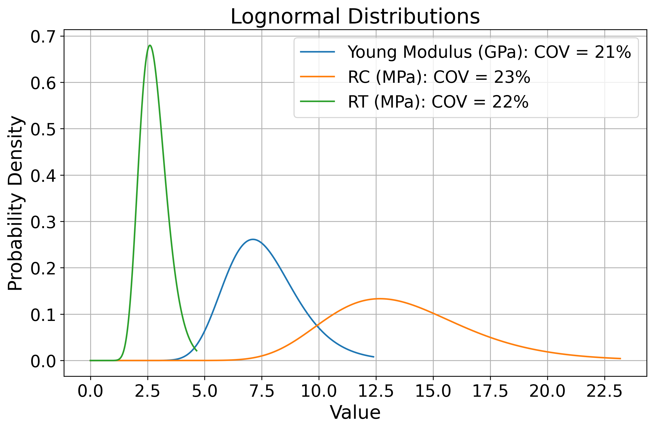
Practical Example
Vertical displacement Unit brick under uniaxial compression
Framework Validation
Simulation example
 | Nodes | Time (s)
Deterministic | 6048 | 21.0
COV = 0.05% |  | 27.47
 | Nodes | Time (s)
Deterministic | 3024 | 5.5
COV = 0.05% |  | 11.0
Simulations |  | 8.6 (Avg)
Club Cast3M 2024. 29th NOV. 2024

Slide 21
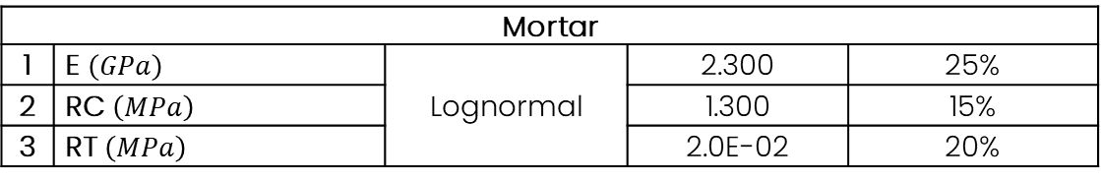
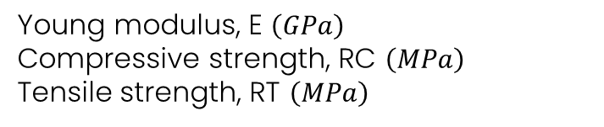
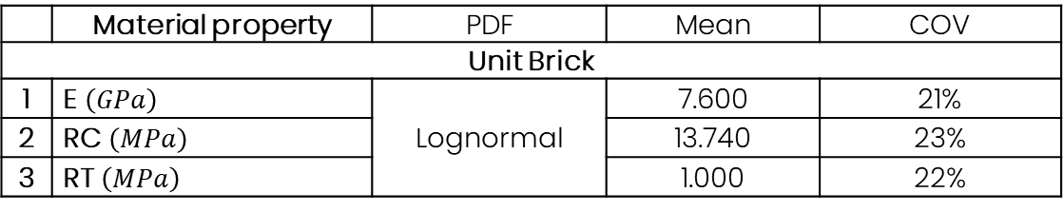
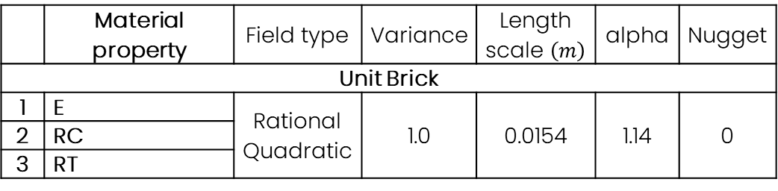
Current Research in Progress
Masonry brick wall in-plane displacement
Correlated unit brick & mortar property fields
Random field statistical parameter
Variogram Parameter
Young modulus, E $\left(GPa\right)$
Compressive strength, RC $\left(MPa\right)$
Tensile strength, RT $\left(MPa\right)$
 | Material property | Field type | Variance | Length scale $\left(m\right)$ | alpha | Nugget
Unit Brick
1 | E | Rational Quadratic | 1.0 | 0.0154 | 1.14 | 0
2 | RC
3 | RT
Mortar
1 | Young modulus | Stable Exponent. | 1.0 | 0.0324 | 1.89 | 0
2 | RC
3 | RT
Marginal PDF Parameter
 | Material property | PDF | Mean | COV
Unit Brick
1 | E $\left(GPa\right)$ | Lognormal | 7.600 | 21%
2 | RC $\left(MPa\right)$ |  | 13.740 | 23%
3 | RT $\left(MPa\right)$ |  | 1.000 | 22%
Mortar
1 | E $\left(GPa\right)$ | Lognormal | 2.300 | 25%
2 | RC $\left(MPa\right)$ |  | 1.300 | 15%
3 | RT $\left(MPa\right)$ |  | 2.0E-02 | 20%
Club Cast3M 2024. 29th NOV. 2024

Slide 22
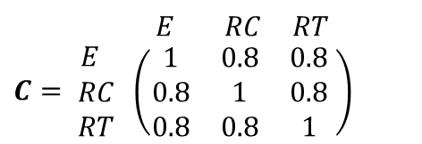
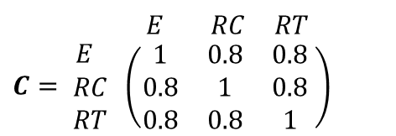
Current Research in Progress
Sample Brick & Mortar Property Random Field Distribution
Unit Brick Cross-Correlation, C
$\begin{matrix}E & RC & RT\end{matrix}$
$$C= \begin{matrix}E \\ RC \\ RT \end{matrix}\left(\begin{matrix}\begin{matrix}1 \\ 0.8 \\ 0.8\end{matrix} & \begin{matrix}0.8 \\ 1 \\ 0.8\end{matrix} & \begin{matrix}0.8 \\ 0.8 \\ 1\end{matrix}\end{matrix}\begin{matrix} \\ \\ \end{matrix}\right)$$
Mortar
Cross-Correlation, C
$\begin{matrix}E & RC & RT\end{matrix}$
$$C= \begin{matrix}E \\ RC \\ RT \end{matrix}\left(\begin{matrix}\begin{matrix}1 \\ 0.8 \\ 0.8\end{matrix} & \begin{matrix}0.8 \\ 1 \\ 0.8\end{matrix} & \begin{matrix}0.8 \\ 0.8 \\ 1\end{matrix}\end{matrix}\begin{matrix} \\ \\ \end{matrix}\right)$$
Club Cast3M 2024. 29th NOV. 2024

Slide 23
Summary.
1
PART 1
Introduction and General Context
2
PART 2
Random Field Simulation and Cross-Correlation
3
PART 3
Random Field Simulation and Propagation Framework
4
PART 4
Practical Example and Current Research in Progress
5
PART 5
Conclusion

Slide 24
Conclusion & future perspective
Conclusion
Realistic representation of property variability.
Realistic uncertainty propagation for FE simulation.
Easy and adaptive for structures with complex properties/multidimensional characteristics .
Future perspective
Sensitivity analysis
Reliability and uncertainty analysis
Thank You For Your Attention!
Any Question?
Club Cast3M 2024. 29th NOV. 2024

Slide 25
References
Vořechovský, M., 2008. Simulation of simply cross correlated random fields by series expansion methods. Struct. Saf. 30, 337–363. https://doi.org/10.1016/j.strusafe.2007.05.002
Cho, H., Venturi, D., Karniadakis, G.E., 2013. Karhunen–Loève expansion for multi-correlated stochastic processes. Probabilistic Eng. Mech. 34, 157–167. https://doi.org/10.1016/j.probengmech.2013.09.004
Zhu, H., Zhang, L.M., Xiao, T., Li, X.Y., 2017. Generation of multivariate cross-correlated geotechnical random fields. Comput. Geotech. 86, 95–107. https://doi.org/10.1016/j.compgeo.2017.01.006
Club Cast3M 2024. 29th NOV. 2024

