Slide 1
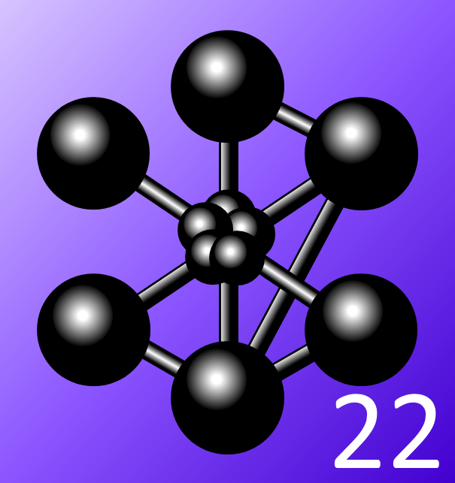
Authors: E. PALI*^{,1,2}, A. Gravouil¹, A. Tanguy¹, O. Kononchuk², D. Landru²
¹ LaMCoS, UMR CNRS 5259 / INSA Lyon, 27 bis avenue Jean Capelle, Bâtiment Sophie Germain,
69621 Villeurbanne, France, lamcos@insa-lyon.fr.
² Soitec, Parc technologique des Fontaines, chemin des Franques, 38190 Bernin (France)
3D X-FEM modeling of crack coalescence phenomena in the Smart-CutTM process
Club cast3M 2022

Slide 2
Outlines
Context and motivations
3D X-FEM formulation and discretization
Prediction of the pressure in the cracks
Application to the modeling of 3D crack coalescence
Conclusion and other expected applications

Slide 3
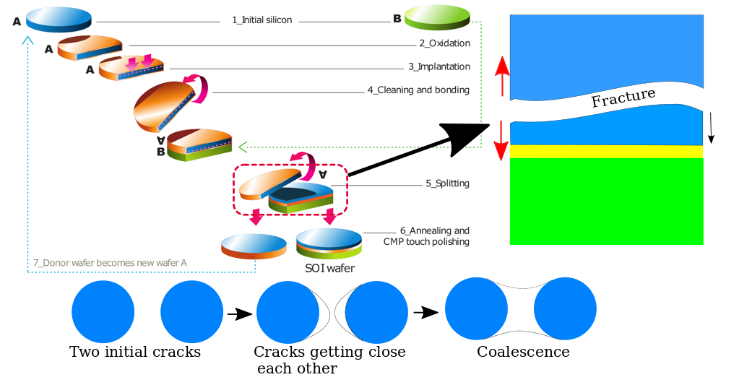
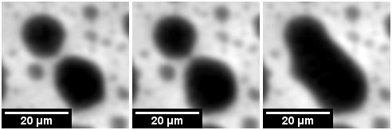
Context and motivations
Smart-CutTM, SOI, Coalescence phenomenon
Smart CutTM: technological process of transfering a thin layer from one substrate on to another;
SOI (Silicon-On-Insulator): transfer of a thin layer of silicon on to a substrate (=> SOITEC);
Applications: starting material for electronic devices;
Fabrication of SOI using Smart CutTM [SUT10]
[SUT 16] D. Sutula. Energy minimising multi-crack growth in linear-elastic materials using the extended
nite element method with application to Smart-CutTM silicon wafer splitting (2016).
[COL 21] L. Colonel, F. Mazen, D. Landru, O. Kononchuk, N. Ben Mohamed, and F Rieutord, In situ observation of pressurized microcrack growth in silicon , Physics Status Solidi A 221 (2021).
Observation of crack coalescence phenomenon using IR microscopy [COL 21]

Slide 4
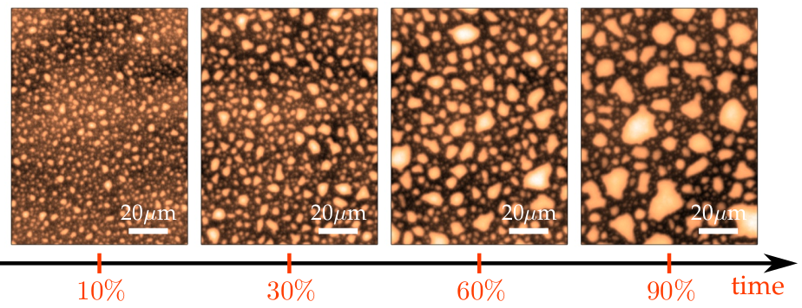
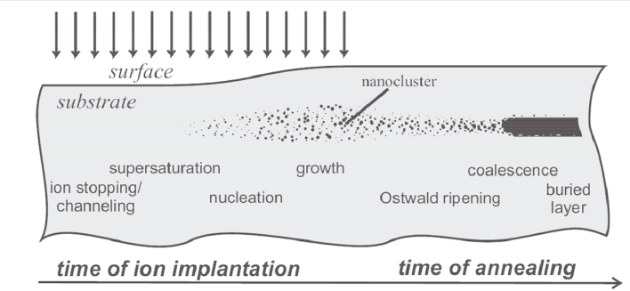
Context and motivations
Implantation and crack growth during annealing
Implantation : introduction of H-ions or He-ions creating a damaged zone and then platelets [PEN 10, SUT 16];
Implantation of H-ions inside the donor wafer [PEN 10]
Crack growth observation by optical microscopy [PEN 10]
Annealing: growth of platelets under internal H₂ gaz pressure;
Separation of the donor wafer during annealing due to the growth and coalescence of microcracks under H₂ internal gaz pressure.
[SUT 16] D. Sutula. Energy minimising multi-crack growth in linear-elastic materials using the extended finite element method with application to Smart-CutTM silicon wafer splitting (2016).
[PEN 2010] Fragilisation et dynamique de la rupture du silicium implanté, PhD thesis, Université de Grenoble, 2010.

Slide 5
Context and motivations
Problematics and objectives
Availability of experimental data on the Smart CutTM [PEN 10, MAS 15, DAG 18, COL 21];
The physics of crack evolution mechanisms difficult to be deduced from analytical approaches ;
Need of numerical approaches.
Main objectives:
Modeling 3D coalescence of cracks under pressure;
Predict internal pressure of a growing crack using a constitutive law in pressure;
Criteria of the coalescence of cracks;
Post-split and post-coalescence roughness.
Actual limitations :
Interactions effects on the coalescence of cracks;
Internal pressure of a growing crack;
Some 2D numerical approaches have been carried out [GER 10, SUT 16] but 3D models have been very less discussed.
[MAS 15] D. Massy, F. Mazen, S. Tardif, J. D. Penot, J. Ragani, F. Madeira, D. Landru, O. Kononchuk, and F. Rieutord, Fracture dynamics in implanted silicon ,
Applied Physics Letters 107 (2015), no. 9, 092102, Publisher: American Institute of Physics.
[DAG 18] N. Daghbouj, N. Cherkashin, and A. Claverie, A method to determine the pressure and densities of gas stored in blisters: Application to H and He sequentialion implantation in silicon , Microelectronic Engineering 190 (2018), 54-56.
[SUT 16] D. Sutula. Energy minimising multi-crack growth in linear-elastic materials using the extended nite element method with application to Smart-CutTM silicon wafer splitting, PhD. Thesis (2016).

Slide 6
Outlines
Context and motivations
3D X-FEM formulation and discretization
Prediction of the pressure in the cracks
Application to the modeling of 3D crack coalescence
Conclusion and other expected applications

Slide 7
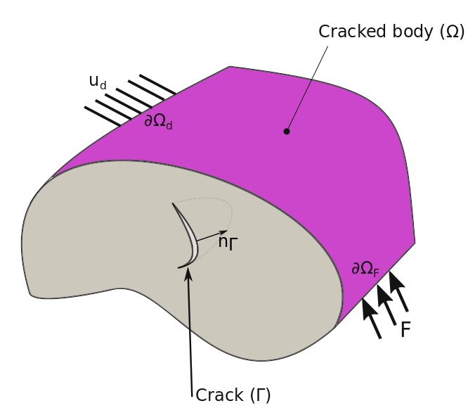
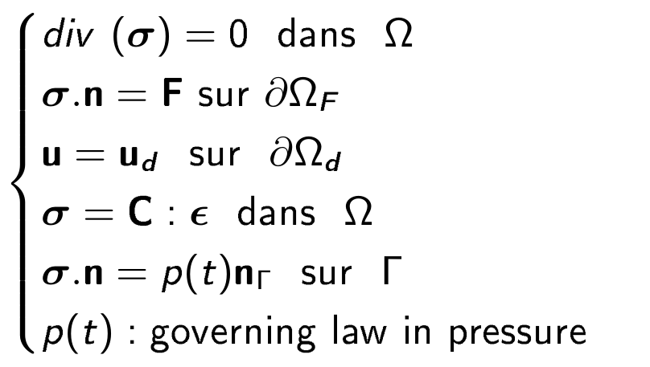
3D X-FEM formulation and discretization
Implantation and crack growth during annealing
Strong formulation:
Where C is the Hooke's tensor and σ the Cauchy stress tensor.
weak formulation:
3D cracked body [PAL 23]
With :
[PAL 23] E. PALI, A. Gravouil, Anne Tanguy , O. Kononchuk and D. Landru, Three-dimensional X-FEM
modeling of crack coalescence phenomena in the Smart CutTM technology, 2023.

Slide 8
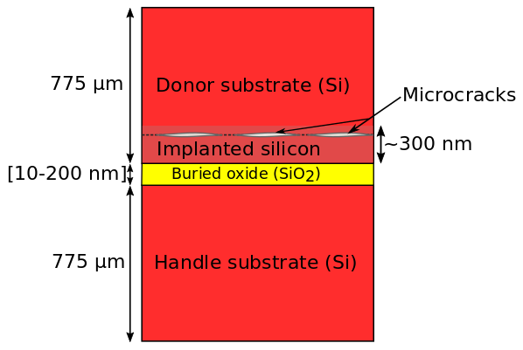
3D X-FEM formulation and discretization
Geometry and discretization aspects
Fractal mesh (Si)
Cross-section 2D representative geometry of SOI [PAL 23]
SiO₂ layer
Interest region
3D Fractal mesh using cast3M [PAL 23]
[PAL 23] E. PALI, A. Gravouil, Anne Tanguy , O. Kononchuk and D. Landru, Three-dimensional X-FEM
modeling of crack coalescence phenomena in the Smart CutTM technology, 20223.

Slide 9
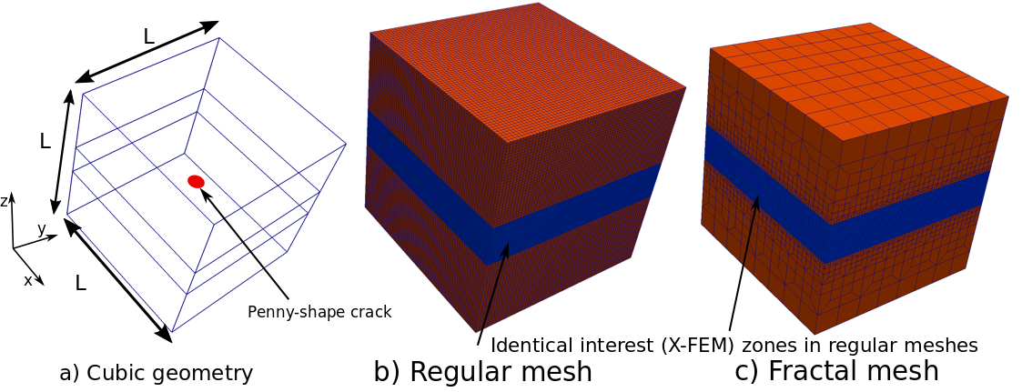
3D X-FEM formulation and discretization
Robustness and efficiency (gain in computation time)
Comparison of gain in CPU time: b) Structured regular mesh and c) Fractal mesh with interest zone discretized with regular mesh
⇒ Number of finite elements reduced on the entire mesh using fractal mesh with respect to structured regular mesh for the same discretisation of the interest zone[PAL 23];
⇒ About 90% gain in CPU time using fractal mesh with respect to structured regular mesh [PAL 23].

Slide 10
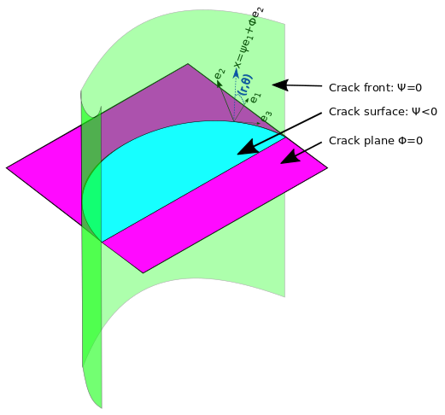
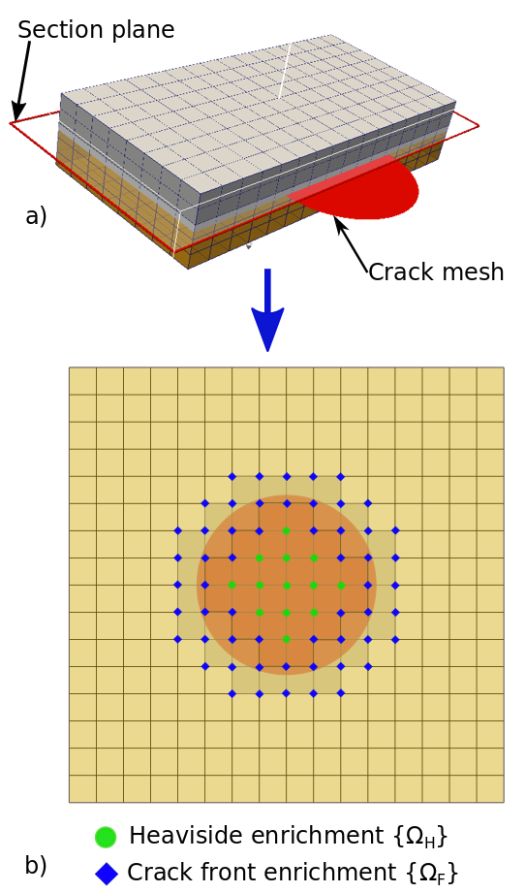
3D X-FEM formulation and discretization
Methods: X-FEM approach
X-FEM: eXtended Finite Elements Method [MOE 99] based on the partition of the unity approach [MEL 96];
Implicit representation of the crack (level sets [GRA 02]);
Explicit representation of the crack and enrichments :
Heaviside enrichment (H):
Crack front enrichment:
Displacement field approximation using X-FEM :
Implicit representation of the crack
(level sets).
Explicit definition of the crac and 3D enrichment technique.
[MOE 99] N. Moës, J. Dolbow, and T. Belytschko, A finite element method for crack growth without remeshing , International Journal for Numerical Methods in Engineering 46 (1999), no. 1, 131-150.
[GRA 02] A. Gravouil, N. Moës, and T. Belytschko, Non-planar 3D crack growth by the extended finite element and level sets-Part II: Level set update , Int. J. Numer. Methods in Eng. 53 (2002), no. 11, 2569-2586.

Slide 11
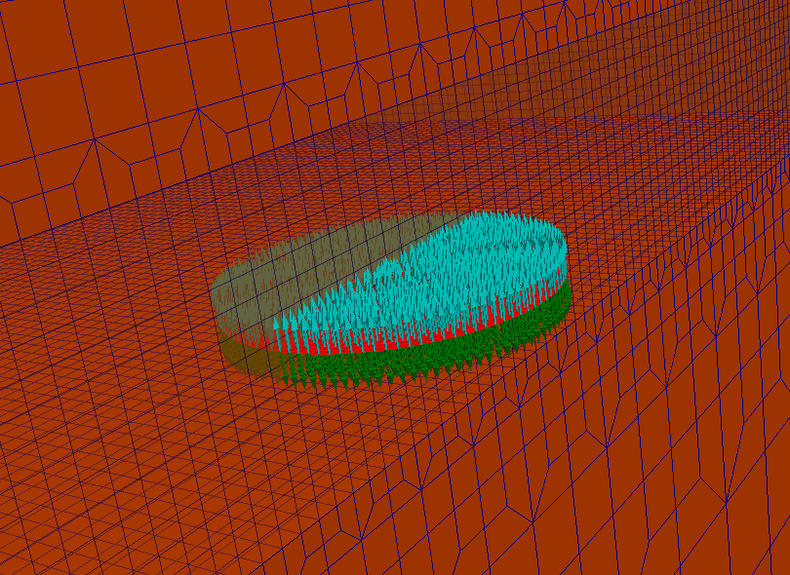
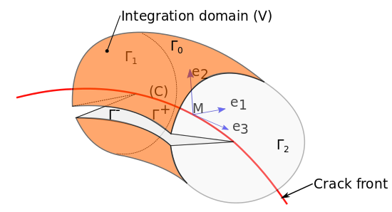
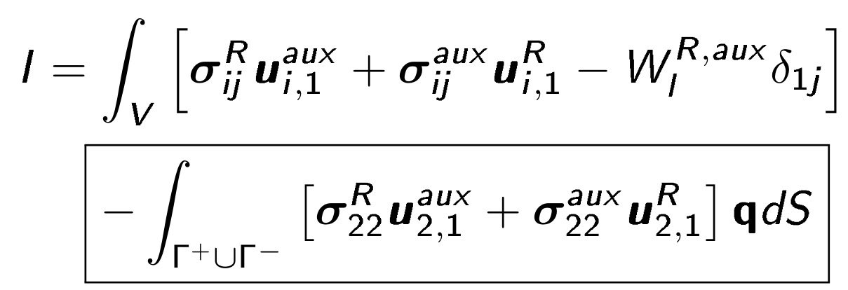
3D X-FEM formulation and discretization
Computation of stress intensity factors (SIFs)
Domain along the crack front:
Interaction integral to extract SIFs at both modes I, II and III (K_{I}, K_{II} and K_{III} respectively):
Interaction integral obtained taking into account internal pressure normal to crack faces expressed in the local basis [PAL 23, TRO 2013]:
Crack under internal pressure
Domain along the crack front to
integrate fields
Domain integral from Eshelby tensor Pij taking into account pressure on crack faces:
[TRO 2013] B. Trolé, Simulation multi-échelles de la propagation des fissures de fatigue dans les rails, PhD. Thesis, 2013.
[PAL 23] E. PALI, A. Gravouil, Anne Tanguy , O. Kononchuk and D. Landru, Three-dimensional X-FEM modeling of crack coalescence phenomena in the Smart CutTM technology, 20223.

Slide 12
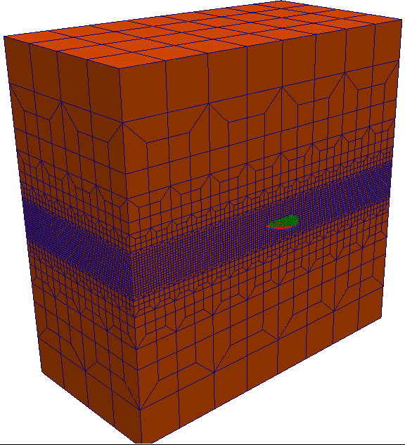
3D X-FEM formulation and discretization
Verification of X-FEM SIF computation with respect to analytical solution: model
Specifications for the model:
A penny-shape crack under internal pressure normal to its faces ;
Crack radius: R = 2µm (Diameter D = 4µm);
Cube of side 10D;
Applied pressure: P = 10 MPa;
Young's modulus: E = 138.6 GPa;
Poisson ratio: ν = 0.28;
Analytical solution of KI: and averaged error:
Penny-shape under internal pressure

Slide 13
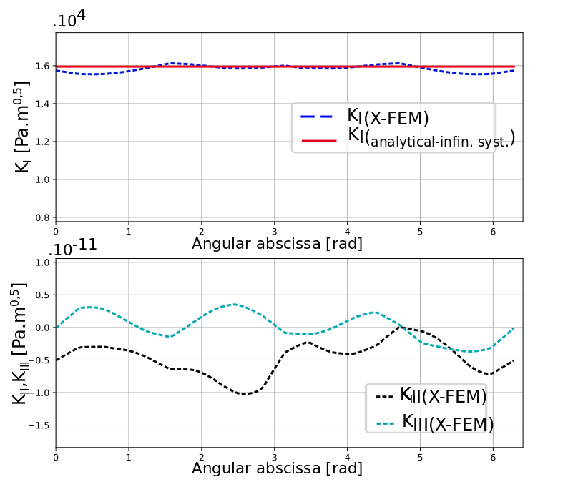
3D X-FEM formulation and discretization
Verification of X-FEM SIF computation with respect to analytical solution: results
Averaged relative error of K_{I}(X-FEM) with respect to its analytical value:
Averaged relative error on K_{I} = 0.7%
Good approximation of K_{I} with respect to its analytical value (relative error < 1%);
K_{II} << K_{I} and K_{III} << K_{I}: agreement to the loading in mode I;
SIFs along a penny-shape crack under pressure in mode I

Slide 14
Outlines
Context and motivations
3D X-FEM formulation and discretization
Prediction of the internal pressure in the cracks
Application to the modeling of 3D crack coalescence
Conclusion and other expected applications

Slide 15
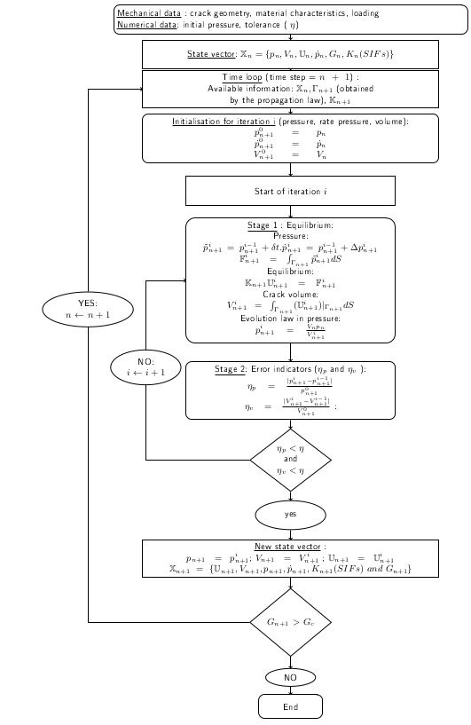
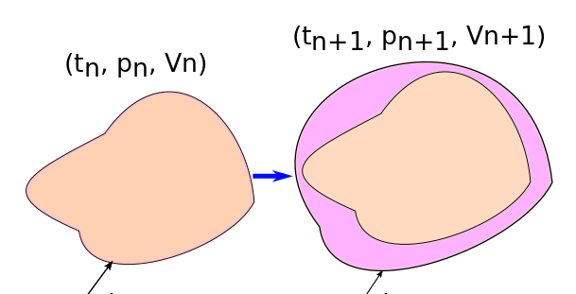
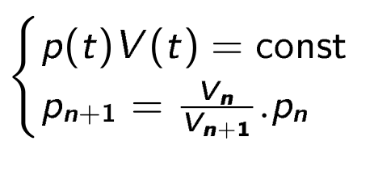
Prediction of the internal pressure in the cracks
Problem statement and X-FEM proposed algorithm
Idea: predict the pressure in a growing crack from an evolution law in pressure;
Crack at time step t_{n}.
Crack at time step t_{n+1}.
Proposed evolution law in pressure: the quantity of H₂ gaz in the crack remains constant:
Non-linear problem
An algorithm implemented in cast3M based on the Euler implicit method to predict pressure (p_{n+1}) at each time step (t_{n+1}) [PAL 23];
[PAL 23] E. PALI, A. Gravouil, Anne Tanguy , O. Kononchuk and D. Landru, Three-dimensional X-FEM modeling of crack coalescence phenomena in the Smart CutTM technology, 2023.
Flowchart

Slide 16
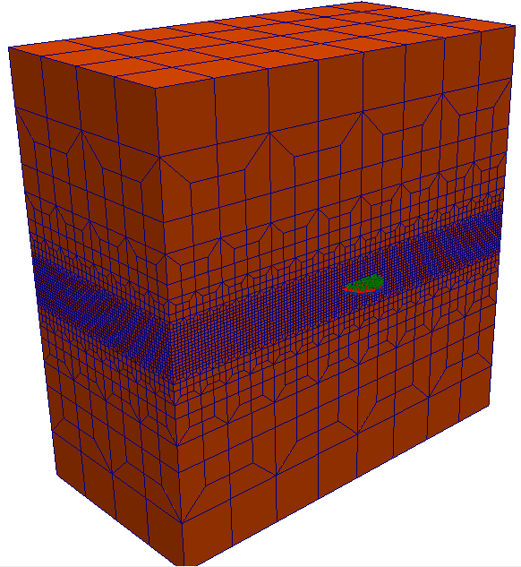
Prediction of the internal pressure in the cracks
Validation of the prediction of pressure
The incremental pressure (pn) in the crack at each time step (tn) is expressed analytically for a penny-shape crack in an infinite medium as follows [PAL 23]:
Example of an initial penny-shaped crack of radius R₀ = 2µm embedded in a cube;
Two test cases varying the initial pressure P₀ = {1.2P_{c} ; 1.5P_{c}} with Pc the critical pressure of a penny-shape [PEN 10]:
Where P₀ is the imposed initial pressure, V₀ the initial volume of the crack and Rn the crack radius at time step tn.
Six (6) values of the convergence tolerance tested: η = {10⁻¹, 10⁻², 10⁻³, 10⁻⁴, 10⁻⁵, 10⁻⁶}
Crack extension assumed to be proportional to (G-Gc), based on Griffith’s energy criterion:
X-FEM crack propagation using level sets as in [FRI 12];
[FRI 12] T.-P. Fries and M. Baydoun, Crack propagation with the extended finite element method and a hybrid explicit-implicit crack description: XFEM with a hybrid explicit-implicit crack description , Int. J. Numer. Meth. Engng 89 (2012), no. 12, 1527-1558.

Slide 17
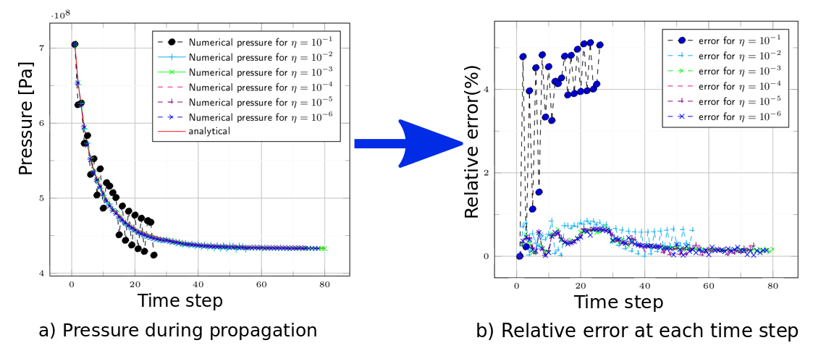
Prediction of the internal pressure in the cracks
Results: comparison to analytical solution [PAL 23]
Decrease of the pressure when the crack propagates;
Relative error between X-FEM approximation with respect to analytical solution less than 1% for small convergence tolerance ( η < 10⁻²);
The crack reaches a stability because of the decrease in pressure.
[PAL 23] E. PALI, A. Gravouil, Anne Tanguy , O. Kononchuk and D. Landru, Three-dimensional X-FEM modeling of crack coalescence phenomena in the Smart CutTM technology, 2023.

Slide 18
Outlines
Context and motivations
3D X-FEM formulation and discretization
Prediction of the pressure in the cracks
Application to the modeling of 3D crack coalescence
Conclusion and other expected applications

Slide 19
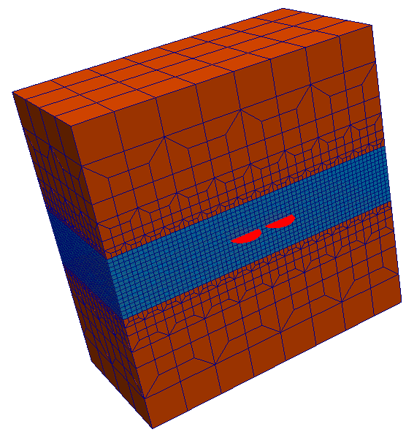
Application to the modeling of 3D crack coalescence
X-FEM discretization aspects
Explicit representation of the crack: no need to remesh the hole bulk when cracks get closer to each other;
The use of level sets and enrichments makes it possible to reach coalescence ;
Let us consider 2 penny-shape cracks of the same dimensions initially spaced by a certain distance embedded in a homogenous cube;
Cracks are initially submitted to pressure sufficient to allow the coalescence (P₀ = 2P_{c});
Application of the implicit algorithm to compute a new pressure at each time step.
Two (2) penny-shaped cracks in 3D
[PAL 23] E. PALI, A. Gravouil, Anne Tanguy , O. Kononchuk and D. Landru, Three-dimensional X-FEM modeling of crack coalescence phenomena in the Smart CutTM technology, 2023.

Slide 20
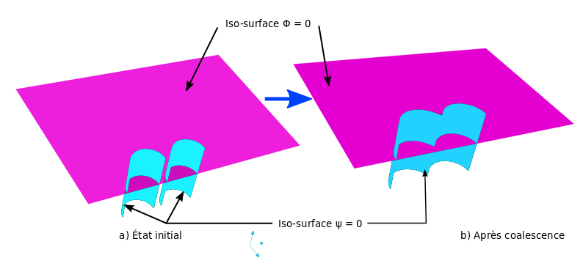
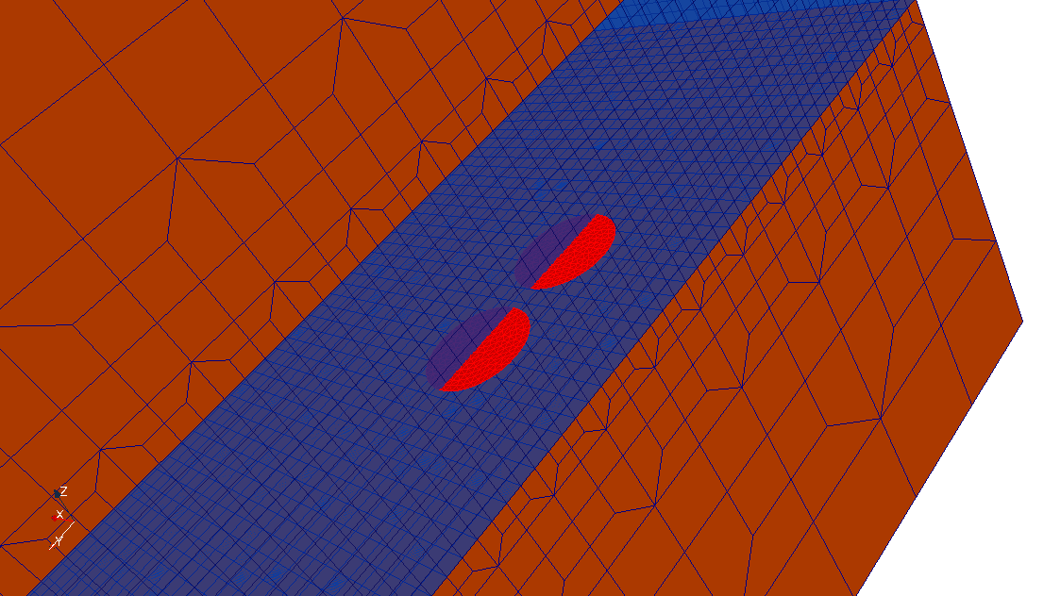
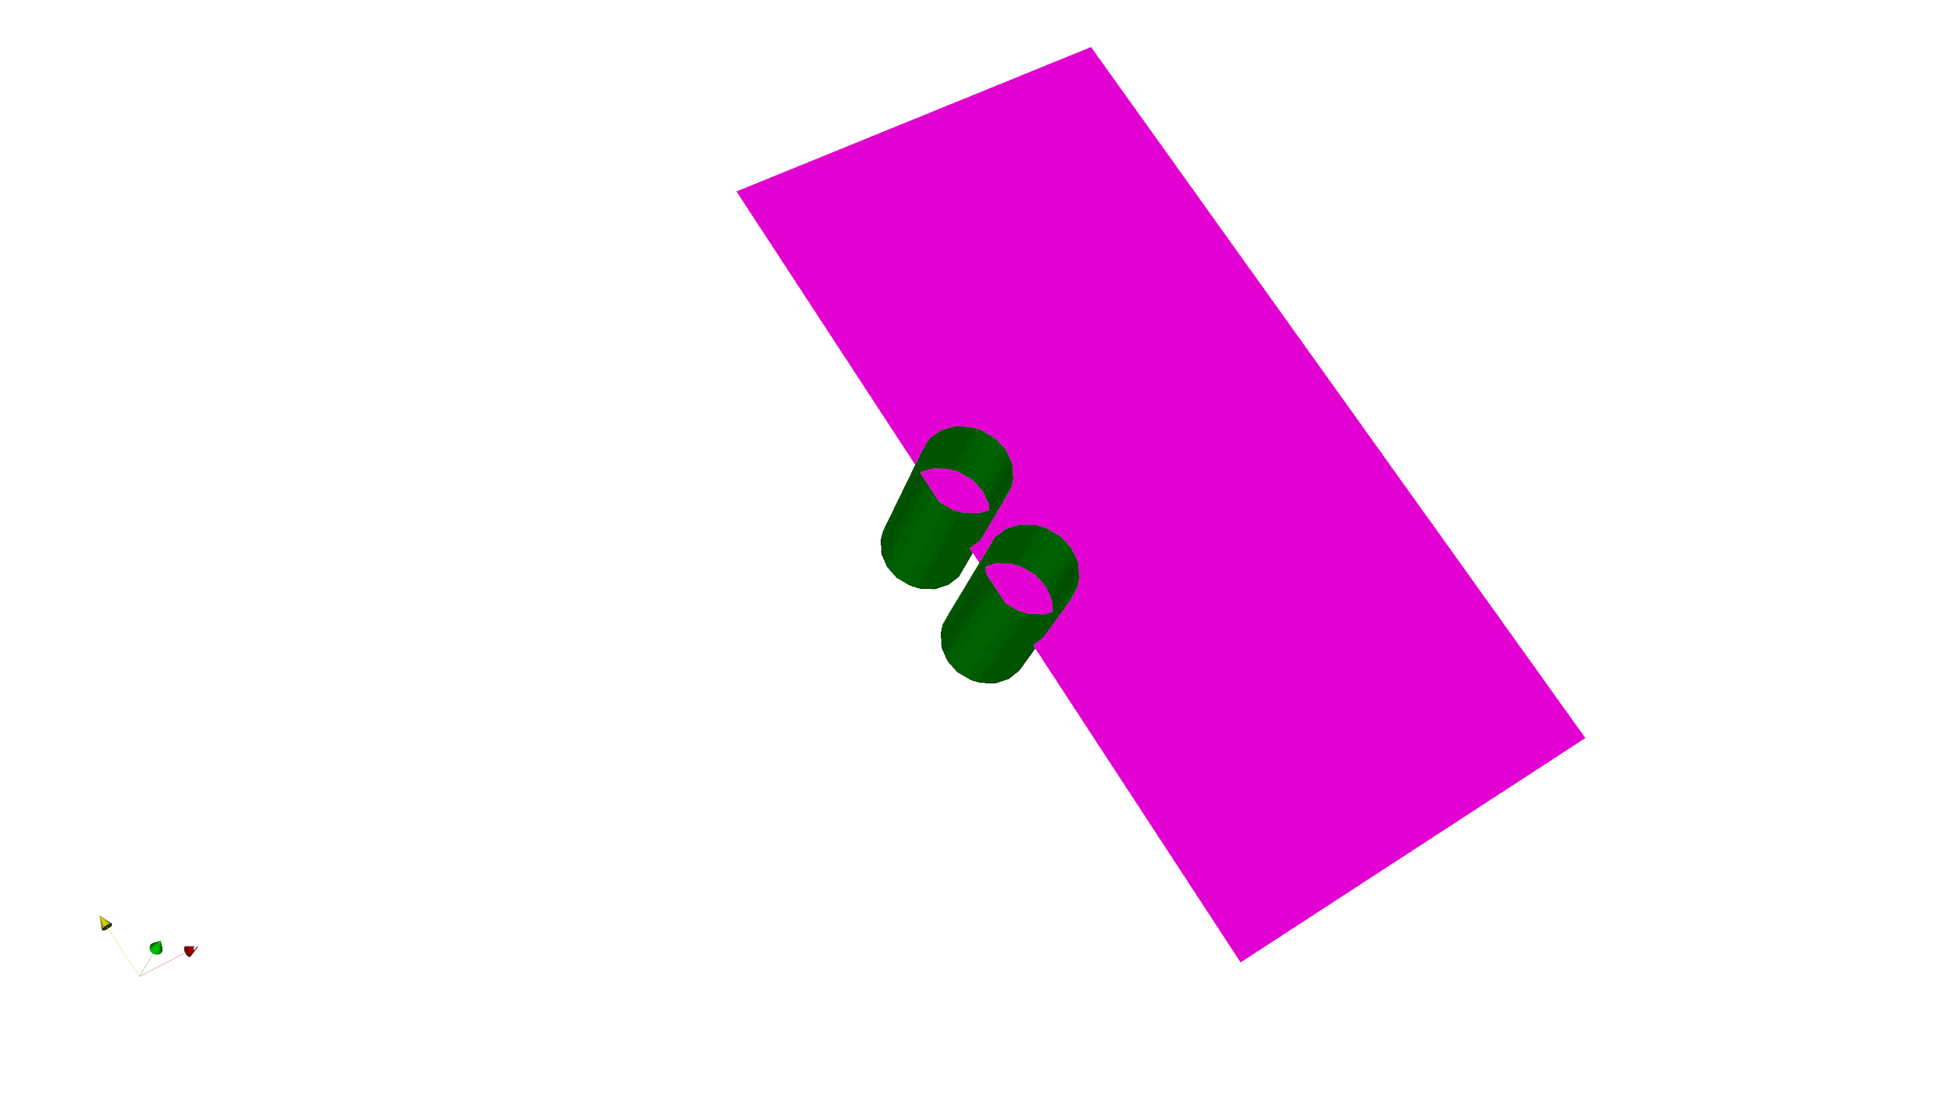
Application to the modeling of 3D crack coalescence
X-FEM discretization aspects
Illustration by level sets evolution [PALI 23]:
Illustration by the evolution crack mesh:
3D coalescence of two cracks
[PAL 23] E. PALI, A. Gravouil, Anne Tanguy , O. Kononchuk and D. Landru, Three-dimensional X-FEM modeling of crack coalescence phenomena in the Smart CutTM technology, 2023.

Slide 21
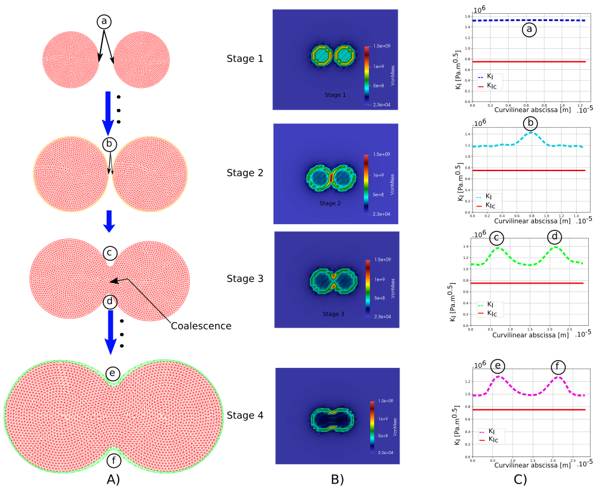
Application to the modeling of 3D crack coalescence
Qualitative analysis of stresses [PAL 23]
Stage 1: local stresses and KI almost uniform along crack fronts => neighboring effects negligible;
Stage 2: cracks get closer, maximum stresses are concentrated in regions where the crack fronts are closest inducing a local maximum of K_{I}: crack interaction effects;
Stage 3 and stage 4: after coalescence, maximum stresses and KI are now localize in regions of the resulting crack with negative curvatures (concavities); crack will advance preferentially in concave regions as experimentally observed in [COL 21].
[PAL 23] E. PALI, A. Gravouil, Anne Tanguy , O. Kononchuk and D. Landru, Three-dimensional X-FEM modeling of
crack coalescence phenomena in the Smart CutTM technology, 2023.
[COL 21] L. Colonel, F. Mazen, D. Landru, O. Kononchuk, N. Ben Mohamed, and F Rieutord, In situ observation
of pressurized microcrack growth in silicon , Physics Status Solidi A 221 (2021).
Stress evolution along the cracks [PAL 23]

Slide 22
Outlines
Context and motivations
3D X-FEM formulation and discretization
Prediction of the pressure in the cracks
Application of modeling of 3D crack coalescence
Conclusion and other expected applications

Slide 23
Conclusion and other expected applications
Key points:
Development of 3D fractal mesh to model cracks under pressure in the Smart CutTM: accuracy, robustness and efficiency;
Modified 3D interaction integral adapted to take into account internal pressure on crack faces in cast3M with X-FEM;
Implementation of an implicit algorithm to predict pressure in a propagating crack of any shape;
Modeling of 3D coalescence of two cracks using X-FEM.
Other expected applications:
Coalescence criteria of two cracks with identical or different sizes and relative orientations;
Roughness: post-fracture and post-coalescence;
Coalescence of multiple cracks with experimentally measured profiles;
Taking into account heterogeneities in material properties.

Slide 24
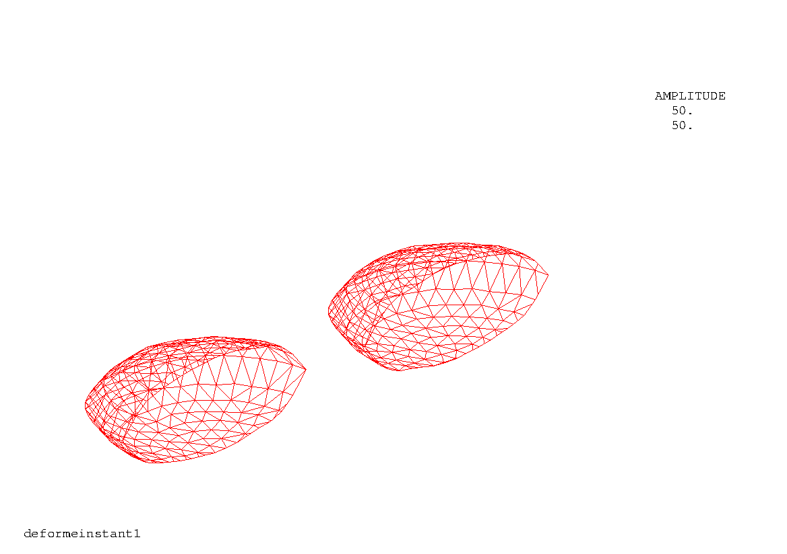
Thank you for your attention
Club Cast3M 2022
Special thanks for their contributions to:
Anthony Gravouil, Anne Tanguy, Didier Landru, Oleg Kononchuk, François Rieutord, Lucas Colonel, Damien Radisson, Jean-Marc Bethoux

Slide 25
E. PALI et al.
SOITEC-LaMCoS

