Slide 1

Numerical simulation of metallic surfaces during
Pulsed laser ablation for microthrusters
PRESENTED BY: CARL TAMERIAN – AUB
SUPERVISED BY: CHRISTOPHER NAHED – CEA, GHASSAN ANTAR - AUB
CLUB CAST3M - NOVEMBER 25, 2022

Slide 2


CONTENT
01.
02.
Overview of Laser Ablation
Underlying Physics
03.
04.
Numerical Methods
Experimental and Numerical model
05.
Simulation Results

Slide 3
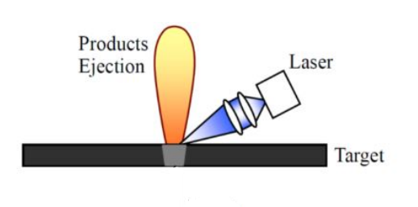
1.1 OVERVIEW OF LASER ABLATION
Laser-induced mass removal from an irradiated zone of a target material.
Causes rapid heating and phase change from solid to liquid to gas.
Laser pulses are classified into ultrashort and nanosecond pulses.
Used in various manufacturing fields including surface processing, welding applications; and aerospace propulsion technologies.

Slide 4
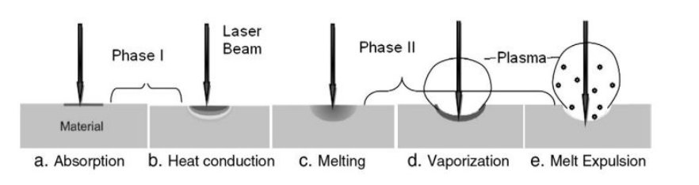
Microthrusters can provide very small and accurate thrust forces to maneuver microsatellites
They are characterized by their small volume and mass, low power requirements, and high specific impulse
Working principle:
- Energy from the laser photons heats up the irradiation zone causing rapid phase change from solid to liquid to gas.
- The gas transforms into plasma once the ionization energy is exceeded.
- The recoil force at the surface propels the system as per the momentum conservation principle.
1.2 MICROTHRUSTERS BASED ON PULSED LASER ABLATION

Slide 5

For nanosecond pulsed lasers, continuum heat transfer theories apply at this scale.
Heat flux equation over a constant control volume $Ω$: $ρ\left(T\right)C_{p}\left(T\right)\frac{∂T(x,y,z,t)}{∂t}−∇⋅\left[k\left(T\right)∇T\left(x,y,z,t\right)\right]=Q(x,y,z,t)$
Heat input absorbed by the material: $Q\left(x,y,z,t\right)=α\left(1−R\right)I_{s}(x,y,t)e^{−αz}$
Boundary conditions:
- Initial condition:$T{\left(x,y,z,0\right)}_{Ω}=T_{0}$
- Radiation at upper surface:${ \left(−λ∇T⋅n\right)}_{∂Ω}=ε(T)σ(T^{4}−T_{∞}^{4}$)
- Adiabatic at other surfaces: ${\left(−λ∇T⋅n\right)}_{∂Ω}=0$
- OR isothermal at other surfaces: $T{\left(x,y,z,t\right)}_{∂Ω}=T_{0}$
2.1 Governing equations

Slide 6
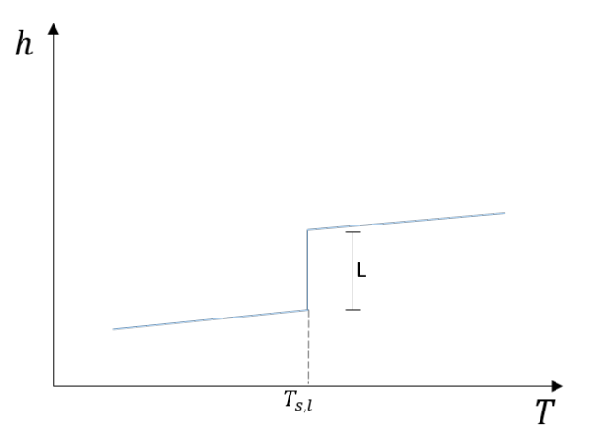
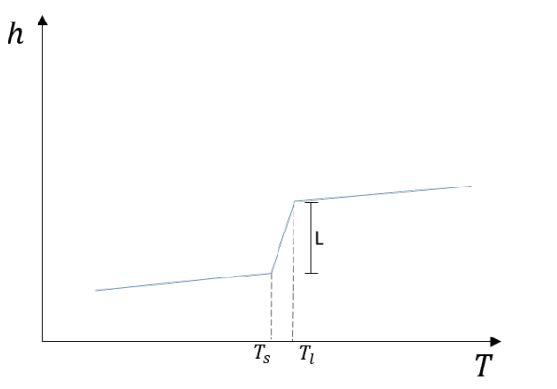
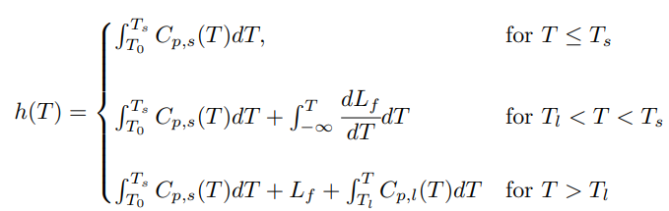
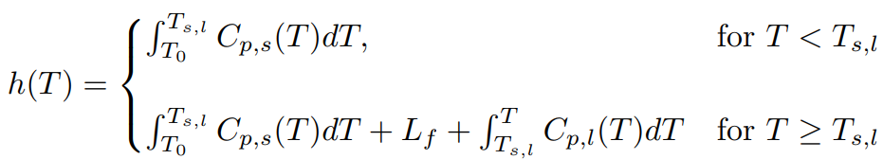
2.2 Solid – liquid phase change
Isothermal Phase Change | Phase Change over Mushy Zone
For idealized materials and pure metals | For metals with impurities or alloys

Slide 7


Once the boiling point of the material is exceeded, ablation is initiated, and surface material is removed.
Depending on the laser intensity, ablation might be due to surface evaporation alone or coupled with phase explosion.
The ablation rate (recession velocity) due to surface evaporation is represented by the Hertz-Knudsen relation:
Ablation depth is calculated by integrating the ablation rate over time
2.3 once ablation is initiated

Slide 8







The total recoil momentum is due to two contributions: pressure exerted by gas/plasma plume on the material and the pressure at the gas/liquid interface.
$M_{rec}=∫∫P_{rec }dAdt$, where $P_{rec }=P_{v}+P_{ev}−P_{∞}$
The pressure is discontinuous at the liquid-gas interface
Using the momentum conservation equation across $dΓ$:
${\left(ρ.u.\left(u.n\right)\right)}_{gas}−{\left(ρ.u.\left(u.n\right)\right)}_{liquid}=(σ_{gas}−$ $σ_{liquid}).n$
$$where σ=−P\text{𝕀}+μ\left(∇u+∇^{T}u−\frac{2}{3}∇⋅u\right)$$
$$σ_{gas}=−P_{gas}\text{𝕀} \left(μ≈0\right)$$
$$σ_{liquid}=−P_{liquid}\text{𝕀} (u≈0)$$
$$∴F_{rec,ev}=ρ_{gas}u_{gas}^{2}$$
Applying the mass conservation equation along $dΓ$: $u_{gas }=\frac{ρ_{liquid}\dot{s}}{ρ_{gas}}$
$$n⋅σ_{gas}$$
Gas/Plasma region
2.4 recoil forces
$$dΓ$$
$$u_{gas}$$
$$Γ$$
Liquid region
$$\dot{s}$$
$$n⋅σ_{liquid}$$

Slide 9
3.1 Introduction to numerical methods
Difficulty obtaining analytical solutions of our heat transfer model due to:
Complex material – laser – plasma interactions
Phase change
Thermophysical properties of the material are temperature dependent
Use of FEM to discretize the heat equation in space and time

Slide 10
Goals: Compute the ablation depth, the recoil force at the interface, and select the optimal material.
Numerical model: Simulate the ablation phenomenon on CAST3M
Obtain the temperature evolution profiles at critical points while accounting for phase change
Account for material removal once ablation is initiated
Compute the ablation depth and recoil force
Compare the performance of three metals: lead, copper, and aluminum
Experimental model: Conduct the PLA experiment at AUB Physics department – Fluid dynamics & Plasma lab
Measure the crater size to validate the numerical model
Measure the recoil force using an interferometer
4.1 OVERVIEW OF OUR PROJECT

Slide 11
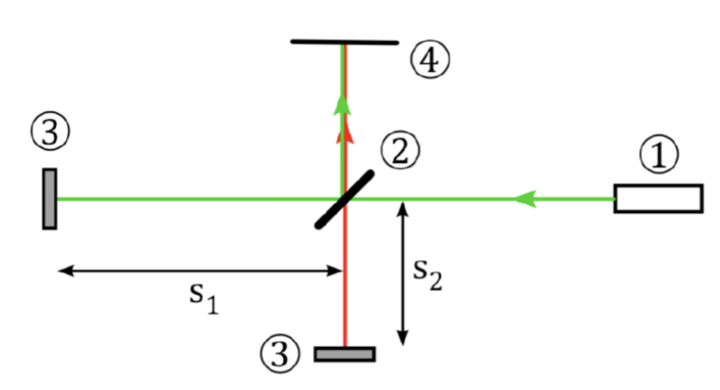
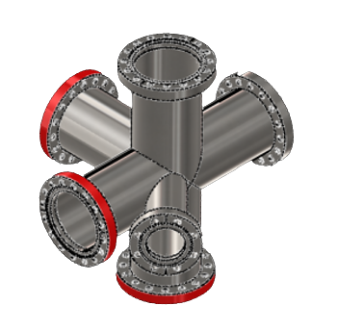
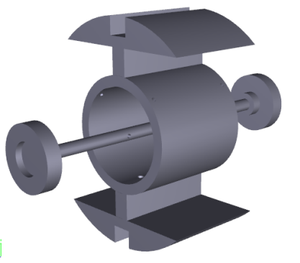
Interferometer:
Sensor that measures micronewton thrust by measuring the speed or displacement of the target.
The splitting and recombination of beams results in an interference pattern.
A high-speed camera captures the interference pattern to analyze the central fringe intensity and direction in which the fringes are moving.
The absolute displacement could be calculated from the phase shift of the sinusoidal mapping of the intensity.
Setup:
Vacuum chamber: lower tube connected to vacuum pump; right tube holds the pendulum with the target at the center; other tubes
for observation purposes.
Pendulum stand which holds the mirror on one end and the target material is on the other.
4.2 EXPERIMENTAL MODEL

Slide 12




4.3.1 NUMERICAL MODEL: CONDITIONS
$$z=h$$
$$x=l$$
The material has a volume of 1mm * 1mm * 10$μ$m
2D simulation in x and z with material size of 0.5mm * 10$μ$m
Mesh size: 1.25$μ$m along the horizontal, variable 10nm – 500 nm along the vertical
Timesteps: 5e-12 s
Initial Boundary condition: $T(x,z,0)=T_{0}$
Adiabatic boundary conditions:

Slide 13
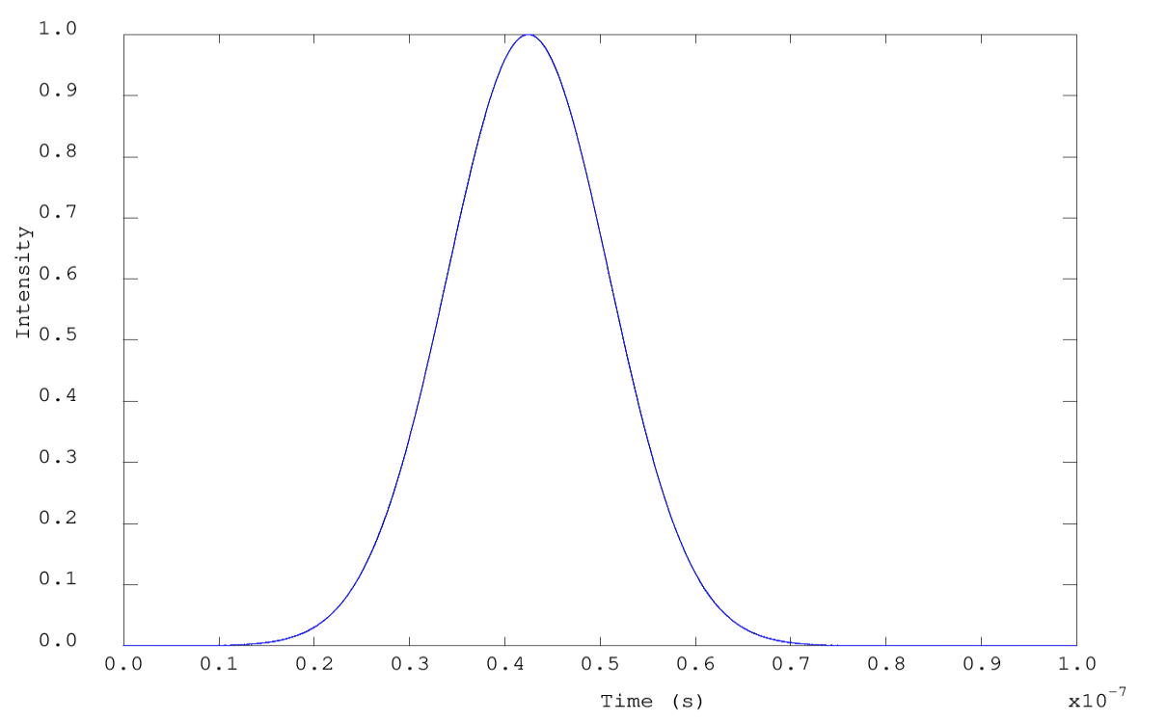
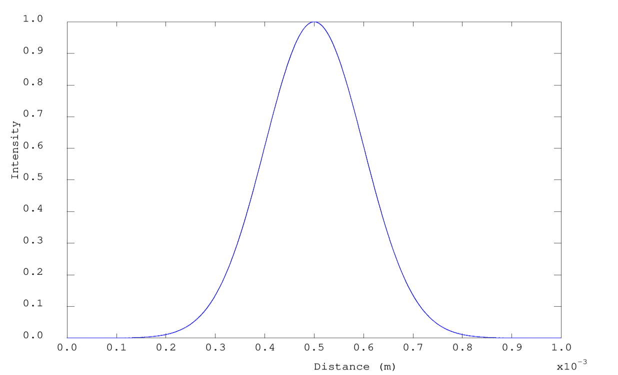



$$Q\left(x,y,z,t\right)=α\left(1−R\right)I_{s}(x,y,t)e^{−αz}$$
4.3.2 LASER PROFILE
Assuming that the laser irradiance is equivalent to the laser intensity
UV laser with $λ=308 nm$
The laser intensity can be fitted into a Gaussian distribution which varies exponentially in space and time
$I_{s}\left(x,y,t\right)=I_{0}e^{−\frac{{\left(x−x_{0}\right)}^{2}}{2σ_{x}^{2}}}$ $e^{−\frac{{\left(y−y_{0}\right)}^{2}}{2σ_{y}^{2}}}$ $e^{−\frac{{\left(t−t_{0}\right)}^{2}}{2σ_{t}^{2}}}$
Given the energy per pulse: $I_{0}=\frac{E}{{\left(2π\right)}^{3/2}σ_{x}{σ_{y}σ}_{t}}$
A laser with a smaller irradiation radius or smaller FWHM results in a larger intensity
$$FWHM=20 ns$$
$$σ_{x}={10}^{−4} m$$

Slide 14
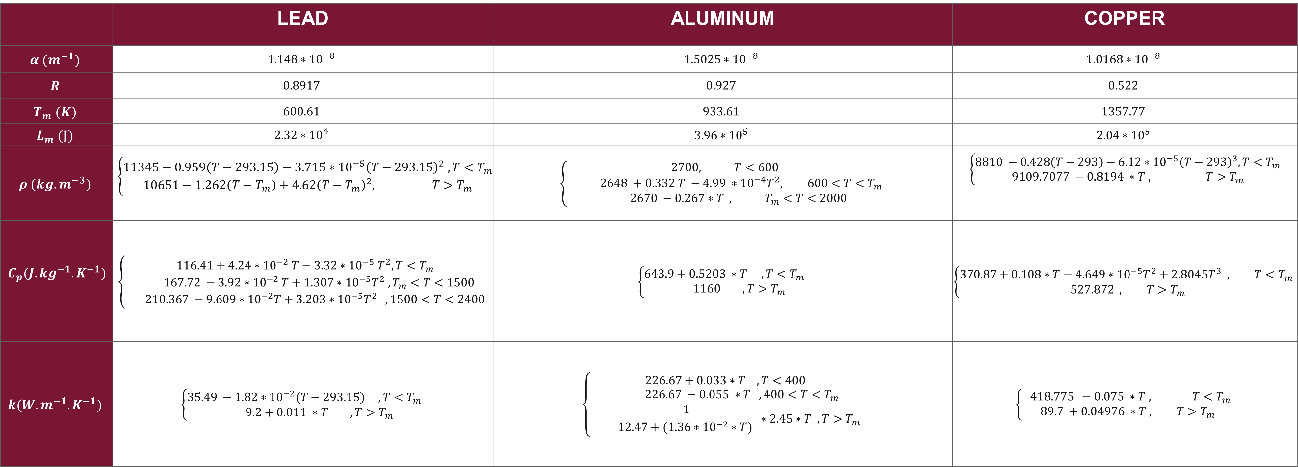
4.3.3 THERMOPHYSICAL and optical PROPERTIES OF DIFFERENT METALS
 | LEAD | ALUMINUM | COPPER
$$α (m^{−1})$$ | $$1.148∗{10}^{−8}$$ | $$1.5025∗{10}^{−8}$$ | $$1.0168∗{10}^{−8}$$
$$R$$ | $$0.8917$$ | $$0.927$$ | $$0.522$$
$$T_{m} (K)$$ | $$600.61$$ | $$933.61$$ | $$1357.77$$
$$L_{m} (J)$$ | $$2.32∗{10}^{4}$$ | $$3.96∗{10}^{5}$$ | $$2.04∗{10}^{5}$$
$$ρ (kg.m^{−3})$$ | $$\left\{\begin{aligned}11345−0.959\left(T−293.15\right)−3.715∗{10}^{−5}{\left(T−293.15\right)}^{2} , T<T_{m} \\ 10651−1.262\left(T−T_{m}\right)+4.62{\left(T−T_{m}\right)}^{2}, T>T_{m}\end{aligned}\right.$$ | $$\left\{\begin{aligned}2700, T<600 \\ 2648 +0.332 T −4.99 ∗{10}^{−4}T^{2}, 600<T<T_{m} \\ 2670 −0.267∗T , T_{m}<T<2000\end{aligned}\right.$$ | $$\left\{\begin{aligned}8810 −0.428\left(T−293\right)−6.12∗{10}^{−5}{\left(T−293\right)}^{3}, T<T_{m} \\ 9109.7077 −0.8194 ∗T , T>T_{m}\end{aligned}\right.$$
$$C_{p}(J.kg^{−1}.K^{−1})$$ | $$\left\{\begin{aligned}116.41+4.24∗{10}^{−2} T−3.32∗{10}^{−5}{ T}^{2}, T<T_{m} \\ 167.72 −3.92∗{10}^{−2} T+1.307∗{10}^{−5}T^{2} ,T_{m}<T<1500 \\ 210.367 −9.609∗{10}^{−2}T+3.203∗{10}^{−5}T^{2} , 1500<T<2400\end{aligned}\right.$$ | $$\left\{\begin{aligned}643.9+0.5203 ∗T , T<T_{m} \\ 1160 , T>T_{m}\end{aligned}\right.$$ | $$\left\{\begin{aligned}370.87+0.108∗T−4.649∗{10}^{−5}T^{2}+2.8045T^{3} , T<T_{m} \\ 527.872 , T>T_{m}\end{aligned}\right.$$
$$k(W.m^{−1}.K^{−1})$$ | $$\left\{\begin{aligned}35.49 −1.82∗{10}^{−2}(T−293.15) , T<T_{m} \\ 9.2+0.011 ∗T , T>T_{m}\end{aligned}\right.$$ | $$\left\{\begin{aligned}226.67+0.033∗T , T<400 \\ 226.67 −0.055 ∗T ,400<T<T_{m} \\ \frac{1}{12.47+(1.36∗{10}^{−2}∗T) } ∗2.45∗T , T>T_{m}\end{aligned}\right.$$ | $$\left\{\begin{aligned} 418.775 −0.075 ∗T , T<T_{m} \\ 89.7 +0.04976 ∗T , T>T_{m}\end{aligned}\right.$$

Slide 15
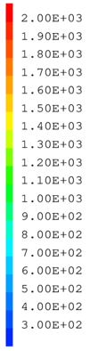
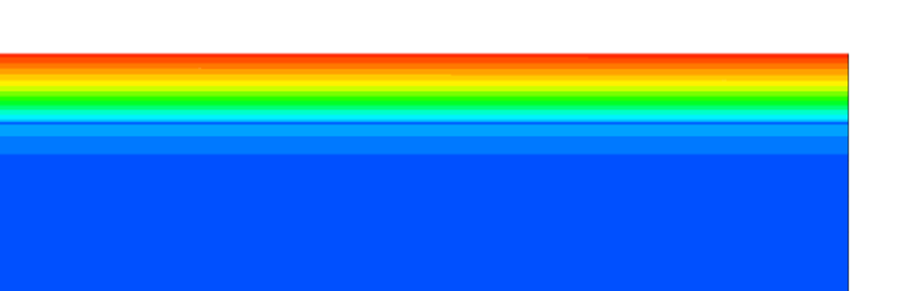
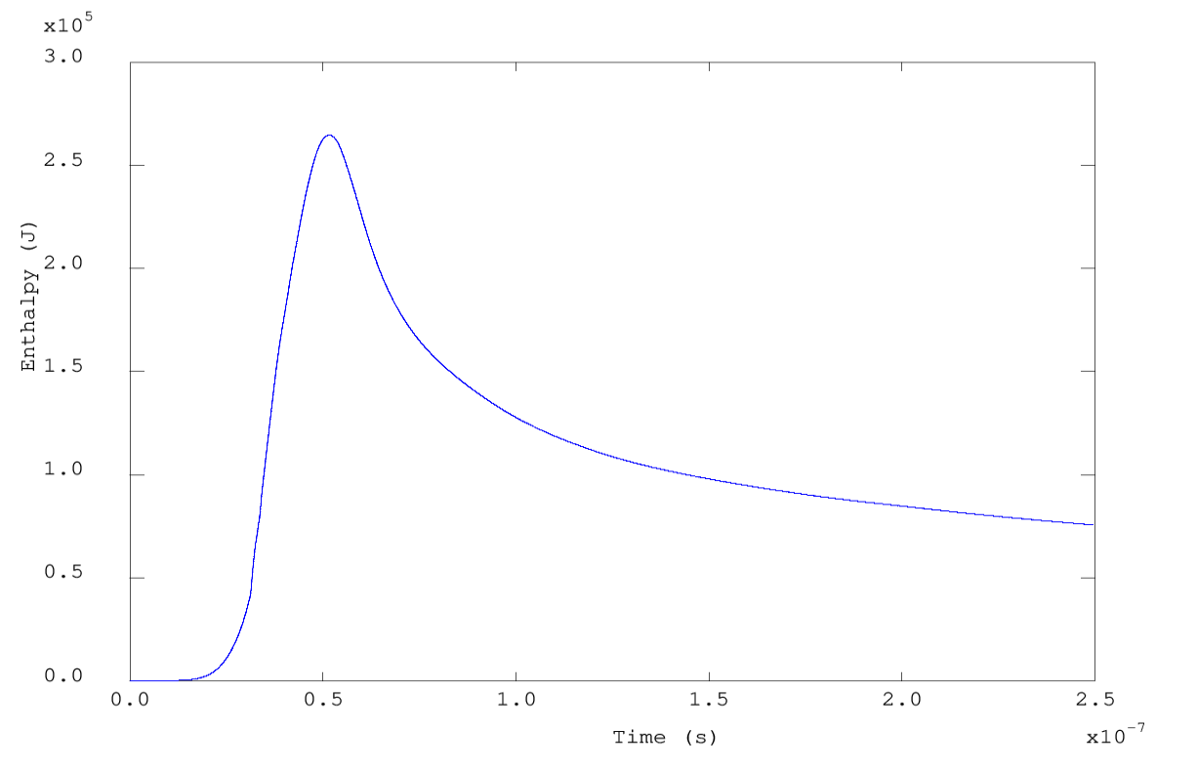
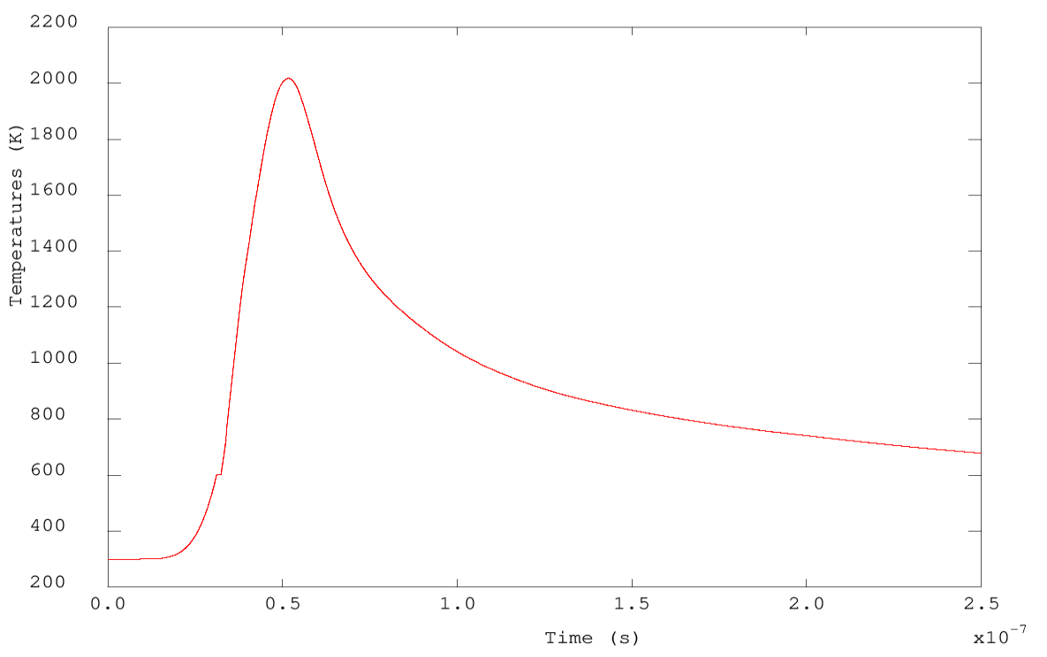
5.1 RESULTS FOR LEAD
S-L Phase Change

Slide 16
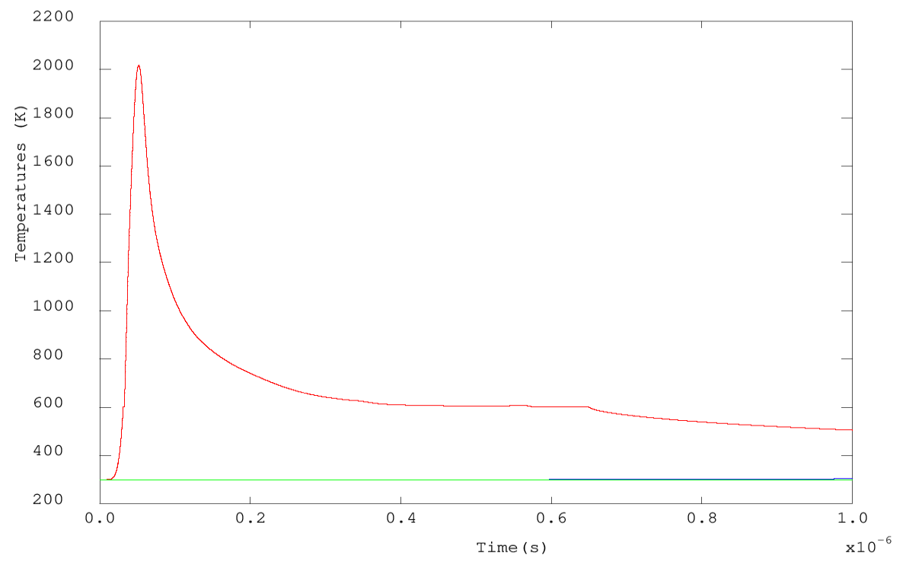
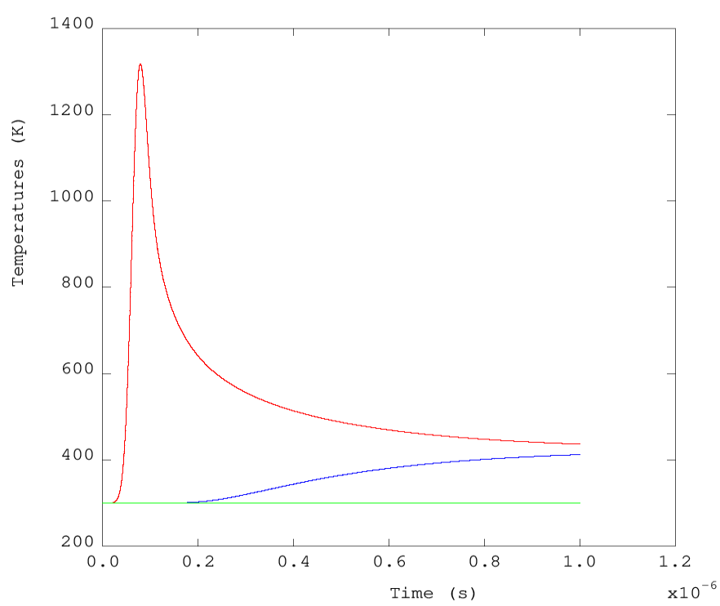
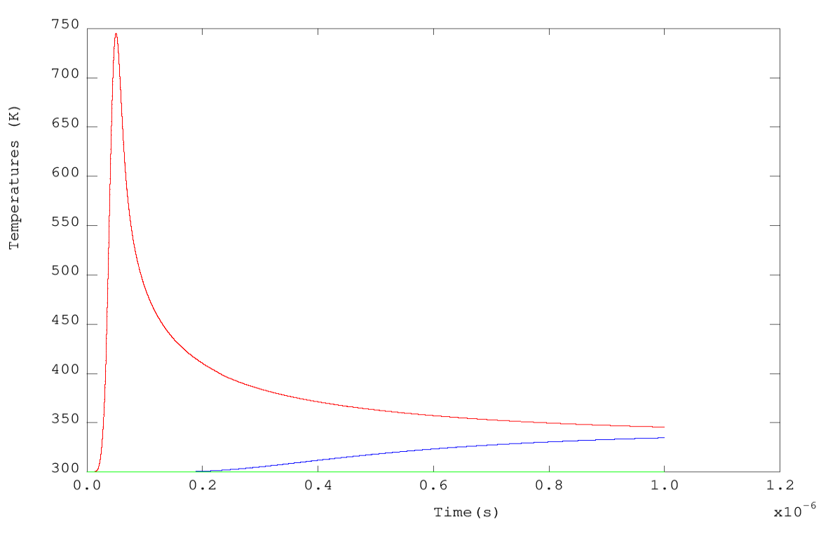


5.2 Comparison of temperature CURVES of lead, copper, and aluminum
$$T_{m}$$
$$T_{m}$$
LEAD
COPPER
ALUMINUM

Slide 17

Lead proves to have the optimal performance among copper and aluminum.
Thermal Response:
$T_{m, Pb}<T_{m,, Al}<$ $T_{m,, Cu}$
$L_{m, Pb}<L_{m, Cu}<L_{m, Al}$
$k_{Pb}<k_{Al}<k_{Cu}$
${\left(Fo\right)}_{Pb}<{(Fo)}_{Al}<{(Fo)}_{Cu}$ , where $Fo=\frac{ αt}{L_{c}^{2}}$ represents the heat conduction through the material relative to the heat stored
Recoil Force and Ablation Rate:
$ρ_{Pb, gas}$is the largest which results in a larger recoil force at the interface
$m_{Pb}$ is the largest which results in the greater ablation rate
6.1 CONCLUSIONS

Slide 18
6.2 FUTURE WORK
Verifying the results obtained via comparison with other time-integrator programs
Adding radiation as a boundary condition on the upper surface
Accounting for the gas phase and material removal
Calculating the instantaneous ablation rate to compute the ablation depth
Computing the recoil force at the interface
Comparing the simulation results with the experimental outcomes
Level-set method to capture the solid, liquid, and gas/plasma phases simultaneously

Slide 19
THANK YOU

