Slide 1


A Multiscale and Thermomechanical Modeling of Shape Memory Alloys using CAST3M
PhD student (Reporter): Xiaofei JU (xiaofei.ju@ensta-paris.fr)
Supervisor: Ziad MOUMNI (ziad.moumni@ensta-paris.fr)
Notes:
i am glad to be here today to present my work about ..

Slide 2
Contents
1
Backgrounds
2
Constitutive Equations
3
Numerical Implementation
4
Selected Results
Notes:
my talk will be in 4 parts

Slide 3
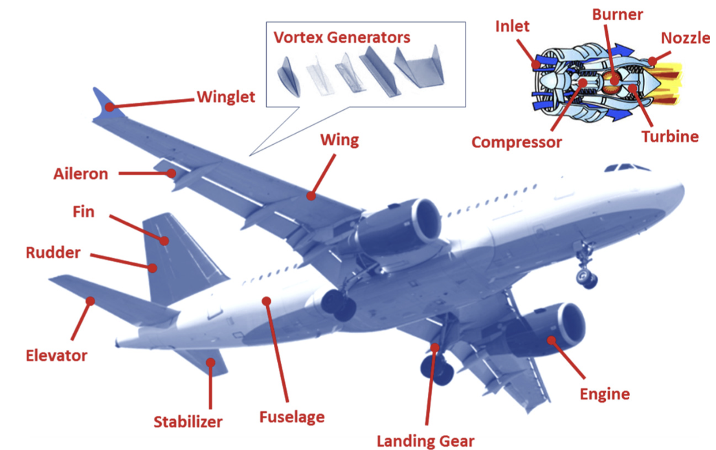
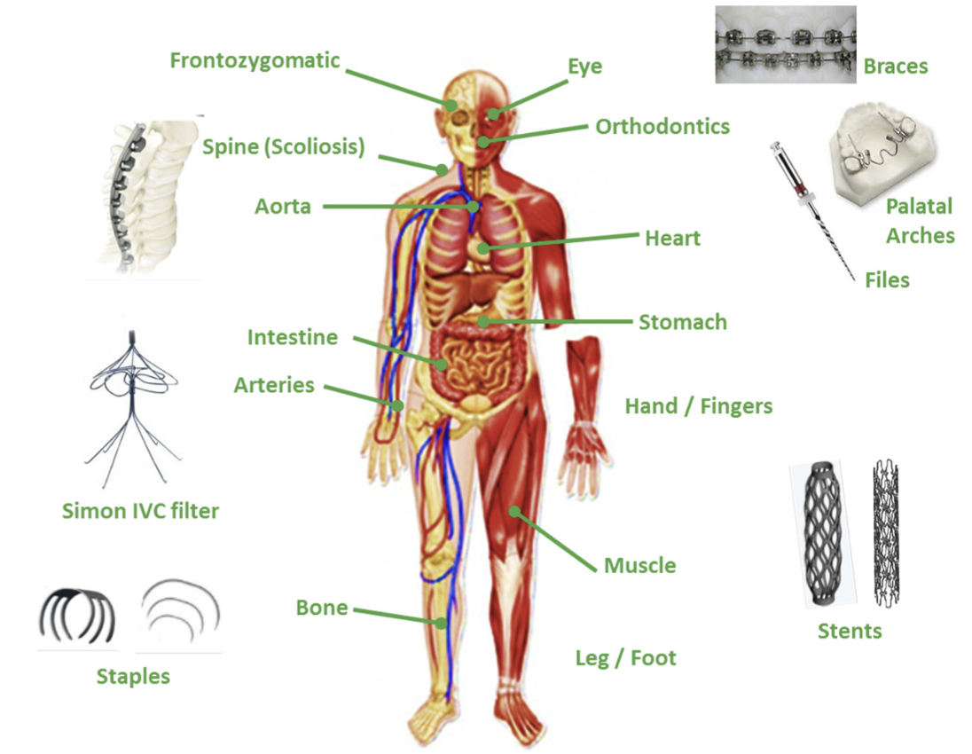
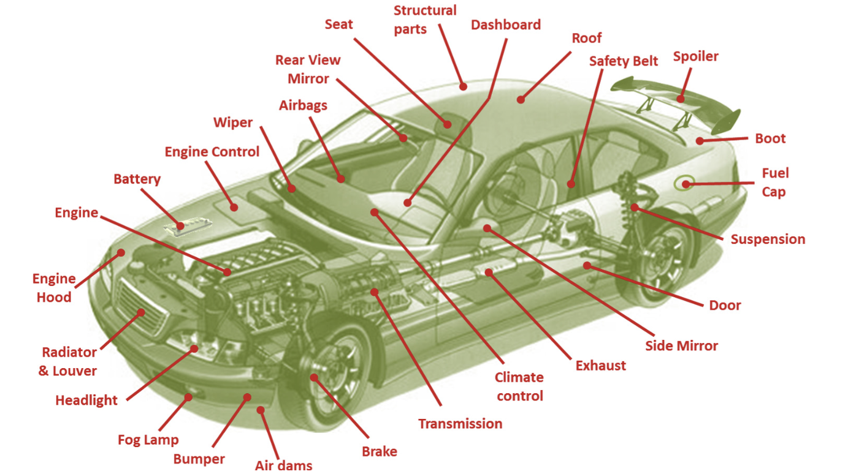
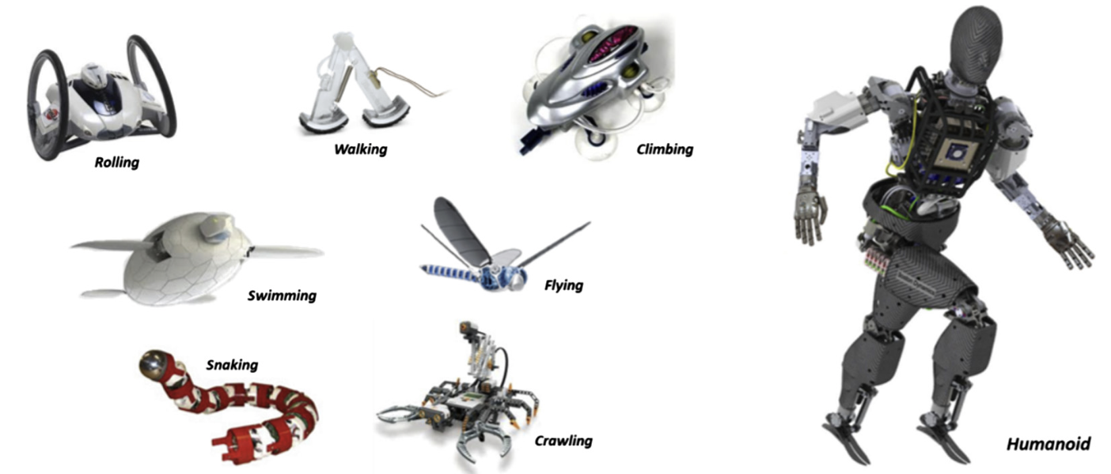
Backgrounds-NiTi Shape Memory Alloys (SMAs)
Unique Properties
Shape Memory Effect: Recover their shape by simple heating after being inelastically strained
Pseudoelasticity: Accommodate large recoverable inelastic strains (6-8%)
Applications
Biomedical
Aerospace
Automotive
Robotic
Promising Material in Applications of Biomedical, Aerospace…
Safety Problem Related with Cycle Fatigue Issue
A Micromechanical-based Model Required for Fatigue Analysis
Jani J M, Leary M, Subic A, et al. ,Materials & Design, 2014
Notes:
stent, orthodontic archwires
during these applications, the safety problem related with cycle fatigue issue becomes important.
We want to enhance their reliability and longevity against fatigue.
To this end, a micromechanical based model considers the physical mechanisms related with fatigue and able to describe the thermoechanical deformation behavior of smasis needed.

Slide 4

Backgrounds – Inelastic Mechanisms
Martensitic Transformation
A solid-solid phase change between cubic austenite and martensitic phase
Pseudoelasticity: T>$A_{f}^{0}$
Mechanical Response
Thermomechanical Coupling Effect
Notes:
Before we go to the model, let’s first have a look at the inelastic mechanisms exist in smas which will affect their fatigue
the first one is martensite transformation. Under thermomechanical loading, a solid to solid phase transformation between austenite and martensite occurs.
because of the involvement of phase transformation, fatigue issue of smass is complexed than conventional materials
we take pseudoelasticity as an example, and our work is mainly focus on this property
stress-temperature diagram in the left, when the temperature is higher than Af, a stress-induced phase transformation occurs. Under external loading, the material in initial austenite state transform to the martensite phase, from a to b. Upon unloading, it goes back from martensite to austenite, b to a. The mechanical response during this process is shown in right. a typical hesteresis loop due to phase transformation is shown. The sigma ms, mf is the critical stress for forward transformation while the sigma as and af is the critical stress for reverse transformation.
Such critical stress are temperature dependent, when the sample temperature increases, these critical stresses increase. cause the change in mechanical response. which will further cause the temperature change due to latent heat related with phase transformation and dissipation, and in turn changes the mechanical response.
this phenomenon is called thermomechanical coupling. it strongly influence the fatigue behavior of smas.

Slide 5
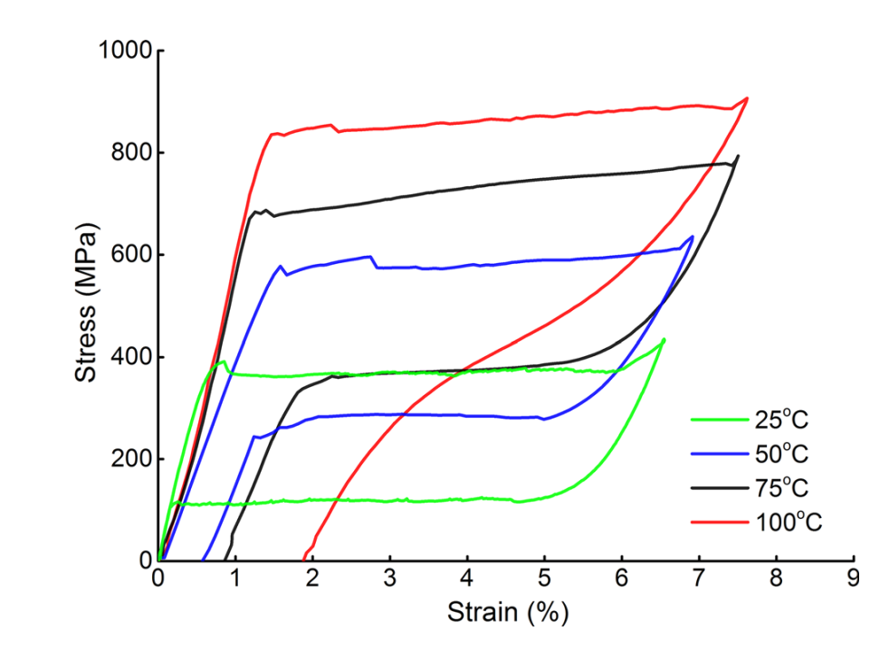
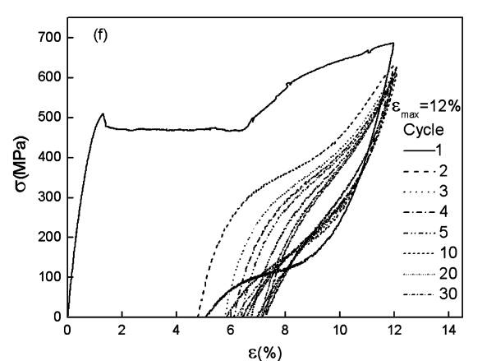
Backgrounds – Inelastic Mechanisms
Deformation Slip in Austenite
Deformation Twinning in Martensite
High Temperature
Large Strain
Xiao Y, Zeng P, Lei L, et al. Shape Memory and Superelasticity, 2015
Wang X, Xu B, Yue Z. Journal of Alloys and Compounds, 2008
Notes:
another two mechanisms that might affect fatigue behavior are the deformation occurs in austenite and martensite.
when test temperature is high, plastic slip occurs in austenite and lead to a large unrecoverable strain.
when the strain amplitude is large, deformation twinning occurs in martensite at higher stress level after the phase transformation plateau.

Slide 6
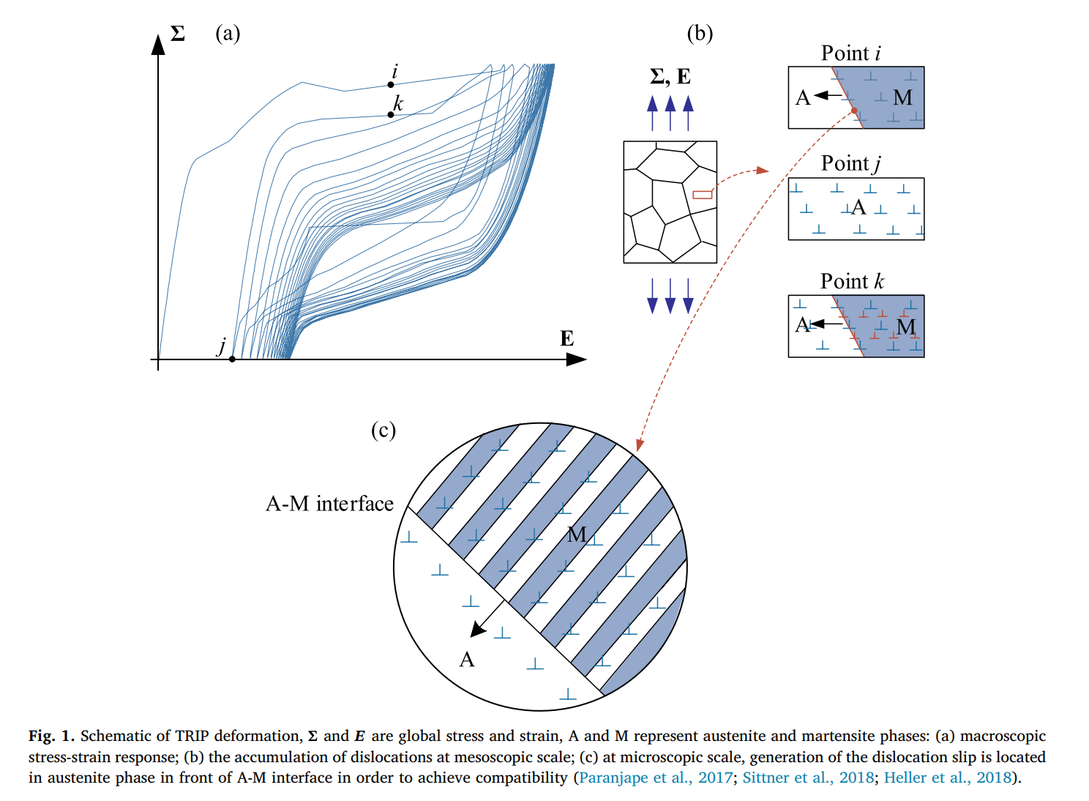
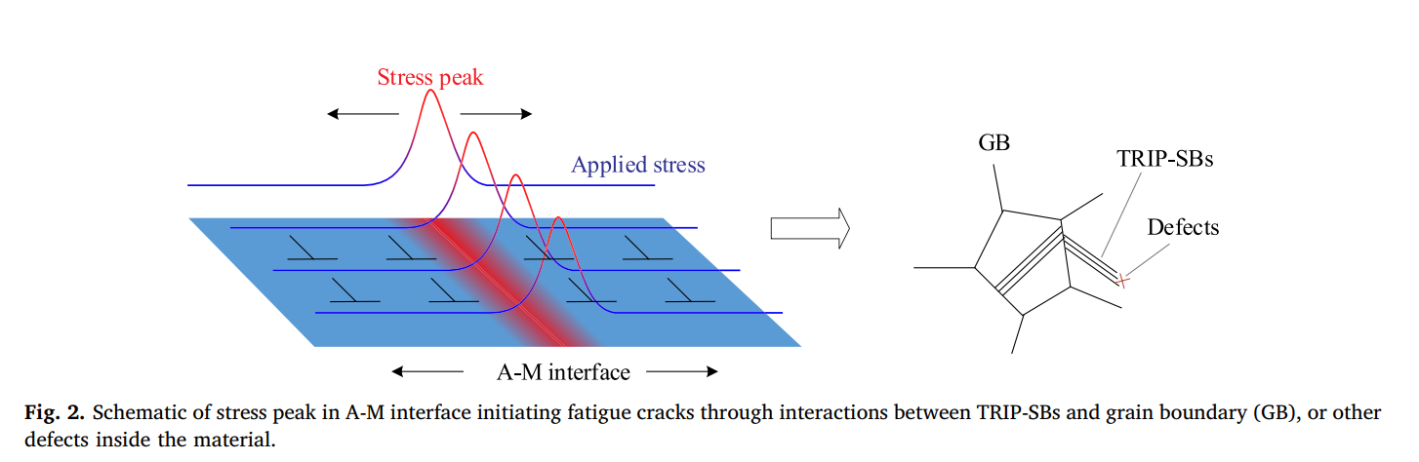
Backgrounds – Inelastic Mechanisms
Transformation-induced Plasticity (TRIP)
Zhang Y, Moumni Z, You Y, et al. International Journal of Plasticity, 2019
Notes:
The last inelastic mechanisms that affect fatigue behavior is transformation induced plasticity (trip)
during phase transformation, dislocation occurs at the interface of austenite and martensite due to the incompatibility of these two face.
with the movement of a-m interfaces, the dislocations spread throughout the transformed regions

Slide 7
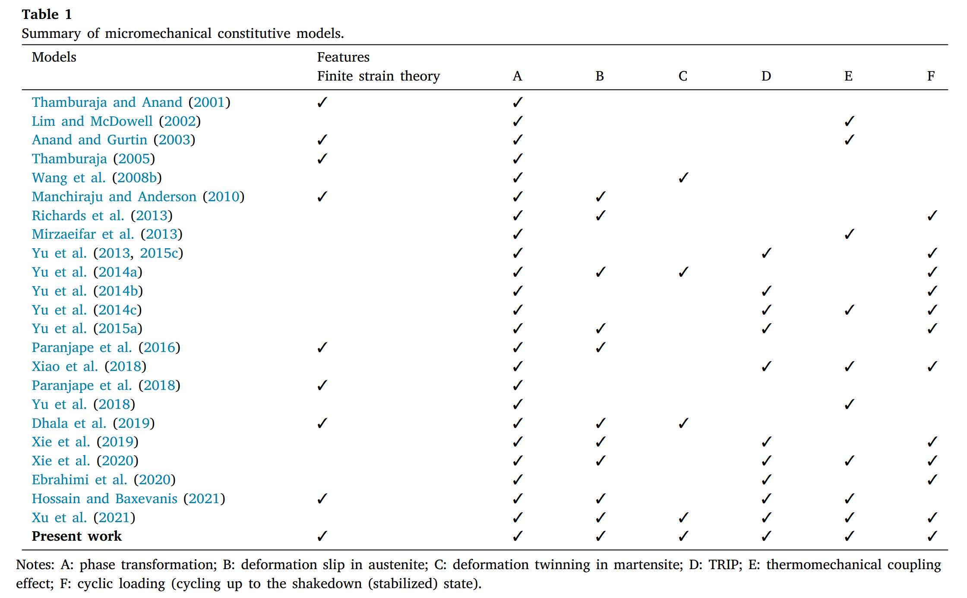
Motivations - Originality
Notes:
there are many micromechaincal models in the literature, here gives a summary of them and also the inelastic mechanisms they considered….
despite the fact that smas are often subjected to large strain, not many of the models are based on finite strain theory. among them, none of the model considers all the mechanisms listed.
In order to address this issue, we propose a model based on crystal plasticity and finite strain thoery, and takes into consideration of all the mechanisms may affect the fatigue behavior, this will help the further development of fatigue criterion.
it shows the originality of the work

Slide 8
Contents
1
Backgrounds
2
Constitutive Equations
3
Numerical Implementation
4
Selected Results

Slide 9
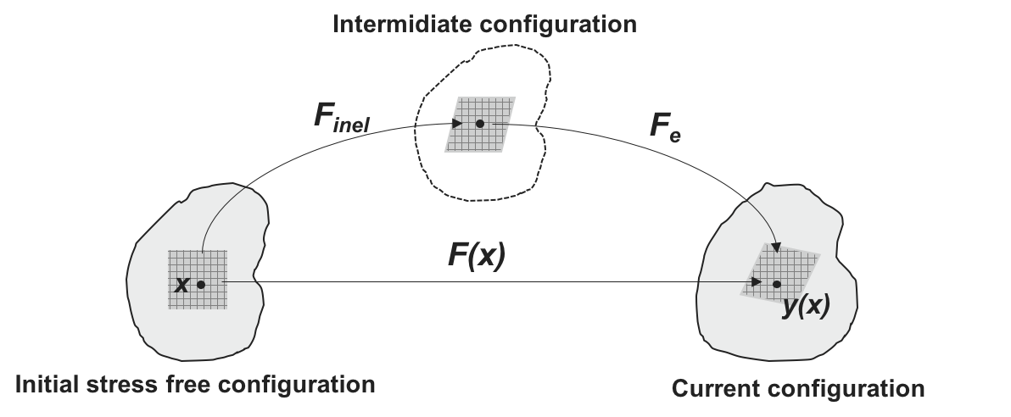
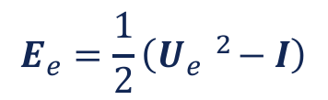



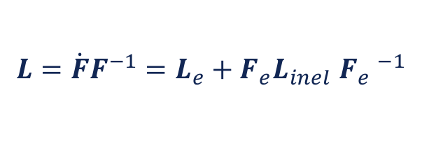



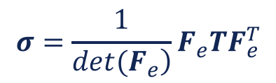
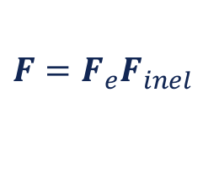


Constitutive Equations
Main Equations
Hooke’s Law
$$T=ℂ:E_{e}$$
Cauchy Stress$σ$
$$σ=\frac{1}{\left.det(F_{e}\right)}F_{e}TF_{e}^{T}$$
Velocity Gradient $L$
Deformation Gradient $F$
$$L=\dot{F}F^{−1}=L_{e}+F_{e}{L_{inel}}_{ }F_{e} ^{−1}$$
$$F=F_{e}{F_{inel}}_{ }$$
Elastic Green Strain $E_{e}$
Inelastic Part of $L$
$$E_{e}=\frac{1}{2}\left(U_{e} ^{2}−I\right)$$
$$L_{inel}≈L_{p}^{A}+L_{tr}+L_{trip}+L_{p}^{M}$$
while
$$F_{e}=R_{e}U_{e}$$
Notes:
the model is in a finite strain framework.
based on continuum mechanics, f is multiplicatively decomposed into elastic part and inelastic part.
then the elastic green strain can be obtained in terms of fe.
second Piola-Kirchoff stress T based on hooke’s law.
and then related T to the cauchy stress through this formula.
Linel is estimated by the sum of contributions from the 4 inelastic mechanisms

Slide 10
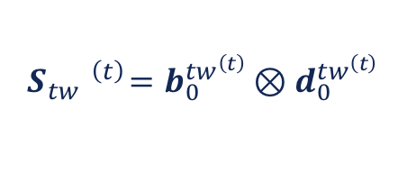
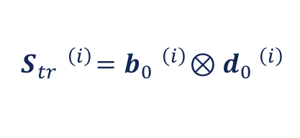
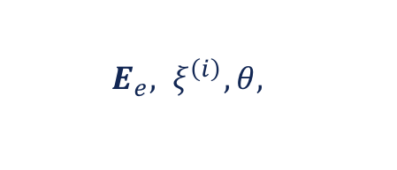

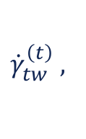
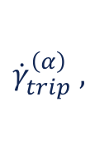

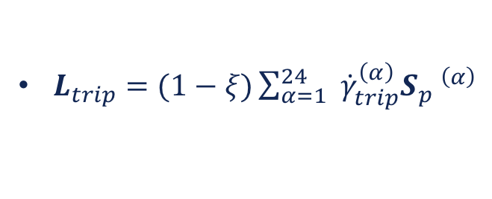
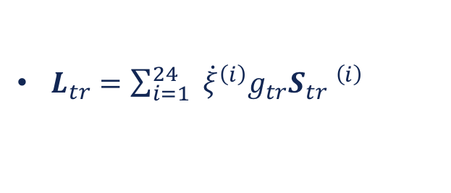

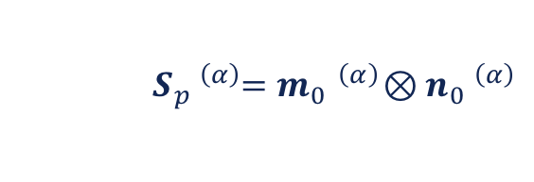
Constitutive Equations
Main Equations
$$L_{inel}≈L_{p}^{A}+L_{tr}+L_{trip}+L_{p}^{M}$$
Orientation Tensor
$${ S}_{p} ^{\left(α\right)}=m_{0} ^{\left(α\right)}⊗n_{0} ^{\left(α\right)}$$
$$S_{tr} ^{\left(i\right)}=b_{0} ^{\left(i\right)}⊗d_{0} ^{\left(i\right)}$$
$L_{p}^{A}=(1−ξ)\sum_{α=1}^{24}{ } {\dot{γ}}_{A}^{\left(α\right)}S_{p} ^{\left(α\right)}$
$$S_{tw} ^{\left(t\right)}=b_{0}^{tw^{\left(t\right)}}⊗d_{0}^{tw^{\left(t\right)}}$$
$L_{tr}=\sum_{i=1}^{24}{ } {\dot{ξ}}^{\left(i\right)}g_{tr}S_{tr} ^{\left(i\right)}$
State Variables
$L_{trip}=(1−ξ)\sum_{α=1}^{24}{ } {\dot{γ}}_{trip}^{\left(α\right)}S_{p} ^{\left(α\right)}$
$${\dot{γ}}_{A}^{\left(α\right)},$$
$${\dot{γ}}_{tw}^{\left(t\right)},$$
$${\dot{γ}}_{trip}^{\left(α\right)},$$
$$B_{int}$$
$$E_{e},{ ξ}^{\left(i\right)}, θ,$$
$L_{p}^{M}=ξ\sum_{t=1}^{11}{ } {\dot{γ}}_{tw}^{\left(t\right)}S_{tw} ^{\left(t\right)}$
Notes:
Based on crystal plasticity theory, plastic deformation is modeled in terms of crystallographic slip at grain scale
We take lpa as an example, gamma a , sp represent, xi represent, on all slip systems/ transformation systems:
so the whole term represents sum of the shear rates on all slip systems in austenite:
similar formula are used for the ltr, ltrip and lpm
slip rate of each austenite system
orientation tensor
m-burger vector
n-normal vector to the slip plane
resolved shear stress
the whole term represents the sum of the shear rate on each slip system
﻿Crystal plasticity is an inherently multi-scale process starting at the atomic scale (dislocation cores)
towards substructural dislocation arrangements in a single grain and up to the macroscopic mechanical
response of the material. Its multi-dimensional nature and a high practical importance build a space for
scientists and engineers working within various methodological domains

Slide 11
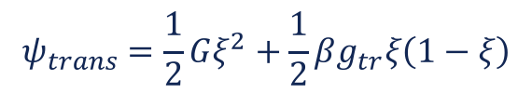
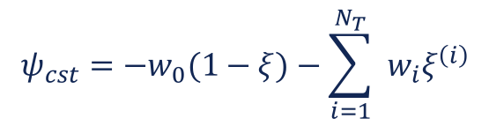

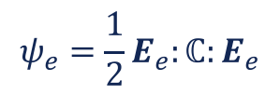
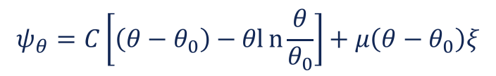

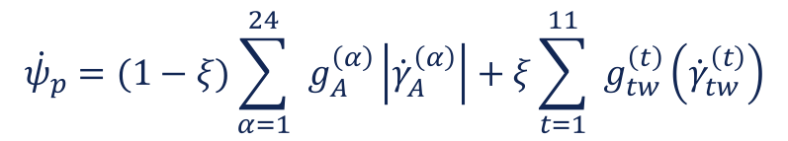
Constitutive relations
Helmholtz free energy density
$$ψ\left(E_{e},ξ^{\left(i\right)},θ\right)=ψ_{e}+ψ_{θ}+ψ_{int}+ψ_{p}+ψ_{trans}+ψ_{cst}$$
where,
$$ψ_{e}=\frac{1}{2}E_{e}:ℂ:E_{e}$$
$${\dot{ψ}}_{p}=(1−ξ)\sum_{α=1}^{24}{ } g_{A}^{\left(α\right)}\left|{\dot{γ}}_{A}^{\left(α\right)}\right|+ξ\sum_{t=1}^{11}{ } g_{tw}^{\left(t\right)}\left({\dot{γ}}_{tw}^{\left(t\right)}\right)$$
$$ψ_{θ}=C\left[\left(θ−θ_{0}\right)−θln{\frac{θ}{θ_{0}}}\right]+μ\left(θ−θ_{0}\right)ξ$$
$$ψ_{trans}=\frac{1}{2}Gξ^{2}+\frac{1}{2}βg_{tr}ξ\left(1−ξ\right)$$
$$ψ_{cst}=−w_{0}(1−ξ)−\sum_{i=1}^{N_{T}}{ } w_{i}ξ^{\left(i\right)}$$
$${\dot{ψ}}_{int}=−B_{int}:\left(L_{tr}+L_{trip}\right)$$
Notes:
elastic strain energy
chemical free energy related to transformation
energy associated with internal stress
energy of plastic deformation in austenite and martensite
contribution of interactions between austenite and martensite variants
the last term is the potential energy due to internal constraints

Slide 12



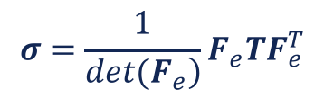
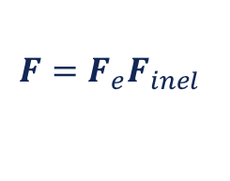
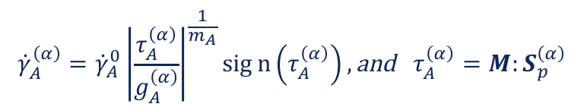
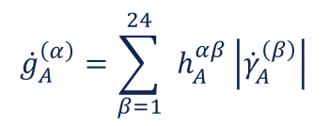
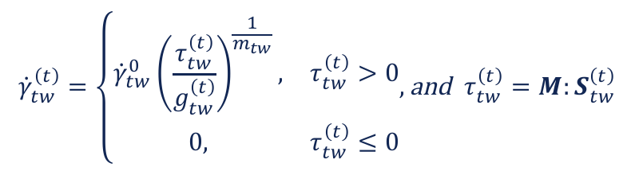
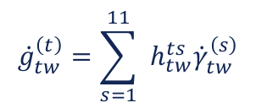
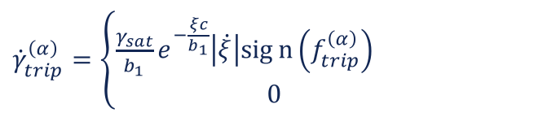

Constitutive relations
Evolution laws
Plasticity in austenite
Transformation induced plasticity (TRIP)
$${\dot{γ}}_{A}^{\left(α\right)}={\dot{γ}}_{A}^{0}{\left|\frac{τ_{A}^{\left(α\right)}}{g_{A}^{\left(α\right)}}\right|}^{\frac{1}{m_{A}}}sign\left(τ_{A}^{\left(α\right)}\right), \text{and} τ_{A}^{\left(α\right)}=M:S_{p}^{\left(α\right)}$$
$${\dot{γ}}_{trip}^{\left(α\right)}=\left\{\begin{aligned}\frac{γ_{sat}}{b_{1}}e^{−\frac{ξc}{b_{1}}}\left|\dot{ξ}\right|sign\left(f_{trip}^{\left(α\right)}\right) \\ 0\end{aligned}\right.$$
$$\text{when}{ SF}_{plastic}^{(α)}> {SF}_{critical}$$
$$\text{otherwise}$$
$${\dot{g}}_{A}^{\left(α\right)}=\sum_{β=1}^{24}{ } h_{A}^{αβ}\left|{\dot{γ}}_{A}^{\left(β\right)}\right|$$
Transformation
Plasticity in martensite
Transformation criteria
$${\dot{γ}}_{tw}^{\left(t\right)}=\left\{\begin{matrix}{\dot{γ}}_{tw}^{0}{\left(\frac{τ_{tw}^{\left(t\right)}}{g_{tw}^{\left(t\right)}}\right)}^{\frac{1}{m_{tw}}}, & τ_{tw}^{\left(t\right)}>0 \\ 0, & τ_{tw}^{\left(t\right)}≤0\end{matrix}, \text{and} τ_{tw}^{\left(t\right)}=M:S_{tw}^{\left(t\right)}\right.$$
$$ℱ_{AM}^{\left(i\right)}=f_{tr}^{\left(i\right)}−f_{c}^{\left(i\right)}=0$$
Forward transformation
$$ℱ_{MA}^{\left(i\right)}=f_{tr}^{\left(i\right)}+f_{c}^{\left(i\right)}=0$$
Reverse transformation
Consistency conditions
$${\dot{g}}_{tw}^{\left(t\right)}=\sum_{s=1}^{11}{ } h_{tw}^{ts}{\dot{γ}}_{tw}^{\left(s\right)}$$
$$ℱ_{AM}^{\left(i\right)}=0 \text{and} {\dot{ℱ}}_{AM}^{\left(i\right)}=0 ⇒ \dot{ξ}>0$$
Forward transformation
$$ℱ_{MA}^{\left(i\right)}=0 \text{and} {\dot{ℱ}}_{MA}^{\left(i\right)}=0 ⇒ \dot{ξ}<0$$
Reverse transformation
Notes:
﻿These CPFE models are mostly based on the
“pseudo-slip” approach in which the twin volume fraction evolution is
treated similarly to dislocation slip and evaluated at all integration
points of a grain simultaneously.
the transformation rate is sufficiently fast
the driving force for phase transformation is always bounded by a critical value fc
the phase change kinematics can be derived from consistency conditions.

Slide 13



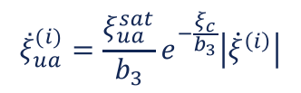
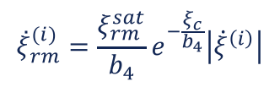
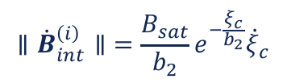
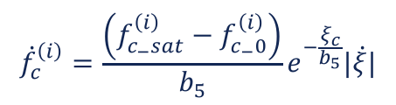
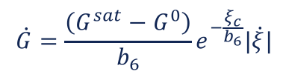

Constitutive relations
Evolution laws
Internal variables related with cyclic degradation
$${\overset{˙}{ξ}}_{ua}^{(i)}=\frac{ξ_{ua}^{sat}}{b_{3}}e^{−\frac{ξ_{c}}{b_{3}}}\left|{\dot{ξ}}^{\left(i\right)}\right|$$
$${\overset{˙}{ξ}}_{rm}^{(i)}=\frac{ξ_{rm}^{sat}}{b_{4}}e^{−\frac{ξ_{c}}{b_{4}}}\left|{\dot{ξ}}^{\left(i\right)}\right|$$
$$\left.∥{\dot{B}}_{int}^{\left(i\right)}∥\right.=\frac{B_{sat}}{b_{2}}e^{−\frac{ξ_{c}}{b_{2}}}{\dot{ξ}}_{c}$$
$${\dot{f}}_{c}^{\left(i\right)}=\frac{\left(f_{c_{−}sat}^{\left(i\right)}−f_{c_{−}0}^{\left(i\right)}\right)}{b_{5}}e^{−\frac{ξ_{c}}{b_{5}}}|\dot{ξ}|$$
$$\dot{G}=\frac{\left(G^{sat}−G^{0}\right)}{b_{6}}e^{−\frac{ξ_{c}}{b_{6}}}|\dot{ξ}|$$
Dislocation density and stored energy
$$E_{st}≈ρ_{tot}E_{dis}≈\frac{1}{2}ρ_{tot}G_{shear}b^{2}$$
$$ρ_{tot}=(1−ξ)ρ_{A}+ξ⋅ξ_{tw}⋅ρ_{M},$$
${\dot{ρ}}_{A}^{\left(α\right)}=c_{1}(\sqrt{\sum_{α=1}^{24}{ } ρ_{A}^{\left(α\right)}}−c_{2}ρ_{A}^{\left(α\right)})(\left|{\overset{˙}{γ}}_{A}^{\left(α\right)}\right|+\left|{\overset{˙}{γ}}_{trip}^{\left(α\right)}\right|$)
${\dot{ρ}}_{M}^{\left(t\right)}=c_{3}(\sqrt{\sum_{t=1}^{11}{ } ρ_{M}^{\left(t\right)}}−c_{4}ρ_{M}^{\left(t\right)})(|{\dot{γ}}_{tw}^{\left(t\right)}|$)
Notes:
in order to capture the chatacterestics of cyclic deformation behavior of shape memory alloys, we introduce some internal variables and evolution laws.
for example the evolution law fc here is to reproduce the drop of the start transformation stress during cyclic loading
in order to provide basis for further fatigue criterion based on microscale parameters, like the stored energy. to this end, microstructural related parameters, as dislocation and stored energy are introduced in the model

Slide 14
Contents
1
Backgrounds
2
Constitutive Equations
3
Numerical Implementation
4
Selected Results
Notes:
my talk will be in 4 parts

Slide 15
Numerical Implementation
Subroutine Interface
mo_util = MODE 'MECANIQUE' 'ELASTIQUE' 'ORTHOTROPE' 'NON_LINEAIRE' 'UTILISATEUR' 'NOM_LOI' 'cp'
'C_MATERIAU' LCMAT ' C_VARINTER’ LCVAR ;
'C_MATERIAU’ – give access to the list of names associated with the material properties, LCMAT
'C_VARINTER’ – give access to the list of names associated with the material’s internal variables, LCVAR
Demanded by System
LCMAT = MOTS 'YG1' 'YG2' 'YG3' 'NU12' 'NU23' 'NU13' 'G12' 'G23’ 'G13' 'V1X’ 'V1Y' 'V1Z’ 'V2X' 'V2Y’ 'V2Z'
'FAI1' 'THTA’ 'FAI2’
Euler Angles
'G0' 'G_' 'H0’ 'dgam0’ 'm' 'a' 'q'
Deformation Slip
'gtr’ 'G’ 'beta’ 'miu’ 'theta0’ 't_ambient’ 'fc'
Transformation
'Gw' 'G_w' 'H0w' 'dxiw' 'mw' 'aw’ 'qw'
Deformation twinning
'b_' 'b1' 'b2’ 'gam_'
TRIP
'h’ 'c_p’ 'volume’ 'area'
Thermomechanical Coupling
'fc_' 'gx_' 'b5' 'b6' 'G1' 'G2' 'H1' 'H2' 'tw_a’'tw_b';
Cyclic deformation
Notes:
key words associated with elasticity is mechanic, elastic, orthotropic
key words associated with plasticity is non-linear, user, name of the law, cp, which is the name of constitutive law defined by user
young’s moduli, poisson’s ratio, shear moduli
two directions of principal axes

Slide 16
Numerical Implementation
Subroutine Interface
'C_VARINTER’ – give access to the list of names associated with the material’s internal variables, LCVAR
LCVAR = LCHOOK ET LCR ET FININV ET BINT ET LCTAUP ET LCG ET LGAM ET LCTAUTR ET LXI ET LXITOT
ET LCTAUTW ET LCGW ET LXITW ET LXITWTOT ET LGAMTW ET LCTAUTRI ET LGAMTRIP ET LXIC
ET LTHETA ET LTMD ET LTLT ET LTH ET LGAMTOT ET LGAMTWOT ET LGAMTROT ET LFC ET LGX;
LXI = MOTS 'XI01’ 'XI02' 'XI03' 'XI04'
'XI05' 'XI06’ 'XI07' 'XI08'
'XI09' 'XI10' 'XI11’ 'XI12'
'XI13' 'XI14' 'XI15' 'XI16'
'XI17' 'XI18' 'XI19' 'XI20'
'XI21' 'XI22' 'XI23’ 'XI24';
Notes:
lcvar here listed the internal variables included in my model.
for example, the lxi represents the internal variable of martensite volume fraction of each transformation system. since we have 24 transformation systems, here list xi01 to xi24.

Slide 17
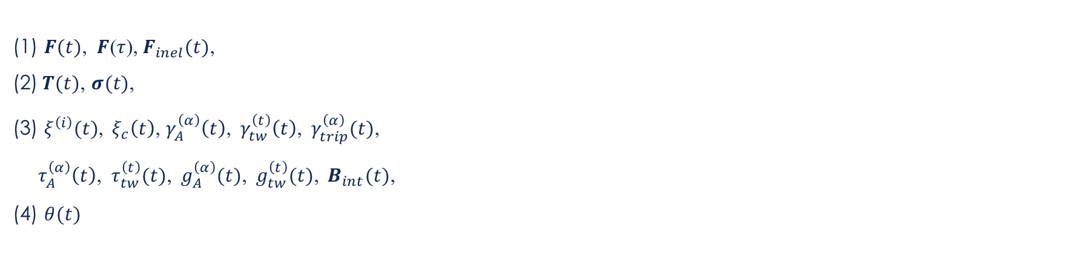
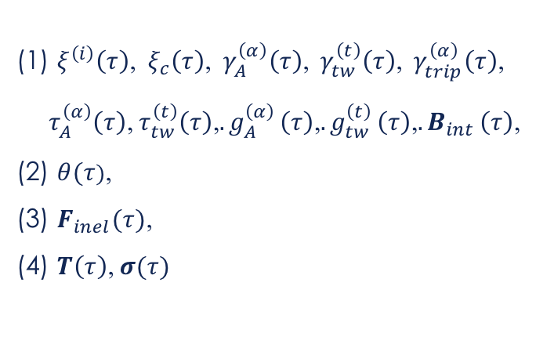
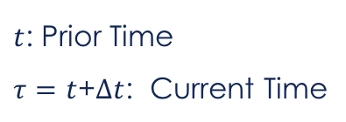
Numerical Implementation
Time-integration Procedure
$t$: Prior Time
$τ=t$+$∆t$: Current Time
Given:
To Calculate:
(1) $F(t)$,$F$($τ$),${ F}_{inel}(t)\text{,}$
(2)$T(t)$, $σ(t)$,
(3) $ξ^{\left(i\right)}(t)$,${ ξ}_{c}\left(t\right)$,$γ_{A}^{\left(α\right)}\left(t\right)\text{,}{ γ}_{tw}^{\left(t\right)}\left(t\right)\text{,}{ γ}_{trip}^{\left(α\right)}(t)\text{,}$
$τ_{A}^{\left(α\right)}\left(t\right)\text{,} τ_{tw}^{\left(t\right)}(t)\text{,}{ g}_{A}^{\left(α\right)}(t)\text{,}{ g}_{tw}^{\left(t\right)}(t)$,$B_{int}(t)\text{,}$
(4)$θ(t)$
(1) $ξ^{\left(i\right)}\left(τ\right)\text{,}{ ξ}_{c}\left(τ\right)\text{,}{ γ}_{A}^{\left(α\right)}\left(τ\right)\text{,}{ γ}_{tw}^{\left(t\right)}\left(τ\right)\text{,}{ γ}_{trip}^{\left(α\right)}\left(τ\right)\text{,}$
$$τ_{A}^{\left(α\right)}\left(τ\right)\text{,}{ τ}_{tw}^{\left(t\right)}\left(τ\right)\text{,}{. g}_{A}^{\left(α\right)}\left(τ\right)\text{,}{. g}_{tw}^{\left(t\right)}\left(τ\right)\text{,}{. B}_{int}\left(τ\right)\text{,}$$
(2) $θ(τ)\text{,}$
(3) $F_{inel}(τ)\text{,}$
(4) $T\left(τ\right)\text{,} σ(τ)$
UMAT
Notes:
here goes to the time-integration procedure.
infinitisimal time increment
The objective of the algorithm is to update all variables at time tau by the variables at time t and the proposed new deformation gradient F

Slide 18












Numerical Implementation
Time-integration Procedure
Step4: Calculate trial resolved shear stress
Step1: Calculate ${E_{e}\text{(}τ\text{)}}^{trial}$
Step2: Calculate elastic modulus
Step5: Calculate trial driving force for each mechanism
Step3: Calculate${ T\text{(}τ\text{)}}^{trial},{ M\text{(}τ\text{)}}^{trial}$
Step6: Calculate $∆γ_{A}^{(α)}$($τ$), $∆γ_{tw}^{(t)}$($τ$), ${Δξ}^{(i)}$($τ$) and $∆γ_{trip}^{(α)}$($τ$)
Step7: Renew $ξ^{(i)}$($τ$), $ξ$($τ$) and $ξ_{c}$($τ$)
Notes:
here list explicit steps for the integration procedure
we first calculate a trail elastic deformation gradient Fe. it is in terms of the deformation gradient at current time and the inelastic deformation gradient at prior time.
using this trail elastic deformation gradient, followed these steps, we can calculate the increment of shear rate and increment of martensite volume fraction, based on evolution laws and transformation criterion.

Slide 19
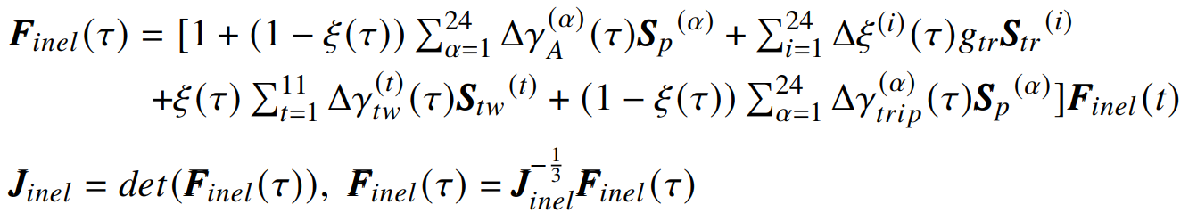




Numerical Implementation
Time-integration Procedure
Step8: Calculate temperature change $∆θ(τ)$
Step9: Calculate and normalize $F_{inel}$($τ$)
Step10: Update $ℂ\text{(}τ)$
Step11: Compute $F_{e}$($τ$), T($τ$)and$σ$($τ$)
Step12: Renew a group of internal variables
Notes:
Then we can calculate and normalize the inelastic deformation gradient.
after that we compute the cauchy stress at current time, and renew the internal variables
f is normalized to ensure the isochoricity of plastic deformation

Slide 20

Numerical Implementation
Generalize the Model for Polycrystalline
Simulation on each element
Output$σ$and$ε$ (Average over RVE)
Notes:
the model is firstly constructed at single crystal scale.
to generalize it for polycrystalline, we use the euler angles.
The polycrystalline is represented by a series of elements, each element represents a single crystal. The shading indicates the variation in orientations. For each element, the crystal orientation
is defined by certain Euler angles input as material properties. we do the simulation on each element and the output is calculated in an average manner of the whole RVE.

Slide 21
Contents
1
Backgrounds
2
Constitutive Equations
3
Numerical Implementation
4
Selected Results
Notes:
my talk will be in 4 parts

Slide 22
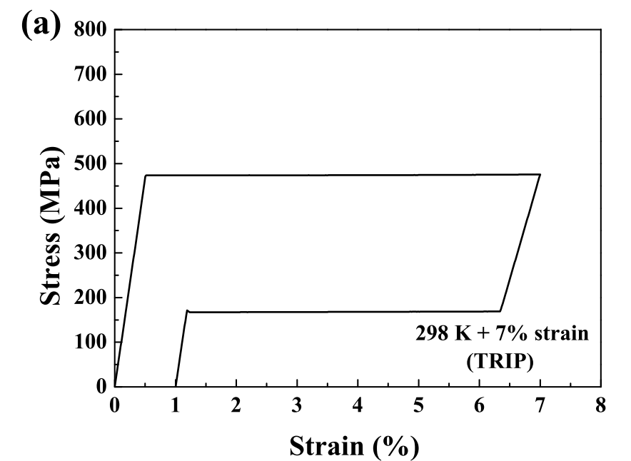
Selected Results
Activation of inelastic mechanisms
(a)
(b)
(c)
(d)
(e)
(a): Room Temperature
(b): High Temperature
(c): Large Strain Amplitude
(d): TRIP
(e): Thermomechanical Coupling
Ju X, Moumni Z, Zhang Y, et al. International Journal of Plasticity, 2022.
Notes:
In order to activate the inelastic mechanisms we included in the model, we do the simulations under different loading conditions, such as room temperature, high temperature, large strain amplitude, different strain rates.
It is shown that the model is capable to qualitatively reproduce the deformation behaviors of sma under these loading conditions.

Slide 23
Selected Results
Cyclic Responses of Single Crystal of Different Orientations
Loading cycles
Gall K, Maier H J. Acta Materialia, 2002
[210]
[111]
[321]
Ju X, Moumni Z, Zhang Y, et al. International Journal of Plasticity, 2022.
Notes:
To quantitatively verify the model, we gave a comparison between experimental and simulation results.
Here shows the cyclic response of single crystals considering orientations.
for the single crystal in 210 orientation. a good fit can be seen even at 100 cycles.
here are the results for single crystal in two other orientations. also matches well with the experimental data.
so, the orientation effect and cyclic deformation behavior has been well quantitatively reproduced.

Slide 24

Selected Results
Cyclic Responses of Polycrystalline at Different Strain Amplitudes
Experiment (Wang et al., 2008)
Our Simulation
($γ$- fiber {111})
Notes:
Here gives the results showing cyclic response of polycrystalline at different strain amplitudes.
Compare with the experimental data reported by wang, our simulation matches well with the experimental observations.
the cyclic responses containing deformation twinning at large strains have also been reproduced.

Slide 25


Selected Results
Evolution of Microstructural-related Variables
(a)
(b)
(c)
$$ρ_{tot}=(1−ξ)ρ_{A}+ξ⋅ξ_{tw}⋅ρ_{M},$$
$$E_{st}≈ρ_{tot}E_{dis}≈\frac{1}{2}ρ_{tot}G_{shear}b^{2}$$
Ju X, Moumni Z, Zhang Y, et al. International Journal of Plasticity, 2022.
Notes:
now, we have verified the capability of our model to predict the thermomechanical behavior of smas under different loading conditions.
Based on this, we investigate the evolution of microscale parameters we introduced in the model.
here shows the simulated evolution of dislocation density and corresponding stored energy during cyclic loading.
The tendency of simulated dislocation density is consistent with the experimental report in the literature.

Slide 26
Conclusions
Developed a Multiscale and Thermomechanical Model for SMAs
As-received
Zone A
Implemented the model into CAST3M and Well Reproduced Cyclic Response of SMAs
Zone A
Introduced Variables Associated with Microstructural Changes for Fatigue Analysis
Zone M
Active Zone
Zone M
Active Zone

Slide 27
Thank you for your attention!
PhD student (Reporter): Xiaofei JU (xiaofei.ju@ensta-paris.fr)
Supervisor: Ziad MOUMNI (ziad.moumni@ensta-paris.fr)

Slide 28
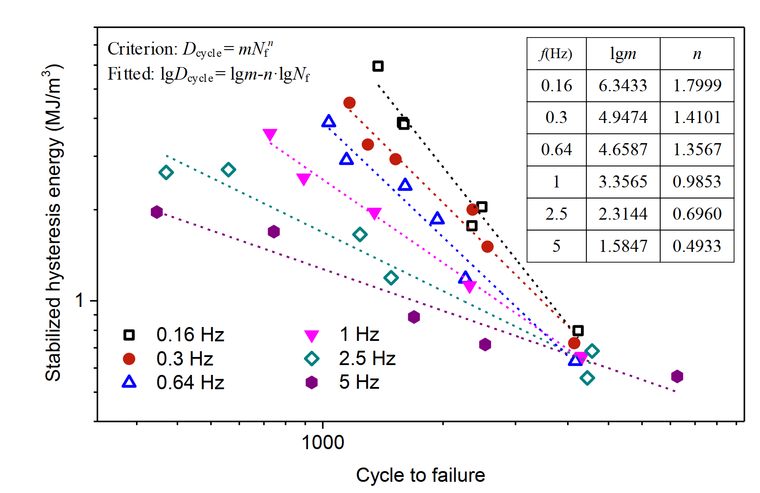
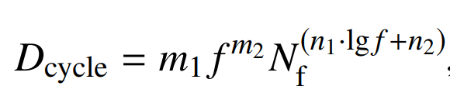
Motivations
Development of a Reliable Fatigue Criterion
Intrinsic Indicator for Fatigue Behavior
?
For NiTi SMAs:
Micromechanical-based Models are the key for Investigating the fatigue behavior & further establishing a good fatigue criterion
Zhang Y. Low cycle fatigue of shape memory alloys [phd thesis]. 2018
Notes:
in order to address the fatigue issue of smas, we aim to develop a reliable fatigue criterion.
there are many fatigue criteria for smas, however most of them are emperical criteria based on macroscale parameters. they fail to reflect the intrinsic physical mechanisms of fatigue, which harms their pedictivity for the fatigue behavior of smas. here gives an example of an energy based criterion, which links the hysteresis energy with fatigue lifetime. You can see that under different loading rates, marked by different symbols, the formula for criterion changes. which means it cannot reflect the thermomechanical coupling effect.
hystersis work is a parameter at macro-scale, it causes problem when you link it directly to the fatigue damage, which is the phemomenon at meso/ microscale. In fact, during cyclic loading, the hysteresis work is divided into two parts, one dissipated to heat, the rest remained in the material as stored energy. the stored energy is storage of internal energy in the material which links to the microstruacture changes, as formation of defects. The accumulation of the defects ultimately results in fatigue failure. Since stored energy and fatigue damage are both linked to the microstructural change at lower scale, compared to the hysteresis work, stored energy may be a more relevant fatigue indicator.
To study this issue and propose a good fatigue criterion, we need a micomechanical based modele which reflect the intrinsic physics.

Slide 29
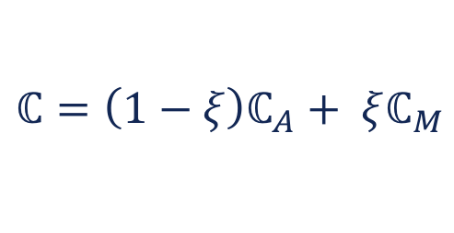

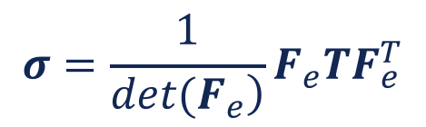
Equations
Definition of Effective Anisotropic Elastic Moduli
$$ℂ=\left(1−ξ\right)ℂ_{A}+ ξℂ_{M}$$
$$T=ℂ:E_{e}$$
$$σ=\frac{1}{\left.det(F_{e}\right)}F_{e}TF_{e}^{T}$$
Notes:
Rule of mixture approach

Slide 30
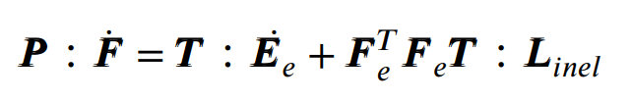
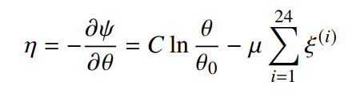




Equations
Thermomechanical Coupling
The first law of thermodynamics
$$ψ=U−θq$$
$$\dot{U}=P:\dot{F}−∇⋅q$$
$$θ\dot{η}=P:\dot{F}−\dot{ψ}−\dot{θ}η−∇⋅q$$
$$θ\dot{η}=\sum_{i=1}^{24}{f_{tr}^{\left(i\right)}{\dot{ξ}}^{\left(i\right)}} +(1−ξ)\sum_{α=1}^{24}{f_{A}^{\left(α\right)}{\dot{γ}}_{A}^{\left(α\right)}}+ξ\sum_{t=1}^{11}{f_{tw}^{\left(t\right)}{\dot{γ}}_{tw}^{\left(t\right)}}+(1−ξ)\sum_{α=1}^{24}{f_{trip}^{\left(α\right)}{\dot{γ}}_{trip}^{\left(α\right)}} −∇⋅q$$
$$\begin{matrix}C\dot{θ}+∇⋅q= & \underset{\text{Mechanical} \text{dissipation} }{\underbrace{\sum_{i=1}^{24}{f_{tr}^{\left(i\right)}{\dot{ξ}}^{\left(i\right)}}+(1−ξ)\sum_{α=1}^{24}{f_{A}^{\left(α\right)}{\dot{γ}}_{A}^{\left(α\right)}}+ξ\sum_{t=1}^{11}{f_{tw}^{\left(t\right)}{\dot{γ}}_{tw}^{\left(t\right)}}+(1−ξ)\sum_{α=1}^{24}{f_{trip}^{\left(α\right)}{\dot{γ}}_{trip}^{\left(α\right)}}}}+\underset{\text{Latent} \text{heat} }{\underbrace{θμ\sum_{i=1}^{24}{{\dot{ξ}}^{\left(i\right)}}}} \\ & \end{matrix}$$
Notes:
Q: heat flux

Slide 31











Simulation Part – Basic Model
Helmholtz free energy density
Thermodynamic Driving Forces
$$ψ\left(E_{e},ξ^{\left(i\right)},θ\right)=ψ_{e}+ψ_{θ}+ψ_{int}+ψ_{p}+ψ_{trans}+ψ_{cst}$$
$$P:\dot{F}−\dot{ψ}−η\dot{θ}−\frac{q∇θ}{θ}≥0$$
Clausius-Duhem Inequality
where,
= 0
= 0
$≥$ 0
$$ψ_{e}=\frac{1}{2}E_{e}:ℂ:E_{e}$$
$$\left(T−\frac{∂ψ}{∂E_{e}}\right):{\dot{E}}_{e}−\left(η+\frac{∂ψ}{∂θ}\right)\dot{θ}+\sum_{i=1}^{24}{ } \left[g_{tr}\left(M+B_{int}\right):S_{tr}^{(i)}−\frac{∂ψ}{∂ξ^{\left(i\right)}}\right]{\dot{ξ}}^{\left(i\right)}$$
$$ψ_{θ}=C\left[\left(θ−θ_{0}\right)−θln{\frac{θ}{θ_{0}}}\right]+μ\left(θ−θ_{0}\right)ξ$$
$≥$ 0
$≥$ 0
$${\dot{ψ}}_{int}=−B_{int}:\left(L_{tr}+L_{trip}\right)$$
$$+(1−ξ)\sum_{α=1}^{24}{ } \left[\left(M:S_{p} ^{\left(α\right)}\right){\dot{γ}}_{A}^{\left(α\right)}−g_{A}^{\left(α\right)}\left|{\dot{γ}}_{A}^{\left(α\right)}\right|\right]+ξ\sum_{t=1}^{11}{ } \left(M:S_{tw} ^{\left(t\right)}−g_{tw}^{\left(t\right)}\right){\dot{γ}}_{tw}^{\left(t\right)}$$
$${\dot{ψ}}_{p}=\left(1−ξ\right)\sum_{α=1}^{24}{ } g_{A}^{\left(α\right)}\left|{\dot{γ}}_{A}^{\left(α\right)}\right|+ξ\sum_{t=1}^{11}{ } g_{tw}^{\left(t\right)}\left({\dot{γ}}_{tw}^{\left(t\right)}\right)$$
$$+(1−ξ)\sum_{α=1}^{24}{ } \left[{\left(M+B_{int}\right):S_{p}}^{\left(α\right)}\right]{\dot{γ}}_{trip}^{\left(α\right)}−\frac{q∇θ}{θ}≥0$$
$$ψ_{trans}=\frac{1}{2}Gξ^{2}+\frac{1}{2}βg_{tr}ξ\left(1−ξ\right)$$
$≥$ 0
$≥$ 0
$$ψ_{cst}=−w_{0}(1−ξ)−\sum_{i=1}^{N_{T}}{ } w_{i}ξ^{\left(i\right)}$$
Thermodynamic Driving Force For Phase Transformation
$$f_{tr}^{\left(i\right)}=g_{tr}(M+{ B}_{int}):{S_{tr}}^{\left(i\right)}−\frac{1}{2}E_{e}:Δℂ:E_{e}−μ(θ−θ_{0})$$
$$−Gξ−\frac{1}{2}βg_{tr}(1−2ξ)+w_{0}−w_{i}$$
Notes:
the helmholtz free energy density is defined in the reference configuration, it includes 6 parts.
elastic strain energy
chemical free energy related to transformation
energy associated with internal stress
energy of plastic deformation in austenite and martensite
contribution of interactions between austenite and martensite variants
the last term is the potential energy due to internal constraints
To satisfy the clausius-duhem inequality, we can obtain the driving forces for each inelastic mechanisms. for example, the driving force for each transformation system is the term conjugate with the xi dot.

Slide 32


Implementation
Detailed procedure for step 6
Explicit method
(4) $f\left(\left.Δγ_{A}^{\left(α\right)}(τ\right)\right)≐Δγ_{A}^{\left(α\right)}(τ)−[(1−θ_{1}){\dot{γ}}_{A}^{\left(α\right)}(t)+θ_{1}{\dot{γ}}_{A}^{\left(α\right)}(τ)]Δt$
(5) solve $f\left(\left.Δγ_{A}^{\left(α\right)}(τ\right)\right)≐0$ by Newton-Raphson method
Implicit method

Slide 33

Implementation
Detailed procedure for step 6

Slide 34


Implementation
Boundary Conditions

Slide 35



Implementation
Pasapas
Displacement Control Loading
Force-control Unloading

Slide 36




Random orientation
Euler Angles
Use Euler angles to represent the transformation matrix
Rotate sequence: Z-X-Zwiththeangleof($φ_{1}$,$φ$, $φ_{2}$)
Transport of the transformation matrix
ABC- Global coordinate system
XYZ- Local coordinate system
Rangeoftheangles
${ φ}_{1}∈\left[0,2π\right]$,
$φ∈\left[0,π\right]$,
$$φ_{2}∈[0,2π]$$

Slide 37




Random Orientation
Range of the angles
$φ_{1}∈\left[0,2π\right]$,
$φ∈\left[0,π\right]$,
$$φ_{2}∈[0,2π]$$
Code in dgibi file
Generate a random value list in the defined range for the Euler angles
Output the random value list for the Euler angles
Spread the values of Euler angles on each element

Slide 38


Random Orientation
Generate pole figure from Euler angles (to check the orientations generated by simulations)
Use MTEX Toolbox
Code in Matlab
Define the symmetry of crystal and specimen
Input the Euler angles in the form of txt file.
Read the txt file as orientations
Set the direction for the pole figure
Plot the pole figure in the crystallographic orientations

Slide 39



Texture
Range of the angles (<111>{1-10} texture)
=> [111], [1-10], [11-2]
consider wobble angle for polycrystal
$φ_{1}∈\left[0,360°\right]$,
$φ=55°±5°$,
$φ_{2}$=$45°$
=>${ φ}_{1}=$0,$φ$=55$°$,$φ_{2}=$45$°$
Code in dgibi file
Generate a random value list in the defined range for the Euler angles
Output the random value list for the Euler angles
Spread the values of Euler angles on each element

Slide 40
Results
Deformation slip in austenite at high temperature
298 K
323 K
(a)
(b)
(c)
(d)
Ju X, Moumni Z, Zhang Y, et al. International Journal of Plasticity, 2022.
Notes:
here gives the results of two simulation tests done at room temperature and higher temperature, respectively.
figue a shows a typical hysteresis loop due to a complete phase transformation at room temperature. and there is no local slip in this case.
figure b shows the response at higher temperature. the transformation plateau becomes higher, plastic deformation occurs before phase transformation and results in a large unrecoverable strain. It can also revealed in figure d, the slip in austenite occurs under these circumstances. In other words, the model capture the inelastic mechanism at high temperature.

Slide 41
Results
Deformation twinning in martensite at large strain
(a)
(b)
(c)
(d)
Ju X, Moumni Z, Zhang Y, et al. International Journal of Plasticity, 2022.
Notes:
here shows the simulation results tested at large strain amplitude. plastic deformation occurs after the transformation plateau at higher stress. from figure c that we can tell that such plastic deformation is due to the twinning in martensite. the volume fraction of twinned martensite is shown in figure d.
The deformation behavior at large strain is captured.

Slide 42
Results
Thermomechanical coupling
Ju X, Moumni Z, Zhang Y, et al. International Journal of Plasticity, 2022.
Notes:
here are the simulated responses of a single crystal tested with different loading rates. It shows a strong rate dependence. The mechanical responses and phase transformation are influenced by the strain rates. So the thermomechanical coupling effect is captured by the model.

Slide 43
Results
Polycrystalline
[111] // RD
[111] // ND
(100)
(111)
(110)
(100)
(111)
(110)
Random Orientation

