Slide 1




Simulation of thermal impacts induced by fires with a coupling OpenFOAM-Cast3m
F. Salmon, J-C. Mindeguia, D. Lacanette, C. Sirieix,
C. Ferrier, J-C. Leblanc
Notes:
Simulation numérique de l’impact de feux par un couplage OpenFOAM-Cast3m

Slide 2
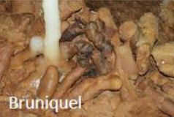
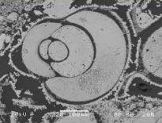
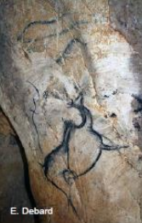
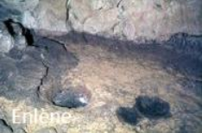
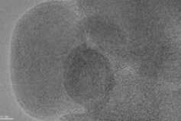
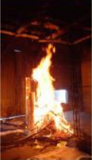
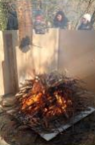
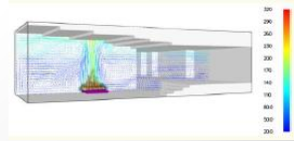
Purposes of CarMoThaP
Archaeological data
Purposes
Database of microstructure of thermo-alterations
Database of microstructure of fuels
Experimentations
High resolution transmission microscopy of a soot particle
Numerical simulations of fires
30/11/18
Simulation of wall temperatures
2
Notes:
2
This thesis is included in the Carmothap program. This project concerns the fires made during the Paleolithic inside caves, especially in the endokarst.
From the experimental reproduction of the fires, based on archaeological data, the program has several objectives:
-Make a frame of reference of thermal faciès allowing their recognition. It will be made for two materials: limestone and speleothems
-Build a database to identify fuels from combustion residues on the walls (especially soots)
-Set up a numerical model of fire simulation with a thermomechanical coupling. This model makes possible the test of several scenarios with different fuel quantities or method of supply for example.

Slide 3
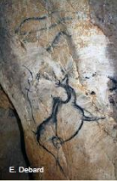
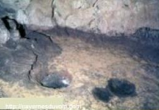
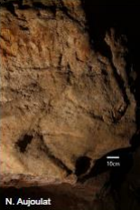
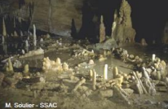
CarMoThaP – Studied sites
Bruniquel
(Tarn-et-Garonne)
J. Jaubert
Chauvet-Pont d'Arc
(Ardèche)
J-M. Geneste
Enlène (Ariège)
R. Begouën
Comarque
(Dordogne)
O. Fuentes
Habitat
Magdalenian
Fuel: bones (and wood ?)
Middle Paleolithic
Fuel: bones (and wood ?)
Speleothems
Painted cave (Aurignacian)
Fuel: scots pine
Thermo-alterations on the ceiling
Softening of the walls
Painted cave
Magdalenian and medieval occupation
Fuel: wood ?
30/11/18
3
Notes:
3
The carmothap program concerns several sites:
- The Bruniquel cave in the Tarn et Garonne where the circular structure of speleothems with little fires was dated to about 175 000 years. / It was made 175 000 years ago
- The Chauvet-Pont d’Arc cave in Ardèche contains Aurignacian fires.
- The Enlene cave in Ariège that is a deep Magdalenian habitat
The Comarque cave in Dordogne that is a magdalenian ornate cave. It was occupied again during the Middle Age.
The program began in 2016. I will speak about the fires in the Chauvet-Pont d’Arc cave in the following.

Slide 4
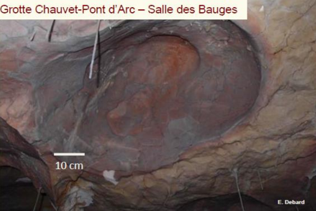
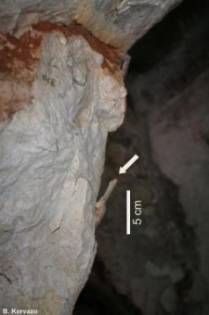
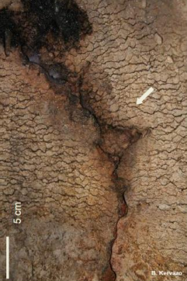

Some questions
Colour change
Spalling
Soot deposit
Chemical reactions
Red (rubification) ~ 250°C
Grey ~ 350°C
Amount of wood
Source of ignition
Method of supply
Number of fires
30/11/18
4
Notes:
4
Today, there are still marks made by fires in the cave. The first thermoalteration is the colour changes of walls. It occurs when the rock is heated up to 250 °C during 10 minutes for a red colour and to 350°C during 10 minutes for a grey colour. The second alteration is spalling. A high temperature involves great stress in the rock. Then a fragmentation can happen. The last evidence of combustion is the deposition of soot on walls.
Chamber of the Bear Hollows
So, the question is what kind of fire the Aurignacians made in the cave. The amount of wood, … , are the parameters that we would like to know.
Did the Aurignacian supply the hearth during the combustion or not ?

Slide 5
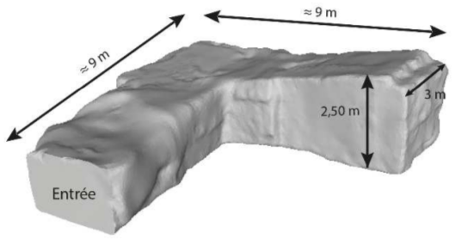
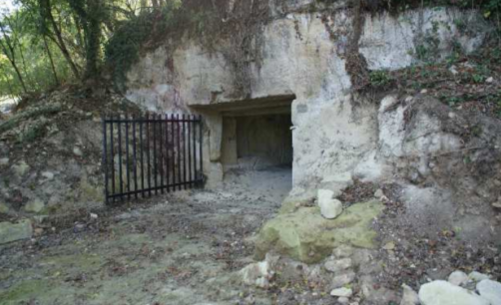
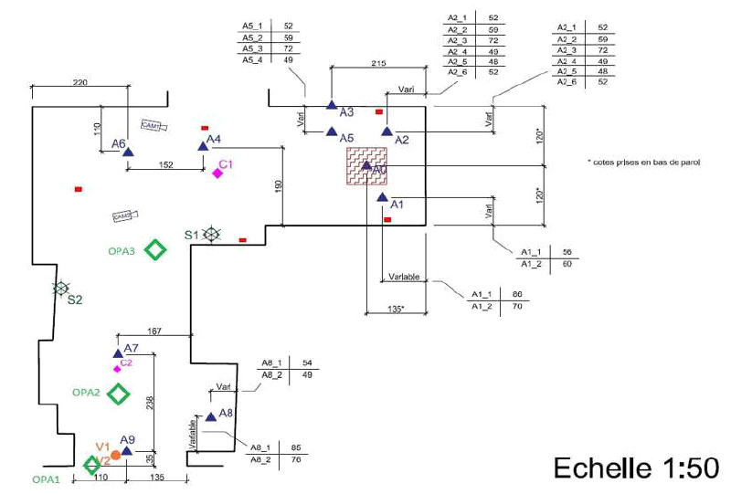
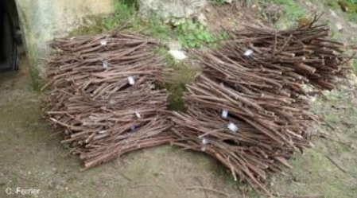
Experimentations
Former quarry
Bundled pinus sylvestris
Instrumentations
Thermocouples
Anemometers
Sensors of gas concentrations
Weighing scale under the hearth
30/11/18
5
Notes:
5
One of the objective of the Carmothap program is the reproduction of the thermoalterations in a quarry without any archaeological interest. The quarry consists of two right angle galleries of 9 meters. The ceiling is 2m40 high. [The width of the galleries is about 3 meters.]
As in the Chauvet cave, we burnt pinus sylvestris. It was bundled to make its transport easier. [The branches were 80 cm length with diameters inferior to 4 cm].
The shape of the hearth at the ignition was a tepee in order to impact the ceiling as much as possible. 135 kg of wood were bunrt during this experiment.
Moreover, to get experimental data in order to compare with the simulation, the quarry was intrumented by dozens of sensors: TC, anemometers, …
The weighing scale was useful to know the power of the fire during all the experiment.

Slide 6
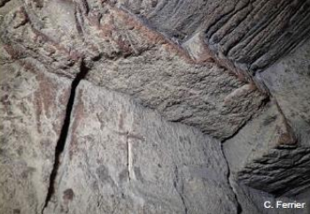
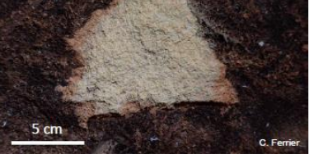
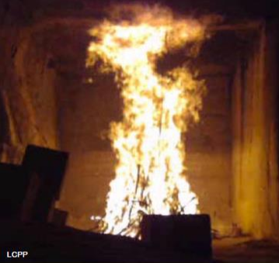
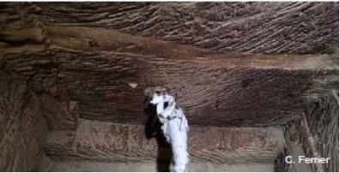
Thermo-alterations reproduction
Rubification
Spalling
30/11/18
6
Notes:
6
(We successfully reproduced) We observed thermo-alterations after the end of the fire. Above the fire, the ceiling became grey due to very high temperature. Further, the ceiling became red (as a remind, it means that the ceiling was heated to 250°C during 10 minutes). To heat the rock to 250 °C, the gases must be hotter because there is loss near the walls. For example, the gases raised 600°C during the experiment. Moreover, the temperature in a rock rises slowly, then, the duration of the fire must be sufficient to heat the rock to 250°C.
A little spalling is visible there. Since the experiment, a lot of similar spallings have happened.
So, we reproduced the thermo alterations of the Chauvet cave within a quarry.

Slide 7
Numerical modelling
Open source software
OpenFOAM - FireFOAM
Cast3m
2D Thermo-mechanical calculation
Compressible Navier-Stokes
+
Convection-diffusion equations for each chemical specie
+
Radiative transfer equation
Coupling (Python codes)
Geometry mesh
Solving 1D heat equation at the walls
Geometry & temperatures retrieval
30/11/18
7
Notes:
7

Slide 8
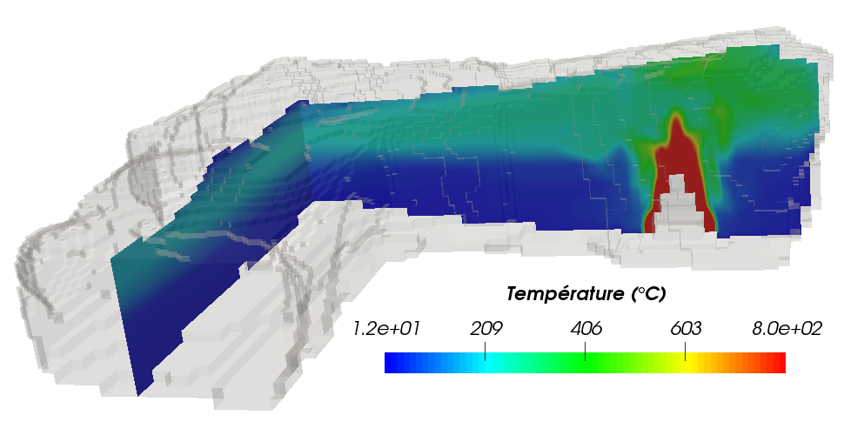
OpenFOAM results
40 minutes after the ignition
Entrance
30/11/18
8
Notes:
8
The software used is OpenFOAM. It is an open source software. We can simulate a fire thanks to the tool firefoam included in OpenFOAM.
The right picture corresponds to the numerical fire and the left one corresponds to the experimental fire.

Slide 9
Comparison of the results 1/2
30/11/18
9
Notes:
9
Now, we will see some compaisons between simulation and experiment.
I won’t present all the results because they are a lot.
On the left, this is a cut-away view of the quarry with the locations of the hearth and the sensors.
On the right there is the vertical locations of the thermocouples of the corresponding tree, T1 here.
In the middle, the graph represents the comparison between the experimental temperatures (in dashed line) and the simulated temperatures (continuous-solid-full line) corresponding to the thermocouples on the right. Each colour corresponds to one thermocouple.
The two hottest temperatures validate the simulation because the gap between experiment and simulation is very weak.
As I said just before, the temperature in the hot layer is homogeneous.
The thermocouples T1_1 and T1_2 measured the same temperature despite they are vertically distant of 50 cm.
In the cold layer, we underestimate a bit the temperature. But this is not the case for the next tree.

Slide 10

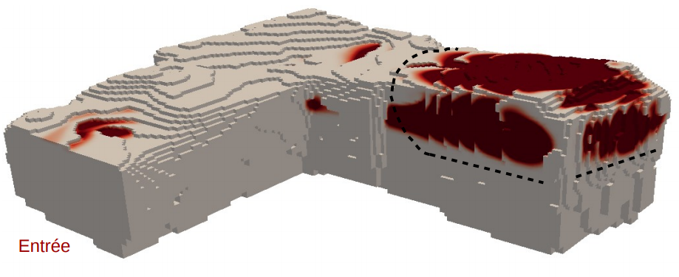
Confrontation des résultats
Comparison of the results 2/2
Numerical rubification
Experimental rubification
Rubification
250 °C – 10 min
Entrée
Entrance
30/11/18
10
Notes:
10
In order to compare simulation with visual marks in the Chauvet Pont d’Arc cave, we need to get good numerical thermo-alterations.
Here, I present the comparison between experiment and simulation for rubification (as a reminder 250°C during 10 minutes).
The red area are the numerical rubification. The dashed line corresponds to the experimental rubification.
We approximate the rubification very well depiste a little underestimation on the walls.

Slide 11
Coupling OpenFOAM-Cast3m 1/4
1st step – Defining the boundary geometry
30/11/18
11
Notes:
11
Now, we move on to the Chauvet cave. On the left, you can see the 3D geometry of the cave. We are more interested in the Megaloceros gallery that is in black, around the red arrow. At the end, we have the End Chamber. Indeed, there are several fire areas within this gallery and we do not know if all the fires had the same characteristics.
As you can see, this is at the end of the cave because the entrance is at the bottom of the picture. Within the cave, at the red arrow, you can see a big spalling, a big block felt down because of fires. There is also a grey colour. We can see that from another point of view.

Slide 12
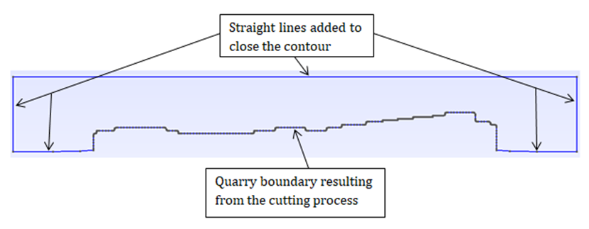
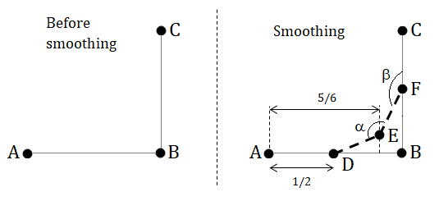
Coupling OpenFOAM-Cast3m 2/4
2nd step – Smoothing
Right-angle → Stress singularity
Smoothing process →
30/11/18
12

Slide 13
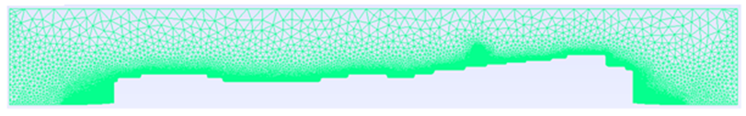

Coupling OpenFOAM-Cast3m 3/4
3rd step – Geometry mesh
Mesh performed by GMSH according to user settings
4th step – Thermal boundary conditions
Boundary line temperature
Temperature of the closest OpenFOAM boundary face
$$⇔$$
5th step – Writing the .dgibi file
30/11/18
13
Notes:
5eme pas: contient toutes les lignes, toutes les conditions limites en fonction du temps + lis le maillage .unv

Slide 14
Coupling OpenFOAM-Cast3m 4/4
6th step – Run Cast3m
Thermal modelling
Mechanical modelling
Isotropic
Thermal properties depending on temperature
Isotropic
Elastic
Mechanical properties depending on temperature
7th step – Post processing
VTK output → ParaView
OpenFOAM and Cast3m simulations → same post-processing
30/11/18
14

Slide 15
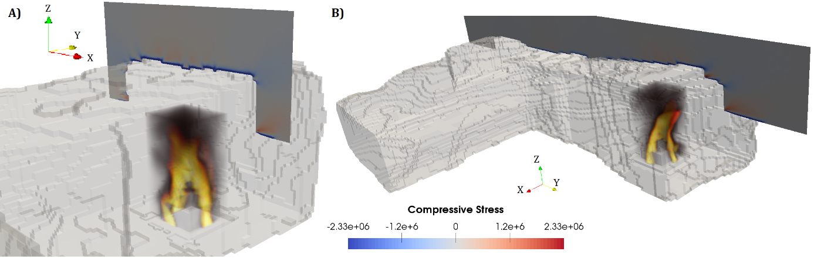
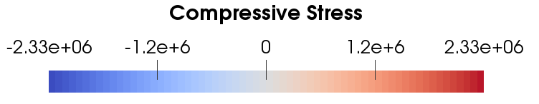
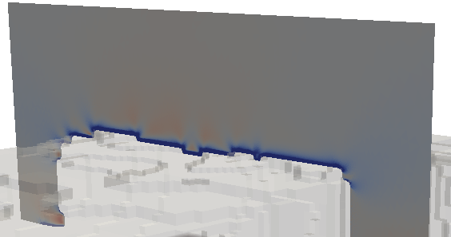
Cast3m results 1/2
30/11/18
15
Notes:
Résistance en compression

Slide 16
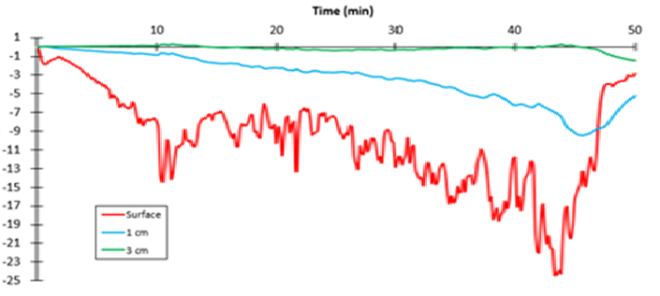
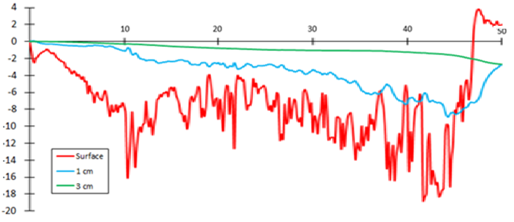




Cast3m results 2/2
$$Time (min)$$
$$σ_{xx} (MPa)$$
$$Time (min)$$
$$σ_{yy} (MPa)$$
30/11/18
16

Slide 17
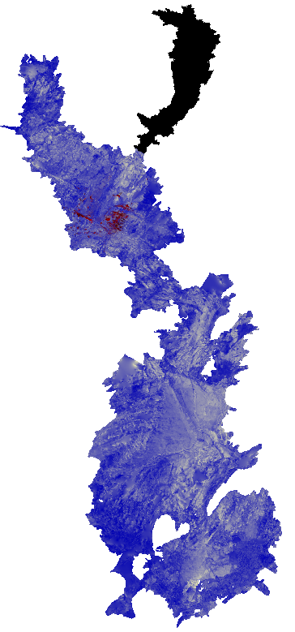
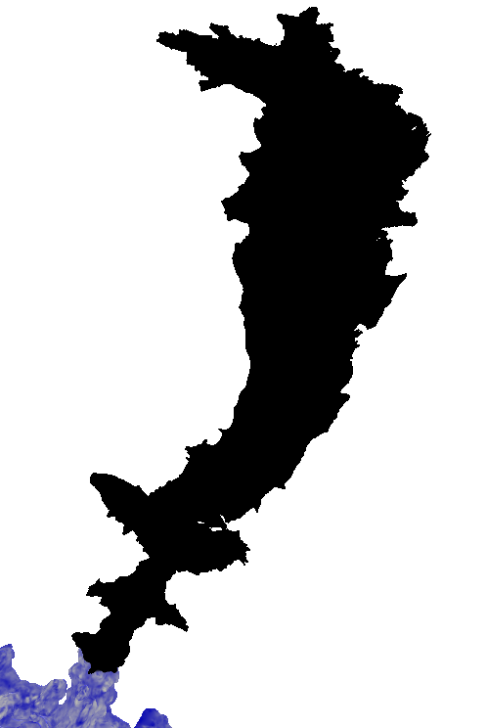
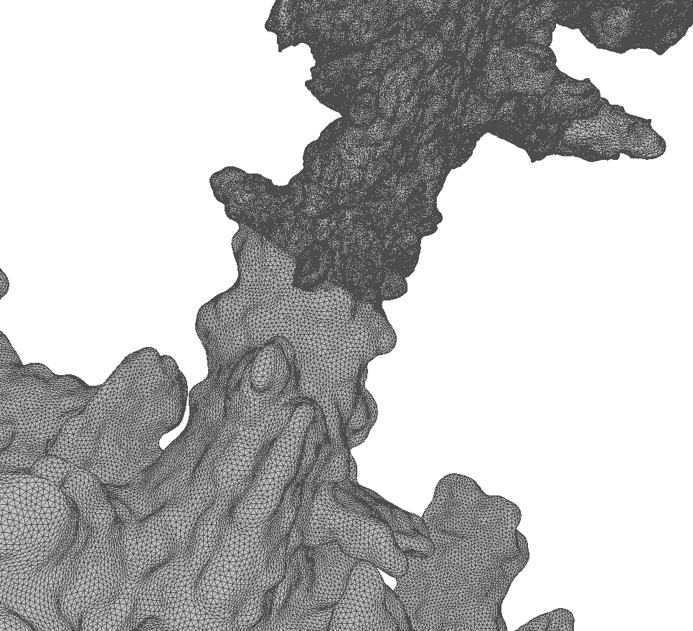
The Chauvet-Pont d'Arc cave
200 m
Ministère de la Culture
DRAC Auvergne – Rhônes-Alpes
Archéotranfert UMS 3657 (P. Mora)
30/11/18
17
Notes:
17
Here, you are an observator of the same spalling but from the outside of the cave, like if you were at the arrowhead.
Then, you can see in a better way the grey colour wich means that the rock reached at least 350°C during 10 minutes.

Slide 18
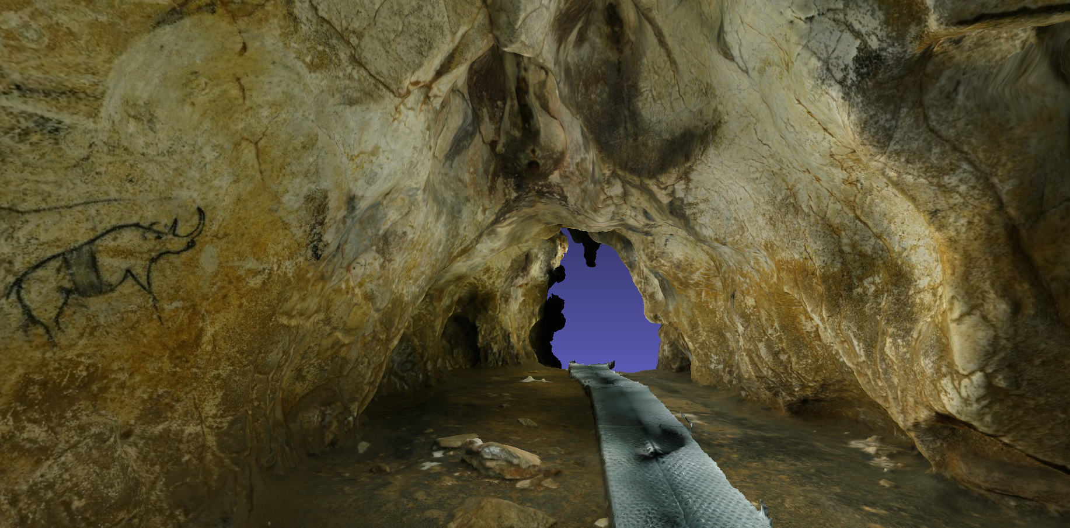
Thermo-alterations in the Megaloceros gallery
Spalling
~ 1,50 m
Grey colour
350°C – 10 min
30/11/18
Photogrammetry made by Thomas Sagory
Musée d'Archéologie nationale, domaine national de Saint-Germain-en-Laye

Slide 19
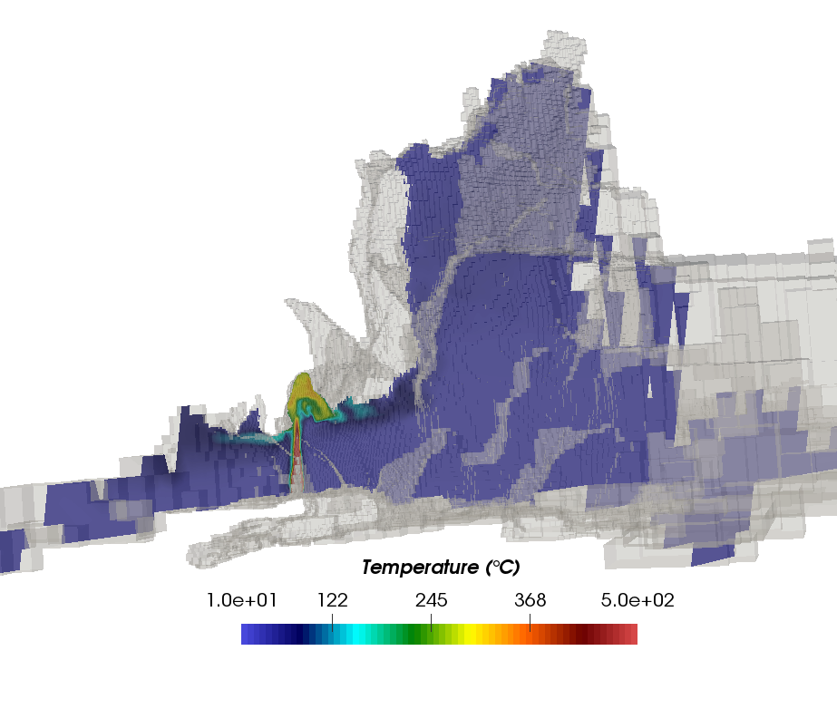
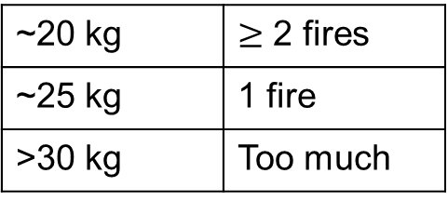
Simulation in the Chauvet-Pont d'Arc cave
~20 kg | $≥$ 2 fires
~25 kg | 1 fire
>30 kg | Too much
Hillaire Chamber
End Chamber
30/11/18
19
Notes:
19
To know the fire characteristics, we can now run several simulations until these alterations are reproduced.
For example, for the previous area, the simulations reveal that 60 kg are far too much (we reproduce too much alterations). Then, the protocol of the experimentations in the quarry is also too intense.
Less wood is a better possibility. But it is hard to decide because several little fires could reproduce these alterations. For example, with 30 kg, perhaps X fires could make these alterations. The accumulation of fires can be a possibility.

Slide 20
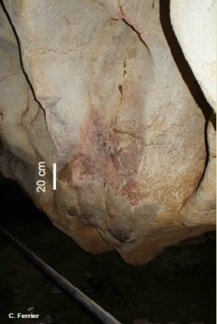

Conclusion
Conclusion
Construction of a fluid-structure coupling
Open-source
3D OpenFOAM → 2D Cast3m
Application to the Chauvet-Pont d’Arc fires
Simulation of scenarios
Amount of wood
Source of ignition
Supply method
Number of fires
Function(s) of the fires in the Chauvet-Pont d’Arc cave ?
30/11/18
20
Notes:
20
So far, we do not know if the other fires in the Megaloceros gallery had the same characteristics. So until the end of my thesis, I will run scenarios of fires for the other areas and try to understand the fires within the cave. In addition, the dangers will be taken into account in order to know if the hearth could have been supplied by Aurignacians.
We hope that all these researches will help archaeologists in the understanding of the functions of the fires in the Chauvet-Pont d’Arc cave.

Slide 21
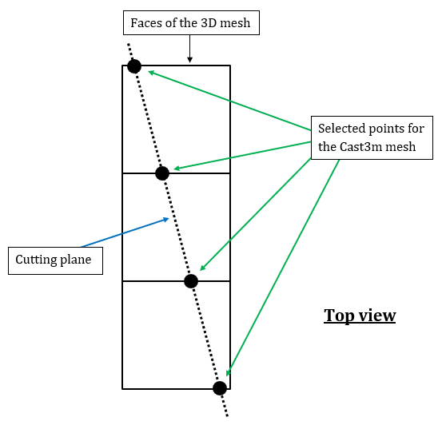
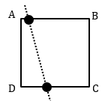

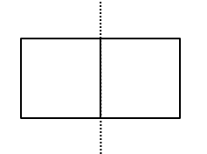






Appendix A
Points acquisition
Based on the cartesian equation of the cutting plane
$$℘=ax+by+cz+d$$
$$℘<0$$
$$℘>0$$
$$℘<0$$
$$℘>0$$
Issue: all the points are on the same side
→ Moving the cutting plane
30/11/18

Slide 22


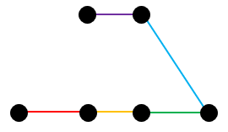
Appendix B
Process to connect the points
Connection to the closest point
1st case
Sequence of steps
2nd case
Some issues can occur
→ Moving the cutting plane
30/11/18

