Slide 1
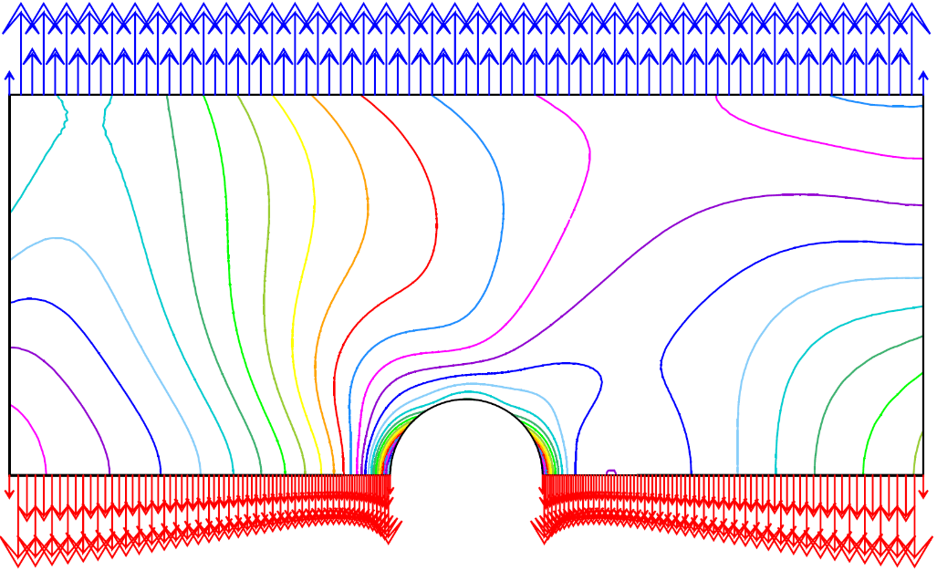
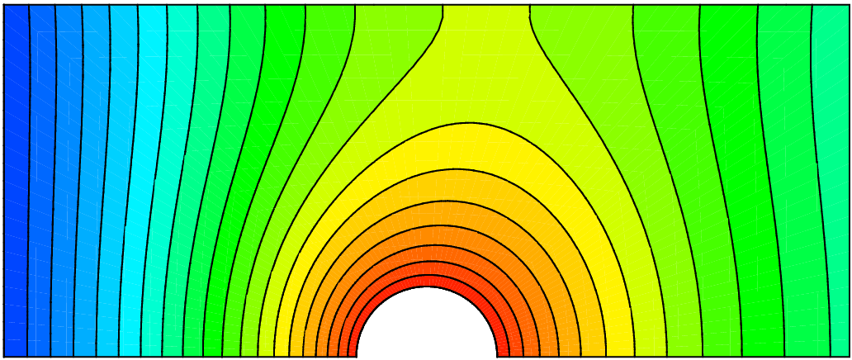
Starting with Cast3M Thermomechanical calculations available on: http://www-cast3m.cea.fr/index.php?xml=formations
François DI PAOLA
Last changes: march 27 2023

Slide 2
summary
Introduction to Cast3M
Gibiane language
Tutorial class thermo-mechanical behavior of a structure with a circular cavity
Complements
Objects in Gibiane

Slide 3
Introduction to Cast3M

Slide 4
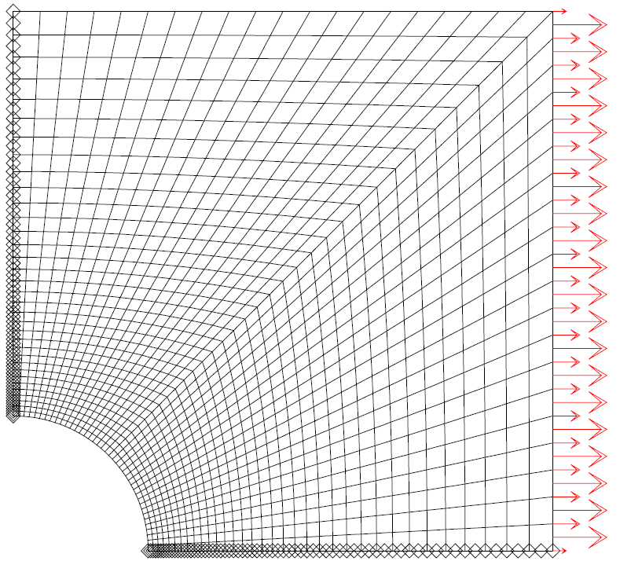
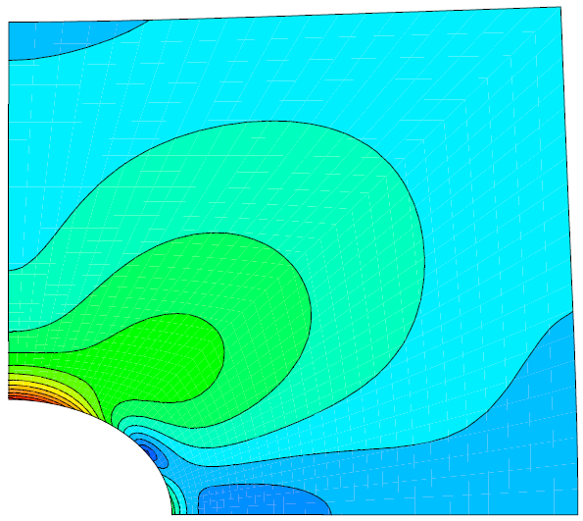
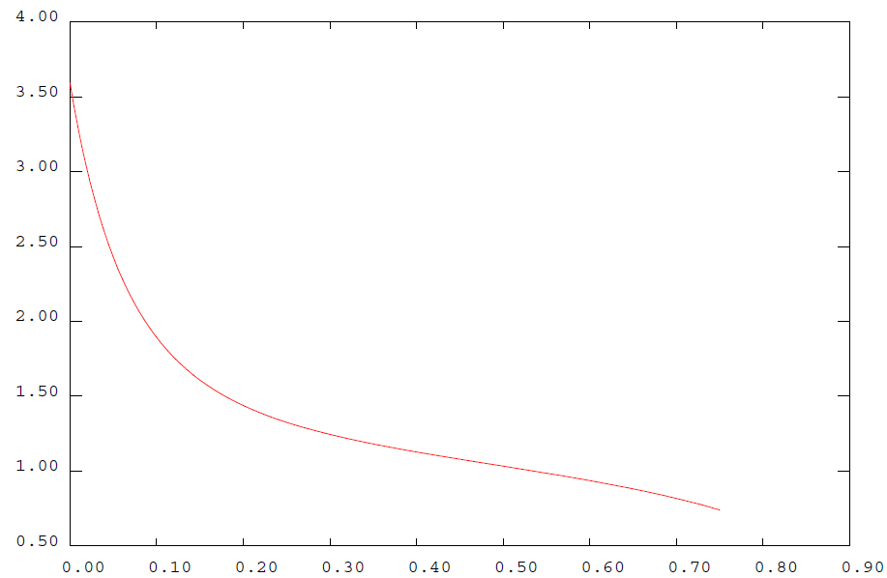
What is Cast3M?
A simulation software
using the finite element method
thermal and mechanical analysis of structures and fluids
Partial differential equations solved thanks to the finite element method
Complete software: solver, pre-processing and post-processing, visualization, reading/writing data…
Based on a programming language: Gibiane (objet-oriented)

Slide 5
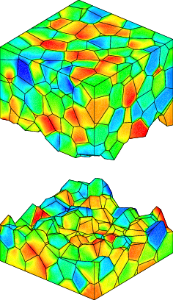
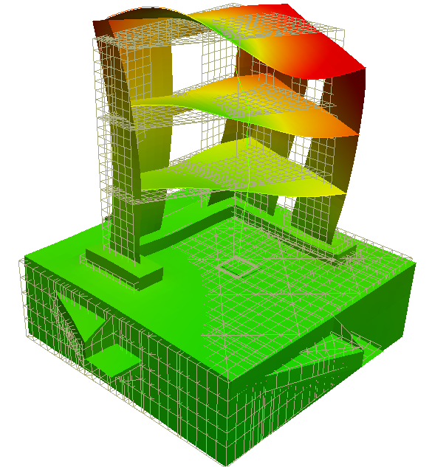
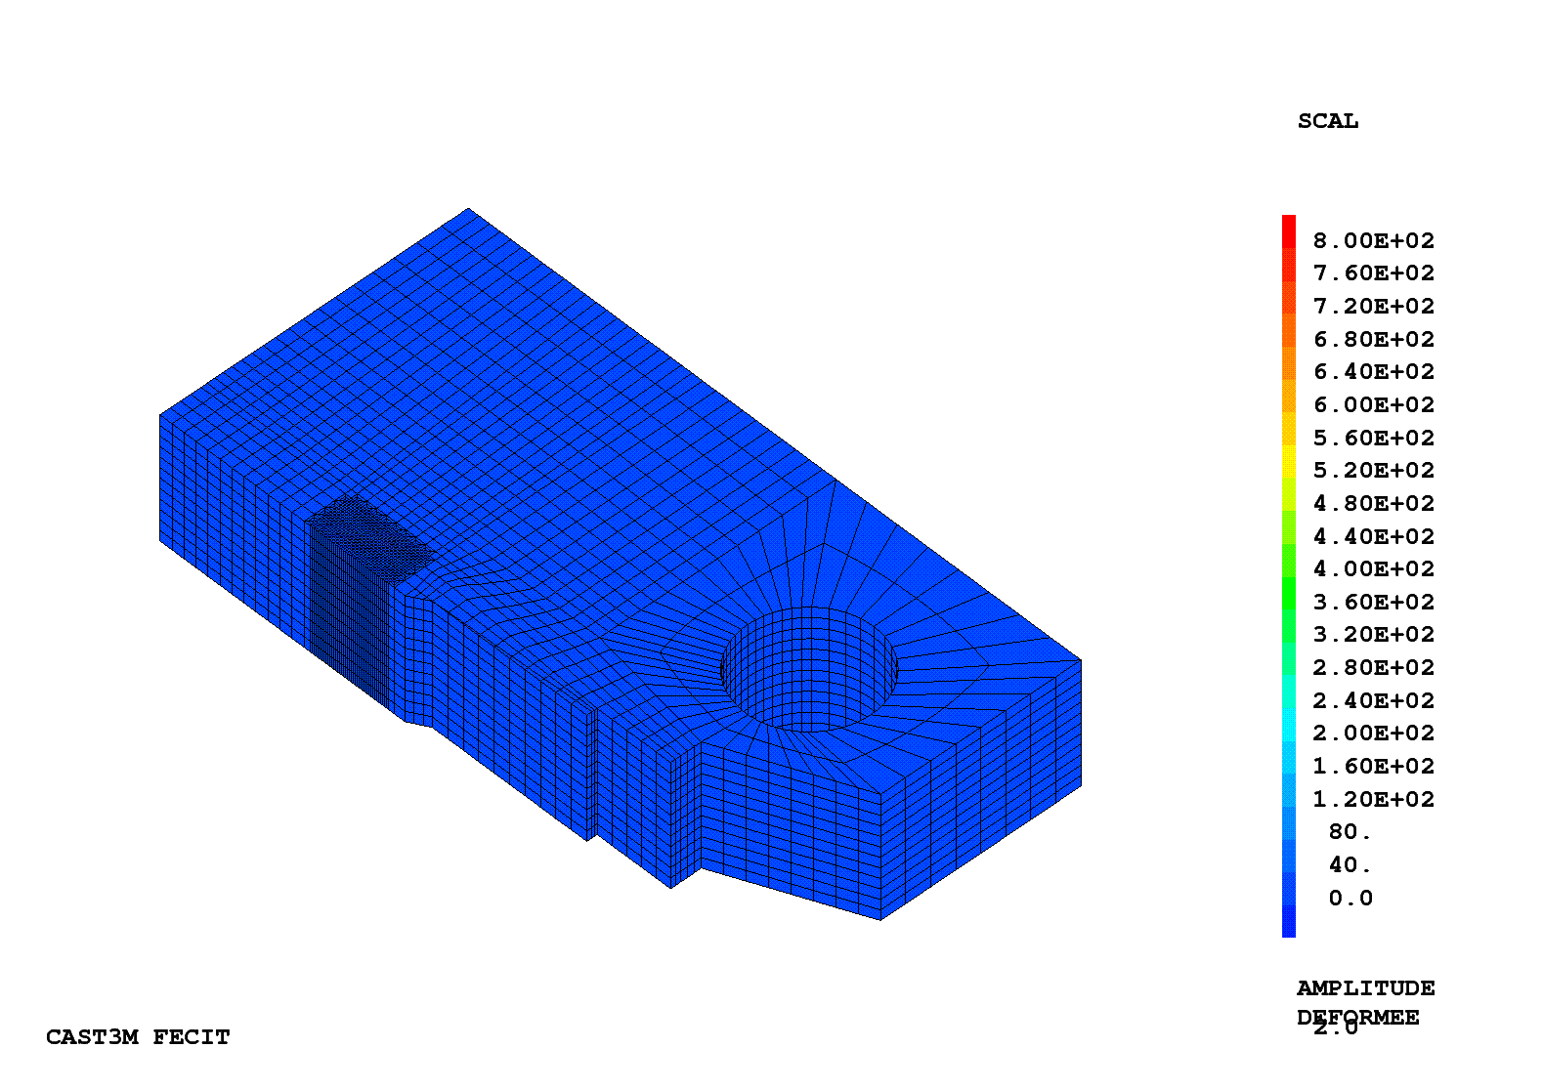
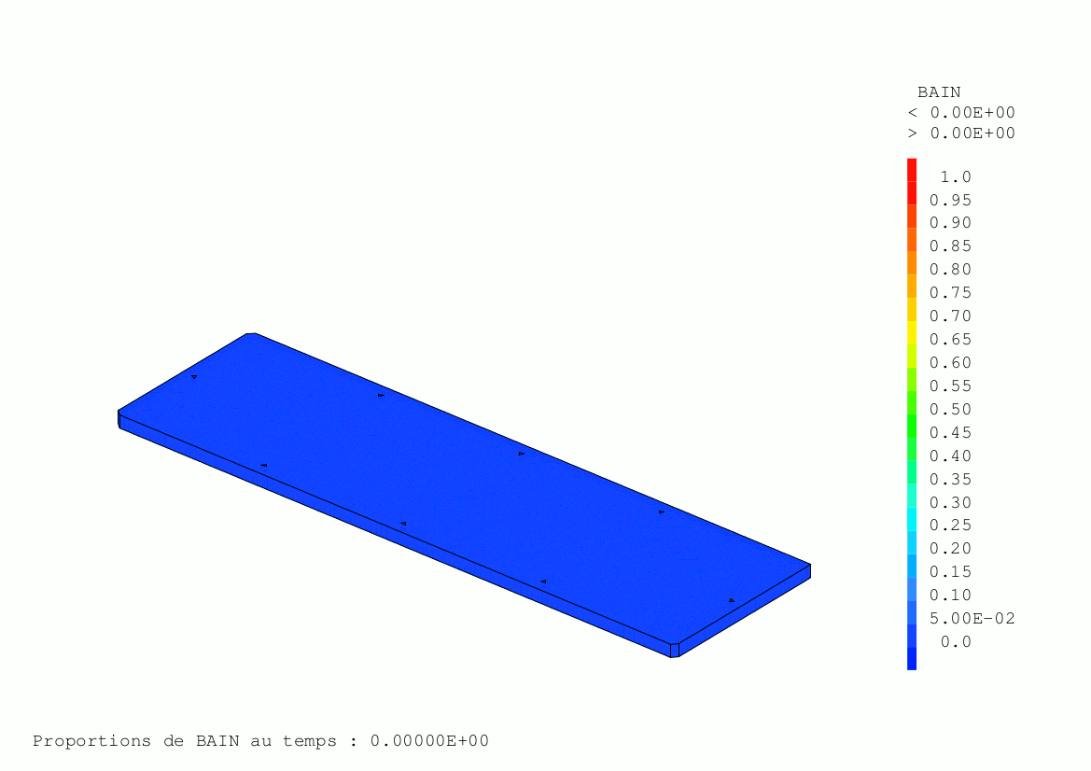
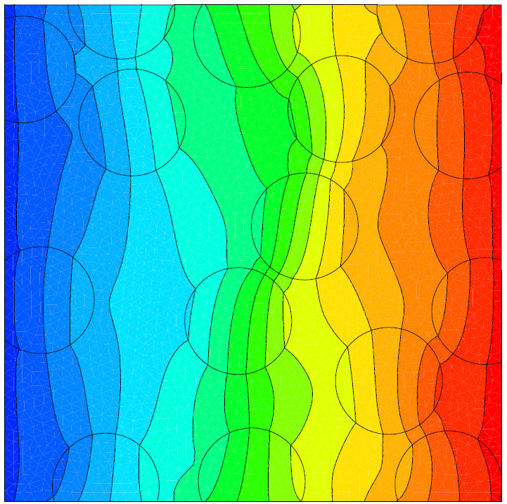
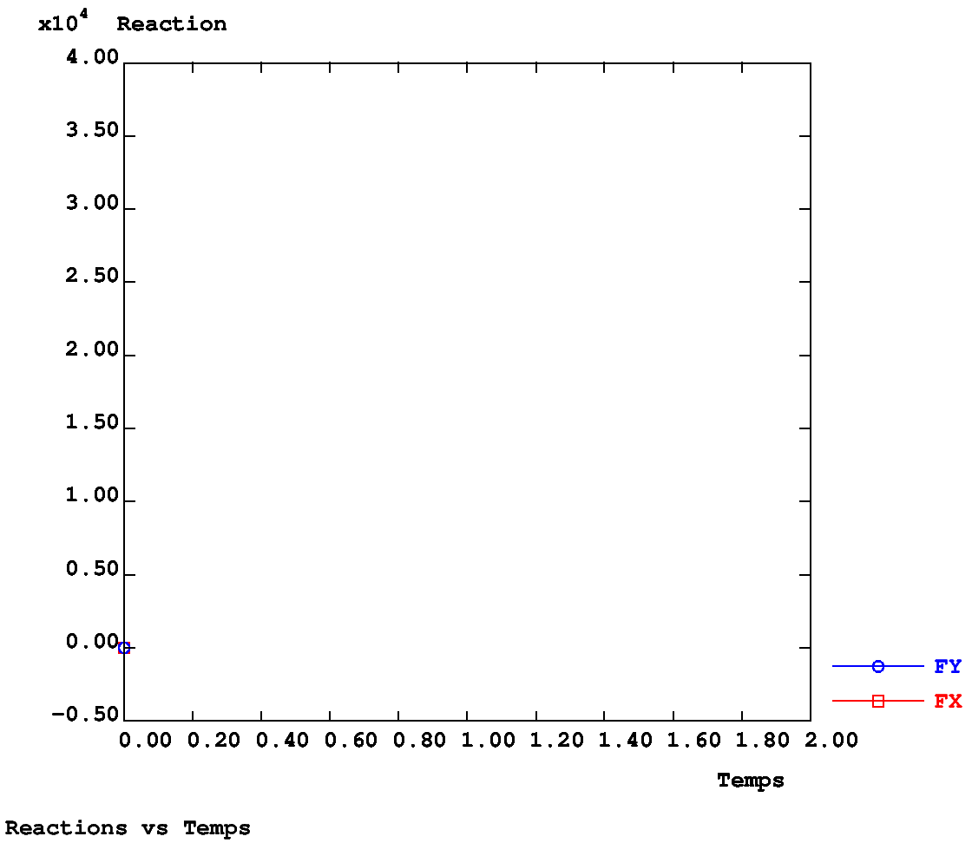
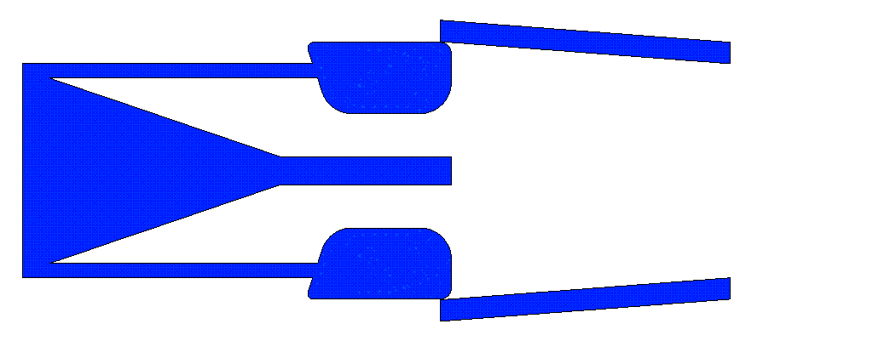
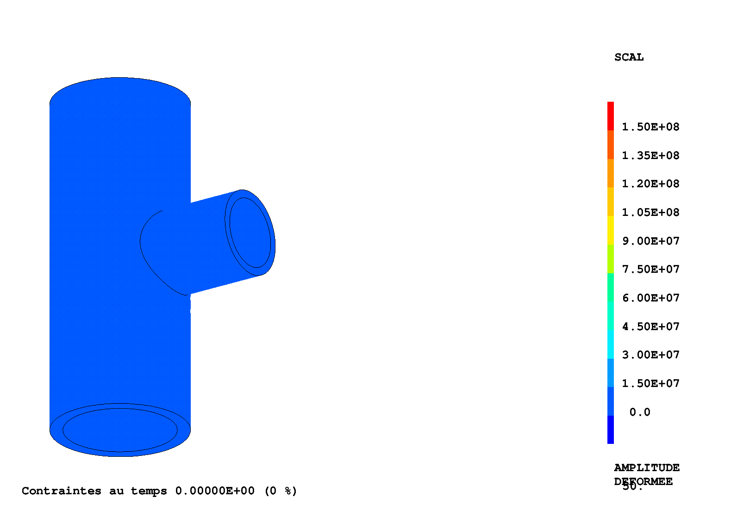
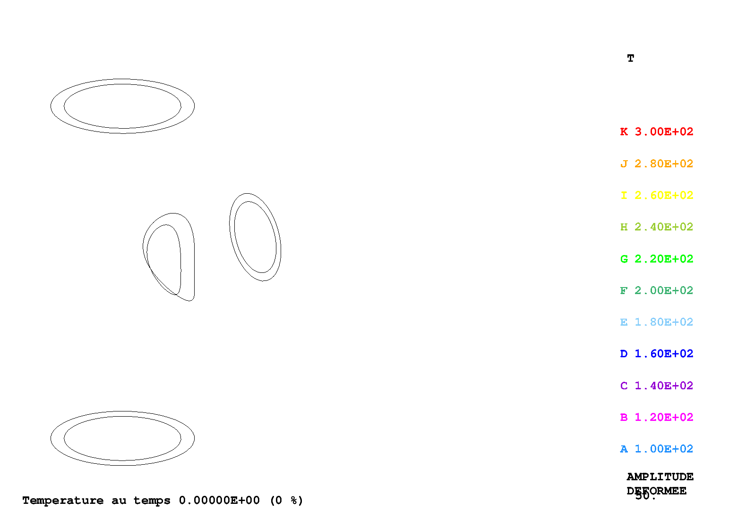
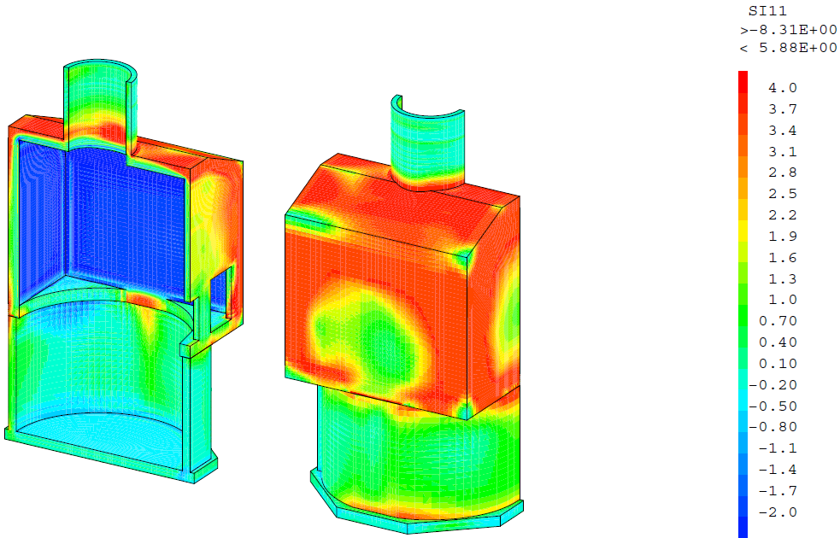
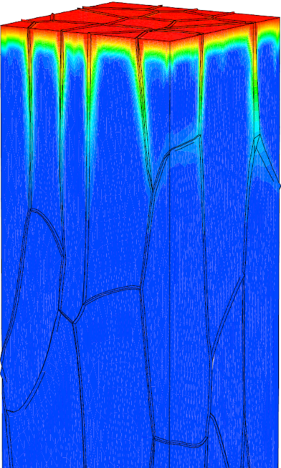
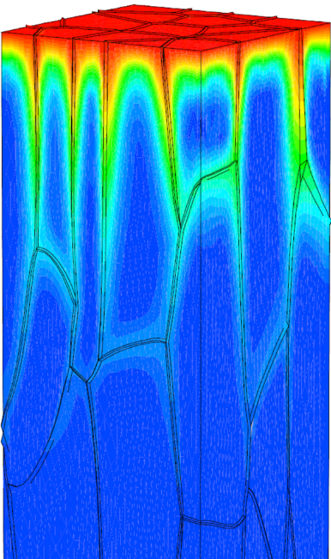
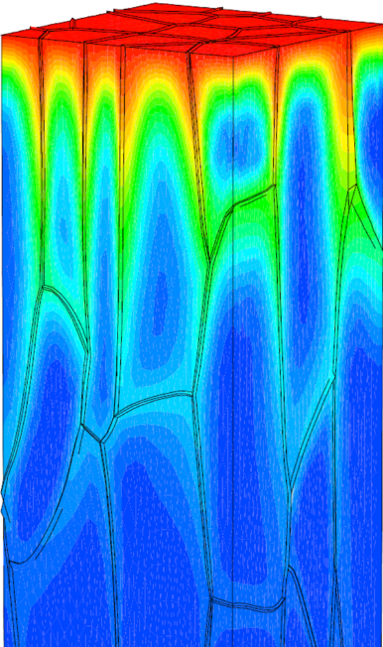
Application areas
Structural mechanics
Quasi-static (non linear behavior, geometry, boundary conditions)
Contact/friction, Buckling
Dynamic (temporal, modal, fluid structure interaction)
Fracture (XFEM, dynamic propagation, cohesive zones models, …)
Thermal analysis
Conduction, convection, radiation, phase transition
Fluid mechanics
Metallurgy
Magneto-statics
Multi species diffusion (Fick’s law)
Thermo-hygro-mechanics coupling

Slide 6
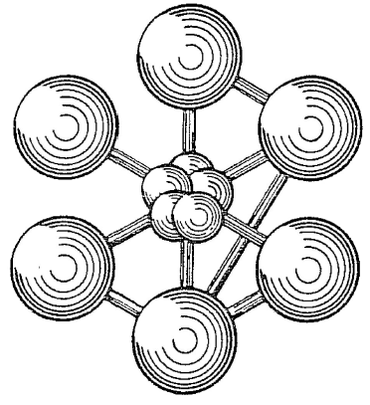
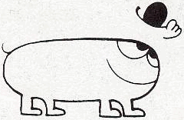
History
1970
AQUAMODE
CEASEMT: package of dedicated software:
COCO (mesh), ESPACE, TEMPS, VISU (post-processing),
SANSON (eq. properties)
TEDEL (beams, pipes), TRICO (shells), BILBO (solids)
PASTEL (2D, plasticity) ➔ INCA
DELPHINE (thermal), AQUAMODE (modal analysis)
Start of GIBI (meshing software)
Initiation of Castem 2000 (based on GIBI)
Official release of Castem2000
Procedures, introduction of fluid physics and other physics
Development of dedicated applications (Toutatis, Esus, …)
Castem 2000 ➔ Cast3M
Platforms for dev. of dedicated applications (Pléiades, Alliance, …)
New dedicated applications (Brasero, Gerboise, Rotor, …)
TRICO
INCA
COCO
ESPACE
SANSON
TEMPS
VISU
TEDEL
BILBO
1981
DELPHINE
1983
1986
1990
2000

Slide 7
What, where, how, how much, who?
Cross platform
Windows, Linux, macOS
Where can I download Cast3M?
http://www-cast3m.cea.fr/index.php?page=dlcastem
Access to the source code
Open collaboration
Compiler / Linker are provided
Price
Free license, for education and research use
Paid license, for enterprise use
Some users/customers
Universities, engineering schools …
IRSN, EDF, SNCF, CNRS, Framatome, Air Liquide, CERN, …
Reference FEM tool for IRSN for safety analysis of French nuclear installations
Reference tool for Framatome for fracture mechanics

Slide 8
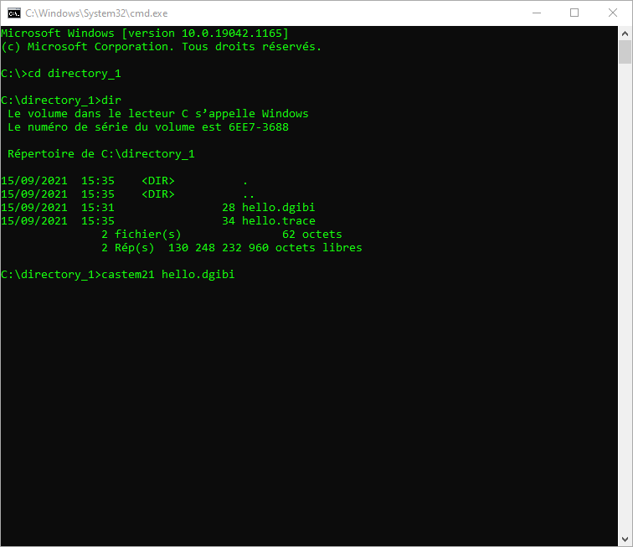
How to launch CAST3M?
1) Write a Gibiane script in a text file
and save it in a working directory
2) Open a terminal / command prompt
and go to the working directory here are some basic Linux commands:
ls list present files
cd foo/bar change directory
pwd print the current working directory
3) Launch Cast3M on this file
castem22 hello.dgibi
You can also use it without .dgibi file
(interactive mode):
castem22

Slide 9
The Cast3M web site
The Cast3M web site: "the place to be"
http://www-cast3m.cea.fr
Cast3M presentation
Training courses and video tutorials
Documentation (manual pages, source code, examples)
Anomaly and development reports
Downloads
Contact: Cast3M support
Community: mailing list, Cast3M club

Slide 10
Gibiane: The user Langage

Slide 11
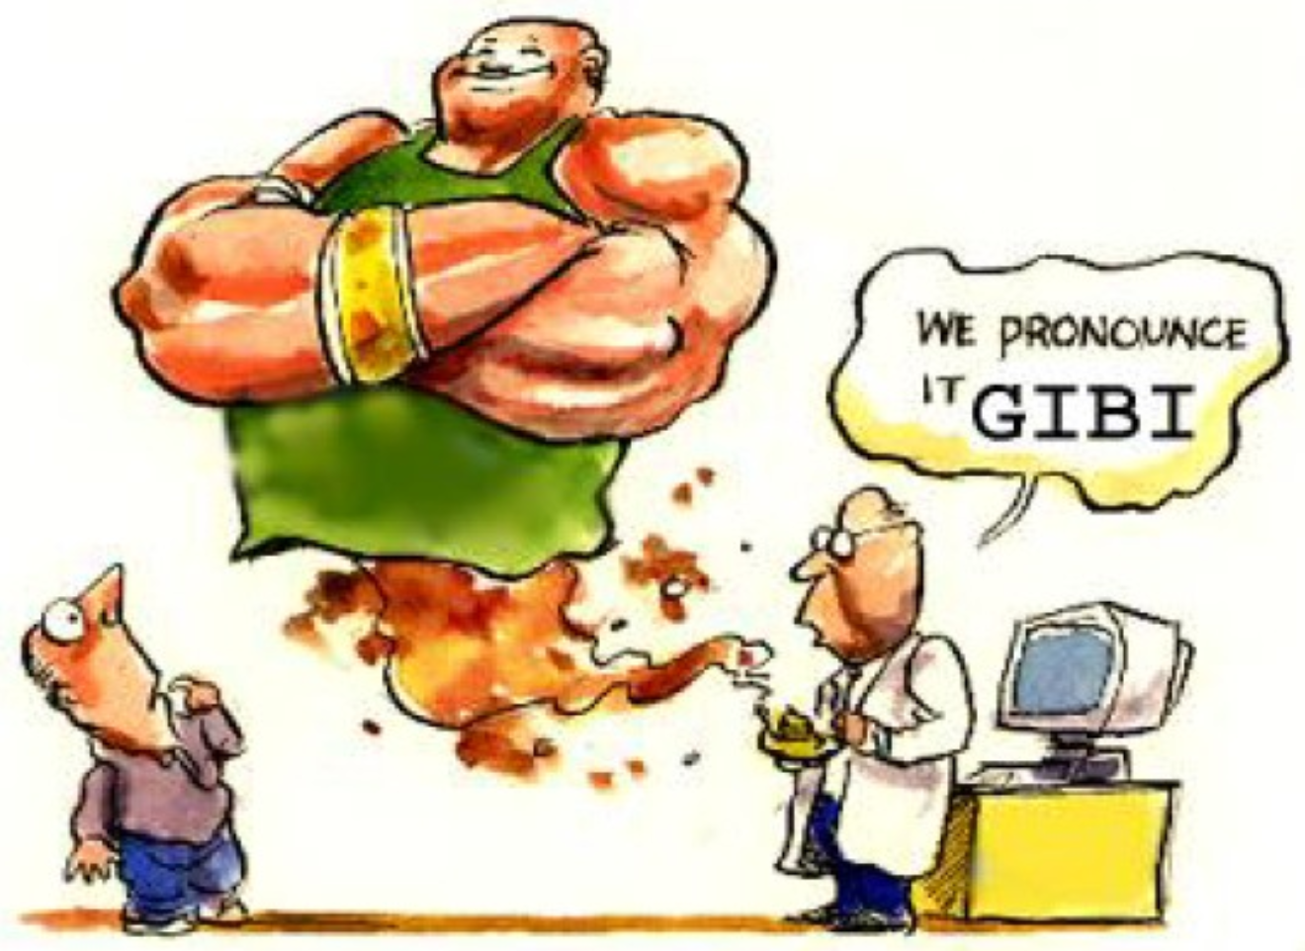
Introduction to GIBIANE
Language dedicated to FE calculation but also a programming language
Classical objects (integer, floating-point, string, logical , tables…)
Flow control statements
Loops and iterations
Subroutines
Recursion
Interpreted language
You can run the program as soon as you make changes to the file
You can run it in a interactive mode
Object-oriented language
Everything in the program is treated as an object
No need to declare variables or to specify the type of a variable
French key words
Easy to learn, easy to read

Slide 12
Gibiane: syntax rules
Statements lines
500 characters max per statement
A statement can be written on several lines
End with a semicolon ;
The assignment operator is the equals sign =
Case insensitive
TOTO = 3.14 ;
A = 2. * tOTo ; variable A has the value of 6.28
excepted characters strings 'blabla' ≠ 'BLABLA' enclosed by single quotes mot1 = 'Hello bro' ;
Program ends
with statement FIN ; ➔ Cast3M stop
empty line or EOF ➔ interactive mode
A * in the first column means that the rest of the line is a comment
Empty lines accepted

Slide 13
Gibiane: syntax rules
No precedence in operators (from left to rigth)
1+2*3 = 9 ➔ use parentheses
1+(2*3) = 7
Prohibitions
No tab key ➔ incomprehensible error message
No double quotes "
Guidelines
No special characters (é, ç, ~, œ …)
Use line indentation (with spaces)
Adjust the text editor
syntax highlighting, switch tabulations by spaces,…
Common errors
Semicolon ; forgotten at the end of the statement
➔ the statement is not ended
Single quote ’ forgotten at the end of a string ➔ the string is not ended

Slide 14
Gibiane: syntax example
Not good!
N = 7 ; F = 1 ;i=1;
REPETER boucle1;
sI (i <eg N) ;
f = F * I ;I=i+1;
SINON;quitter BOUCLE1 ;
finsi;
FIN BOUCLE1;
message F ;FIN ;
Good!
** Initialisation d’un entier N
N = 7 ;
** Calcul de la factorielle du nombre entier N
F = 1 ;
I = 1 ;
REPETER BOUCLE1 ;
SI (I <EG N) ;
F = F * I ;
I = I + 1 ;
SINON ;
QUITTER BOUCLE1 ;
FINSI ;
FIN BOUCLE1 ;
** Affichage du resultat
MESSAGE F ;
FIN ;

Slide 15
Gibiane: objects
Definition
Any data/result with a defined type (possibly a sub-type) and name
Objects Names
User Defined
Limited to 8 characters chosen in:
letters a to z or A to Z, digits (0 to 9) and underscore ( _ )
Traps
more than 8 characters: additional characters ignored
dash sign – ➔ not allowed
letters with accents: é, è ➔ not allowed
Objects types
There are more than 40 types of objects
A detailed list of the most often used objects is given at the end of the presentation (link)

Slide 16
Gibiane: objects
Examples (non exhaustive)
OBJ1 = 3 ; type: ENTIER (integer)
OBJ2 = 3.14 ; type: FLOTTANT (floating)
OBJ3 = 'How are you?' ; type: MOT (string)
OBJ4 = VRAI ; type: LOGIQUE (logical)
poin1 = POIN 0. 0. ; type: POINT
poin2 = POIN 1. 3. ; type: POINT
OBJ5 = DROI 8 poin1 poin2 ; type: MAILLAGE (mesh)
LIST OBJ5 ;
MAILLAGE 3520406 : 8 élément(S) de type SEG2
0 sous-référence(s)
1ère ligne numéro élément : 2ème couleur : 3ème... noeud(s)
1 2 3 4 5 6 7 8
DEFA DEFA DEFA DEFA DEFA DEFA DEFA DEFA
1 3 4 5 6 7 8 9
3 4 5 6 7 8 9 2

Slide 17
Gibiane: operators
Definition
Any processing with a name (Gibiane instruction) that creates new object(s) from pre-existing object(s)
Operators Names
Pre-defined
These are Gibiane instructions
Case insensitive
Only the four first characters are necessary and taken into account (DROITE = DROI)
Excepted abbreviations
DROI ➔ D (or d)
CERC ➔ C (or c)

Slide 18
Gibiane: operators
Examples of operator call
Common cases (single object on the left of the equals sign)
obj1 = OPER obj2 ;
obj3 = OPER obj4 obj5 ;
obj6 = obj7 OPER obj8 obj9 ;
Unusual cases (multiple objects on the left of the equals sign)
obj1 obj2 obj3 = OPER obj4 obj5 ;
The "no name" operator: POINTS creation
in 2 dimensions Point1 = 0. 0. ;
in 3 dimensions Point1 = 0. 0. 0. ;

Slide 19
Gibiane: operators
Arguments order
do not matters if arguments have different types (with a few exceptions pointed in the manual)
matters if same type arguments
Overwriting an object
Always possible, the overwritten object does not exists any longer
A = ‘Hello' ; ➔ A has type MOT
B = 28 ;
C = 3 ;
A = B**C ; ➔ A has type ENTIER, its value is 21952
Traps
Object name = operator name ➔ operator cannot be called excepted if you call it with quotes A = 'OPER' B C ;
in upper case!
Objet name c, C, d or D !

Slide 20
Gibiane: directives
Definition
Statement without assignment operator =
Does not create a new object
Examples
OPTI 'DIME' 3 'ELEM' 'CUB8' ;
OPTI 'TITR' 'Meshing of the structure' ;
DEPL mail1 'PLUS' (28. -0.3 20.03) ;
OPTI is often the first statement of a Gibiane program
It defines Cast3M general options
Examples:
space dimension (1 to 3), elements type, mesh size, output file name, axial symmetry hypothesis, and others…

Slide 21
Gibiane: procedures
Definition
Set of Gibiane statements having a name with input and output arguments
Similar to Fortran subroutine or a C function
Procedures names
As other objects (a procedure is an object with PROCEDUR type)
Declaration
DEBP my_proc arg_e1*entier arg_e2*flottant ... arg_en*mchaml ;
statement 1 ;
statement 2 ;
...
statement k ;
FINP arg_s1 arg_s2 ... arg_sm ;

Slide 22
Gibiane: procedures
Calling
As an operator or directive
obj1 obj2 ... objm = my_proc ent1 flot2 ... champn ;
Pre-existing procedures in Cast3M
List in: http://www-cast3m.cea.fr/index.php?page=notices
PASAPAS ➔ non-linear calculations
FLAMBAGE ➔ buckling calculations
DYNAMIC ➔ dynamics calculations
THERMIC ➔ thermal calculations
G_THETA ➔ line integrals computation (fracture)
…
other procedures to discover in the manual pages

Slide 23
Gibiane: procedures
Traps
FINP missing
➔ Cast3M stops, error message that can be misunderstood
FINP existing but missing ;
➔ Cast3M stops, error message that can be misunderstood
Procedure called before it is declared
➔ Cast3M stops, error message in the = operator difficult to interpret

Slide 24
Gibiane: some useful statements
Debugging
INFO OPER ; OPTI 'LANG' 'ANGL' ;
➔ print the manual page of a operator/directive/procedure
OPTI 'DONN' 5 ;
➔ stop to run the file .dgibi
➔ run from scream: interactive prompt
OPTI 'DONN' 3 ;
➔ return to run the file .dgibi (from where it stops previously)
LIST OBJ1 ;
➔ print information about the object OBJ1
LIST 'RESU' OBJ1 ;
➔ printing is reduced to the headings
OPTI 'DEBU' 1 ;
➔ stop on a error inside a procedure
TRAC OBJ1 (OBJ2) ;
➔ plot an object (mesh, iso-values of fields, deformed mesh, …)
MESS 'Here I am!' ;
➔ print a message

Slide 25
Documentation
Manual pages of operators/directives/procedures
1) The INFO directive, example: INFO EXTR ;
2) Local html page: in the installation directory
example on a Linux system: /home/john_doe/CAST3M_2022/doc/index.html
example on a Windows system: C:\Cast3M\PCW_22\doc\index.html
3) The web site: http://www-cast3m.cea.fr/index.php?page=notices
dedicated to the up to date version !
Users manual
On the web site, see the "Documentation" tab

Slide 26
Tutorial classes Modeling of the Thermo-mechanical behavior of A structure with a circular cavity

Slide 27
Problem Description and boundary conditions
Thermal
Mechanical
Surface force
Convection
Radiation
Surface heat flux
Volume force (weight)
Volume heat source
Prescribed temperature
Blocking (symetry)

Slide 28
reminder
Method to perform finite element calculations (4 main steps)
1) Geometry description and meshing
a) Description of points, lines, surfaces, volumes
b) Discretization
2) Mathematical model definition
a) Definition of the model data (type of analyze, formulation, material behavior, types of elements)
b) Definition of the material properties (Young’s modulus, density, …)
c) Definition of the geometrical properties (shell thickness, moments of inertia for beams, …)
d) Definition of the boundary conditions and loadings
f) Definition of the initial values
3) Solving the discretized model
a) Elementary stiffness matrix and elementary mass matrix calculation
b) Global matrix calculation
c) Introduction of the loadings and boundary conditions
e) Solving the system of equations
4) Analysis et post-processing
a) Local quantities (strains, stresses, displacements, …)
b) Global quantities (maximal strains, strain energy, …)

Slide 29
solution files
The solution files of this tutorial are in the examples base
Download them from the web site:
http://www-cast3m.cea.fr/index.php?page=exemples
Three files will be used:
formation_debutant_1_maillage.dgibi
formation_debutant_2_thermique.dgibi
formation_debutant_3_mecanique.dgibi

Slide 30
Chap. 1: Geometry and mesh
Objective: to create a parametered mesh of the plate with the hole
locate the main points
mesh the closed border
mesh the internal surface
Y
nlong
haut
nhaut
nqcg
nqcd
rayon
nbasg
nbasd
X
O
long

Slide 31
Chap. 1: Meshing and general statements
General options and parameters
* GENERAL OPTIONS AND TYPE OF FINITE ELEMENTS
OPTI 'DIME' 2 'ELEM' 'QUA8' ;
* LENGTHS AND MESH DENSITY DEFINITIONS
LONG = 24.E-1 ;
HAUT = 10.E-1 ;
RAYON = 2.E-1 ;
NLONG = 24 ;
NHAUT = 4 ;
NBASG = 10 ;
NBASD = 10 ;
NQCG = 8 ;
NQCD = 8 ;
Y
nlong
haut
nhaut
nqcg
nqcd
rayon
nbasg
nbasd
O
X
long
New objects ENTIER, FLOTTANT, MOT

Slide 32
Chap. 1: Meshing and general statements
Points creation
* CREATION OF POINTS SUPPORTING THE MESH
PA = 0. 0. ;
PB = ((0.5 * LONG) – RAYON) 0. ;
PC = (0.5 * LONG) RAYON ;
PD = ((0.5 * LONG) + RAYON) 0. ;
PE = LONG 0. ;
PF = LONG HAUT ;
PG = 0. HAUT ;
PCEN = (0.5 * LONG) 0. ;
PG
PF
PC
PCEN
PA
PB
PD
PE
new object POINT

Slide 33
Chap. 1: Meshing and general statements
Lines and closed contour
* STRAIGHT LINES CONSTRUCTION (DROI or D)
LIAB = DROI NBASG PA PB ;
LIDE = DROI NBASD PD PE ;
LIEF = D NHAUT PE PF ;
LIFG = D NLONG PF PG ;
LIGA = D NHAUT PG PA ;
* CONSTRUCTION OF CIRCLES (CERC or C)
(It’s up to you: see the manual pages)
* CLOSED CONTOUR OBTAINED FROM THE ELEMENTARY LINES ASSEMBLY
CO = LIAB ET CE ET LIDE ET LIEF ET LIFG ET LIGA ;
new object MAILLAGE

Slide 34
Chap. 1: Meshing and general statements
Lines and closed contour
* STRAIGHT LINES CONSTRUCTION (DROI or D)
LIAB = DROI NBASG PA PB ;
LIDE = DROI NBASD PD PE ;
LIEF = D NHAUT PE PF ;
LIFG = D NLONG PF PG ;
LIGA = D NHAUT PG PA ;
* CONSTRUCTION OF CIRCLES (CERC or C)
CE1 = CERC NQCG PB PCEN PC ;
CE = C NQCD CE1 PCEN PD ;
* CLOSED CONTOUR OBTAINED FROM THE ELEMENTARY LINES ASSEMBLY
CO = LIAB ET CE ET LIDE ET LIEF ET LIFG ET LIGA ;
LIFG
LIGA
LIEF
CE
LIAB
LIDE

Slide 35
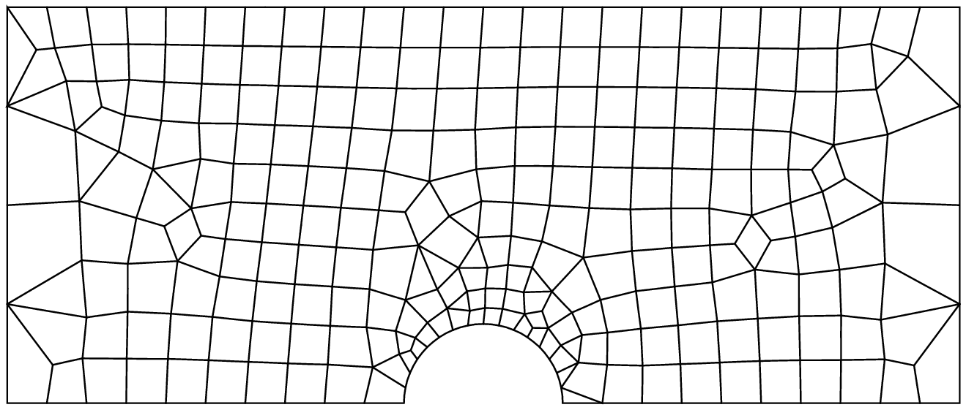
Chap. 1: Meshing and general statements
Surface meshing (free meshing inside the closed contour)
SU = SURF CO ;
TRAC SU ;

Slide 36
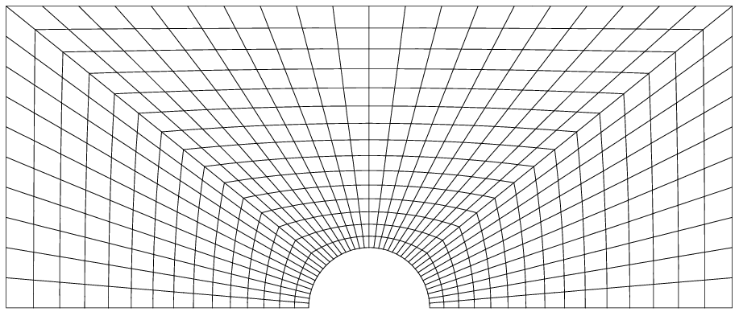
Chap. 1: Meshing and general statements
Objective: to create a regular mesh of the half-plate with a hole
- contains only quadrangle
- controlled elements size
- respect the symmetry of the shape

Slide 37
Chap. 1: Meshing and general statements
Objective: to create a regular mesh of the half-plate with a hole
regular mesh, symmetry, variable elements size
PG
PH
PF
nhaut = 10
PC
nqcg = 20
PA
variable density 0.1 – 0.05
PB
PCEN
PD
PE

Slide 38
Chap. 1: Meshing and general statements
Surface meshing (regular mesh surface relative to two lines)
NHAUT = 10 ;
NQCG = 20 ;
PH = (locate point PH ➔ POIN)
LIHG = (define line HG ➔ DROI)
LIGA = (define line GA ➔ DROI)
CE1 = (define quarter-circle CE1 ➔ CERC)
SU1 = (mesh the surface SU1 ➔ REGL)
SU2 = (using symmetry mesh the surface SU2 ➔ SYME)
SU = (group the two meshes SU1 and SU2 ➔ ET)

Slide 39
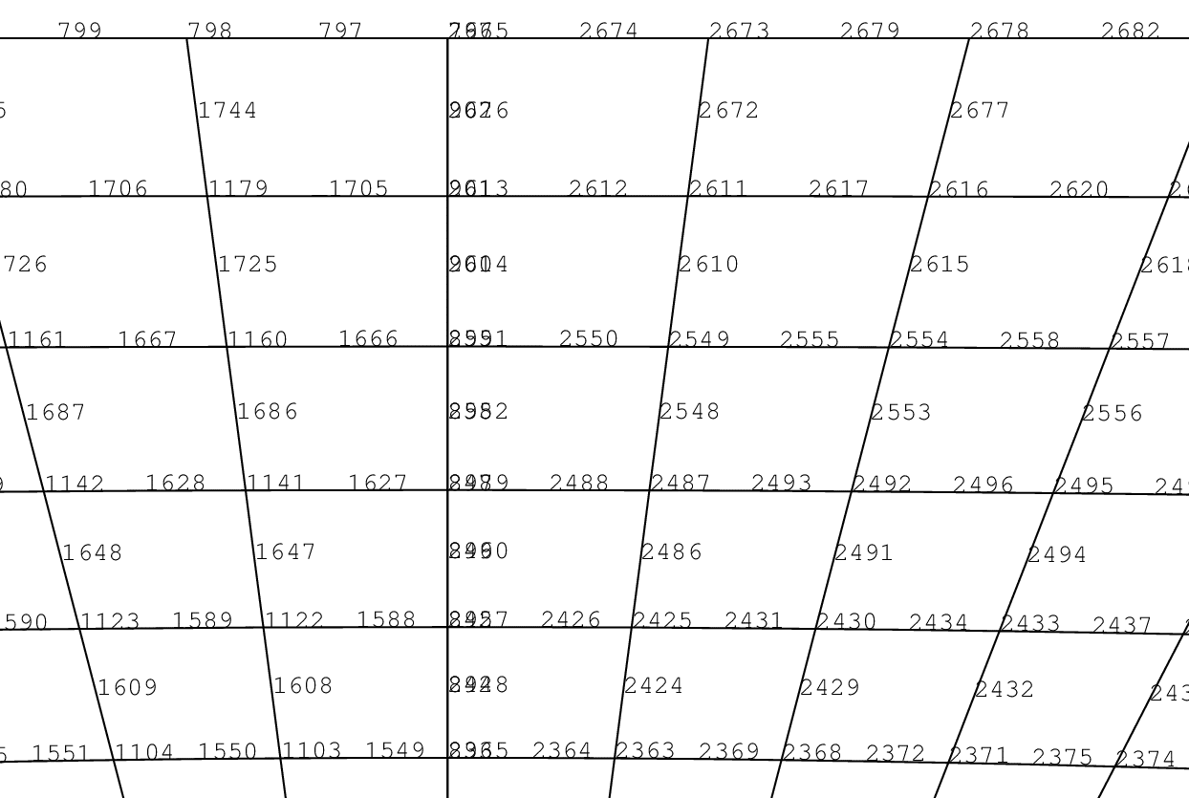
Chap. 1: Meshing and general statements
Surface meshing (regular mesh surface relative to two lines)
NHAUT = 10 ;
NQCG = 20 ;
PH = (0.5 * LONG) HAUT ;
LIHG = DROI (NQCG - NHAUT) PH PG ;
LIGA = DROI NHAUT PG PA ;
CE1 = CERC NQCG PB PCEN PC ;
SU1 = REGL 'DINI' 0.05 'DFIN' 0.1 (INVE CE1) (LIHG ET LIGA) ;
SU2 = SU1 SYME 'DROI' PCEN PH ;
SU = SU1 ET SU2 ;
TRAC SU ;

Slide 40
Chap. 1: Meshing and general statements
Elimination of double nodes, directive ELIM
ELIM SU 1.E-9 ;
TRAC SU ;
➔ all SU nodes distant less than 10⁻⁹ m are merged in a single one
➔ does not change the element type
➔ directive to use carefully !
See also REGE operator
➔ regeneration of elements with merged nodes
➔ change the element type if necessary

Slide 41
Chap. 1: Meshing and general statements
Meshed zones recovery
* HALF-CIRCLE MESH, UPPER AND LINES MESHES RETRIEVAL WITH 'POIN' ET 'ELEM'
CSU = CONT SU ; (Contour of SU mesh recovery)
PCE = SU POIN 'SPHE' PCEN PC 1.E-9 ; (Points of SU located on sphere recovery)
CE = CSU ELEM 'APPU' 'STRI' PCE ; (Elements containing points of CE recovery)
PLHAUT = (It’s up to you); (Points of line PF PG recovery)
LHAUT = (It’s up to you); (Elements containing points of PLHAUT recovery)
PLBAS = (It’s up to you); (Points of line PA PE recovery)
LBAS = (It’s up to you); (Elements containing points of PLBAS recovery)

Slide 42
Chap. 1: Meshing and general statements
Meshed zones recovery
* HALF-CIRCLE MESH, UPPER AND LINES MESHES RETRIEVAL WITH 'POIN' ET 'ELEM'
CSU = CONT SU ;
PCE = SU POIN 'SPHE' PCEN PC 1.E-9 ;
CE = CSU ELEM 'APPU' 'STRI' PCE ;
PLHAUT = SU POIN 'DROI' PF PG 1.E-9 ;
LHAUT = CSU ELEM 'APPU' 'STRI' PLHAUT ;
PLBAS = SU POIN 'DROI' PE PCEN 1.E-9 ;
LBAS = CSU ELEM 'APPU' 'STRI' PLBAS ;

Slide 43
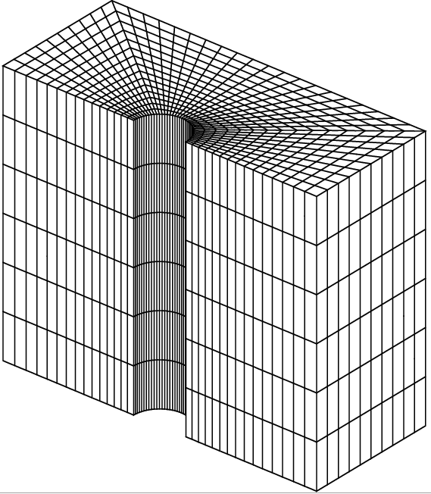
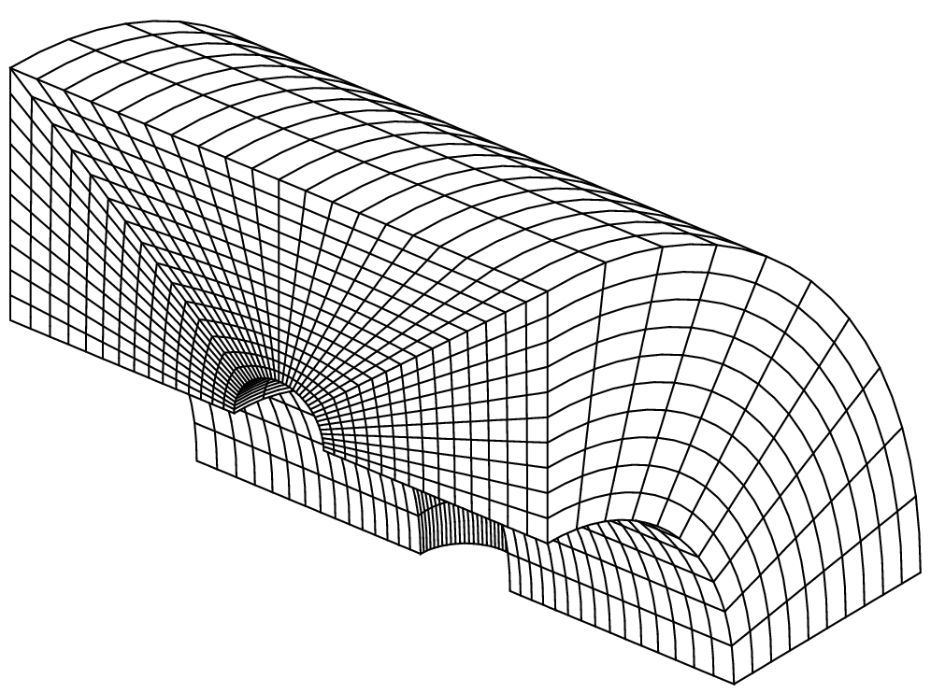
[Bonus] 3D Meshing
Volume meshing (complement)
* CHANGE TO DIMENSION 3
OPTI 'DIME' 3 'ELEM' 'CU20' ;
* VOLUME FROM EXTRUSION
VO = SU VOLU 6 'TRAN' (0. 0. 2.) ;
* VOLUME FROM ROTATION
VO = SU VOLU 10 'ROTA' 90. (0. -1. 0.) (1. -1. 0.) ;
* DISPLAYING
TRAC VO ;
TRAC 'CACH' VO ;
OPTI 'TRAC' 'OPEN' ;
TRAC 'CACH' VO ;
* BACK TO DIMENSON 2
OPTI 'DIME' 2 ;

Slide 44
Chap. 1: Meshing and general statements
Saving data and end of program
* NAME OF THE OUTPUT FILE
OPTI 'SAUV' 'formation_debutant_1_maillage.sauv' ;
* WRITTING THE FILE
SAUV ;
* END OF THE GIBI PROGRAM
FIN ;
All of the objects are saved in the output file
The output file is binary (XDR format )
Other formats available (text, …), see the manual page of OPTI 'SAUV' and SAUV

Slide 45
Thermal analysis: reminder
Heat equation
$ρc_{p}\frac{∂T}{∂t}+div\left(−λ \vec{grad}(T)\right)−q=0$ on $V$
with:
$T$ : temperature
$q$ : volume heat flux source
$λ$ : thermal conductivity
$ρ$ : volumetric mass density
$c_{p}$ : specific heat capacity
$t$ : time
Boundary conditions
Prescribed temperatures $T=T_{imp}$ on $∂V^{T}$
Prescribed surface heat flux
$\vec{n} .\left(λ \vec{grad}(T)\right)=φ_{imp}+\underset{convection}{\underbrace{h\left(T_{f}−T\right)}}+\underset{radiation}{\underbrace{εσ\left(T_{∞}^{4}−T^{4}\right)}}$ on $∂V^{φ}$

Slide 46
Thermal analysis: reminder
Discrete form (finite elements)
FE discretization: $T\left(x\right)=\left[N(x)\right]\left\{T\right\} \vec{grad}(T)=\left[B(x)\right]\left\{T\right\}$
Weak formulation + EF:
$$\left[C\right]\left\{\dot{T}\right\}+\left[K\right]\left\{T\right\}=\left\{F\right\}$$
Matrices
$\left[C\right]=\int_{V}{ρc_{p}{\left[N\right]}^{T}\left[N\right]dV}$ capacity matrix (J.K⁻¹)
$\left[K\right]=\int_{V}{{\left[B\right]}^{T}\left[λ\right]\left[B\right]dV}+\int_{∂V^{φ}}{h{\left[N\right]}^{T}\left[N\right]dS}$ conductivity matrix (W.K⁻¹)
Equivalent nodal flux vectors (W)
$\left\{F\right\}=\int_{V}{{\left[N\right]}^{T}q dV}$ $+$ $\int_{∂V^{φ}}{{\left[N\right]}^{T}\left(φ_{imp}+hT_{f}+εσ\left(T_{∞}^{4}−T^{4}\right)\right)dS}$

Slide 47
Chap. 2: stationary linear thermal Analysis
Objective: stationary thermal calculation with prescribed temperatures (time independent)
$\left[C\right]\left\{\dot{T}\right\}+\left[K\right]\left\{T\right\}=\left\{F\right\}$ → Linear system
conductivity matrix calculation $\left[K\right]$(1st member)
fixed nodal heat fluxes calculation $\left\{F\right\}$ (2nd member)
solving with RESO ➔ temperature $\left\{T\right\}$ (unknown)
-3,5 10⁴ W.m⁻²
250 °C

Slide 48
Chap. 2: stationary linear thermal Analysis
Input data from previous computation (mesh, parameters, …)
* NAME OF THE INPUT FILE (RESTITUTION)
OPTI 'REST' 'formation_debutant_1_maillage.sauv' ;
* LOADING INTO MEMORY
REST ;
→ All of the objects are loaded into memory
→ They can be called now
* MATERIAL PROPERTIES
CONDUMAT = 210. ;
CAPAMAT = 900. ;
RHOMAT = 2700. ;
* INITIAL AND REFERENCE TEMPERATURE
T0 = 25. ;

Slide 49
Chap. 2: stationary linear thermal Analysis
Mathematical formulation
* THERMAL MODEL (CONDUCTION) UNIFORM AND STATIONARY MATERIAL PROPERTIES
MOT = MODE SU 'THERMIQUE' ;
MAT = MATE MOT 'K' CONDUMAT 'C' CAPAMAT 'RHO' RHOMAT 'TINI' T0 ;
* CONDUCTIVITY MATRIX CALCULATION (FIRST MEMBER)
CON = COND MOT MAT ;
$$\left[K\right]=\int_{V}{{\left[B\right]}^{T}\left[λ\right]\left[B\right]dV}+\int_{∂V^{φ}}{h{\left[N\right]}^{T}\left[N\right]dS}$$
new objects MMODEL, MCHAML, RIGIDITE

Slide 50
Chap. 2: stationary linear thermal Analysis
Boundary conditions
* BOUNDARY CONDITIONS: PRESCRIBED TEMPERATURE ON THE HOLE
BLT = BLOQ CE 'T' ;
* NODAL HEAT FLUX (LOADINGS) FOR CONSTRAINTS link
TMAX = 250. ;
FLT1 = DEPI BLT TMAX ;
* PRESCRIBED HEAT FLUX ON THE LEFT SIDE
FLT2 = FLUX MOT LIGA -3.5E4 ;
Linear system solving
* TEMPERATURE FIELD CALCULATION USING 'RESO'
TCON1 = RESO (CON ET BLT) (FLT1 ET FLT2) ;
$$\left\{F\right\}=\int_{V}{{\left[N\right]}^{T}q dV}+\int_{∂V^{φ}}{{\left[N\right]}^{T}\left(φ_{imp}+hT_{f}+εσ\left(T_{∞}^{4}−T^{4}\right)\right) dS}$$
new object CHPOINT

Slide 51
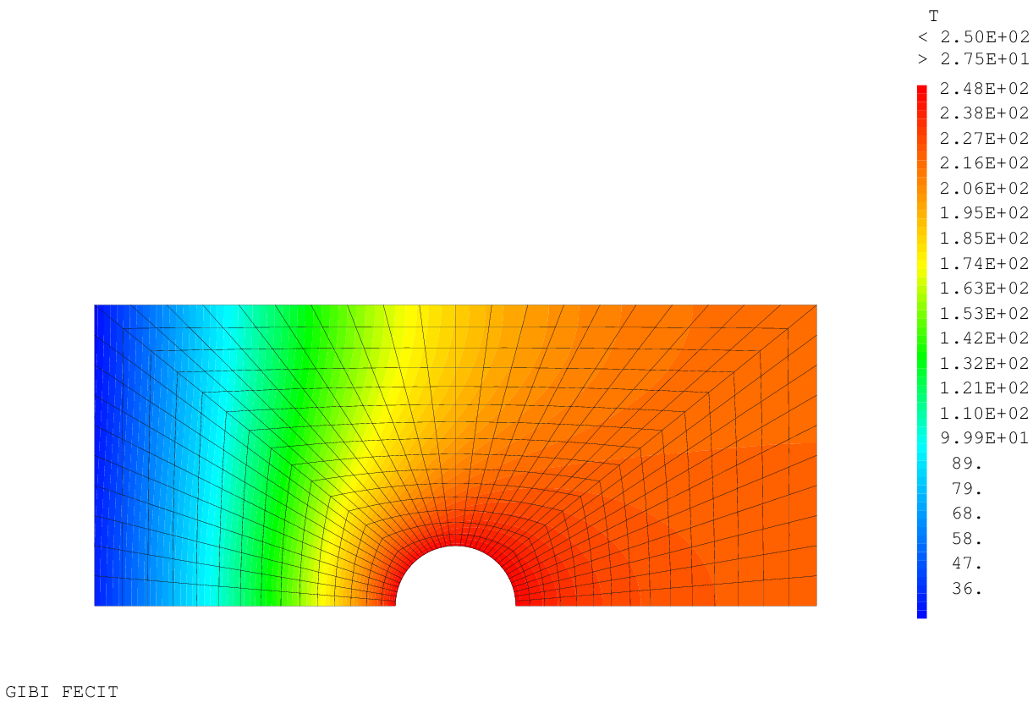
Chap. 2: stationary linear thermal Analysis
Results display
* DISPLAY THE TEMPERATURE FIELD
TRAC TCON1 SU ;

Slide 52
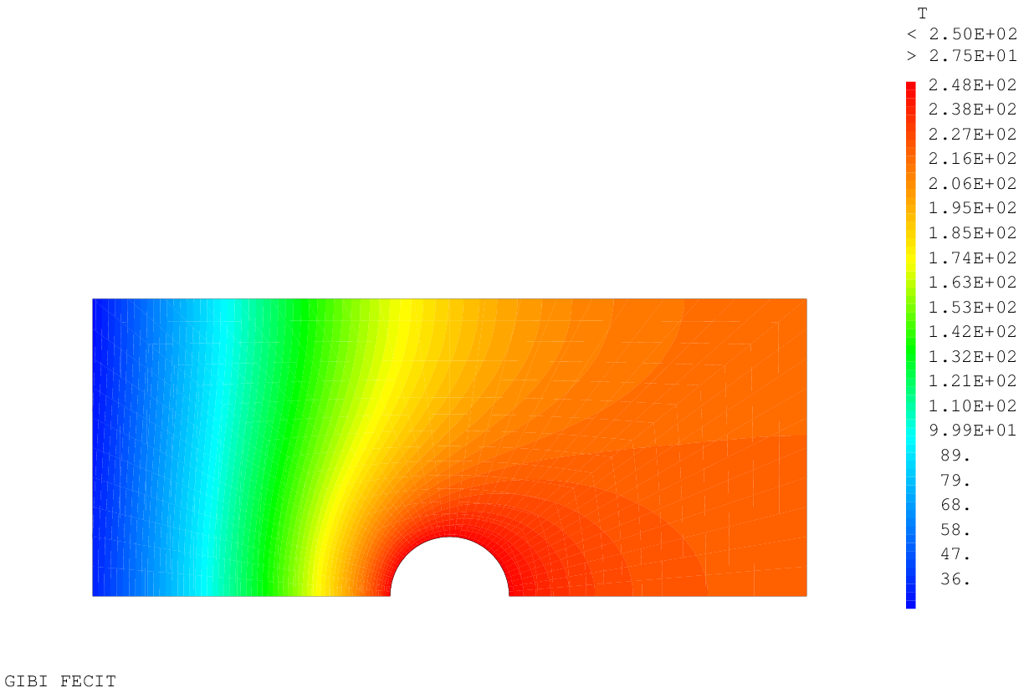
Chap. 2: stationary linear thermal Analysis
Results display
* DISPLAY THE TEMPERATURE FIELD
TRAC TCON1 SU CSU ;

Slide 53
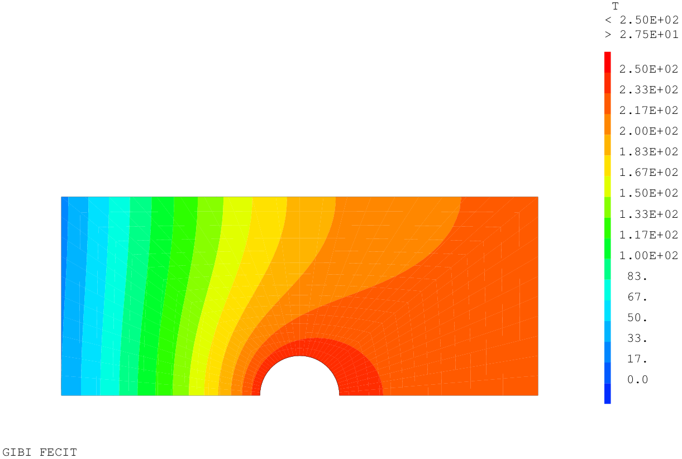
Chap. 2: stationary linear thermal Analysis
Results display
* DISPLAY THE TEMPERATURE FIELD
LISO1 = PROG 0. 'PAS' (TMAX / 15.) TMAX ;
TRAC TCON1 SU CSU LISO1 ;
new object LISTREEL

Slide 54
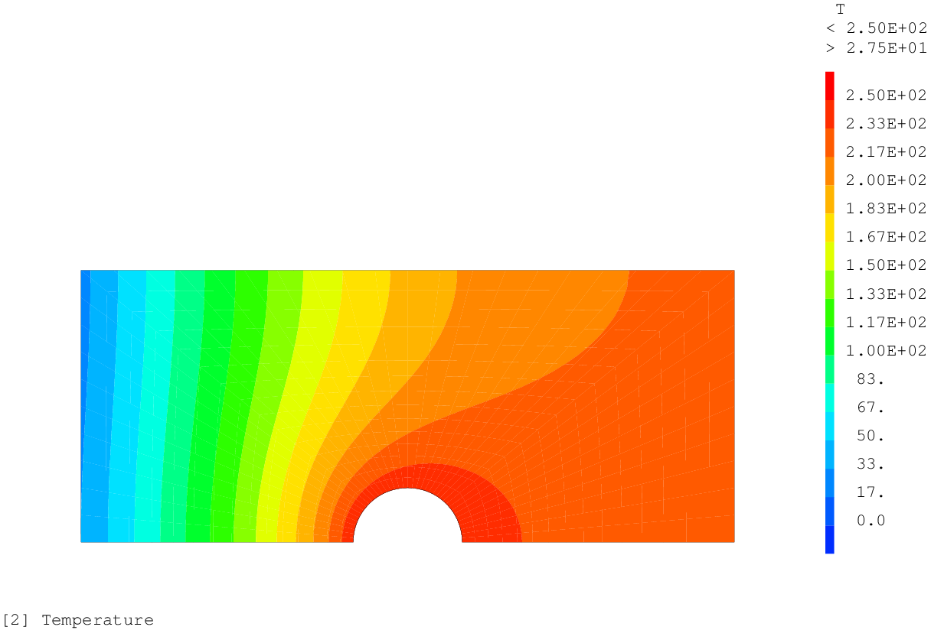
Chap. 2: stationary linear thermal Analysis
Results display
* DISPLAY THE TEMPERATURE FIELD
TRAC TCON1 SU CSU LISO1 'TITR' '[2] Temperature' ;

Slide 55
Chap. 2.1: stationary linear thermal Analysis convection and volume heat source
Objective: previous thermal calculation
+ convection
+ volume heat source
convection model
volume source load
T∞ = 25 °C h = 100 W.K⁻¹.m⁻²
-3,5 10⁴ W.m⁻²
10⁵ W.m⁻³
250 °C

Slide 56
Chap. 2.1: stationary linear thermal Analysis convection and volume heat source
Mathematical formulation
* CONVECTION MODEL
MOC = MODE LHAUT 'THERMIQUE' 'CONVECTION' ;
MAC = MATE MOC 'H' 100. ;
Conductivity matrix (but for convection !)
* FIRST MEMBER FOR CONVECTION
CONH = COND MOC MAC ;
Equivalent nodal heat flux vector (convection)
* SECOND MEMBER FOR CONVECTION
CHTC = MANU 'CHPO' LHAUT 'T' T0 ;
FLH = CONV MOC MAC CHTC ;
$$\left[K\right]=\int_{V}{{\left[B\right]}^{T}\left[λ\right]\left[B\right]dV}+\int_{∂V^{φ}}{h{\left[N\right]}^{T}\left[N\right]dS}$$
$$\left\{F\right\}=\int_{V}{{\left[N\right]}^{T}q dV}+\int_{∂V^{φ}}{{\left[N\right]}^{T}\left(φ_{imp}+hT_{f}+εσ\left(T_{∞}^{4}−T^{4}\right)\right) dS}$$

Slide 57
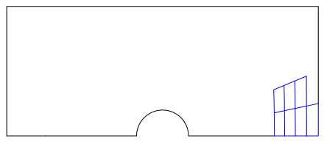
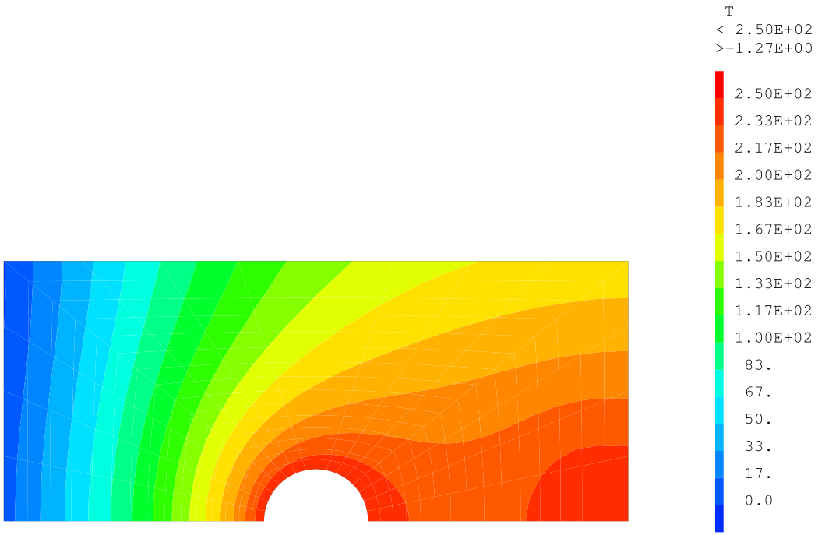
Chap. 2.1: stationary linear thermal Analysis convection and volume heat source
Equivalent nodal heat flux vector (volume source)
* SECOND MEMBER FOR THE VOLUME SOURCE
X Y = COOR SU ;
PT1 = X POIN 'SUPERIEUR' 20.E-1 ;
PT2 = (REDU Y PT1) POIN 'INFERIEUR' 5.E-1 ;
ELSOU = SU ELEM 'APPUYE' 'STRICTEMENT' PT2 ;
FLS = SOUR (REDU MOT ELSOU) 1.E5 ELSOU ;
Linear system solving
* TEMPERATURE FIELD CALCULATION USING 'RESO'
TCON2 = RESO (CON ET CONH ET BLT) (FLT1 ET FLT2 ET FLH ET FLS) ;
* DISPLAY THE TEMPERATURE FIELD
TRAC TCON2 SU CSU LISO1 ;
$$\left\{F\right\}=\int_{V}{{\left[N\right]}^{T}q dV}+\int_{∂V^{φ}}{{\left[N\right]}^{T}\left(φ_{imp}+hT_{f}+εσ\left(T_{∞}^{4}−T^{4}\right)\right) dS}$$

Slide 58
Note: the nodal field (CHPOINT)
The CHPOINT type object
Values are located on POINTS (nodes)
Examples:
scalar temperature field
vector displacement field (3 components)
vector coordinates fields
second member of a linear problem $\left[K\right]\left\{x\right\}=\left\{F\right\}$, for instance:
nodal forces
nodal heat flux
and others…
Some characteristics:
only one value per node
do not depends on the mesh, only on nodes!
when plotted, the field is continuous on the mesh

Slide 59
Note: the element field (MCHAML)
The MCHAML type object
Values are located into ELEMENTS of a mesh
Examples:
material properties
stress, strains fields
internal variables field
gradient of a CHPOINT object
and others…
Some characteristics:
several support points available:
integration points for stresses
integration points for stiffness
integration points for mass
center of gravity
nodes
interpolation functions depends on the model
non continuous between elements

Slide 60
Chap. 3: Transient linear thermal analysis convection, source, pASAPAS
Objective: previous thermal calculation
+ transient (with an initial temperature = 25 °C)
$$\left[C\right]\left\{\dot{T}\right\}+\left[K\right]\left\{T\right\}=\left\{F\right\}$$
time description of loading
initial conditions
using the PASAPAS solving procedure
T∞ = 25 °C h = 100 W.K⁻¹.m⁻²
-3,5 10⁴ W.m⁻²
10⁵ W.m⁻³
250 °C

Slide 61
Chap. 3: Transient linear thermal analysis convection, source, pASAPAS
Initial conditions
* FINAL INSTANT
TPSFIN = 5.E4 ;
Loading definition (BC as function of space and time)
* TEMPERATURE LOAD
LIST1 = PROG 0. (0.1 * TPSFIN) TPSFIN ;
LIST2 = PROG (T0 / TMAX) 1. 1. ;
EVT1 = EVOL 'MANU' LIST1 LIST2 ;
CHATIMP = CHAR 'TIMP' FLT1 EVT1 ;
* HEAT FLUX LOAD
LIST3 = PROG 0. (0.2 * TPSFIN) (0.4 * TPSFIN) TPSFIN ;
LIST4 = PROG 0. 0. 1. 1. ;
EVT2 = EVOL 'MANU' LIST3 LIST4 ;
CHAFIMP = CHAR 'Q' FLT2 EVT2 ;
* CONVECTION TEMPERATURE LOAD
LIST5 = PROG 0. TPSFIN ;
LIST6 = PROG 1. 1. ;
EVCTE = EVOL 'MANU' LIST5 LIST6 ;
CHACONV = CHAR 'TECO' CHTC EVCTE ;
* HEAT SOURCE LOAD
CHASOUR = CHAR 'Q' FLS EVT2 ;
CHAT = CHATIMP ET CHAFIMP ET CHACONV ET CHASOUR ;
Loading $\left\{F\right\}\left(t\right)=k\left(t\right).\left\{F\right\}$
k
1
EVCTE
EVT1
EVT2
0,1
t / TPSFIN
0
0,1
0,2
0,4
1
new objects EVOLUTIOn and CHARGEMEnt

Slide 62
Chap. 3: Transient linear thermal analysis convection, source, pASAPAS
Construction of TAB1: table for procedure PASAPAS
* TABLE OF ARGUMENTS NECESSARY AS ENTRIES FOR THE PASAPAS PROCEDURE
TAB1 = TABL ;
TAB1 . 'MODELE' = MOT ET MOC ;
TAB1 . 'CARACTERISTIQUES' = MAT ET MAC ;
TAB1 . 'BLOCAGES_THERMIQUES' = BLT ;
TAB1 . 'CHARGEMENT' = CHT ;
TAB1 . 'TEMPS_CALCULES' = PROG 0. 'PAS' (0.02 * TPSFIN) TPSFIN ;
Solving with PASAPAS procedure
* PASAPAS CALL
PASAPAS TAB1 ;
new object TABLE

Slide 63
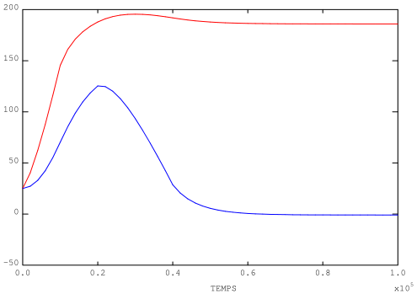
Chap. 3: Transient linear thermal analysis convection, source, pASAPAS
Post processing: evolution curves, field plot
* VARIATION OF TEMPERATURE AT TWO POINTS AS A FUNCTION OF TIME
* IN ORDER TO VERIFY STEADY STATE IS REACHED
PMIL = SU POIN 'PROC' ((0.5 * LONG) (0.5 * HAUT)) ;
EV1 = EVOL 'ROUG' 'TEMP' TAB1 'TEMPERATURES' 'T' PMIL ;
EV2 = EVOL 'BLEU' 'TEMP' TAB1 'TEMPERATURES' 'T' PG ;
DESS (EV1 ET EV2) ;

Slide 64
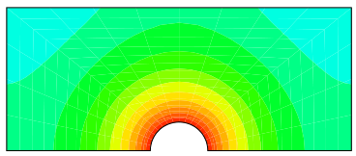
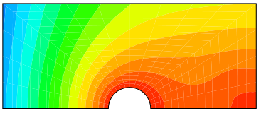
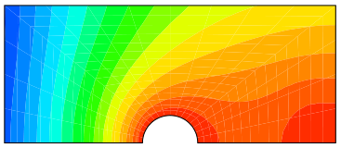
Chap. 3: Transient linear thermal analysis convection, source, pASAPAS
Post processing: iterative loop for plotting
* LOOP ON EACH TIME STEP AND PLOT OF TEMPERATURE FIELD
N1 = DIME (TAB1 . 'TEMPERATURES') ;
REPE B1 N1 ;
T_I = TAB1 . 'TEMPERATURES' . (&B1 - 1) ;
TPS_I = TAB1 . 'TEMPS' . (&B1 - 1) ;
PRC_I = ENTI (100. * TPS_I / TPSFIN) ;
MOT_I = CHAI '[3] Temperatures at time ' TPS_I ' (' PRC_I ' %)' ;
TRAC T_I SU CSU 'TITR' MOT_I LISO1 ;
FIN B1 ;
Loop counter
1, 2, 3, … , N1

Slide 65
Chap. 3: Transient linear thermal analysis convection, source, pASAPAS
Procedure writing (heat flux vector calculation)
* HEAT FLUX VECTOR ==> PROCEDURE WRITING
DEBP VECFLU CHP1*'CHPOINT' MOD1*'MMODEL' MAT1*'MCHAML' ;
* GRADIENT CALCULATION AND CHANGE OF ITS TYPE
G1 = GRAD CHP1 MOD1 ;
G2 = CHAN 'TYPE' G1 'CARACTERISTIQUES' ;
* MULTIPLICATION OF THE ELEMENT FIELDS
Q = MAT1 * G2 (MOTS 'K' 'K') (MOTS 'T,X' 'T,Y') (MOTS 'QX' 'QY') ;
Q = -1. * Q ;
* VECTOR OBJECT CREATION
VEC1 = VECT Q MOD1 (MOTS 'QX' 'QY') 2.E-6 ;
FINP VEC1 ;
new objects PROCEDURe, LISTMOTS, VECTEUR

Slide 66
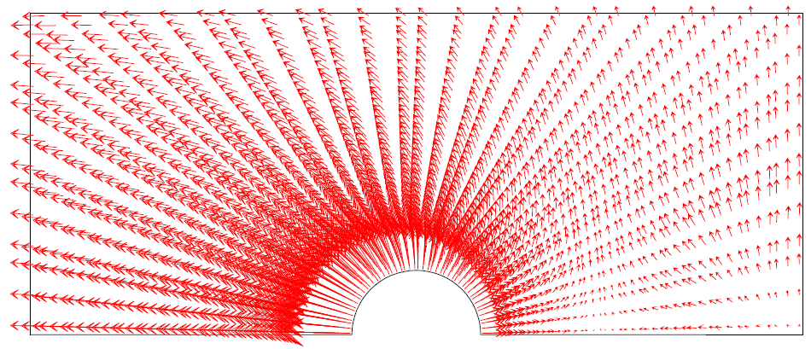
Chap. 3: Transient linear thermal analysis convection, source, pASAPAS
Post processing: heat flux vector plot
* LOOP ON EACH TIME STEP AND PLOT OF HEAT FLUX VECTOR
REPE B1 N1 ;
T_I = TAB1 . 'TEMPERATURES' . (&B1 - 1) ;
VF_I = VECFLU T_I MOT MAT ;
TRAC VF_I CSU ;
FIN B1 ;

Slide 67
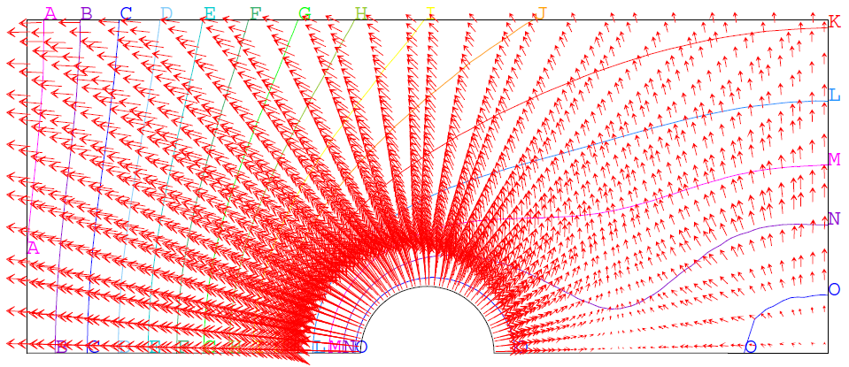
Chap. 3: Transient linear thermal analysis convection, source, pASAPAS
Post processing: plot of heat flux vector and temperature isovalue lines
* FLUX VECTOR AND TEMPERATURE FIELD AS ISOVALUE LINES
OPTI 'ISOV' 'LIGN' ;
TRAC VF_I T_I SU CSU 15 ;
OPTI 'ISOV' 'SURF' ;

Slide 68
Chap. 4: Transient NON-linear thermal analysis convection, source, RADIATION, PASAPAS
Objective: previous thermal calculations
+ radiation
addition of a model and loading for radiation
T∞ = 25 °C ε = 0.8
T∞ = 25 °C h = 100 W.K⁻¹.m⁻²
-3,5 10⁴ W.m⁻²
10⁵ W.m⁻³
250 °C

Slide 69
Chap. 4: Transient NON-linear thermal analysis convection, source, RADIATION, PASAPAS
Radiation heat transfer model
* RADIATION MODEL ON THE UPPER LINE
MOR = MODE LHAUT 'THERMIQUE' 'RAYONNEMENT' 'INFINI' ;
MAR = MATE MOR 'EMIS' 0.8 ;
Loading with the surroundings temperature
* RADIATION LOADING IS THE SURROUNDINGS TEMPERATURE
CHTR = MANU 'CHPO' LHAUT 1 'T' T0 ;
CHARAYE = CHAR 'TERA' CHTR EVCTE ;
CHAT = CHAT ET CHARAY ;

Slide 70
Chap. 4: Transient NON-linear thermal analysis convection, source, RADIATION, PASAPAS
PASAPAS table building
* RE-DEFINITION OF TABLE TAB1 FOR PASAPAS PROCEDURE
TAB1 = TABL ;
TAB1 . 'MODELE' = (It’s up to you) ;
TAB1 . 'CARACTERISTIQUES' = (It’s up to you) ;
TAB1 . 'BLOCAGES_THERMIQUES' = (It’s up to you) ;
TAB1 . 'CHARGEMENT' = (It’s up to you) ;
TAB1 . 'TEMPS_CALCULES' = (It’s up to you) ;
Other indexes ?? (It’s up to you)
Solving with PASAPAS procedure
* PASAPAS CALL
(It’s up to you)

Slide 71
Chap. 4: Transient NON-linear thermal analysis convection, source, RADIATION, PASAPAS
Post processing
* RE-DEFINITION OF TABLE TAB1 FOR PASAPAS PROCEDURE
TAB1 = TABL ;
TAB1 . 'MODELE' = MOT ET MOC ET MOR ;
TAB1 . 'CARACTERISTIQUES' = MAT ET MAC ET MAR ;
TAB1 . 'BLOCAGES_THERMIQUES' = BLT ;
TAB1 . 'CHARGEMENT' = CHAT ;
TAB1 . 'TEMPS_CALCULES' = PROG 0. 'PAS' (0.02 * TPSFIN) TPSFIN ;
TAB1 . 'CELSIUS' = VRAI ;
Solving with PASAPAS procedure
* PASAPAS CALL
PASAPAS TAB1 ;

Slide 72
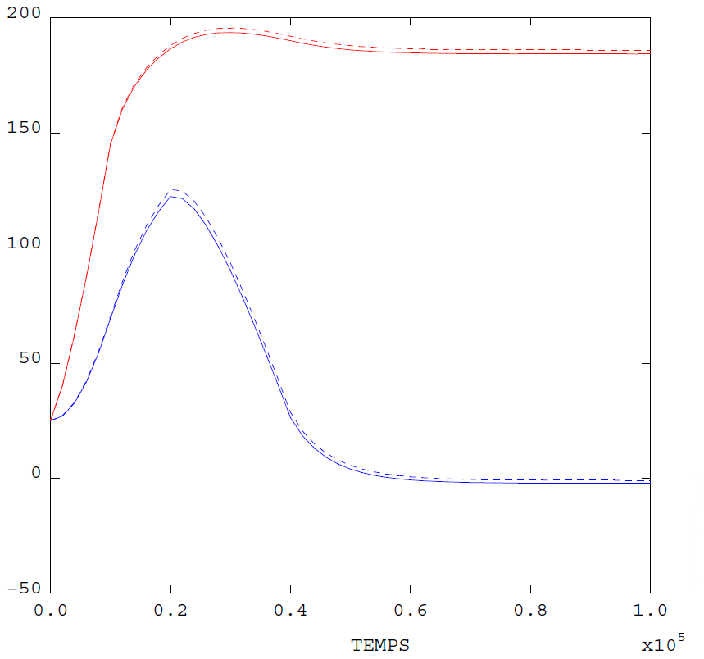
Chap. 4: Transient NON-linear thermal analysis convection, source, RADIATION, PASAPAS
Post processing
* TIME EVOLUTION OF TEMPERATURE ON 2 POINTS
EV11 = EVOL 'ROUG' 'TEMP' TAB1 'TEMPERATURES' 'T' PMIL ;
EV22 = EVOL 'BLEU' 'TEMP' TAB1 'TEMPERATURES' 'T' PG ;
TL = TABL ;
TL . 1 = 'TIRR' ;
TL . 2 = 'TIRR' ;
TL . 'TITRE' = TABL ;
TL . 'TITRE' . 1 = 'PMIL' ;
TL . 'TITRE' . 2 = 'PG ' ;
TL . 'TITRE' . 3 = 'PMIL with rad' ;
TL . 'TITRE' . 4 = 'PG with rad' ;
DESS (EV1 ET EV2 ET EV11 ET EV22) 'LEGE' TL ;

Slide 73
Chap. 4: Transient NON-linear thermal analysis convection, source, RADIATION, PASAPAS
Saving data and end of program
OPTI 'SAUV' 'formation_debutant_2_thermique.sauv' ;
SAUV ;
FIN ;

Slide 74
Mechanics: reminder
Equilibrium equation (statics)
$div\left(σ\right)+\vec{f}=\vec{0}$ on $V$
Boundary conditions
Prescribed displacements: $\vec{u}=\vec{d}$ on $∂V^{d}$
Prescribed surface forces: $σ. \vec{n}=\vec{t}$ on $∂V^{t}$
with:
$\vec{u}$ : displacement vector
$σ$ : stress tensor
$\vec{f}$ : volume forces vector
$\vec{n}$ : normal vector to a surface

Slide 75
Mechanics: reminder
FE discretization
$$\vec{u}\left(x\right)=\left[N(x)\right]\left\{u\right\}$$
Weak formulation of equilibrium + FE discretization
$$\left\{F\right\}−\int_{V}{{\left[B\right]}^{T}\left\{σ\right\}dV}=\left\{0\right\}$$
$$\underset{{\left\{F\right\}}^{S}}{\underbrace{\int_{∂V^{t}}{{\left[N\right]}^{T}\left\{t\right\} dS}}} + \underset{{\left\{F\right\}}^{R}}{\underbrace{\int_{∂V^{d}}{{\left[N\right]}^{T}\left\{σ.n\right\}dS}}} + \underset{{\left\{F\right\}}^{V}}{\underbrace{\int_{V}{{\left[N\right]}^{T}\left\{f\right\} dV}}} − \underset{\left[B\right]\left\{σ\right\}}{\underbrace{\int_{V}{{\left[B\right]}^{T}\left\{σ\right\}dV}}} = \left\{0\right\}$$
Equivalent nodal forces vector (N) to:
${\left\{F\right\}}^{S}$ prescribed surface forces $\vec{t}$
${\left\{F\right\}}^{R}$ surface forces in reaction to prescribed displacements $\vec{d}$
${\left\{F\right\}}^{V}$ prescribed volume forces $f$
$\left[B\right]\left\{σ\right\}$ internal volume forces
Matrices
$\left[N\right]$ matrix of shape functions ( . )
$\left[B\right]$ matrix of derivative of shape functions (m⁻¹)

Slide 76
Mechanics: reminder
FE discretization
$$\vec{u}\left(x\right)=\left[N(x)\right]\left\{u\right\}$$
Weak formulation of equilibrium + FE discretization
$$\left\{F\right\}−\int_{V}{{\left[B\right]}^{T}\left\{σ\right\}dV}=\left\{0\right\}$$
Small strain hypothesis $ε(x)=\left[B(x)\right]\left\{u\right\}$ + elasticity
$$\int_{V}{{\left[B\right]}^{T}\left\{σ\right\}dV}=\underset{\left[K\right]}{\underbrace{\int_{V}{{\left[B\right]}^{T}\left[C\right]\left[B\right]dV}}}.\left\{u\right\}$$
$$\left[K\right]\left\{u\right\}=\left\{F\right\}$$
Matrices
$\left[K\right]$ stiffness matrix (N. m⁻¹)

Slide 77
Chap. 5: elastic mechanical analysis
Objective: elastic calculations
with prescribed displacements
and surface and volume forces
$\left[K\right]\left\{u\right\}=\left\{F\right\}$ → Linear system
stiffness matrix calculation $\left[K\right]$ (1st member)
nodal forces calculation $\left\{F\right\}$ (2nd member)
solving with RESO ➔ displacements $\left\{u\right\}$ (unknown)
σ = 30 MPa
f = ρg
Ux = 0
Uy = 0

Slide 78
Chap. 5: elastic mechanical analysis
Input data from previous computation (mesh, parameters, …)
OPTI 'REST' 'formation_debutant_2_thermique.sauv' ;
REST ;
* MECHANICAL MATERIAL PARAMETERS
YOUNGMAT = 30.E9 ;
NUMAT = 0.2 ;
ALPHAMAT = 12.E-6 ;
SIGYMAT = 120.E6 ;
Plane strain hypothesis
OPTI 'MODE' 'PLAN' 'DEFO' ;
Linear elastic isotropic mechanical model
MOM1 = MODE SU 'MECANIQUE' 'ELASTIQUE' ;
MAM1 = MATE MOM1 'YOUN' YOUNGMAT 'NU' NUMAT 'ALPH' ALPHAMAT 'TREF' T0 'TALP' T0 ;

Slide 79
Chap. 5: elastic mechanical analysis
$$\left[K\right]=\int_{V}{{\left[B\right]}^{T}\left[C\right]\left[B\right]dV}$$
Stiffness matrix (1st member)
RI = RIGI MOM1 MAM1 ;
Constraints on displacements (1st member)
BLMX = BLOQ PA 'UX' ; (point A locked along x)
BLMY = BLOQ (It's up to you); (lower line locked along y)
RITOT = (It's up to you); (assembly of stiffness)
Equivalent nodal forces to the pressure (2nd member)
FS = PRES (It's up to you);
Equivalent nodal forces to the volume forces (2nd member)
FV = CNEQ (It’s up to you);
Linear system solving
U5 = (It's up to you)

Slide 80
Chap. 5: elastic mechanical analysis
$$\left[K\right]=\int_{V}{{\left[B\right]}^{T}\left[C\right]\left[B\right]dV}$$
Stiffness matrix (1st member)
RI = RIGI MOM1 MAM1 ;
Constraints on displacements (1st member)
BLMX = BLOQ PA 'UX' ; (point A locked along x)
BLMY = BLOQ LBAS 'UY' ;
RITOT = RI ET BLMX ET BLMY ;
Equivalent nodal forces to the pressure (2nd member)
FS = PRES 'MASS' MOM1 LHAUT 30.E6 ;
Equivalent nodal forces to the volume forces (2nd member)
ROG = MANU 'CHPO' SU 2 'FX' 0. 'FY' (-9.81 * RHOMAT) ;
FV = CNEQ MOM1 ROG ;
Linear system solving
U5 = RESO RITOT (FS ET FV) ;
$${\left\{F\right\}}^{S}=\int_{∂V^{t}}{{\left[N\right]}^{T}\left\{t\right\} dS}$$
$${\left\{F\right\}}^{V}=\int_{V}{{\left[N\right]}^{T}\left\{f\right\} dV}$$

Slide 81
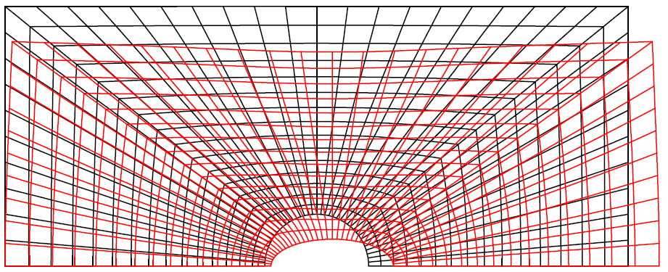
Chap. 5: elastic mechanical analysis
Post processing: strains, stresses, deformed mesh
* DEFORMED MESH PLOT
DEF_5 = DEFO SU U5 150. 'ROUG' ;
DEF_INI = DEFO SU U5 0. ;
TRAC (DEF_INI ET DEF_5) ;
* PLOT OF THE DEFORMED MESH BORDER
(It's up to you)
new object DEFORMEE

Slide 82
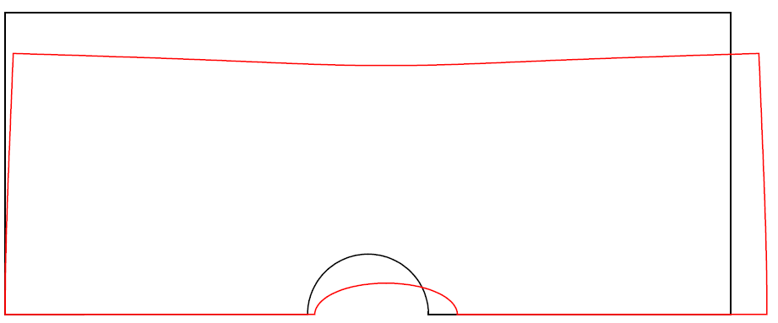
Chap. 5: elastic mechanical analysis
Post processing: strains, stresses, deformed mesh
* DEFORMED MESH PLOT
DEF_5 = DEFO SU U5 150. 'ROUG' ;
DEF_INI = DEFO SU U5 0. ;
TRAC (DEF_INI ET DEF_5) ;
* PLOT OF THE DEFORMED MESH BORDER
DEF_5C = DEFO CSU U5 150. 'ROUG' ;
DEF_INIC = DEFO CSU U5 0. ;
TRAC (DEF_INIC ET DEF_5C) ;
new object DEFORMEE

Slide 83
Chap. 5: elastic mechanical analysis
Post processing: strains, stresses, deformed mesh
With two statements:
* STRAINS CALCULATION
DEF = EPSI U5 MOM1 'LINE' ;
* STRESSES CALCULATION FROM STRAINS
SIG = ELAS DEF MOM1 MAM1 ;
With one statement:
* STRESSES CALCULATION FROM DISPLACEMENTS
SIG = SIGM U5 MOM1 MAM1 'LINE' ;
$ε=\frac{1}{2}\left(grad\left(u\right)+{grad}^{T}\left(u\right)\right)$
$\left\{ε\right\}=\left[B\right]\left\{u\right\}$
$$\left\{σ\right\}=\left[C\right]\left\{ε\right\}$$
$$\left\{σ\right\}=\left[C\right]\left[B\right]\left\{u\right\}$$

Slide 84
Chap. 5: elastic mechanical analysis
Post processing: stresses on the deformed mesh
* STRESSES PLOT ON THE INITIAL SHAPE
TRAC (It's up to you) ;

Slide 85
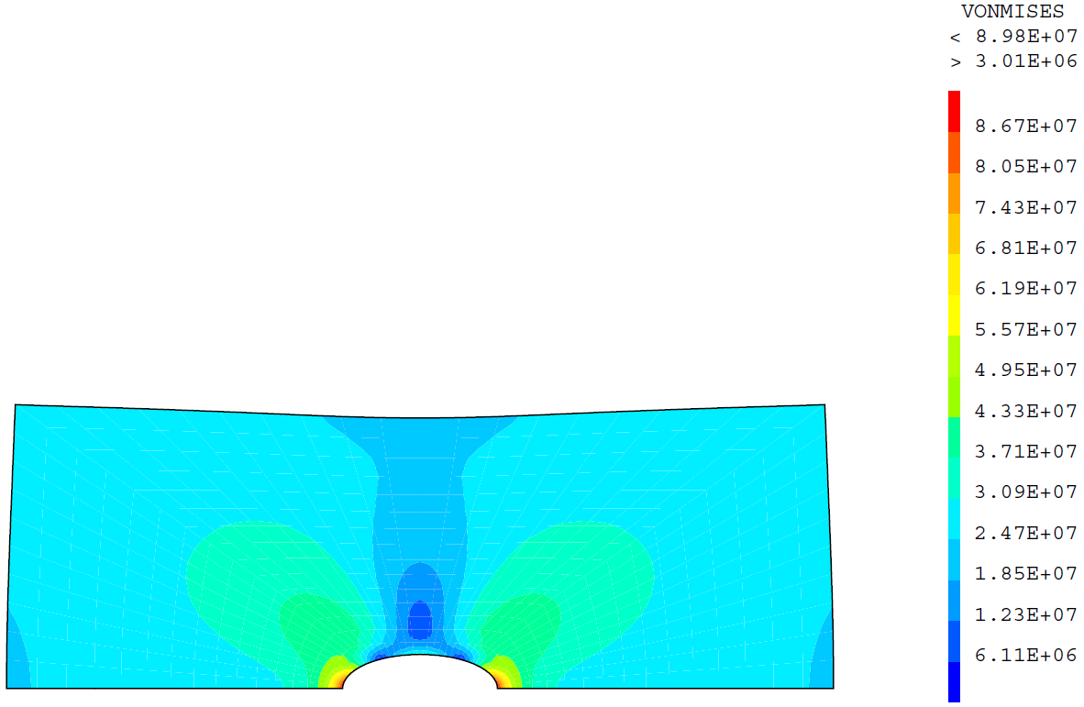
Chap. 5: elastic mechanical analysis
Post processing: stresses on the deformed mesh
* STRESSES PLOT ON THE INITIAL SHAPE
TRAC SIG MOM1 ;
* STRESSES PLOT ON THE DEFORMED SHAPE
DEF_5B = DEFO SU U5 150. ;
TRAC SIG MOM1 DEF_5B CSU ;

Slide 86
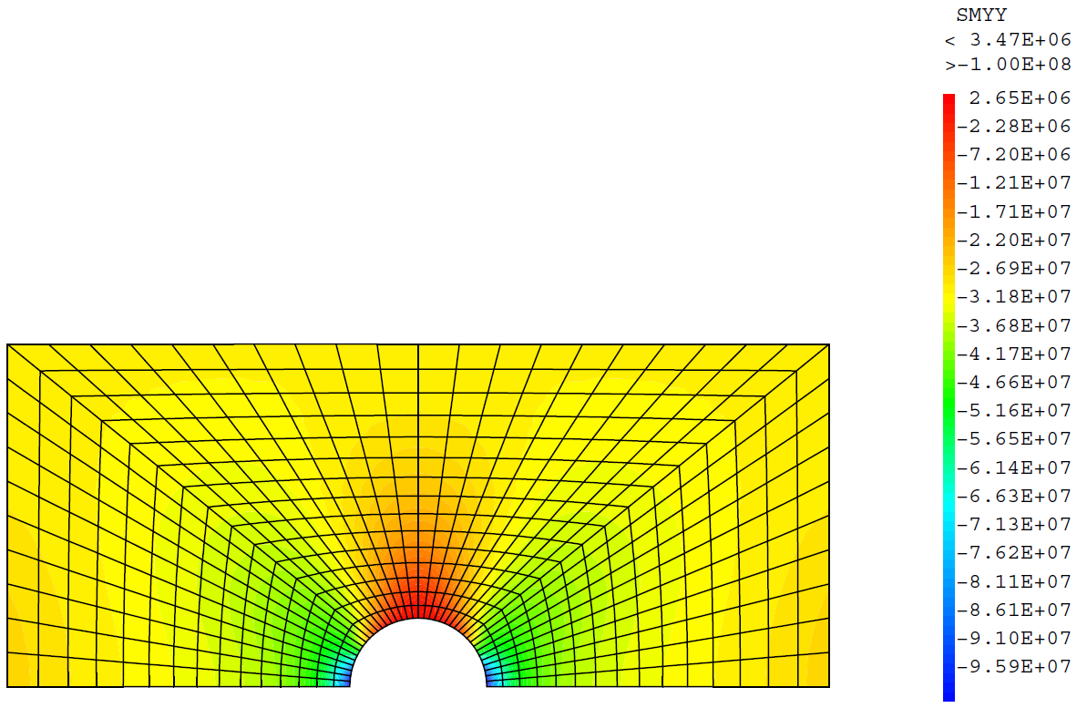
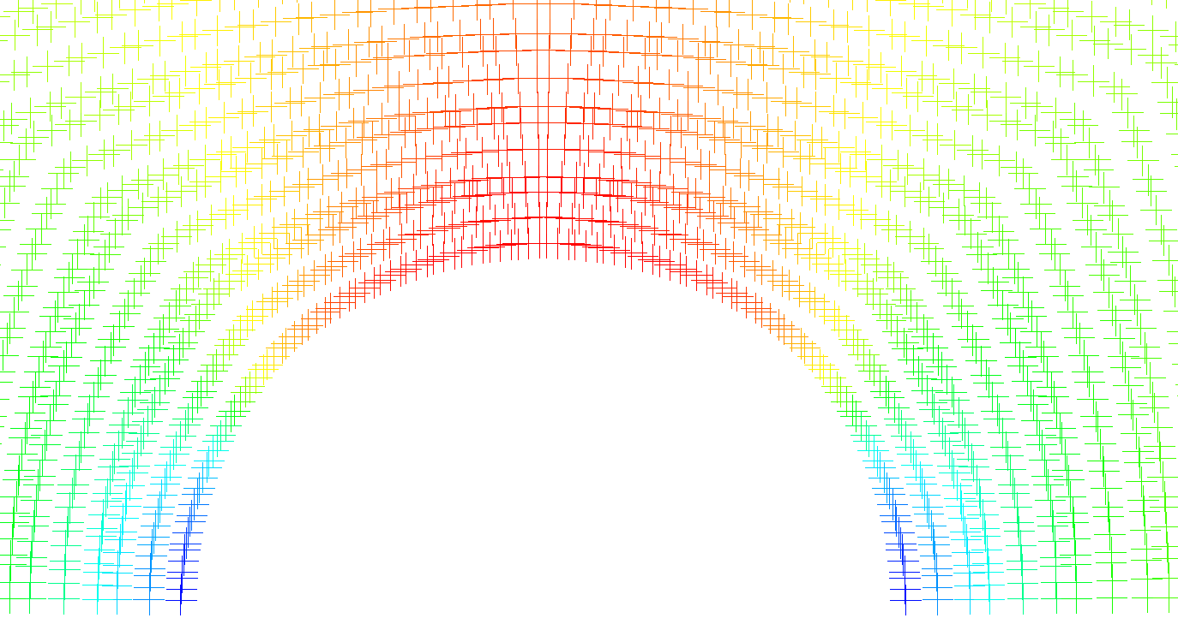
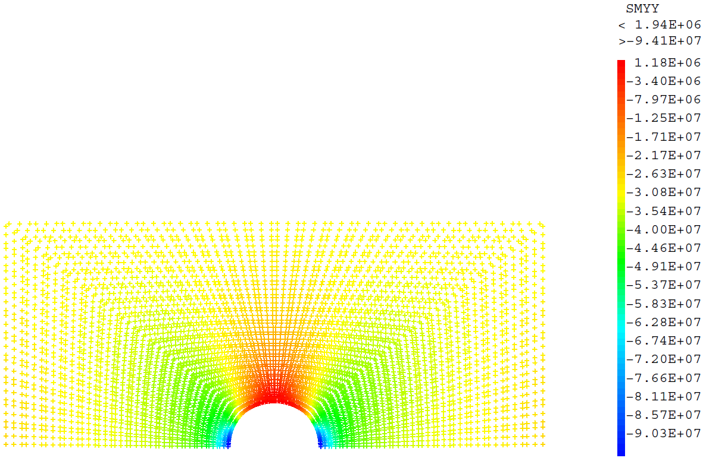
Chap. 5: elastic mechanical analysis
Post processing: stresses at Gauss points
* STRESS PLOT ON THE MESH
SIGYY = EXCO SIG 'SMYY' ;
MESS 'Mini and Maxi for Sigma YY : ' (MINI SIGYY) (MAXI SIGYY) ;
TRAC SIGYY MOM1 ;
SIGYYG = CHAN 'CHPO' SIGYY MOM1 'SUPP' ;
MPGAUSS = EXTR SIGYYG 'MAIL' ;
TRAC SIGYYG MPGAUSS ;

Slide 87
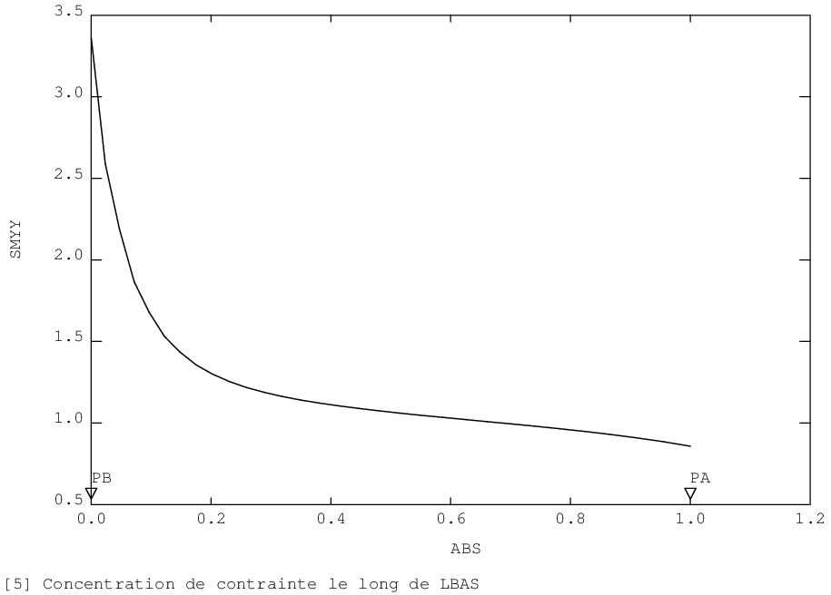
Chap. 5: elastic mechanical analysis
Post processing: stress concentration evolution curve (along the lower side)
SIGB = CHAN 'CHPO' SIG MOM1 ;
LBASG = LBAS ELEM 'COMP' PB PA ;
EVSIG = EVOL 'CHPO' SIGB 'SMYY' LBASG ;
EVK = (ABS EVSIG) / 30.E6 ;
DESS EVK ;

Slide 88
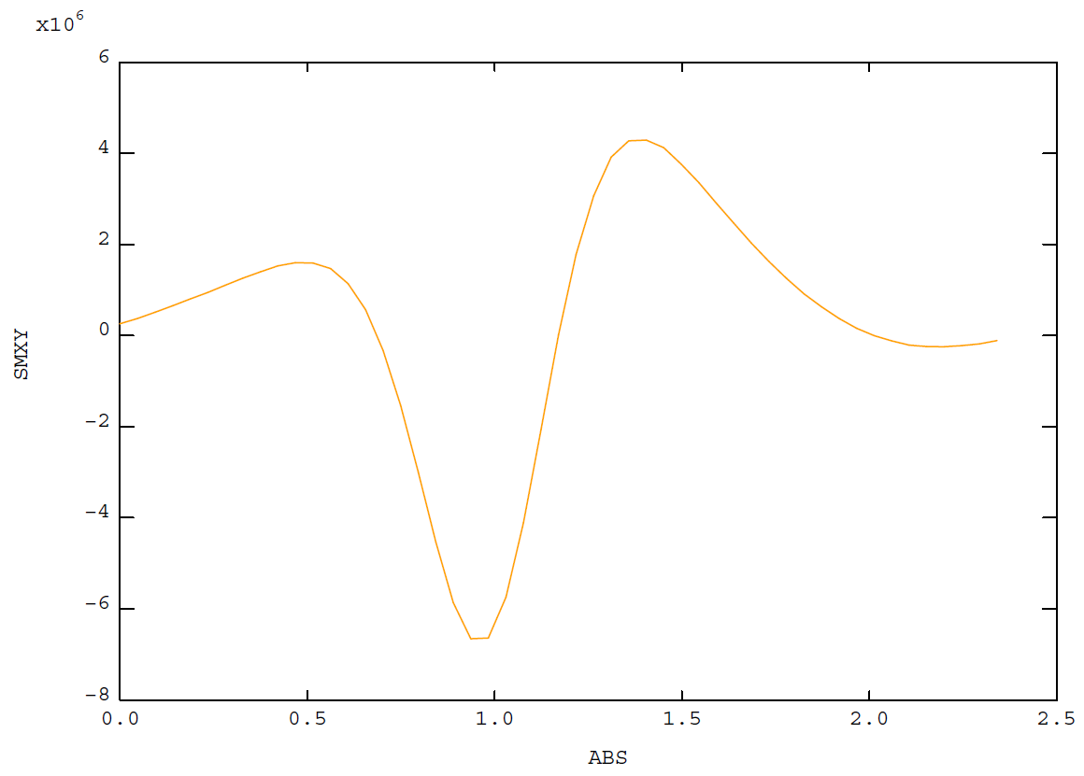
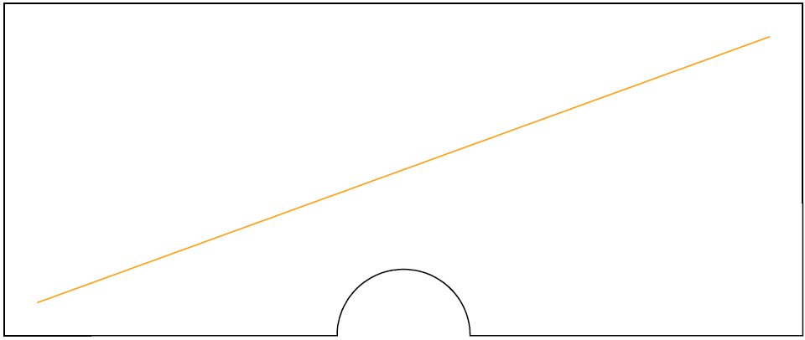
Chap. 5: elastic mechanical analysis
Post processing: evolution along any line
OPTI 'ELEM' 'SEG2' ;
LIG1 = DROI 50 (0.1 0.1) (2.3 0.9) COUL 'ORAN' ;
TRAC (CSU ET LIG1) ;
SIGT = CHAN 'NOEUD' MOM1 SIG ;
SIGLBAS = PROI SIGT LIG1 ;
EVSIG2 = EVOL 'ORAN' 'CHPO' SIGLBAS 'SMXY' LIG1 ;
DESS EVSIG2 ;

Slide 89
Chap. 5: elastic mechanical analysis
Post processing: force reaction
* SUPPORTS REACTIONS PLOT AS VECTORS
REAC1 = REAC U5 (BLMX ET BLMY) ; (reaction due to a constraint)
VREAC = VECT REAC1 'FORC' 'ROUG' ; (arrows for plotting)
* IDEM FOR APPLIED FORCES
VFIMP = (It's up to you)
TRAC (It's up to you) ;

Slide 90
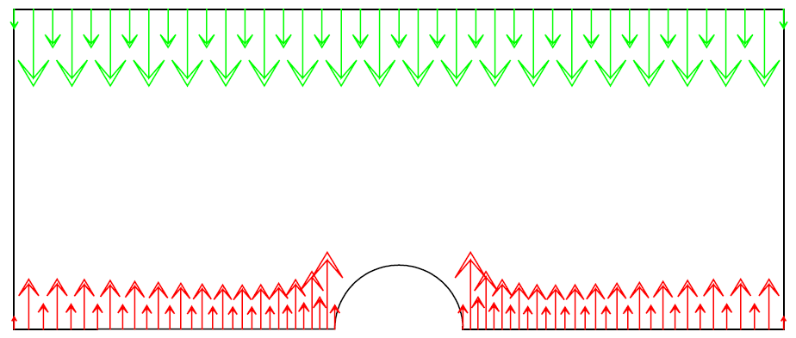
Chap. 5: elastic mechanical analysis
Post processing: force reaction
* SUPPORTS REACTIONS PLOT AS VECTORS
REAC1 = REAC U5 (BLMX ET BLMY) ; (reaction due to a constraint)
VREAC = VECT REAC1 'FORC' 'ROUG' ; (arrows for plotting)
* IDEM FOR APPLIED FORCES
VFIMP = VECT FS 'FORC' 'VERT' ;
TRAC (VFIMP ET VREAC) CSU ;

Slide 91
Chap. 5: elastic mechanical analysis
Bonus: case with prescribed displacements
* STIFFNESS MATRICES (1ST MEMBER) link
BLMY2 = BLOQ LHAUT 'UY' ;
RITOT2 = RI ET BLMX ET BLMY ET BLMY2 ;
* SECOND MEMBER ASSOCIETED TO THE STIFFNESS MATRIX
FU = DEPI BLMY2 (8.E-3 * RAYON) ;
* RESOLUTION
U52 = RESO RITOT2 (FU ET FV) ;
* POST PROCESSING
DEF_5C2 = DEFO CSU U52 150. 'VERT' ;
TRAC (DEF_INIC ET DEF_5C ET DEF_5C2) ;

Slide 92
Chap. 6: Linear elasticity THERMAL LOADING
Objective: previous mechanical calculation
+ thermal loading
thermal strain calculation
add the nodal forces equivalent to the thermal strain (link)
+

Slide 93
Chap. 6: Linear elasticity THERMAL LOADING
Nodal forces resulting from thermal strain (2nd member)
* THERMAL STRAINS FROM TEMPERATURE FIELD CALCULATED
* TAKING INTO ACCOUNT CONVECTION + RADIATION
TFINAL = TAB1 . 'TEMPERATURES' . (N1 - 1) ;
EPT = EPTH TFINAL MOM1 MAM1 ;
* PSEUDO STRESS FROM THERMAL STRAINS
SIT = ELAS EPT MOM1 MAM1 ;
* NODAL FORCES FROM THIS STRESS
FT = BSIG SIT MOM1 ;
Linear system solving (additional term to the 2nd member)
* DISPLACEMENTS CALCULATION BY CALLING SOLVER WITH THERMAL PSEUDO FORCES
* ADDED TO THE MECHANICAL ONES
U6 = (It's up to you);
$${\{ε\}}^{th}=\left[α\right]\left\{T−TALP\right\}$$
$${\{σ\}}^{th}=\left[C\right]{\{ε\}}^{th}$$
$${\{F\}}^{th}=\int_{V}{{\left[B\right]}^{T}{\{σ\}}^{th} dV}$$

Slide 94
Chap. 6: Linear elasticity THERMAL LOADING
Nodal forces resulting from thermal strain (2nd member)
* THERMAL STRAINS FROM TEMPERATURE FIELD CALCULATED
* TAKING INTO ACCOUNT CONVECTION + RADIATION
TFINAL = TAB1 . 'TEMPERATURES' . (N1 - 1) ;
EPT = EPTH TFINAL MOM1 MAM1 ;
* PSEUDO STRESS FROM THERMAL STRAINS
SIT = ELAS EPT MOM1 MAM1 ;
* NODAL FORCES FROM THIS STRESS
FT = BSIG SIT MOM1 ;
Linear system solving (additional term to the 2nd member)
* DISPLACEMENTS CALCULATION BY CALLING SOLVER WITH THERMAL PSEUDO FORCES
* ADDED TO THE MECHANICAL ONES
U6 = RESO RITOT (FS ET FV ET FT) ;
$${\{ε\}}^{th}=\left[α\right]\left\{T−TALP\right\}$$
$${\{σ\}}^{th}=\left[C\right]{\{ε\}}^{th}$$
$${\{F\}}^{th}=\int_{V}{{\left[B\right]}^{T}{\{σ\}}^{th} dV}$$

Slide 95
Chap. 6: Linear elasticity THERMAL LOADING
Post processing: deformed mesh, strains, stresses
* THERMOMECANICAL DEFORMED MESH
DEF_6 = (It's up to you)
DEF_6C = (It's up to you)
TRAC (It's up to you) ;

Slide 96
Chap. 6: Linear elasticity THERMAL LOADING
Post processing: deformed mesh, strains, stresses
* THERMOMECANICAL DEFORMED MESH
DEF_6 = DEFO SU U6 150. ;
DEF_6C = DEFO CSU U6 150. 'ORAN' ;
TRAC (DEF_INIC ET DEF_5C ET DEF_6C) ;

Slide 97
Chap. 6: Linear elasticity THERMAL LOADING
Post processing: deformed mesh, strains, stresses
* TOTAL STRAINS
EP = (It's up to you, EPSI operator)
* ELASTIC STRAINS
EPE = (It's up to you)
* STRESSES CALCULATED FROM ELASTIC STRAINS
SIGT = (It's up to you)
TRAC SIGT MOM1 DEF_6 CSU ;

Slide 98
Chap. 6: Linear elasticity THERMAL LOADING
Post processing: deformed mesh, strains, stresses
* TOTAL STRAINS
EP = EPSI MOM1 U6 'LINE' ;
* ELASTIC STRAINS
EPE = EP - EPT ;
* STRESSES CALCULATED FROM ELASTIC STRAINS
SIGT = ELAS EPE MOM1 MAM1 ;
TRAC SIGT MOM1 DEF_6 CSU ;

Slide 99
Chap. 7: Linear elasticity THERMAL LOADING, non uniform properties
Objective: previous thermo-mechanical calculation
+ thermal expansion α variable in space
calculation of the field α(x) (from coordinates)
material property described by α(x)
updating of the nodal thermal pseudo forces
α
$$α\left(x\right)=α_{0}\left(1+β{\left(\frac{x−x_{mean}}{x_{max}−x_{min}}\right)}^{3}\right)$$
α₀
x
x_{min}
x_{mean}
x_{max}

Slide 100
Chap. 7: Linear elasticity THERMAL LOADING, non uniform properties
Non uniform thermal expansion coefficient
XX = COOR SU 1 ;
XMAX = MAXI XX ;
XMIN = MINI XX ;
XMOY = 0.5 * (XMAX + XMIN) ;
BETA = 7. ;
CHP_ALPH = ALPHAMAT * (1. + (BETA * (((XX - XMOY) / (XMAX - XMIN)) ** 3))) ;
Material properties updating
* CONVERSION FROM CHPOINT -> TO MCHAML
CHM_ALPH = CHAN 'CHAM' CHP_ALPH MOM1 ;
* UPDATING OF THE MATERIAL MCHAML WITH THE NON UNIFORM ALPHA
MAM1B = MATE MOM1 'YOUN' YOUNGMAT 'NU' NUMAT
'ALPH' CHM_ALPH 'TREF' T0 'TALP' T0 ;

Slide 101
Chap. 7: Linear elasticity THERMAL LOADING, non uniform properties
Updating the nodal forces due to thermal strains (2nd member)
* UPDATING THE PURE THERMAL STRAINS WITH ALPHA VARIABLE
EPT = (It's up to you, EPTH operator)
* UPDATING THE THERMAL PSEUDO STRESSES WITH ALPHA VARIABLE
SIT = (It's up to you, ELAS operator)
* UPDATING THE NODAL FORCES FOR THESE THERMAL STRAINS
FT = (It's up to you, BSIG operator)
Linear system solving
* DISPLACEMENTS WITH ALPHA VARIABLE
U7 = RESO RITOT (FS ET FV ET FT) ;

Slide 102
Chap. 7: Linear elasticity THERMAL LOADING, non uniform properties
Updating the nodal forces due to thermal strains (2nd member)
* UPDATING THE PURE THERMAL STRAINS WITH ALPHA VARIABLE
EPT = EPTH TFINAL MOM1 MAM1B ;
* UPDATING THE THERMAL PSEUDO STRESSES WITH ALPHA VARIABLE
SIT = ELAS EPT MOM1 MAM1B ;
* UPDATING THE NODAL FORCES FOR THESE THERMAL STRAINS
FT = BSIG SIT MOM1 ;
Linear system solving
* DISPLACEMENTS WITH ALPHA VARIABLE
U7 = RESO RITOT (FS ET FV ET FT) ;

Slide 103
Chap. 7: Linear elasticity THERMAL LOADING, non uniform properties
Post processing: deformed mesh, strains, stresses
* DEFORMED SHAPE WITH ALPHA VARIABLE
(It's up to you)
(It's up to you)
TRAC (It's up to you) ;

Slide 104
Chap. 7: Linear elasticity THERMAL LOADING, non uniform properties
Post processing: deformed mesh, strains, stresses
* DEFORMED SHAPE WITH ALPHA VARIABLE
DEF_7 = DEFO SU U7 150. ;
DEF_7C = DEFO CSU U7 150. 'ROUG' ;
TRAC (DEF_INIC ET DEF_6C ET DEF_7C) ;

Slide 105
Chap. 7: Linear elasticity THERMAL LOADING, non uniform properties
Post processing: deformed mesh, strains, stresses
* STRAINS WITH ALPHA VARIABLE
EP = EPSI U7 MOM1 ;
* ELASTIC STRAINS WITH ALPHA VARIABLE
EPE = EP - EPT ;
* STRESSES WITH ALPHA VARIABLE
SIGT = ELAS EPE MOM1 MAM1B ;
TRAC SIGT MOM1 DEF_7 CSU ;

Slide 106
Chap. 8: Elasto-plastic mechanical analysis THERMAL LOADING, non uniform properties, PASAPAS
Objective: previous thermo-mechanical calculation
+ perfect elasto-plastic material
starting from the previous transient thermal analysis
add a non-linear mechanical model
temporal description of mechanical loadings
solving with the PASAPAS procedure
σ
σ_{Y}
E
ε

Slide 107
Chap. 8: Elasto-plastic mechanical analysis THERMAL LOADING, non uniform properties , PASAPAS
Model and material properties updating
* MECHANICAL MODEL UPDATING
MOM2 = MODE SU 'MECANIQUE' 'ELASTIQUE' 'PLASTIQUE' 'PARFAIT' ;
* MATERIAL PROPERTIES UPDATING (YIELD STRENGTH 'SIGY' ADDED TO PROPERTIES)
MAM2 = MATE MOM2 'YOUN' YOUNGMAT 'NU' NUMAT 'SIGY' SIGYMAT
'ALPH' CHM_ALPH 'TREF' T0 'TALP ' T0 ;
Incremental mechanical loading
* TEMPORAL MECHANICAL LOADS DESCRIPTION
EVTM = EVOL 'MANU' (PROG 0. (0.98 * TPSFIN) TPSFIN)
(PROG 0. 0. 1.) ;
CHAFS = CHAR 'MECA' FS EVTM ;
CHAFV = CHAR 'MECA' FV EVCTE ;
CHAM = CHAFS ET CHAFV ;

Slide 108
Chap. 8: Elasto-plastic mechanical analysis THERMAL LOADING, non uniform properties , PASAPAS
Building of the table for PASAPAS procedure
* PASAPAS TABLE
TAB2 = TABL ;
………
………
………
(It's up to you)
………
………
………
PASAPAS TAB2 ;

Slide 109
Chap. 8: Elasto-plastic mechanical analysis THERMAL LOADING, non uniform properties , PASAPAS
Building of the table for PASAPAS procedure
* PASAPAS TABLE
TAB2 = TABL ;
TAB2 . 'MODELE' = MOT ET MOC ET MOR ET MOM2 ;
TAB2 . 'CARACTERISTIQUES' = MAT ET MAC ET MAR ET MAM2 ;
TAB2 . 'BLOCAGES_MECANIQUES' = BLMX ET BLMY ;
TAB2 . 'BLOCAGES_THERMIQUES' = BLT ;
TAB2 . 'CHARGEMENT' = CHAT ET CHAM ;
TAB2 . 'TEMPS_CALCULES' = PROG 0. 'PAS' (0.02 * TPSFIN) (0.98 * TPSFIN)
'PAS' (0.001 * TPSFIN) TPSFIN ;
TAB2 . 'CELSIUS' = VRAI ;
PASAPAS TAB2 ;

Slide 110
Chap. 8: Elasto-plastic mechanical analysis THERMAL LOADING, non uniform properties , PASAPAS
Post-processing: stresses
* LOOP ON EACH TIME STEP
LISO2 = PROG 0. 'PAS' 10.E6 100.E6 ;
N2 = DIME (TAB2 . 'DEPLACEMENTS') ;
REPE B1 N2 ;
U_I = TAB2 . 'DEPLACEMENTS' . (&B1 - 1) ;
DEF_I = DEFO SU U_I 150. ;
S_I = TAB2 . 'CONTRAINTES' . (&B1 - 1) ;
TRAC S_I MOM2 DEF_I CSU LISO2 ;
FIN B1 ;
DEF_8C = DEFO CSU U_I 150. 'VIOL' ;

Slide 111
Chap. 8: Elasto-plastic mechanical analysis THERMAL LOADING, non uniform properties , PASAPAS
Post-processing: cumulated plastic strains (link)
* LOOP ON EACH TIME STEP
VI = TAB2 . 'VARIABLES_INTERNES' . (N2 - 1) ;
EQ_MAX = MAXI (EXCO 'EPSE' VI) ;
LISO3 = PROG 0. 'PAS' (EQ_MAX / 10.) EQ_MAX ;
REPE B1 N2 ;
U_I = TAB2 . 'DEPLACEMENTS' . (&B1 - 1) ;
DEF_I = DEFO SU U_I 150. ;
V_I = TAB2 . 'VARIABLES_INTERNES' . (&B1 - 1) ;
TRAC V_I MOM2 DEF_I CSU LISO3 ;
FIN B1 ;

Slide 112
Chap. 9: Elasto-plastic mechanical analysis THERMAL LOADING, variable properties (x,t), PASAPAS
Objective: previous thermo-mechanical calculation
+ conductivity depending on temperature
variable material property depending on the thermal unknown
$$λ$$
250 W.m⁻¹.K⁻¹
210 W.m⁻¹.K⁻¹
T
50 °C
200 °C

Slide 113
Chap. 9: Elasto-plastic mechanical analysis THERMAL LOADING, variAblE properties (x,t), PASAPAS
Updating of material properties
* VARIATION OF CONDUCTIVITY AS A FUNCTION OF T
EVLAM = EVOL 'MANU' 'T' (PROG 50. 200.) 'K' (PROG 210. 250.) ;
* UPDATING OF THE MATERIAL
MAT2 = MATE MOT 'K' EVLAM 'C' CAPAMAT 'RHO' RHOMAT ;
PASAPAS call
(It's up to you)

Slide 114
Chap. 9: Elasto-plastic mechanical analysis THERMAL LOADING, variable properties (x,t), PASAPAS
Updating of material properties
* VARIATION OF CONDUCTIVITY AS A FUNCTION OF T
EVLAM = EVOL 'MANU' 'T' (PROG 50. 200.) 'K' (PROG 210. 250.) ;
* UPDATING OF THE MATERIAL
MAT2 = MATE MOT 'K' EVLAM 'C' CAPAMAT 'RHO' RHOMAT ;
PASAPAS call
TAB2 = TABL ;
TAB2 . 'MODELE' = MOT ET MOC ET MOR ET MOM2 ;
TAB2 . 'CARACTERISTIQUES' = MAT2 ET MAC ET MAR ET MAM2 ;
TAB2 . 'BLOCAGES_MECANIQUES' = BLMX ET BLMY ;
TAB2 . 'BLOCAGES_THERMIQUES' = BLT ;
TAB2 . 'CHARGEMENT' = CHAT ET CHAM ;
TAB2 . 'TEMPS_CALCULES' = PROG 0. 'PAS' (0.02 * TPSFIN) (0.98 * TPSFIN)
'PAS' (0.001 * TPSFIN) TPSFIN ;
TAB2 . 'CELSIUS' = VRAI ;
PASAPAS TAB2 ;

Slide 115
Chap. 9: Elasto-plastic mechanical analysis THERMAL LOADING, variable properties (x,t), PASAPAS
Post processing: deformed mesh
* COMPARISON OF THE FINAL SHAPE WITH THOSE OF THE PREVIOUS CALCULATIONS
N2 = DIME (TAB2 . 'DEPLACEMENTS') ;
U9 = TAB2 . 'DEPLACEMENTS' . (N2 - 1) ;
DEF_9 = DEFO SU U9 150. ;
DEF_9C = DEFO CSU U9 150. 'BLEU' ;
TRAC (DEF_INIC ET DEF_7C ET DEF_8C ET DEF_9C) ;

Slide 116
Chap. 9: Elasto-plastic mechanical analysis THERMAL LOADING, variable properties (x,t), PASAPAS
Post processing: cumulated plastic strains
VI9 = TAB2 . 'VARIABLES_INTERNES' . (N2 - 1) ;
EQ_MAX = MAXI (EXCO 'EPSE' VI9) ;
LISO3 = PROG 0. 'PAS' (EQ_MAX / 10.) EQ_MAX ;
U9 = TAB2 . 'DEPLACEMENTS' . (N2 - 1) ;
DEF9 = DEFO SU U9 150. ;
TRAC VI9 MOM2 DEF9 CSU LISO3 ;

Slide 117
ADDENDA

Slide 118
TRUSS, Beam, shell, joint … F.E.
The choice of the finite elements is made in MODE
MODP1 = MODE LIG1 'MECANIQUE' 'ELASTIQUE' | 'POUT' | ;
| 'TIMO' |
MODC1 = MODE SUR1 'MECANIQUE' 'ELASTIQUE' | 'DKT' | ;
| 'COQ8' |
You should give the geometrical characteristics
MATP1 = MATE MODP1 'YOUN' 210.E9 'NU ' 0.3
'SECT' 1.E-2 'INRY' 1.E-4 'INRZ' 2.E-4 'TORS' 3.E-4 ;
MATC1 = MATE MODC1 'YOUN' 210.E9 'NU ' 0.3
'EPAI' 1.E-2 ;
Then you can prescribe d.o.f. for displacements and rotation
BL1 = BLOQ P1 'UX' 'UY' 'UZ' 'RX' 'RY' 'RZ' ;

Slide 119
Shell elements in 3D
Example of a cylindrical shell under pressure (in 3D)
OPTI 'DIME' 3 'ELEM' 'QUA4' ;
p1 = 4. 0. 0. ;
lig1 = CERC 45 'ROTA' 360. p1 (0. 0. 0.) (0. 0. 1.) ;
ELIM lig1 1.E-2 ;
sur1 = lig1 TRAN 20 (0. 0. 10.) ;
mo = MODE sur1 'MECANIQUE' 'COQ4' ;
ma = MATE mo 'YOUN' 210.E9 'NU' 0.3 'EPAI' 0.3 ;
rig = RIGI mo ma ;
bl1 = BLOQ 'UX' 'UY' 'UZ' 'RX' 'RY' 'RZ' lig1 ;
f1 = PRES 'COQU' mo 42.E5 'NORM' ma ;
u = RESO (rig ET bl1) f1 ;
def1 = DEFO sur1 u ;
TRAC 'CACH' def1 ;

Slide 120
Shell elements in 2D
The same case (in 2D axisymmetric)
OPTI 'DIME' 2 'MODE' 'AXIS' 'ELEM' 'SEG2' ;
p1 = 4. 0. ;
lig1 = DROI 20 p1 (4. 10.) ;
mo = MODE lig1 'MECANIQUE' 'COQ2' ;
ma = MATE mo 'YOUN' 210.E9 'NU' 0.3 'EPAI' 0.3 ;
rig = RIGI mo ma ;
bl1 = BLOQ 'UR' 'UZ' 'RT' p1 ;
f1 = PRES 'COQU' mo -42.E5 'NORM' ;
u = RESO (rig ET bl1) f1 ;
def1 = DEFO lig1 u ;
TRAC def1 ;

Slide 121
And some other options (1D, 2D AXIS, etc…)
Example of steady state 2D axisymmetric conduction problem
OPTI 'DIME' 2 'MODE' 'AXIS' 'ELEM' 'QUA8' ;
p1 = 10. 0. ;
p2 = 50. 0. ;
lig1 = DROI 10 p1 p2 ;
sur1 = lig1 TRAN 1 (0. 1.) ;
cot1 = sur1 COTE 4 ;
cot2 = sur1 COTE 2 ;
mo = MODE sur1 'THERMIQUE' ;
ma = MATE mo 'K' 42. ;
con = COND mo ma ;
bl1 = BLOQ 'T' cot1 ;
bl2 = BLOQ 'T' cot2 ;
f1 = DEPI bl1 20. ;
f2 = DEPI bl2 500. ;
t = RESO (con ET bl1 ET bl2) (f1 ET f2) ;
TRAC t sur1 ;
evt = EVOL 'CHPO' t 'T' lig1 ;
DESS evt ;

Slide 122
And some other options (1D, 2D AXIS, etc…)
The same case in 1D (cylindrical)
OPTI 'DIME' 1 'MODE' 'UNID' 'AXIS' 'ELEM' 'SEG3' ;
p1 = POIN 10. ;
p2 = POIN 50. ;
lig1 = DROI 10 p1 p2 ;
mo = MODE lig1 'THERMIQUE' ;
ma = MATE mo 'K' 42. ;
con = COND mo ma ;
bl1 = BLOQ 'T' p1 ;
bl2 = BLOQ 'T' p2 ;
f1 = DEPI bl1 20. ;
f2 = DEPI bl2 500. ;
t = RESO (con ET bl1 ET bl2) (f1 ET f2) ;
TRAC t lig1 ;
evt = EVOL 'CHPO' t 'T' lig1 ;
DESS evt ;

Slide 123
Reading / writing DATA
Binary file: backup / recovery
OPTI 'SAUV' 'foo' ; SAUV ;
OPTI 'REST' 'foo' ; REST ;
Also possible by a text file
Run an EXTErnal command
TAB1 = EXTE 'grep –in mechanical foo.dgibi' 'RC' ;
➔ TAB1 contents the output of the grep command
The ACQUisition command
Read a texte file, line by line
OPTI 'ACQU' 'foo.txt' ;
ACQU N1*'ENTIER' A*'FLOTTANT' ;
ACQU N2*'ENTIER' L1*'LISTREEL' 4 ;
foo.txt
1 3.14 X Y Z
2 25.2 28.3 24.3 16.6

Slide 124
Reading / writing data
Writing in a text file
➔ using the SORT directive
OPTI 'SORT' 'my_file.txt' ;
SORT 'CHAI' 'I am writing a text file!' ;
SORT 'CHAI' 4 8 15 16 23 42 ;
SORT 'CHAI' ' ' ;
SORT 'CHAI' '#iteration Fibonacci' ;
FIBO1 = 0 ;
FIBO2 = 1 ;
SORT 'CHAI' 0 FIBO1 ;
SORT 'CHAI' 1 FIBO2 ;
REPE B1 15 ;
FIBO2B = FIBO2 ;
FIBO2 = FIBO1 + FIBO2 ;
FIBO1 = FIBO2B ;
SORT 'CHAI' (&B1 + 1) FIBO2 ;
FIN B1 ;
foo.txt
I am writing in a text file!
4 8 15 16 23 42
#iteration Fibonacci
0 0
1 1
2 1
3 2
4 3
5 5
6 8
7 13
8 21
9 34
10 55
11 89
12 144
13 233
14 377
15 610
16 987

Slide 125
Reading / writing data
LIRE / SORT reading / writing different file formats
Read/write tabular data (CSV or other)
concerned objects: lists, TABLE
used by text editors, spreadsheet (Excel)
OPTI 'SORT' 'foo.csv' ;
SORT 'EXCE' OBJECT1 ;
TAB1 = 'LIRE' 'CSV' 'foo.csv' ;
The column separator can be changed:
semicolon, comma, space, tab, slash

Slide 126
Reading / writing data
LIRE / SORT reading / writing different file formats
Read the UNV format (text file)
concerned objects: MAILLAGE (meshes)
used by Gmsh, Salomé, HyperMesh, …
TAB1 = LIRE 'UNV' 'foo.unv' ;
Read/wrtite the AVS format (text file)
concerned objects: MAILLAGE, CHPOINT, MCHAML
.inp extension used by Abaqus
OPTI 'SORT' 'foo.inp' ;
SORT 'AVS' OBJET1 'TEMPS' 12.3 ;
OPTI 'LECT' 'foo.inp' ;
TAB1 = LIRE 'AVS' ;

Slide 127
Reading / writing data
LIRE / SORT reading / writing different file formats
Write the VTK format
concerned objects: MAILLAGE, CHPOINT, MCHAML
used by Paraview
OPTI 'SORT' 'foo.vtk' ;
SORT 'VTK' MAIL1 'SCREW' MAIL2 'NUT'
DEP1 'DISPLACEMENTS' SIG1 'STRESSES' ;

Slide 128
Reading / writing data
LIRE / SORT reading / writing different file formats
Read/write the MED format
concerned objects: MAILLAGE, CHPOINT, TABLE (from PASAPAS)
used by Salomé, Europlexus
OPTI 'SORT' 'foo.med' ;
SORT 'MED' OBJET1 ;
TAB1 = LIRE 'MED' 'foo.med' ;
Read the FEM fomat
concerned objetcs: MAILLAGE
used by HyperMesh (Altair)
TAB1 = LIRE 'FEM' 'foo.fem' ;

Slide 129
Development: Gibiane procedures
Concatenate all procedures in a text file with the .procedur extension
Launch castem22 with the –u option
castem22 –u
➔ Cast3M creates a file named UTILPROC (direct access file)
When Cast3M will be launched all procedures will be available
The UTILPROC file must be present in the working directory
Idem for notices (manual pages) (.notice extension files)

Slide 130
Development: Esope sources
The user can modify/correct/add the source code of
operators and directives
Compilation of Esope source files
compilcast22 toto.eso
compilcast22 tata.eso
...
Linking
essaicast22
➔ creation of a binary executable file : cast_64_22
➔ local version of Cast3M
Can be launched as usual
castem22 mon_fichier.dgibi

Slide 131
And to complete
Peruse documentation regularly
~70 instructions reviewed during this course
Around 1400 available instructions!
Subscription to the Cast3M mailing list (see the Cast3M web site)
Send an e-mail at sympa@umontpellier.fr with in the message frame:
SUB cast3m-util your_name your_firstname
and nothing more! (no object, no signature, …)
Club Cast3M: annual users seminar
Each year in November in the south of Paris
Presentation of studies performed with Cast3M, developments in the next release
Free registration!

Slide 132
Plane linear THERMAL ELASTICITY (1) equations
Total strains (linear) $ε=\frac{1}{2}\left(grad\left(u\right)+{grad}^{T}\left(u\right)\right)$ $ε_{ij}=\frac{1}{2}\left(\frac{∂u_{i}}{∂x_{j}}+\frac{∂u_{j}}{∂x_{i}}\right)$
Strains partition $ε=ε^{e}$+$ε^{th}$
Thermal strains $ε^{th}=α∆T δ$
Elasticity $σ=\text{C}\text{ :} ε^{e}=\text{C}\text{ : }\left(ε−ε^{th}\right)$
with: $u$ displacement $ε$ total strain $σ$ stress $ε^{e}$ elastic strain $ε^{th}$ thermal strain $δ$ identity tensor $\text{C}$ stiffness tensor (4th order) $α$ thermal expansion $∆T$ temperature increment

Slide 133
Plane linear THERMAL ELASTICITY (2) plane stresses
Plane strains hypothesis:
$$σ=\left[\begin{matrix}σ_{11} & σ_{12} & 0 \\ σ_{12} & σ_{22} & 0 \\ 0 & 0 & σ_{33}\end{matrix}\right] ε=\left[\begin{matrix}ε_{11} & ε_{12} & 0 \\ ε_{12} & ε_{22} & 0 \\ 0 & 0 & 0\end{matrix}\right]$$
Vector notation:
$$\left\{σ\right\}=\left\{\begin{matrix}σ_{11} \\ σ_{22} \\ σ_{12}\end{matrix}\right\} \left\{ε\right\}=\left\{\begin{matrix}ε_{11} \\ ε_{22} \\ {2ε}_{12}\end{matrix}\right\}$$
Hooke's law:
$$\left\{\begin{matrix}σ_{11} \\ σ_{22} \\ σ_{12}\end{matrix}\right\}=\underset{\left[C\right]}{\underbrace{\frac{E}{1−ν^{2}}\left[\begin{matrix}1 & ν & 0 \\ ν & 1 & 0 \\ 0 & 0 & \frac{1−ν}{2}\end{matrix}\right]}}\left\{\begin{matrix}ε_{11} \\ ε_{22} \\ {2ε}_{12}\end{matrix}\right\}$$
$$\left\{σ\right\}=\left[C\right]\left\{ε\right\}$$
with:$σ_{33}=ν\left(σ_{11}+σ_{22}\right)$
3 independent components
$\left[C\right]$ Hooke matrix

Slide 134
Plane linear THERMAL ELASTICITY (3) finite elements
$$\left\{\begin{matrix}q_{1}^{B} \\ q_{2}^{B}\end{matrix}\right\}$$
Interpolation of primal unknowns:
at each point $(x,y)$ in the element $\left\{q\right\}$ are the displacements of the element nodes
Case of a TRI3 element (6 dof): Strains (linearized):
B
$$\left\{u(x)\right\}=\left[N(x)\right]\left\{q\right\}$$
$$\left\{\begin{matrix}q_{1}^{A} \\ q_{2}^{A}\end{matrix}\right\}$$
A
C
$$\left\{\begin{matrix}q_{1}^{C} \\ q_{2}^{C}\end{matrix}\right\}$$
$$\left\{\begin{matrix}u_{x}(x) \\ u_{y}(x)\end{matrix}\right\}=\left[\begin{matrix}N_{A}(x) \\ 0\end{matrix}\begin{matrix}0 \\ N_{A}(x)\end{matrix}\begin{matrix}N_{B}(x) \\ 0\end{matrix}\begin{matrix}0 \\ N_{B}(x)\end{matrix}\begin{matrix}N_{C}(x) \\ 0\end{matrix}\begin{matrix}0 \\ N_{C}(x)\end{matrix}\right]\left\{\begin{matrix}q_{1}^{A} \\ \begin{aligned}q_{2}^{A} \\ q_{1}^{B} \\ q_{2}^{B} \\ q_{1}^{C} \\ q_{2}^{C}\end{aligned}\end{matrix}\right\}$$
$$\left\{ε(x)\right\}=\left[\begin{matrix}N_{A,x_{1}} \\ \begin{aligned}0 \\ N_{A,x_{1}}\end{aligned}\end{matrix} \begin{matrix}0 \\ \begin{aligned}N_{A,x_{2}} \\ N_{A,x_{2}}\end{aligned}\end{matrix} \begin{matrix}N_{B,x_{1}} \\ \begin{aligned}0 \\ N_{B,x_{1}}\end{aligned}\end{matrix} \begin{matrix}0 \\ \begin{aligned}N_{B,x_{2}} \\ N_{B,x_{2}}\end{aligned}\end{matrix} \begin{matrix}N_{C,x_{1}} \\ \begin{aligned}0 \\ N_{C,x_{1}}\end{aligned}\end{matrix} \begin{matrix}0 \\ \begin{aligned}N_{C,x_{2}} \\ N_{C,x_{2}}\end{aligned}\end{matrix}\right]\left\{q\right\}$$
$$\left\{ε(x)\right\}=\left[B(x)\right]\left\{q\right\}$$
with $N_{A,x_{i}}=\frac{∂N_{A}(x)}{∂x_{i}}$
$\left[B(x)\right]$discrete gradient operator

Slide 135
Plane linear THERMAL ELASTICITY (4) stiffness matrix
Elementary elastic energy:
Assembly:
$$e_{def}=\frac{1}{2}\int_{V_{e}}{σ :ε dV}$$
$$=\frac{1}{2}\int_{V_{e}}{{\left\{ε\right\}}^{T}\left\{σ\right\} dV}$$
$$=\frac{1}{2}\int_{V_{e}}{{\left\{q\right\}}^{T}{\left[B\right]}^{T}\left[C\right]\left[B\right]\left\{q\right\} dV}$$
$$=\frac{1}{2}{\left\{q\right\}}^{T}\underset{\left[k_{e}\right]}{\underbrace{\left[\int_{V_{e}}{{\left[B\right]}^{T}\left[C\right]\left[B\right] dV}\right]}}\left\{q\right\}$$
$V_{e}$ finite element "volume"
$\left[k_{e}\right]$elementary stiffness matrix (obtained by numerical computation)
$$E_{def}=\frac{1}{2}{\left\{Q\right\}}^{T}\sum_{e}{\left[k_{e}\right]}\left\{Q\right\}=\frac{1}{2}{\left\{Q\right\}}^{T}\left[K\right]\left\{Q\right\}$$
$\left\{Q\right\}$ nodes displacements (global mesh)
The $\left[k_{e}\right]$ matrices are extended on all dof with null items
$\left[K\right]$assembly stiffness matrix

Slide 136
Plane linear THERMAL ELASTICITY (5) principle of virtual work
Principle of virtual work:
$f_{v}$ prescribed volume forces
$f_{s}$ prescribed surface forces
$$\int_{V_{e}}{σ :δε^{∗} dV}=\int_{V_{e}}{f_{v}δu^{∗} dV}+\int_{S_{e}}{f_{s}δu^{∗} dS}$$
$$\int_{V_{e}}{{\left\{δε^{∗}\right\}}^{T}\left\{σ\right\} dV}=\int_{V_{e}}{{\left\{δu^{∗}\right\}}^{T}\left\{f_{v}\right\} dV}+\int_{S_{e}}{{\left\{δu^{∗}\right\}}^{T}\left\{f_{s}\right\}dS}$$
$${\left\{δq^{∗}\right\}}^{T}\int_{V_{e}}{{\left[B\right]}^{T}\left\{σ\right\} dV}={\left\{δq^{∗}\right\}}^{T}\left(\int_{V_{e}}{{\left[N\right]}^{T}\left\{f_{v}\right\} dV}+\int_{S_{e}}{{\left[N\right]}^{T}\left\{f_{s}\right\}dS}\right)$$
$$\underset{\left[k_{e}\right]}{\underbrace{\int_{V_{e}}{{\left[B\right]}^{T}\left[C\right]\left[B\right] dV}}}\left\{q\right\}=\underset{\left\{F_{e}\right\}}{\underbrace{\int_{V_{e}}{{\left[N\right]}^{T}\left\{f_{v}\right\} dV}+\int_{S_{e}}{{\left[N\right]}^{T}\left\{f_{s}\right\}dS}}}$$
$$\left[k_{e}\right]\left\{q\right\}=\left\{F_{e}\right\}$$
$\left\{F_{e}\right\}$ nodal equivalent forces

Slide 137
Plane linear THERMAL ELASTICITY (6) thermal load
We add a second member item:
$$\int_{V_{e}}{{\left[B\right]}^{T}\left\{σ\right\} dV}=\left\{F_{e}\right\}$$
$$\int_{V_{e}}{{\left[B\right]}^{T}\left[C\right]\left\{ε−ε^{th}\right\} dV}=\left\{F_{e}\right\}$$
$$\int_{V_{e}}{{\left[B\right]}^{T}\left[C\right]\left\{ε\right\} dV}=\left\{F_{e}\right\}+\underset{\left\{F_{th}\right\}}{\underbrace{\int_{V_{e}}{{\left[B\right]}^{T}\left[C\right]\left\{ε^{th}\right\} dV} }}$$
$$\left[k_{e}\right]\left\{q\right\}=\left\{F_{e}\right\}+\left\{F_{th}\right\}$$

Slide 138
Stiffness and Lagrange multipliers
Mechanics deals with the following constrained problem:
We have to minimize the following function:
with the constrain: $\left[b\right]\left\{Q\right\}−\left\{Q_{0}\right\}=\left\{0\right\}$
The Lagrange theorem introduces new unknowns $\left\{λ\right\}$ so that:
We have to solve the following linear system:
$$\left\{\begin{aligned}\left[K\right]\left\{Q\right\}=\left\{F\right\} \\ \left[b\right]\left\{Q\right\}=\left\{Q_{0}\right\}\end{aligned}\right.$$
$\left[b\right]$ constraints matrix
$\left\{Q_{0}\right\}$ imposed values
$$f\left\{Q\right\}=\frac{1}{2}{\left\{Q\right\}}^{T}.\left[K\right].\left\{Q\right\}−{\left\{Q\right\}}^{T}.\left\{F\right\}$$
$\left[K\right]\left\{Q\right\}−\left\{F\right\}$+${\left[b\right]}^{T}\left\{λ\right\}=\left\{0\right\}$
$$\left[\begin{matrix}K & b^{T} \\ b & 0\end{matrix}\right]\left\{\begin{matrix}Q \\ λ\end{matrix}\right\}=\left\{\begin{matrix}F \\ Q_{0}\end{matrix}\right\}$$

Slide 139
Stiffness anD Lagrange multipliers
Example: one bar element
OPTI 'DIME' 2 'ELEM' 'SEG2' ;
* Mesh
p1 = 0. 0. ;
p2 = 3. 0. ;
l1 = DROI 1 p1 p2 ;
* Model and properties
mo = MODE l1 'MECANIQUE' 'BARR' ;
ma = MATE mo 'YOUN' 210.E9 'NU' 0.3
'SECT' 1.E-2 ;
* Main stiffness matrix
rig1 = RIGI mo ma ;
LIST rig1 ;
* Constraint matrix
bl1 = BLOQ 'UX' p1 ;
LIST bl1 ;
* Second member
f1 = DEPI bl1 1.2 ;
LIST f1 ;
lien 1 lien 2
primal unknowns
dual unknowns
matrices
rig1$=\left[\begin{matrix}\begin{matrix} k & 0 \\ 0 & 0\end{matrix} & \begin{matrix}−k & 0 \\ 0 & 0\end{matrix} \\ \begin{matrix}−k & 0 \\ 0 & 0\end{matrix} & \begin{matrix} k & 0 \\ 0 & 0\end{matrix}\end{matrix}\right] \left[\begin{aligned}{UX}_{1} \\ {UY}_{1} \\ {UX}_{2} \\ {UY}_{2}\end{aligned}\right]$ $\left[\begin{aligned}{FX}_{1} \\ {FY}_{1} \\ {FX}_{2} \\ {FY}_{2}\end{aligned}\right]$
bl1$=\left[\begin{matrix}0 & 1 \\ 1 & 0\end{matrix}\right] \left[\begin{matrix}{LX}_{3} \\ {UX}_{1}\end{matrix}\right] \left[\begin{matrix}{FLX}_{3} \\ {FX}_{1}\end{matrix}\right]$
rig1 ET bl1$=\left[\begin{aligned}\begin{matrix}\begin{matrix}k+0 & 0 & −k\end{matrix} & \begin{matrix}0 & 1\end{matrix}\end{matrix} \\ \begin{matrix}\begin{matrix}0 & 0 & 0\end{matrix} & \begin{matrix}0 & 0\end{matrix}\end{matrix} \\ \begin{matrix}\begin{matrix} −k & 0 & k\end{matrix} & \begin{matrix}0 & 0\end{matrix}\end{matrix} \\ \begin{matrix}\begin{matrix}0 & 0 & 0\end{matrix} & \begin{matrix}0 & 0\end{matrix}\end{matrix} \\ \begin{matrix}\begin{matrix}1 & 0 & 0\end{matrix} & \begin{matrix}0 & 0\end{matrix}\end{matrix}\end{aligned}\right] \left[\begin{aligned}{UX}_{1} \\ {UY}_{1} \\ {UX}_{2} \\ {UY}_{2} \\ {LX}_{3}\end{aligned}\right] \left[\begin{aligned}{FX}_{1} \\ {FY}_{1} \\ {FX}_{2} \\ {FY}_{2} \\ {FLX}_{3}\end{aligned}\right]$
$${FLX}_{3}=1,2$$

Slide 140
Accumulated plastic strain
Definition
Meaning
Measure of the length of the flow trajectory in the plastic strain space
(link)
$$p\left(t\right)=\int_{0}^{t}{\dot{p}\left(τ\right)dτ}$$
$$\dot{p}=\sqrt{\frac{2}{3}{\dot{\overset{̿}{ε}}}^{p}:{\dot{\overset{̿}{ε}}}^{p}}=\sqrt{\frac{2}{3}{{\dot{ε}}^{p}}_{ij}{{\dot{ε}}^{p}}_{ij}}$$
$$ε^{p}(t_{2})$$
$${ε^{p}}_{III}$$
$$ε^{p}(t_{1})$$
$${ε^{p}}_{II}$$
$${ε^{p}}_{I}$$

Slide 141
Description of Gibiane objects

Slide 142
objects Description
General objects
ENTIER Integer
FLOTTANT Real
MOT Characters string
LOGIQUE Boolean (TRUE and FALSE)
LISTENTI List of integers
LISTREEL List of reals
LISTMOT List of word (restricted to 4 digits)
TABLE Set of objects of various types characterized by an index of various types
EVOLUTIO Representation of a function, couple of lists (x ; f(x))

Slide 143
objects Description
Objects for meshing
POINT Coordinates of a point of the space + density
MAILLAGE Region of the discretized space
Objects for calculation
CHPOINT Any data type defined at the mesh nodes (floating, Boolean, fields, …)
MMODEL Association of a type of finite element and a material behavior with a mesh Defines the primal / dual unknowns ex: displacements / forces
temperature / heat flux

Slide 144
objects Description
Objects for calculation (continuation)
MCHAML Any data type defined inside the mesh elements (floating, Boolean, fields, …).
Various supports (Gauss points, center of gravity, nodes, …)
RIGIDITE Stiffness, mass, conductivity matrix, … Coupling the physical unknowns
CHARGEME Loading spatio-temporal description
Objects for post processing
VECTEUR To visualize multi component fields
DEFORMEE To visualize a deformed mesh

Slide 145
DEN/DANS DM2S SEMT
François DI PAOLA
Commissariat à l'énergie atomique et aux énergies alternatives
Centre de Saclay | 91191 Gif-sur-Yvette Cedex
Etablissement public à caractère industriel et commercial | R.C.S Paris B 775 685 019

